Slide 1
The MBA Learning Center
Tammy B. Cyrus
Director of Professional Development
MBA Research & Curriculum Center
Notes:
Introduce yourself.
I would like to take a few minutes today to share information about the MBA Learning Center. I hope this session will benefit you and answer any questions that you may have pertaining to the MBA Learning Center.

Slide 2
SESSION GOALS
Accessing the MBA Learning Center
Developing a Course
Adding the Teacher Role
Retrieving Content from the Commons
Notes:
The goals for today’s session is accessing the Learning Center, developing a course inside of the Learning Center, adding the teacher role, retrieving content from the commons folder, and adding students.

Slide 3
WHAT IS THE MBA LEARNING CENTER?
An interactive, digital database used for teaching business administration courses
Uses a Canvas platform
Houses our Learning Activity Packages (LAPs)
Provides access to our test item bank
Includes 100% standards-aligned content
Notes:
The MBA Learning Center is an interactive, digital database used for teaching business administration courses. Canvas is the platform that is used for the Learning Center. The learning center houses all of our Learning Activity Packages, also known as LAPs and provides access to our test item bank. The test item bank 100% aligns with the national standards.

Slide 4
MBA Learning Center Subscription
Annual subscription set up per school for 5 teachers at that school
Access to 300+ resources including Learning Activity Packages (LAPs)
Build your courses within the MBA Learning Center
Learning Center Course Guides
Coming this Fall
Notes:
The MBA Learning Center subscription is an annual subscription that is set up per school for up to five teachers at that school. This subscription gives you access to over 300 instructional resources including Learning Activity Packages (LAPs), our test item bank, engaging activities, projects, videos, articles, and more. You can create a shell and build your course within the MBA Learning Center and also bring your students into the Learning Center with you to give them engaging and interactive experience within your classroom.
We are currently working to restructure our course content in the Learning Center by Developing Learning Center Course Guides. These course guides will be available this fall.
Thanks to the Nebraska Department of Education, you have free access to the MBA Learning Center.

Slide 5
Where to Start
Enhanced Membership States have FREE access to the Learning Center
Nebraska is an Enhanced Membership State
Send the following information to helpme@mbaresearch.org
Your name
Email address (school issued email required)
School Name
School Address
City, State, Zip
Notes:
If you have not already signed up for The Learning Center, you will need to do that before you can access it. Here is the information that MBA Research needs from you in order to create an account for the Learning Center. If you have not obtained an account at this point, send your name, email address (school email address required), school name, school address, city, state and zip to helpme@mbaresearch.org. The normal turn around time is a couple of days.

Slide 6
The Learning Center
https://mba.instructure.com/
Notes:
To access The Learning Center, go to mba.instructure.com. You can also access the Learning Center through mbaresearch.org’s website and State’s Connection.

Slide 7
STEP 1 – CREATE AN EMPTY COURSE

Slide 8
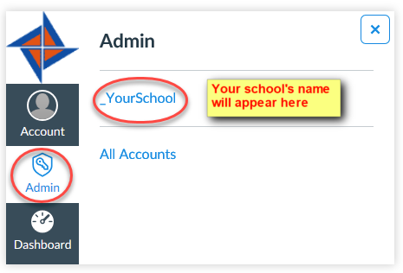
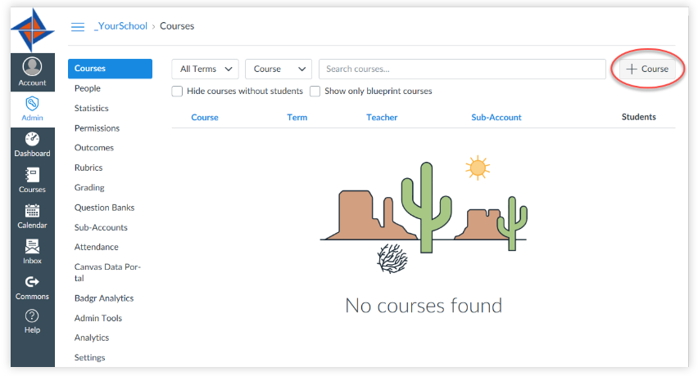
STEP 1 – CREATE AN EMPTY COURSE
Select admin
Select your school
3. Select + course
Notes:
After you have created your account for the MBA Learning Center, the first step that you will need to do is to create an empty course. You have to have a place to put your content, whether you import content from the commons folder or whether you upload information for your course, you have to create a place to store it. This place is an empty course.
The gray navigation menu is the global navigation menu – it is always seen on your screen regardless of where you are in the learning center.
To create a course, you will choose admin from the global navigation menu, then select your school name account. From there you will select + course located on the right side of your screen.

Slide 9
STEP 2 – NAME YOUR COURSE

Slide 10
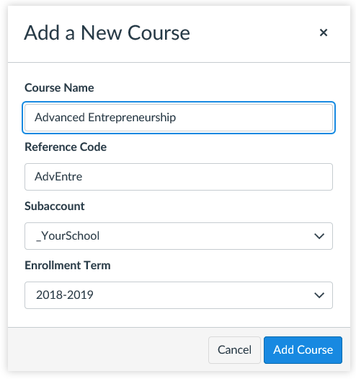
STEP 2 – NAME YOUR COURSE
Name your Course
Provide a Code (you make it up)
Enrollment Term – recommended to use the current school year – do not use default term
Select Add Course
Notes:
Once you select +course, a dialog box will display for you to name your course. This is step 2.
You will create your course name, provide a code (which is something you will make up), and select the current school year. It is not recommended to select default term.

Slide 11
Confirmation that course was added!
Notes:
Select courses and you should see a green box letting you know that the course was successfully added.
Once you create your course shell, you will notice an additional navigation menu appears beside the global navigation menu. This is the course navigation menu and appears anytime that you are inside of a course.

Slide 12
STEP 3 – ENROLL YOURSELF

Slide 13
STEP 3 – ENROLL YOURSELF
Canvas will not allow you to import content into a course until you add a teacher (you!) to the course.
Go to Courses
Locate the course and click the blue linked course name to open the course.
Notes:
In order to begin building your course, you must make yourself the teacher of the course. Go to your list of courses, locate the course that you need to add yourself to, and and click on the blue linked course name to open the course.

Slide 14
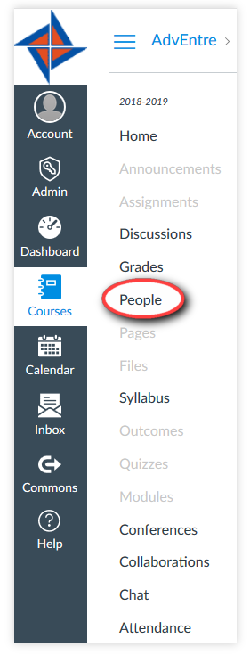
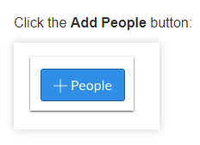
STEP 3 – ENROLL YOURSELF
Select people
Notes:
Once you are inside of the course, click on people located on the navigation menu and click on the +people button located on the right side of your screen.

Slide 15
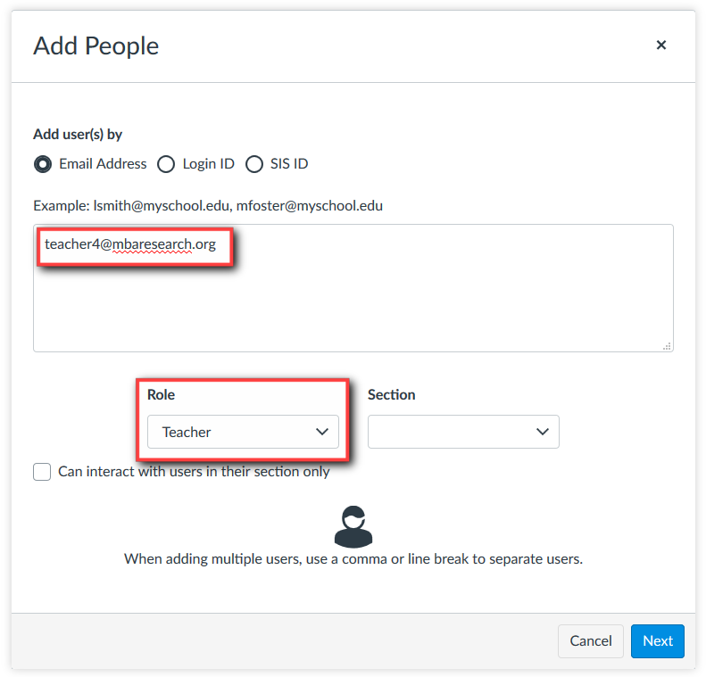
STEP 3 – ENROLL YOURSELF
Add your email address
Select teacher as role
Select Next
Notes:
From here you will add your email address and select teacher as your role. Select next.

Slide 16
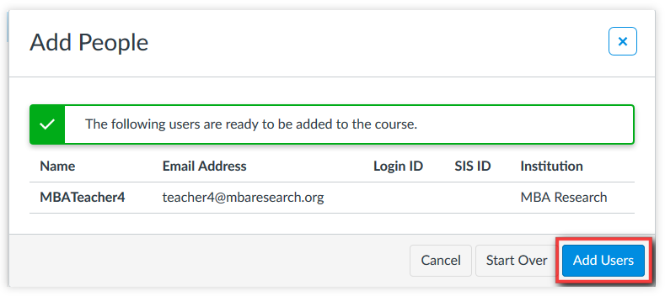
STEP 3 – ENROLL YOURSELF
Select Add Users
Notes:
If you are registered in the MBA Learning Center, your name and email information will be listed. Select Add Users.

Slide 17
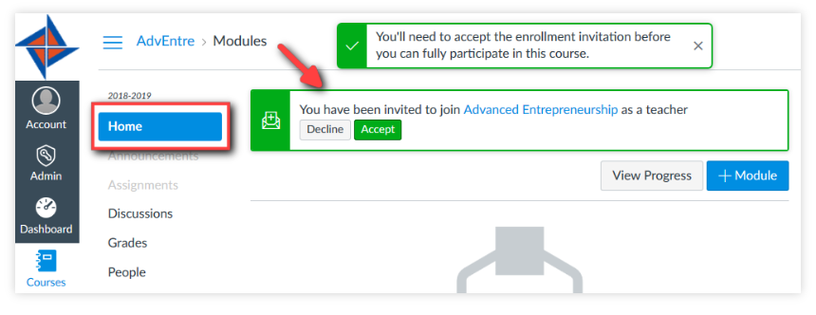
Accept invitation to course
On the homepage of the course, you will receive an invitation to join the course. You must accept to join.
Notes:
After you have added yourself, an invitation will be sent to you to accept. Staying within your course, choose home, and you should see the invitation to join the course. Once you accept the invitation, you will be able to build your course.

Slide 18
STEP 4 – ADD LAPS TO YOUR COURSE

Slide 19
What are LAPs?
Learning Activity Packages (aka Leadership, Attitude, Performance Modules)
Research-based and align with national standards for marketing, management, finance and business administration
Provide relevant information to the topic
Target audience = high school students
Several components of a LAP that can be used
All components do not have to be used to be effective
Notes:
What are LAPs and why use them?
LAPs are one of the major resources that MBA Research and Curriculum Center provide for teachers. LAPs is the acronym for Leadership, Attitude, Performance Modules.
LAPs are research-based and align with national standards for marketing, management, finance and business administration
They provide relevant information to the topic.
LAP writers identify the target audience as high school students
Include numerous components that include a reading guide, knowledge questions, group and individual activities, PowerPoint presentation, Instruction Guide, assessments
Many teacher do not realize that all of the components of a LAP Module do not have to be used to be effective

Slide 20
STEP 4 – ADD LAPS TO YOUR COURSE
MBA Learning Center Canvas DOES NOT communicate with your school district’s Canvas.
You cannot access MBA Learning Center’s Commons from your school district’s Canvas.
Add LAPs to your course by selecting Commons in the MBA Learning Center.
Notes:
MBA Learning Center Canvas DOES NOT communicate with your school district’s Canvas.
You cannot access MBA Learning Center’s Commons from your school district’s Canvas.
Add LAPs to your course by selecting Commons in the MBA Learning Center.
If you are able to retrieve LAPs from your school Canvas account, please note that they were not placed there by MBA Research and the LAP information may be out of date.

Slide 21
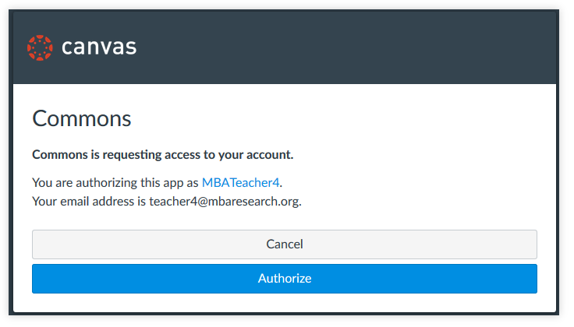
STEP 4 – ADD LAPS TO YOUR COURSE
If this is the first time you have accessed the MBA Learning Center, you will need to authorize it. Click the Authorize button.
Notes:
If this is the first time you have accessed the commons area of the MBA Learning Center, you will need to authorize the Commons database having access to your account it. Click the Authorize button.

Slide 22
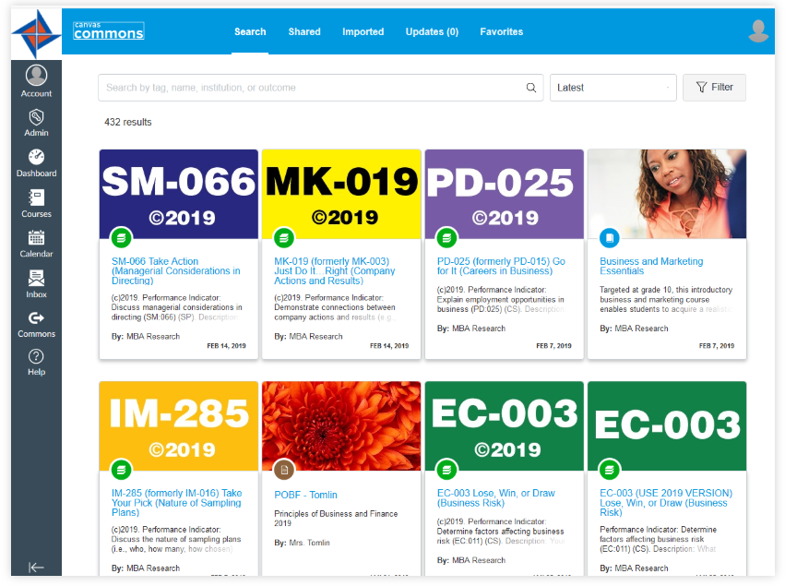
STEP 4 – ADD LAPS TO YOUR COURSE
There are different ways to search for LAPs:
By LAP number (BL-001)
By LAP name
By keyword or subject area
Notes:
Course guides identify which performance indicators have LAPs available. The information provided in determining whether a performance indicator has a LAP includes the word LAP followed by the instructional area and number. The LAP name should also be a part of the course material that you are reviewing. When searching for LAPs, include either the LAP number (use a hyphen between the instructional area abbreviation and the database number or by LAP name, keywords, or subject areas.

Slide 23
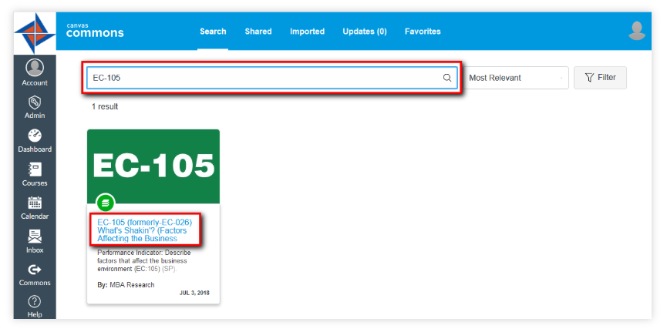
STEP 4 – ADD LAPS TO YOUR COURSE
Once LAP is located, click the resource title (LAP name) to preview the contents and import the LAP.
Notes:
Once the LAP is located, click the resource title (LAP name) to preview the contents and import the LAP.

Slide 24
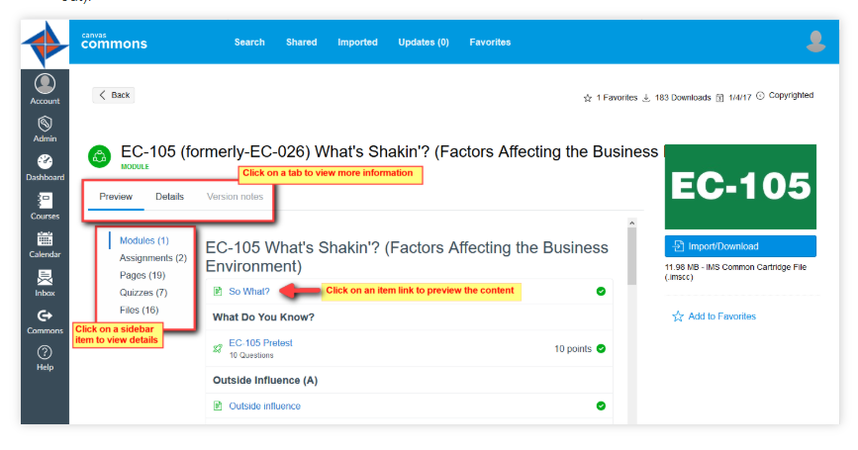
STEP 4 – ADD LAPS TO YOUR COURSE
The preview allows you to see the contents of the LAP before importing. The details tab provides a description of the LAP and the version notes tab gives a history of updates made to the LAP. If the version notes tab is grayed out, there are no updates.
Notes:
The preview allows you to see the contents of the LAP before importing.
The details tab provides a description of the LAP.
The version notes tab gives a history of updates made to the LAP. If the version notes tab is grayed out, there are no updates.

Slide 25
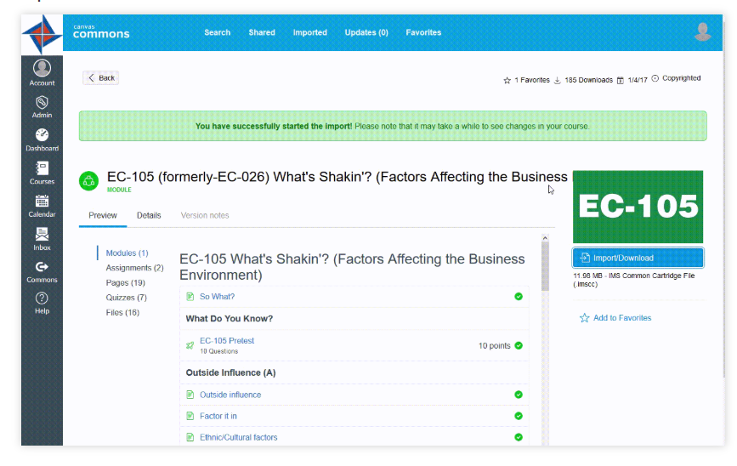
STEP 4 – ADD LAPS TO YOUR COURSE
When you are ready to import the content, click the import/download button.
Select the course that the LAP will be imported into
Select Import into Course
A message will appear that the import has started
Notes:
When you are ready to import the content, click the import/download button.
Select the course that the LAP will be imported into
Select Import into Course
A message will appear that the import has started

Slide 26
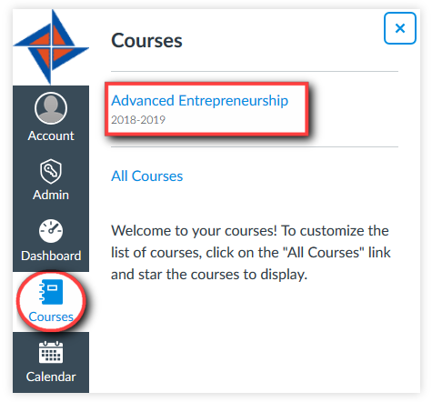
STEP 4 – ADD LAPS TO YOUR COURSE
Select courses from the left hand menu and locate your course
Notes:
Select courses from the left hand menu and locate your course

Slide 27
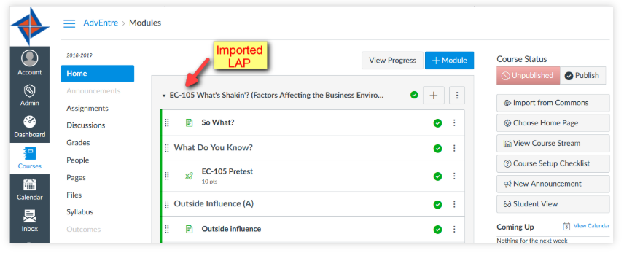
STEP 4 – ADD LAPS TO YOUR COURSE
LAPS appear in the Modules section of the course
Import status link will be available at the top of the page until the import is complete
Notes:
LAPs appear in the Modules section of the course, broken down into several manageable sections.

Slide 28
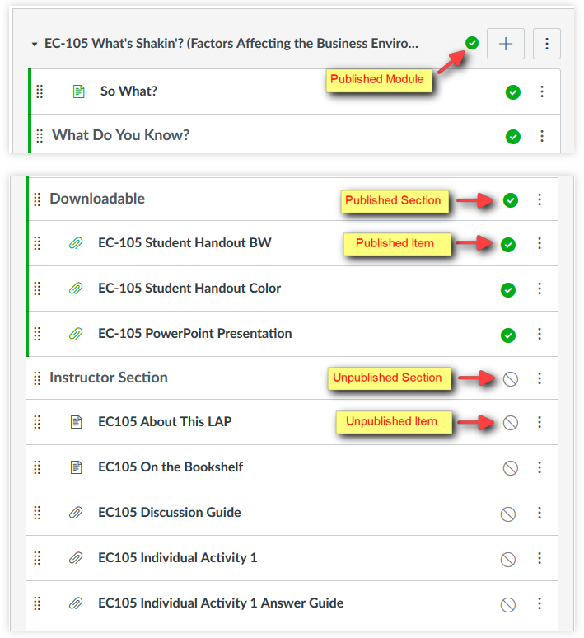
WORKING
WITH MODULES
All LAPs are modules
Sections and items in green are published (students can see and access the content)
Sections in gray are unpublished (not visible to students)
By default, the LAP and its contents come in the course as published (excludes the Instructor Section)
Notes:
Some important things to note:
All LAPs are modules
Sections and items in green are published (students can see and access the content)
Sections in gray are unpublished (not visible to students)
By default, the LAP and its contents come in the course as published (excludes the Instructor Section)

Slide 29
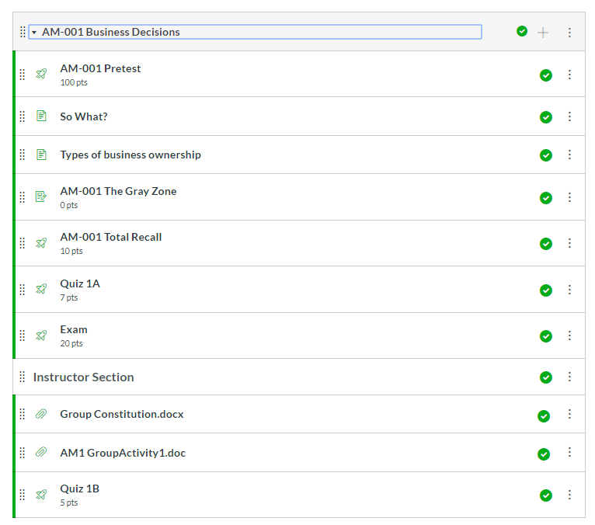
WORKING WITH MODULES
Note of Caution!!
If you unpublish a module then republish it, all components of the module are published – including the instructor section. You have to unpublish each item in the module individually!
Notes:
Just a note of Caution!!
If you unpublish a module then republish it, all components of the module are published – including the instructor section. You have to unpublish each item in the module individually to prevent students from seeing items that you do not want them to see!

Slide 30
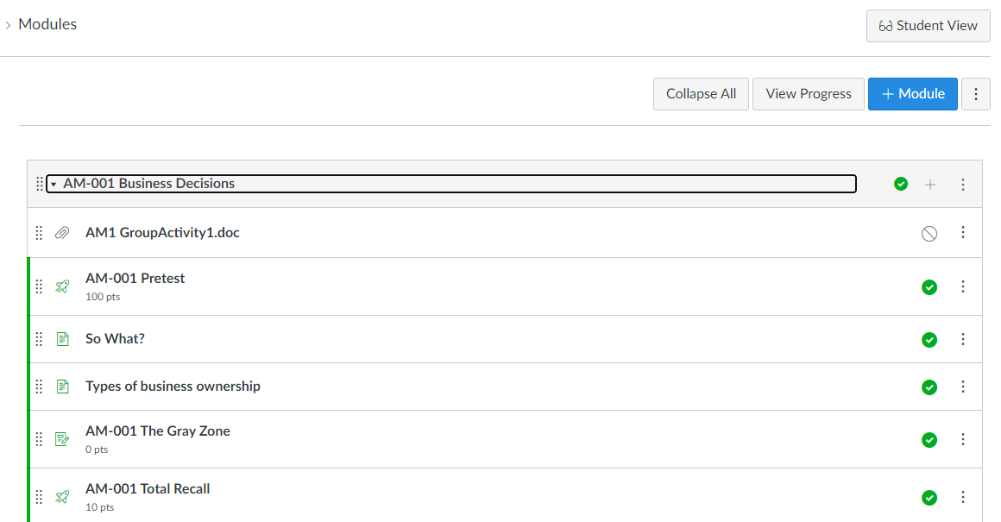
WORKING WITH MODULES
You can always see what the student view looks like by selecting Student View from the menu!
Notes:
If you wonder what the student’s can see, you have the ability to view the page as a student!
While inside of the course, select Student View from the menu on the right side of the screen. This provides an extra level of assurance of what students can see and have access to.

Slide 31
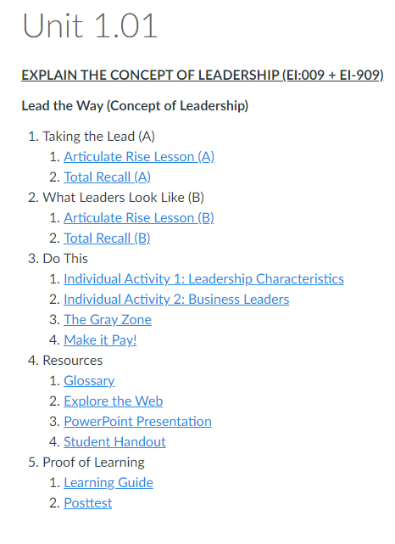
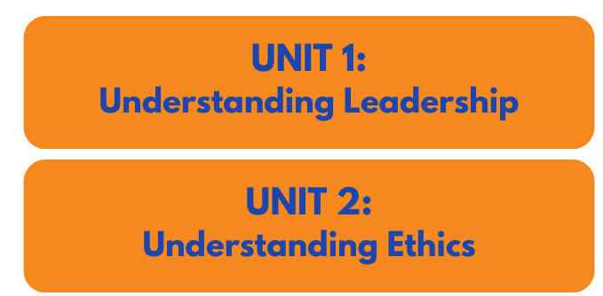
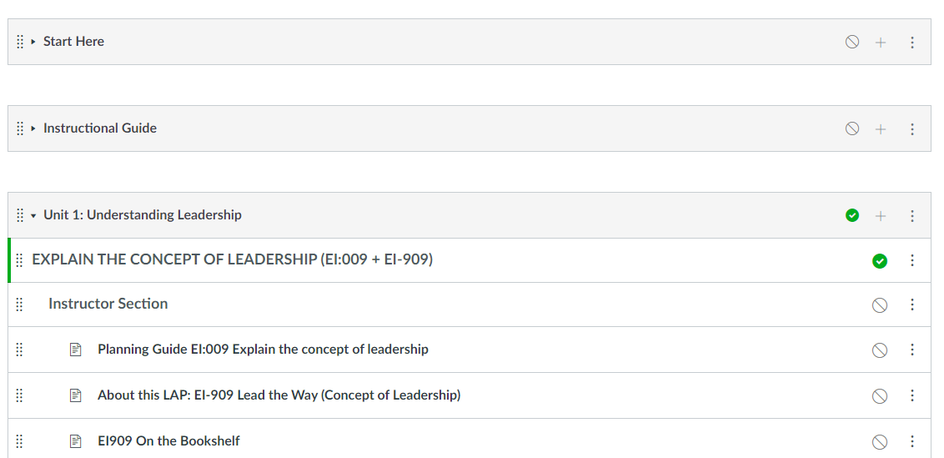
LEARNING CENTER COURSE GUIDES
Teacher modules
Student pages
Ready made course content
Sequence of instruction
Interactive activities
COMING FALL 2021
Notes:
An additional option for using curriculum material in the Learning Center is coming this fall. We will be offering Learning Center Course Guides.
If time permits, go out to the Learning Center and show live.

Slide 32
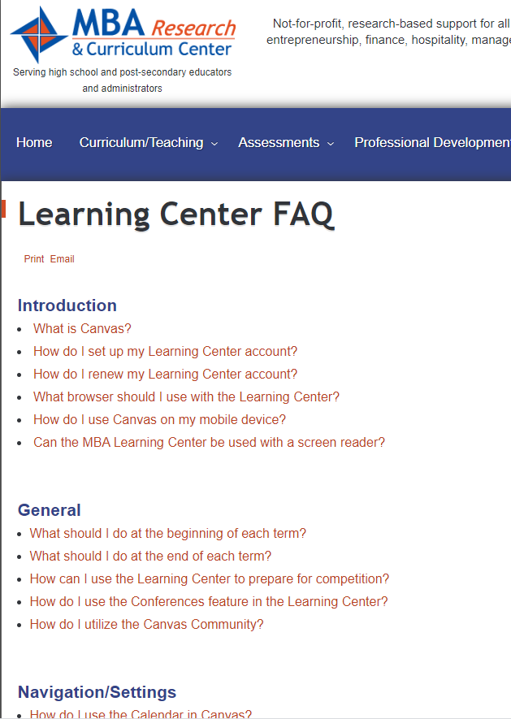
Need Help with The Learning Center?
Visit the FAQ section on the Learning Center
Go to mbaresearch.org
Select Learning Center under Quick Links
Select FAQ under Already signed up?

Slide 33
Connect With Us!
Twitter.com/MBAResearchNews
Facebook.com/MBAResearch
Website – www.MBAResearch.org
Phone – 614.486.6708 800.448.0398
Customer Service – Service@MBAResearch.org
Notes:
You can stay connected to us by following us on twitter or Facebook. I would encourage you to take a look at our website as there are other resources that you may find beneficial. If you have any questions on any of our resources, you can call the office or email service@MBAresearch.org and someone will be happy to assist you.

Slide 34
Questions?
Notes:
As you become more comfortable within the learning center environment, you will see there are new discoveries awaiting you! We hope this session has provided you with enough information to get started and feel better about using this incredible resource. Are there any questions?

