Slide 1
Teaching Coding with HTML and CSS in Web Design
Tonya Skinner, Presenter
Notes:
June 9 at 10 AM
Though many like the “designing” fun part of making webpages, learning to code is arguably one of the most important skills for current as well as future generations to learn. Writing code helps to gain problem-solving skills and improves critical thinking, so what easier way to get students interested than by creating webpages? Learn some tips for teaching coding using HTML/CSS, fun activities to get students excited about coding, and critical thinking challenges you can use right away!

Slide 2
Our Backchannel Site →
http://bit.ly/nce-wd
https://www.notebookcast.com/en/board/s2g1e7610254a

Slide 3
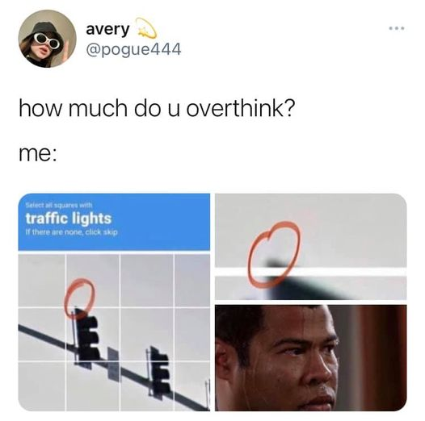
Can You Relate?
Source: Raining Hot Coupons on Facebook

Slide 4
My HTML story…..
1993!

Slide 5
You CAN teach Web Design without code… BUT...

Slide 6
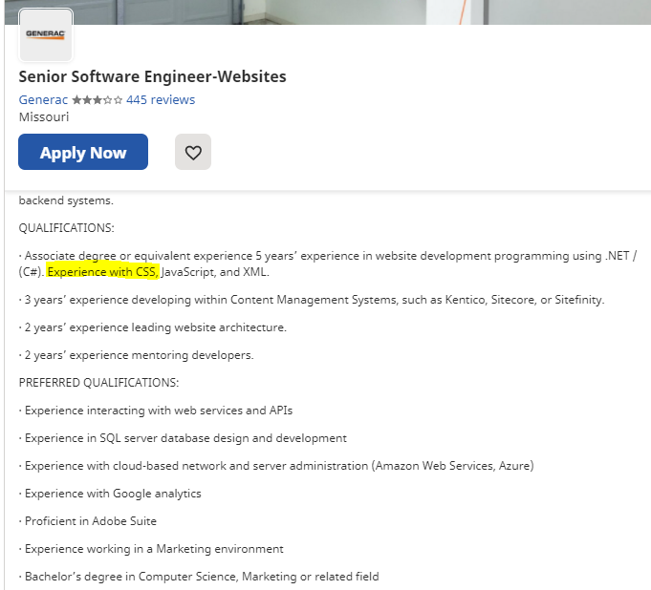
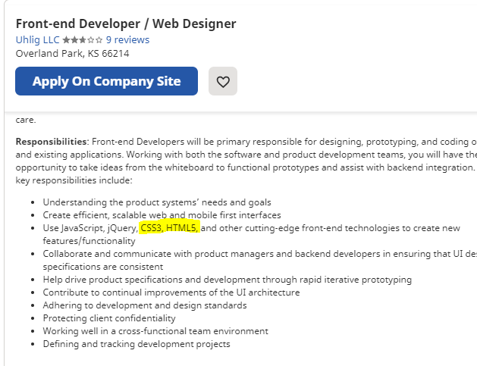
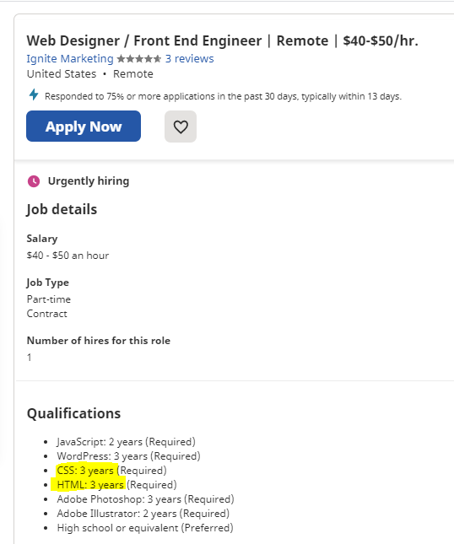
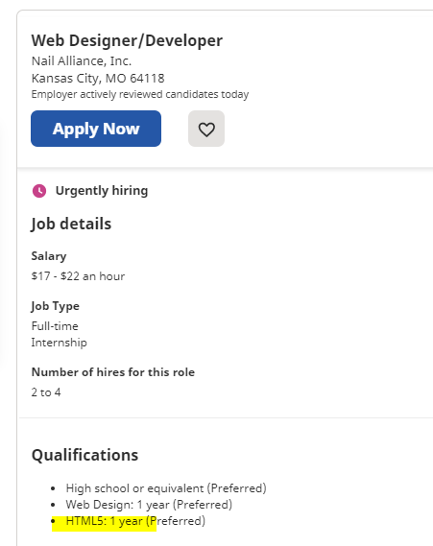
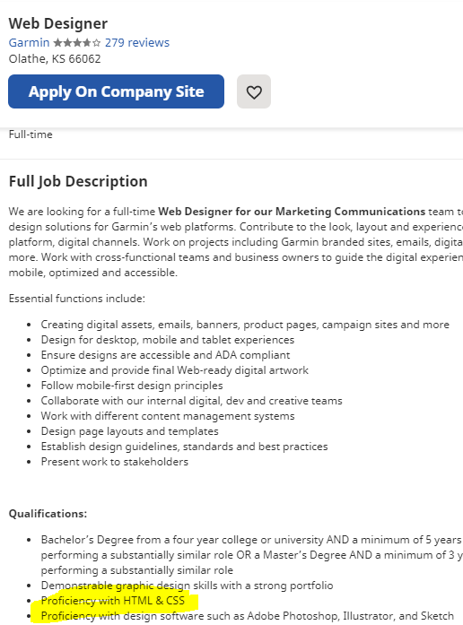
Review Job Openings...
Jobs from https://www.indeed.com/

Slide 7
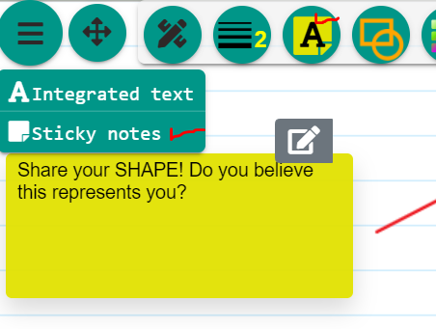
Find out what “shape” your students are in! Take 45 seconds and respond to the 8 questions
https://www.codecademy.com/explore/sorting-quiz
Notes:
I am a question asker! (but “a lot like” User Advocate)
Curiosity, communication, and attention to detail are your underlying strengths. You like doing the research and questioning things in order to be the prepared with an answer. You take action by using your insights to formulate a plan, and working with others to see it through. Things you’re into: investigating mysteries, learning constantly, taking a step back, and that “a ha!” moment when you see the big picture.
Career Opportunities
Potential career fields for question askers include User Research, Equity Analysis, Investigative Journalism, Law, and Data Science.

Slide 8
Why learn to code?
Coding means you are not dependent on a software or a platform to build websites
You have complete control over every aspect of the website
Having the ability to code websites positions you better to compete for jobs
You can build website templates and sell them in online marketplaces
Coding will allow you to modify content management themes for platforms like WordPress
https://creativepro.com/graphic-designers-need-learn-coding-competitive/
Image from Pexels

Slide 9
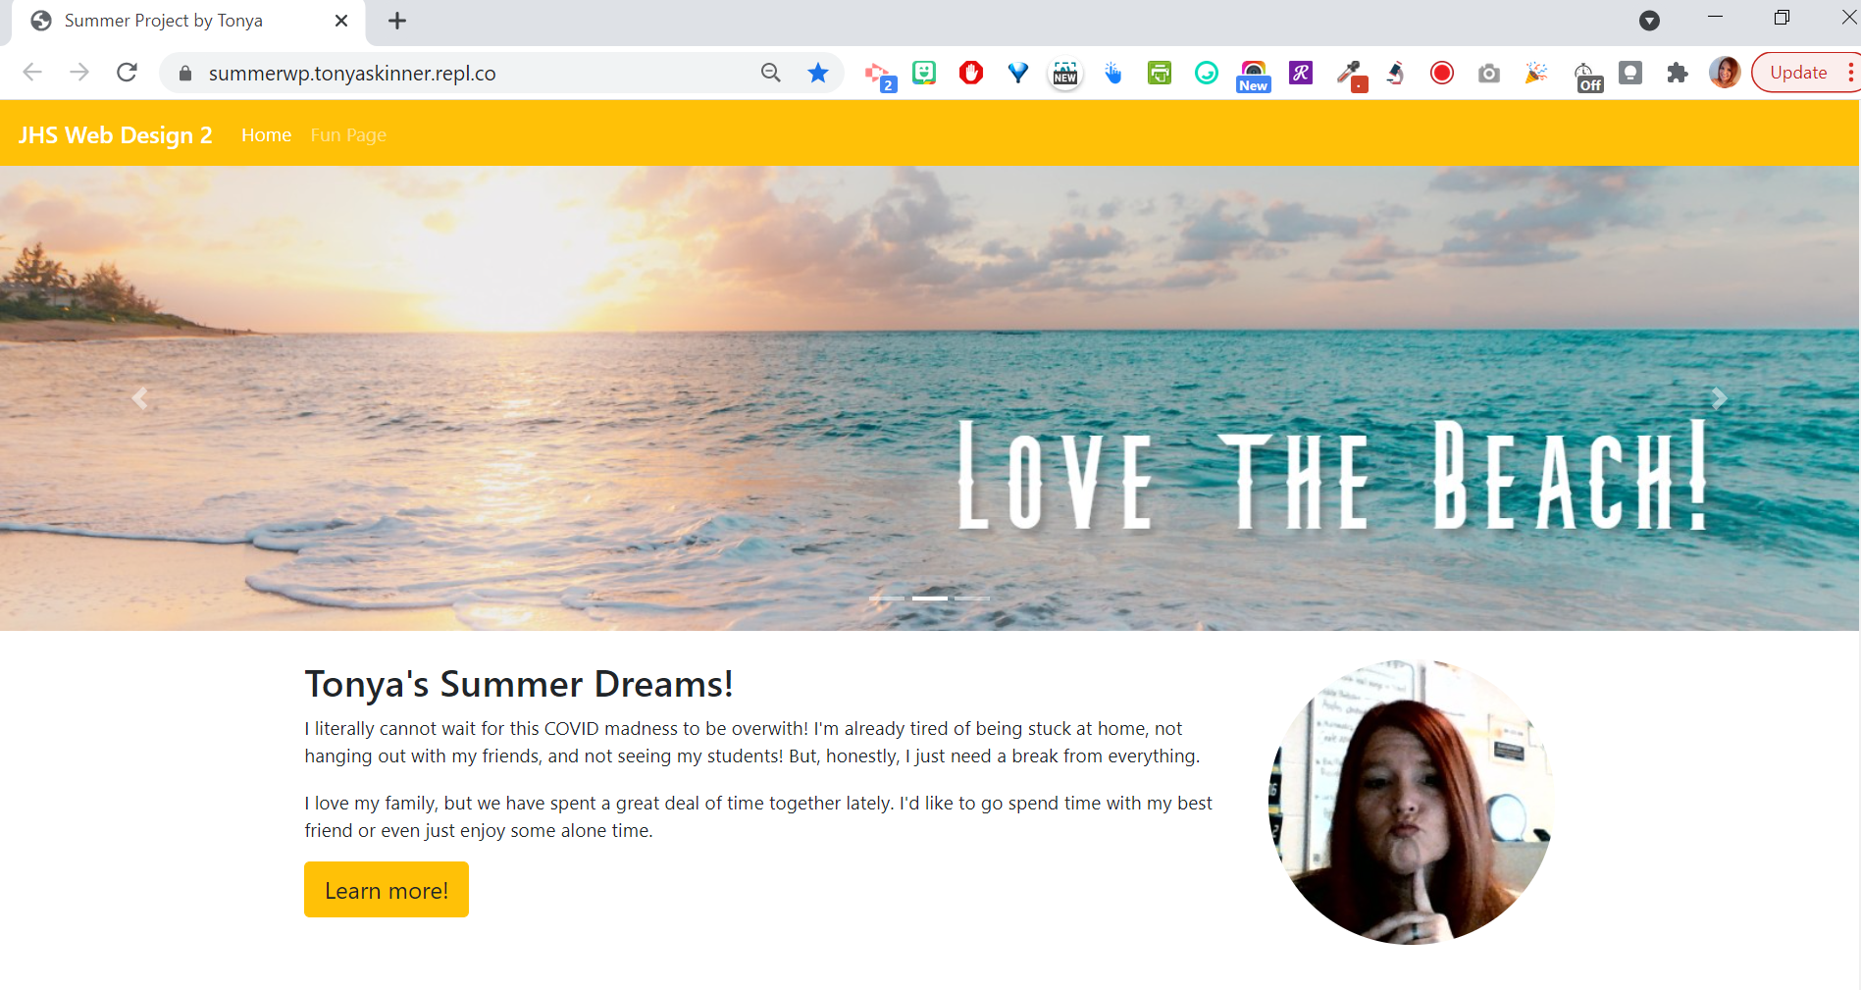
With COVID, the transition required a shift!
https://summerwp.tonyaskinner.repl.co/

Slide 10
Critical Thinking and Problem Solving are KEY!
Planning
FINDING HELP
TESTING
DECOMPOSITION
DEBUGGING
COMMUNICATION
https://junilearning.com/blog/guide/ways-coding-teaches-kids-problem-solving/

Slide 11
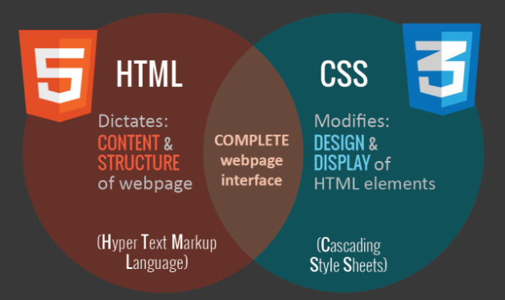
HTML vs CSS
http://www.training-n-development.com/blog/understand-difference-html-css/

Slide 12
Easy Way to Introduce - Burger!
https://www.amberddesign.com/cheeseburger-with-html-and-css/
Starting Example→ https://replit.com/@TonyaSkinner/burger
Bonus Tool→ PiliApp Webpage Pixel Ruler
https://www.piliapp.com/

Slide 13
RESOURCE: CSS Grid
https://learncssgrid.com/

Slide 14
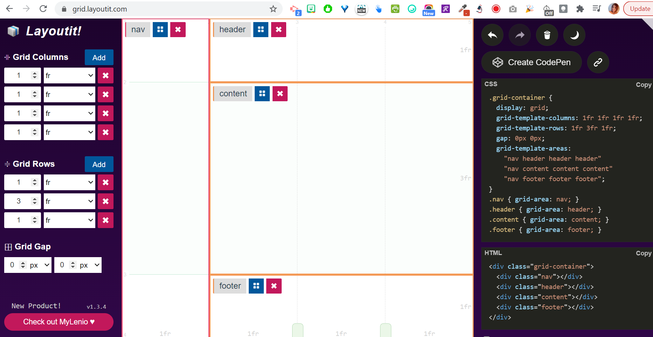
RESOURCE: Grid Layoutit!
https://grid.layoutit.com/

Slide 15
Show How CSS Works...
Lots of generators online--
https://www.cssportal.com/css-style-editor/
https://animista.net/
https://angrytools.com/css/animation/
https://bennettfeely.com/clippy/
Can embed CSS code into Google Sites or other web editors using the embed HTML functions; CSS code must go between <style> and </style> tags first!

Slide 16
Oh, I have zero budget, so...
$0

Slide 17
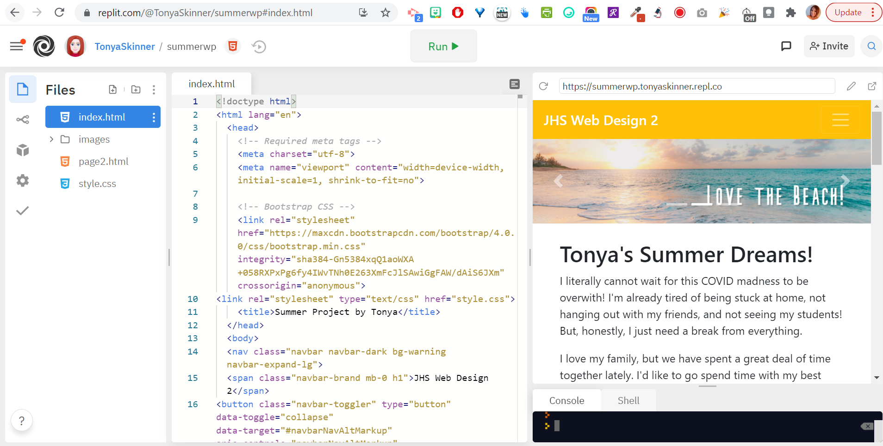
Coding Webpages in the Cloud
REPLIT.COM

Slide 18
Free Hosting and File Manager (AwardSpace)

Slide 19
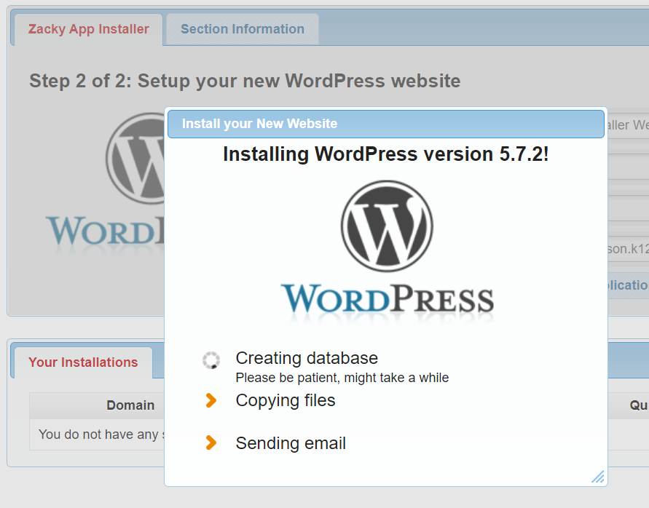
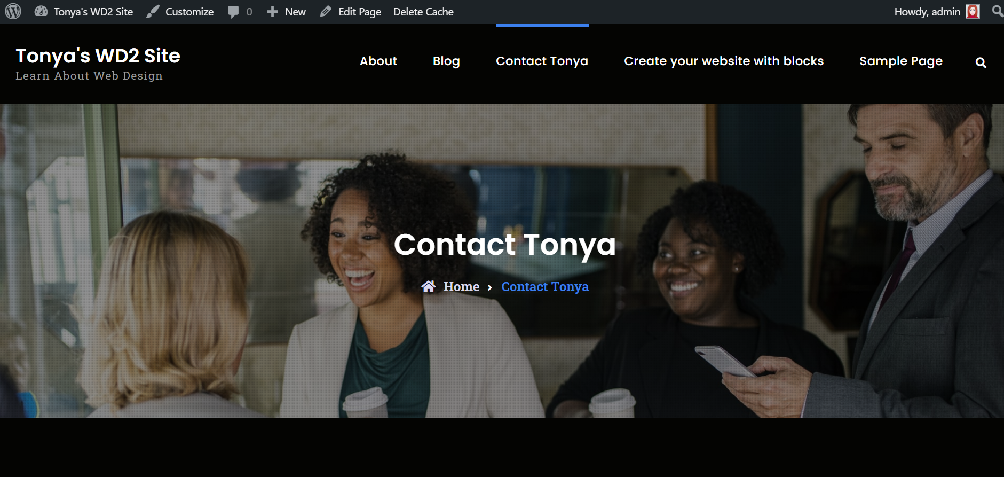
Free WordPress Install in AwardSpace

Slide 20
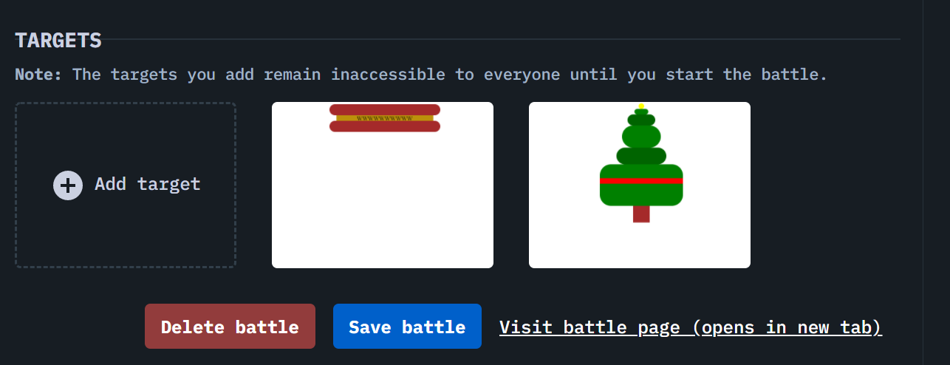
CSS Battles
Great for challenging students to think, research, solve problems!
Most solutions are on YouTube, but it’s a great way to learn
Can create your own battles if you provide students with the images for the battle to upload into their own
https://cssbattle.dev/
Must create the example as 800x600px image PNG file

Slide 21
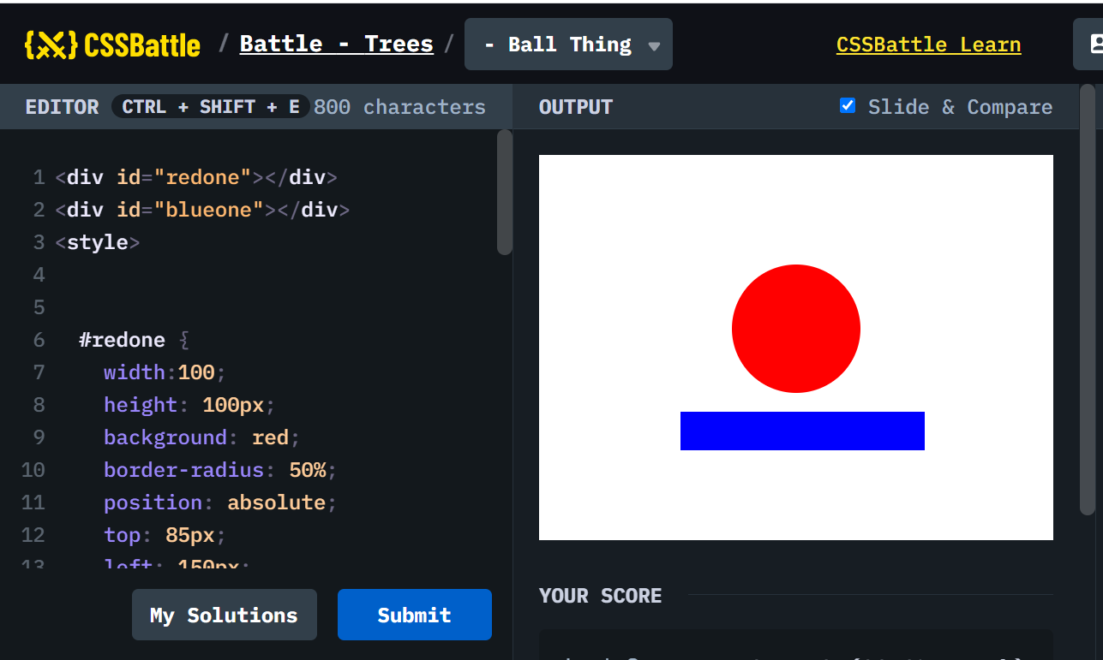
The Way It Works...

Slide 22
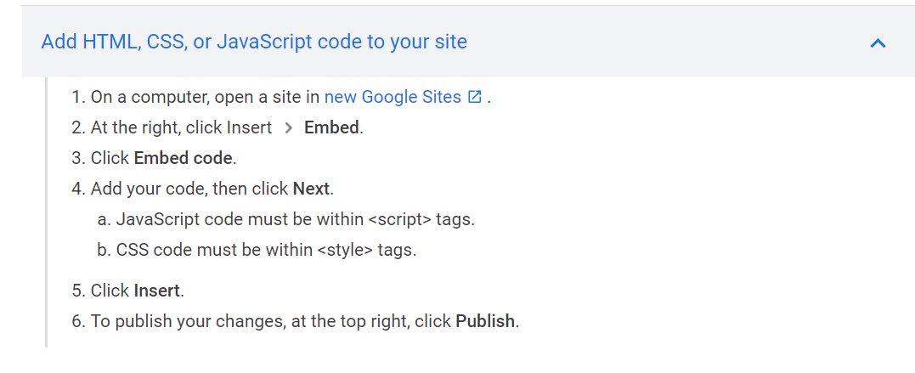
Integrate HTML
Google Sites (from Google Sites support)
https://sites.google.com/

Slide 23
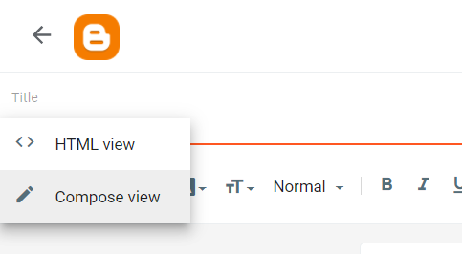
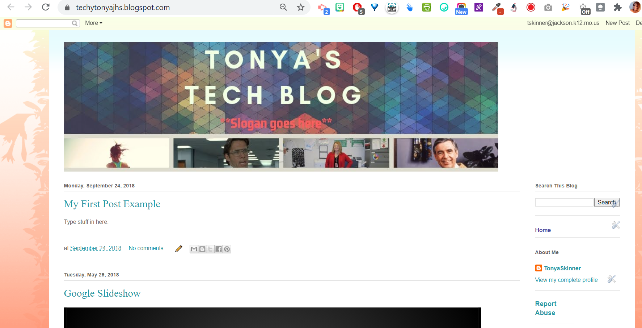
Integrate HTML
https://www.blogger.com/
Blogger (switch from Compose to HTML view)

Slide 24
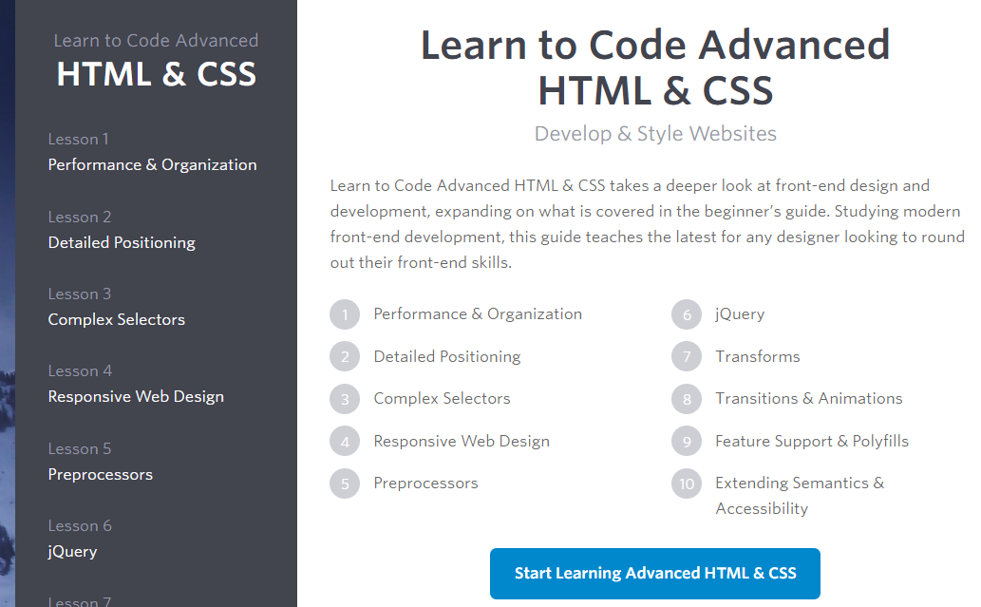
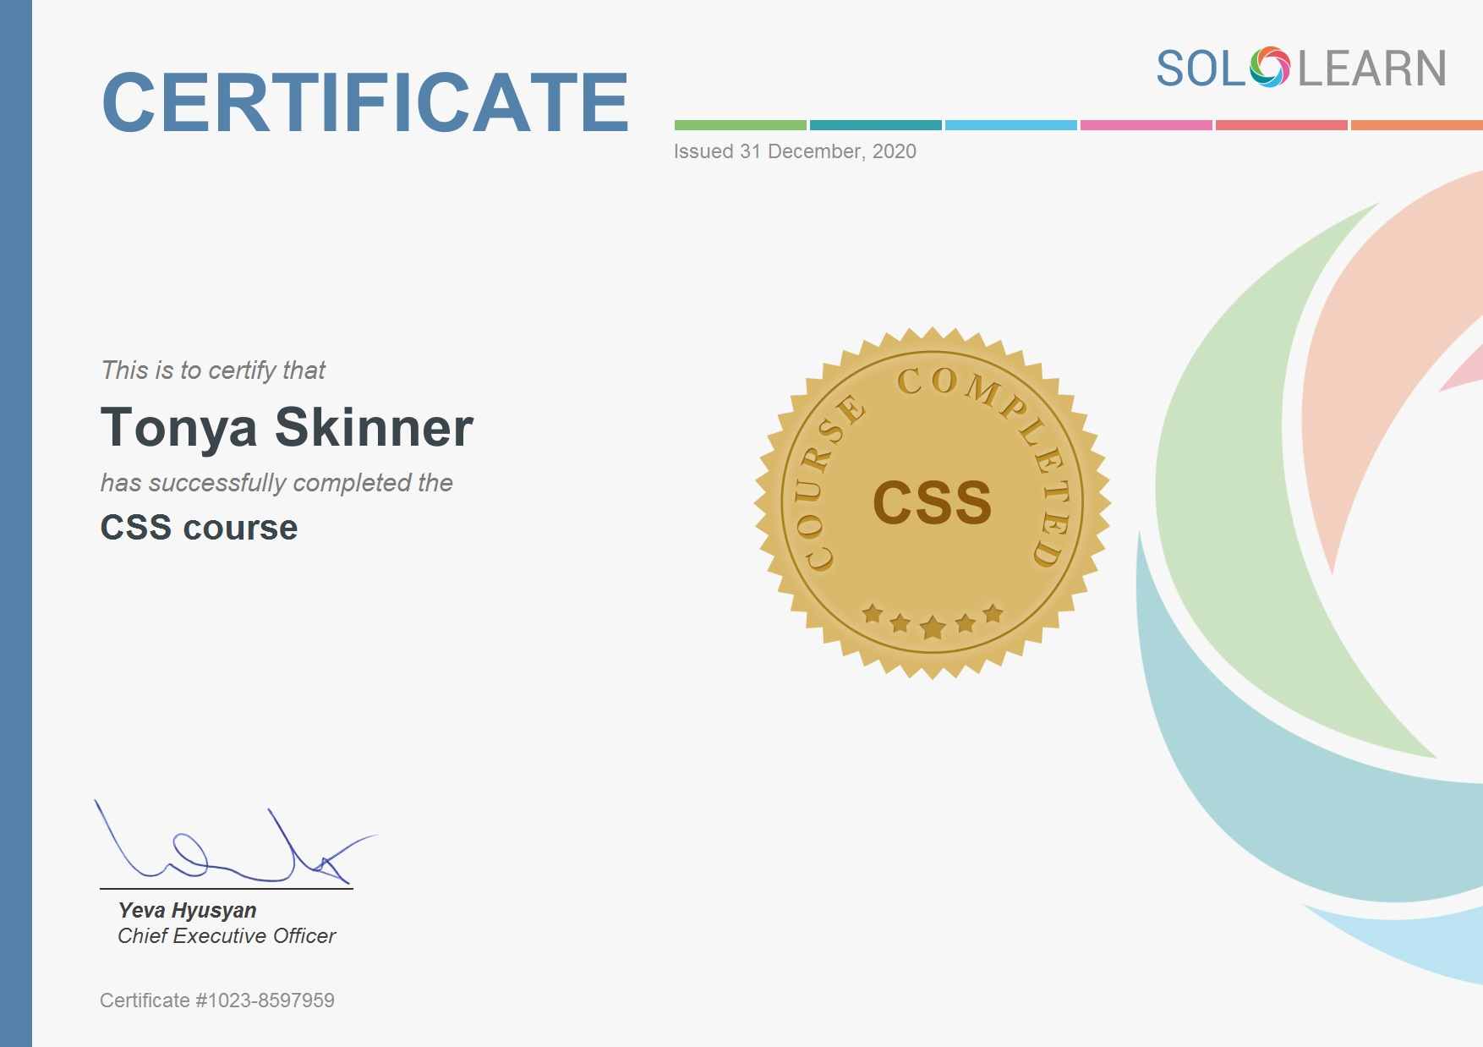
Provide Opportunities to Learn More!
https://www.sololearn.com/
https://learn.shayhowe.com/advanced-html-css/

Slide 25
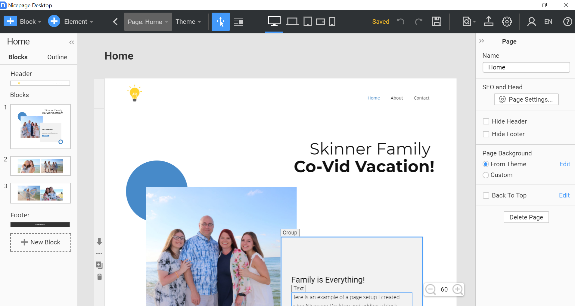
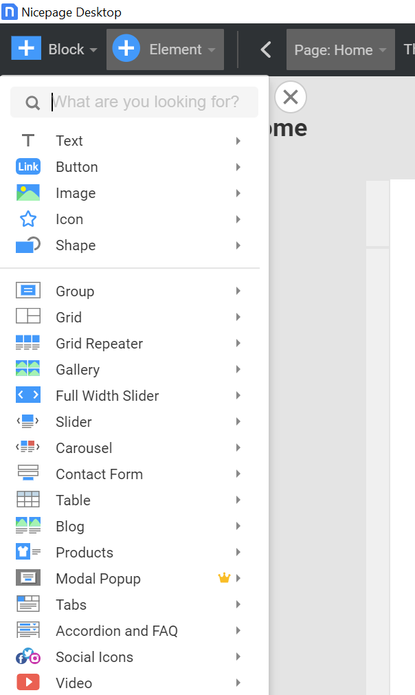
Nicepage (must install to use)
https://nicepage.com/download

Slide 26
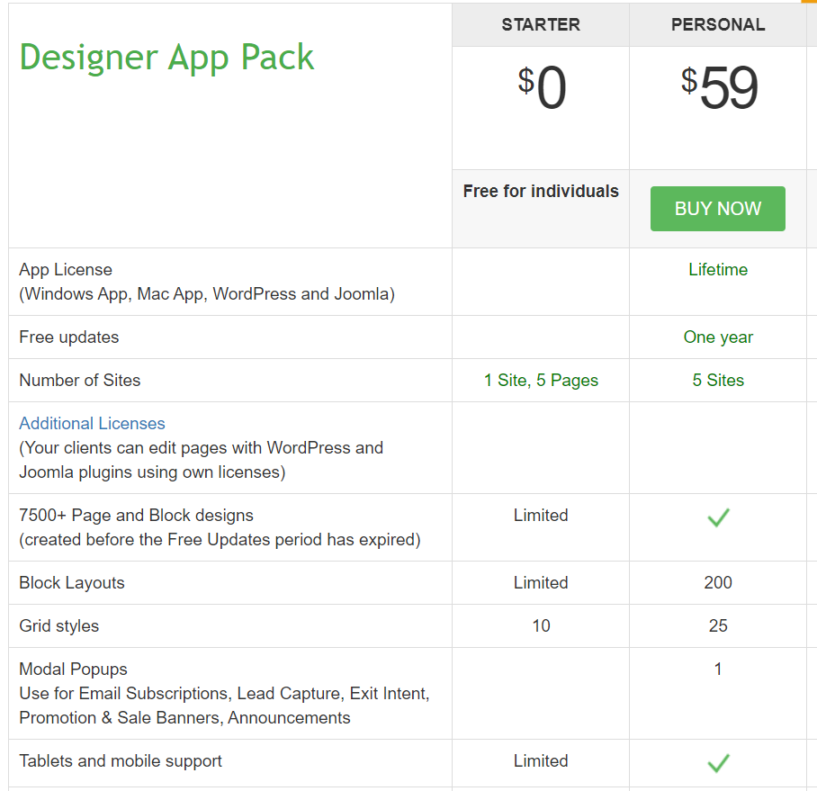
Free is great for trying it, but you can only make one site and there is no access to WordPress or Joomla. Also, some features require premium to use. But, it’s a great start!

Slide 27
Thoughts from those in the industry...
As an engineer, I think people should be exposed to code as early as possible, and I think your approach is a good way to get them started.
Using templates and some editors (like Dreamweaver) that give them a lot of hints will allow them to experiment with code AND see instant results is great. (That is what good developers are constantly doing — we don't necessarily know exactly what to do, we just try things til we find an optimal solution where we can see results fast).
Charlie Triplett https://www.linkedin.com/in/charlietriplett/
Notes:
Noted to check accessibility with a screen reader - https://www.a11yengineer.com/

Slide 28
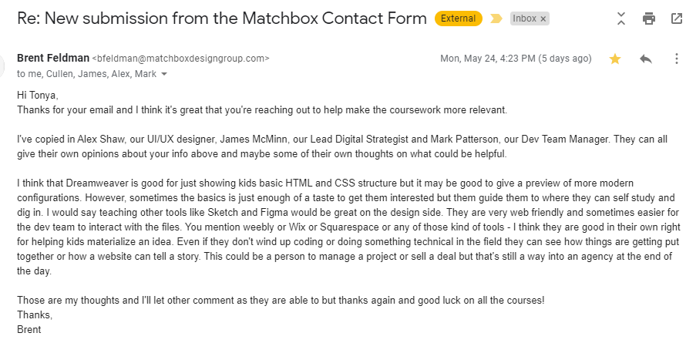
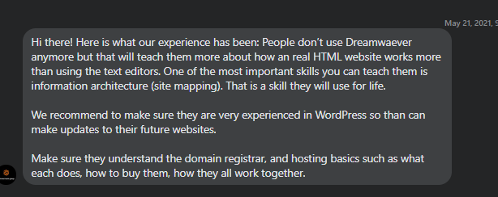
More from my “Research” this year

Slide 29
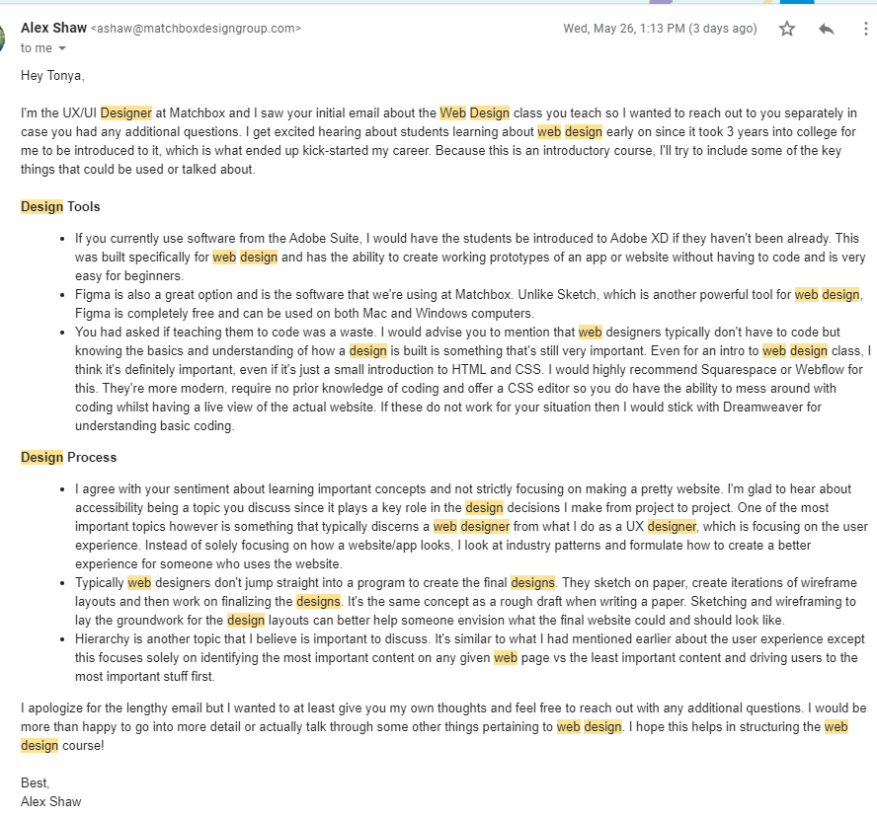

Slide 30
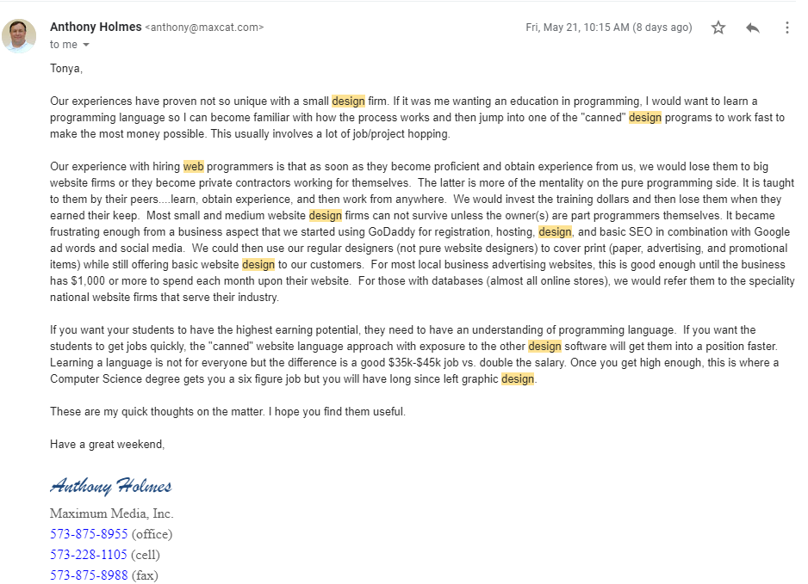

Slide 31
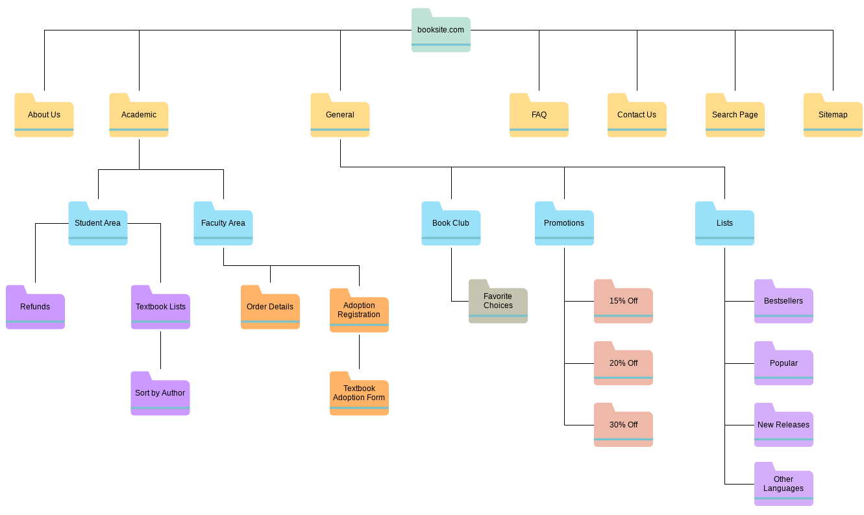
Common Theme - Site Mapping
https://xd.adobe.com/ideas/process/information-architecture/visual-sitemap-examples-website-designs/

Slide 32
Fun “Extras” to Try!
HTML/CSS Tutorial: Thanksgiving Matching Game
I Love Coding Curriculum and Cheat Sheets
https://ilovecoding.org/courses/htmlcss2

Slide 33
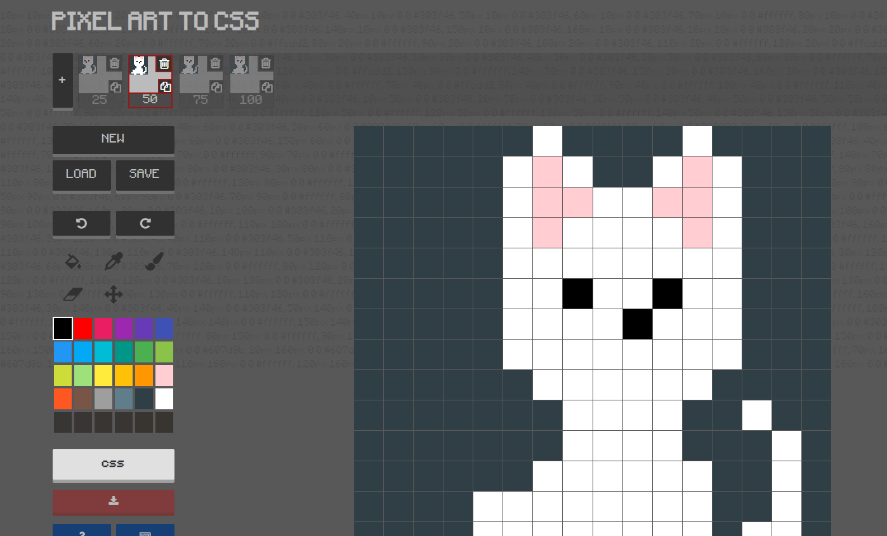
PixelArt to CSS
https://www.pixelartcss.com/

Slide 34
https://rupl.github.io/unfold/
This site is super cool at getting students interested in learning more about positioning and transformations in CSS!

Slide 35
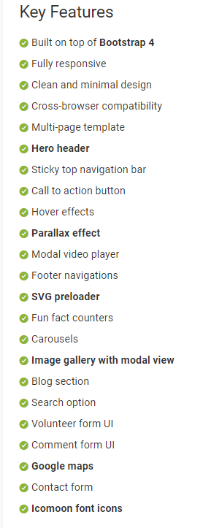
Advanced: Get them
to use Templates!
Many free templates are out there, and understanding how to implement AND identify features is a great skill.
https://themewagon.com/themes/free-bootstrap-4-html5-charity-website-template-givehope/

Slide 36
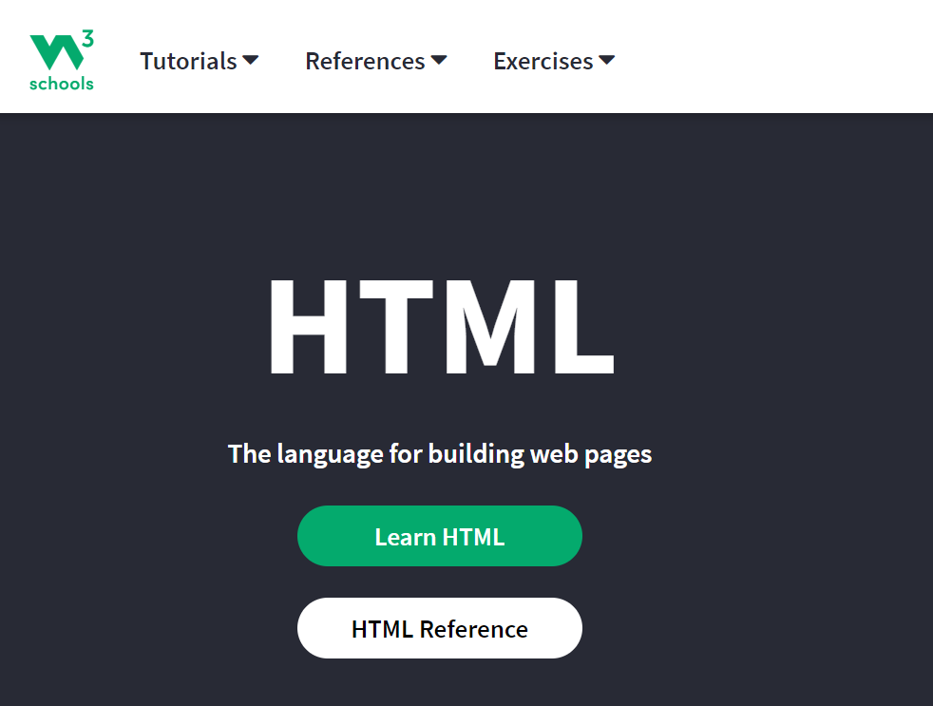
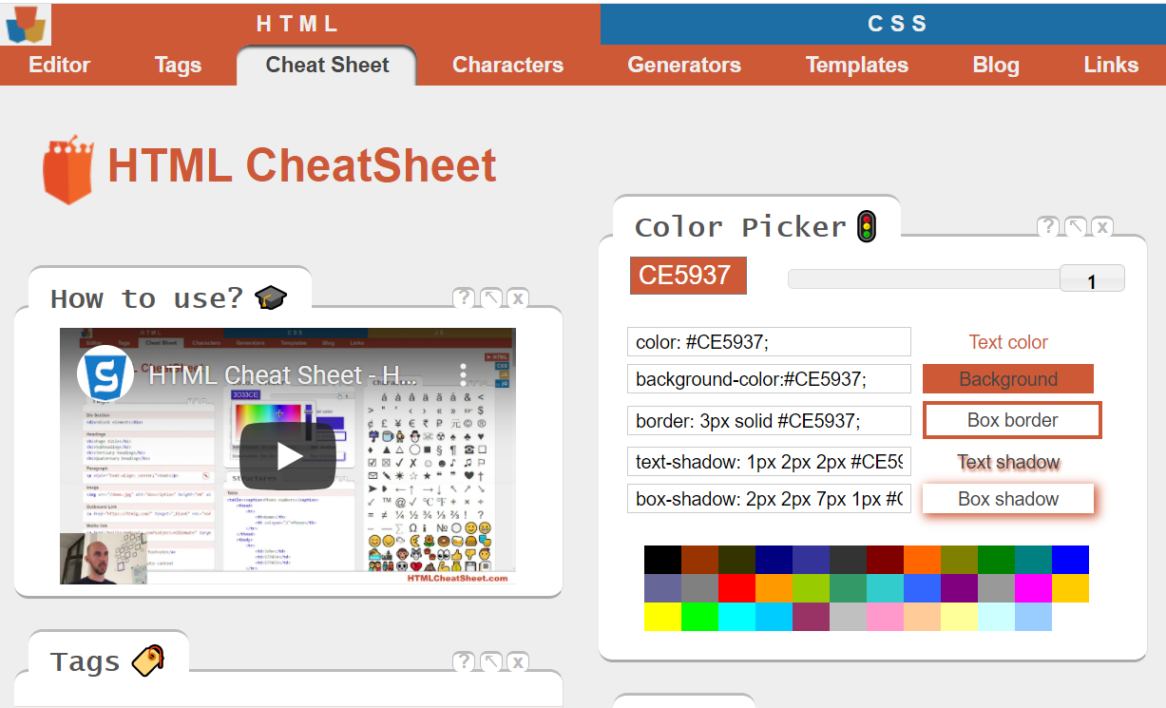
My Favorite Resources...
https://htmlcheatsheet.com/
https://www.w3schools.com/

Slide 37
THOUGHTS?

Slide 38
My final thoughts…
Students need to be able to discuss and use proper terms!

