Slide 1
Student Engagement/Differentiated Instruction for Business/IT Teachers
Tonya Skinner, Educator/Trainer
@tonyaskinner
tonya@btskinner.com

Slide 2
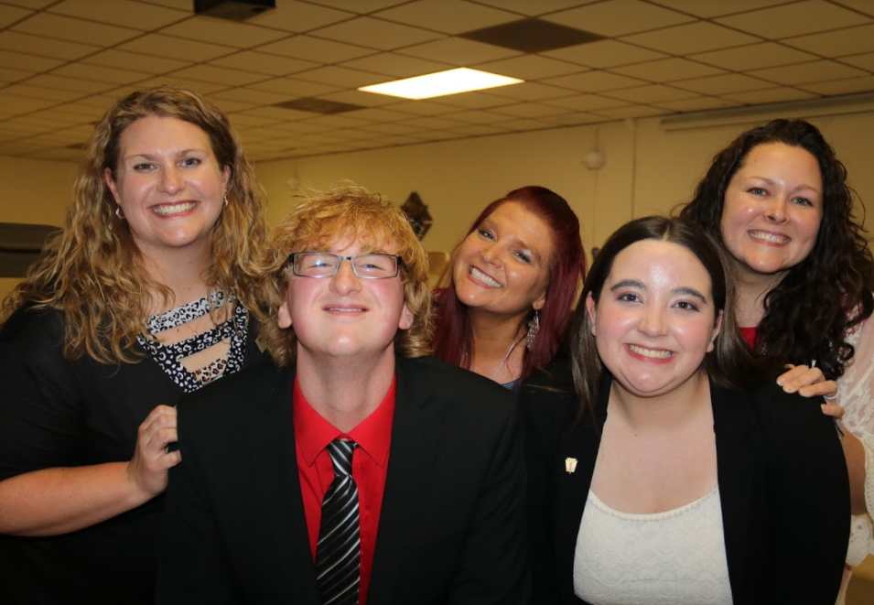
We all want smiling faces...

Slide 3
Engagement is Hard
Students are distracted… by life, phones, grades, sports, work, lack of sleep, stress...
Teachers have enough to do trying to implement a curriculum and do not have time to entertain or be overly creative daily
?
Not all students WANT to be in your class… and not all students LIKE you or think you CARE about them
?

Slide 4
FACT
Competition is NOT a driving force for all kids, but most do at least enjoy a game.

Slide 5
Have you tried BLIND Kahoot?
Use BEFORE instruction as PART of instruction, rather than traditional review.
Can award “zero” points for some questions!
Can include SLIDES in the Kahoot to teach with.
Explain what the correct answer was and why… then, repeat a form of the question!
Let’s Play

Slide 6
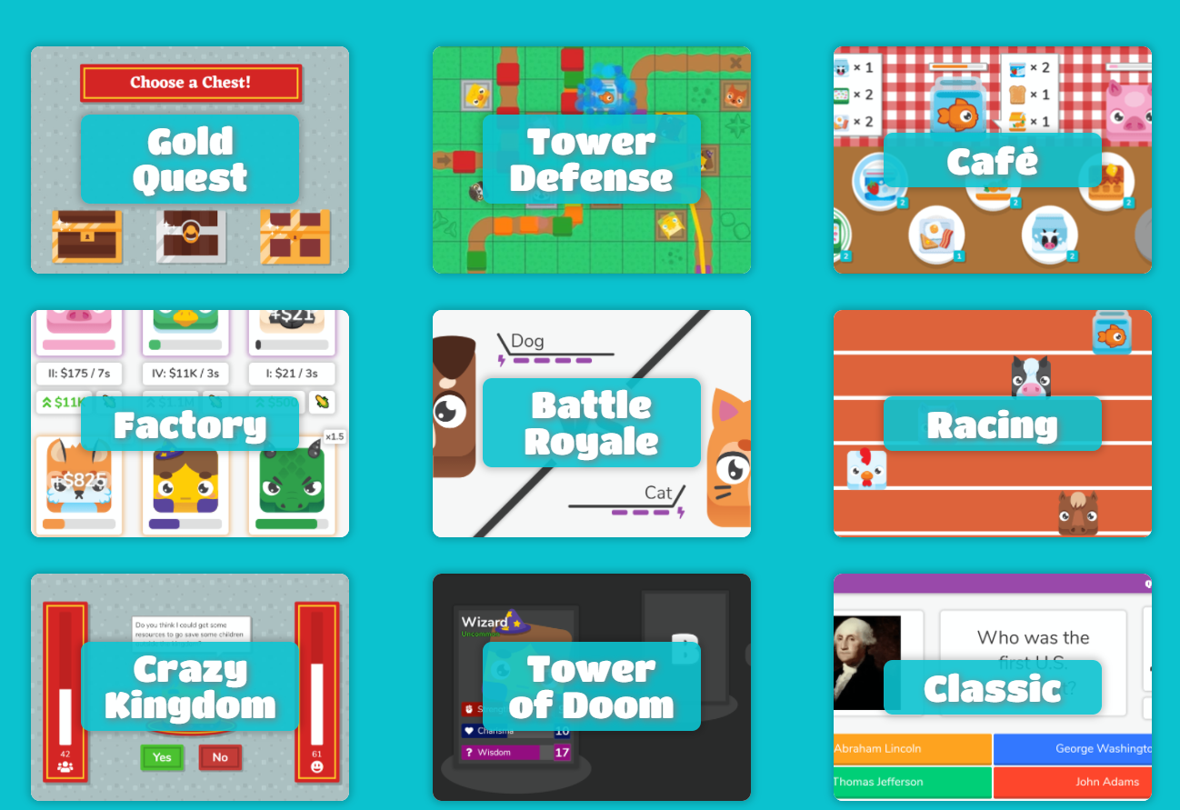
Classroom Favorite for My Kids - Blooket
Can play competitive whole-class games that level the playing field (Gold Quest) or fun team challenges (Battle Royale) OR assign solo games for practice (great for early finishers)
With certain games, can set to specific length of time.
My Games

Slide 7
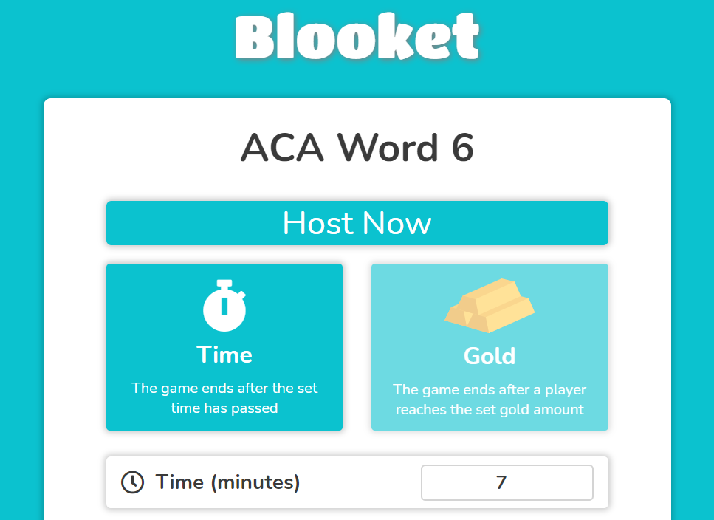
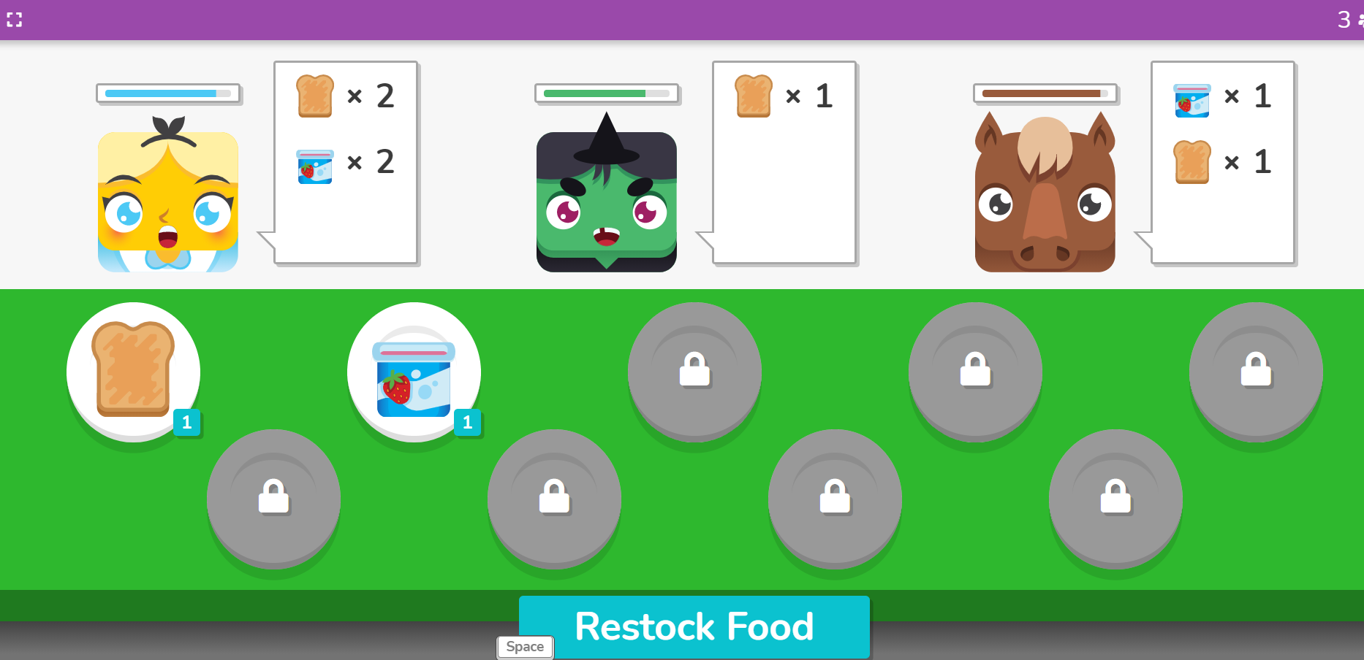
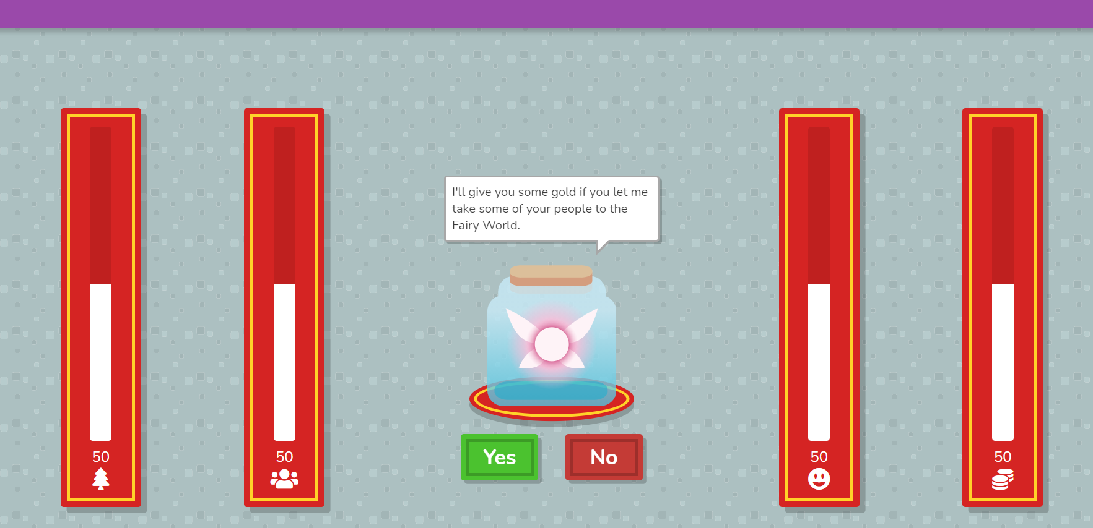
Blooket Screenshots

Slide 8
Blooket Screenshots
Excerpt of History from team Battle Royale game:

Slide 9
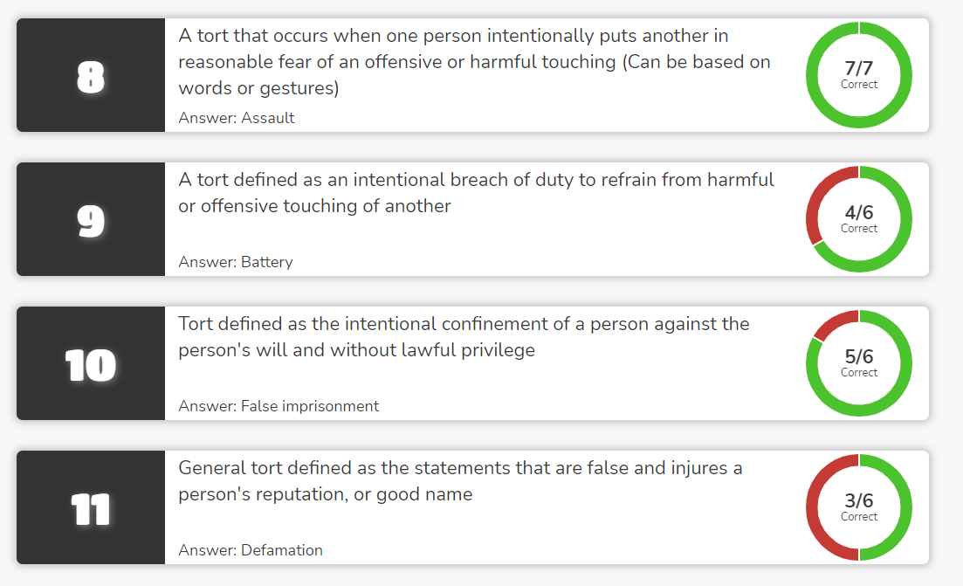
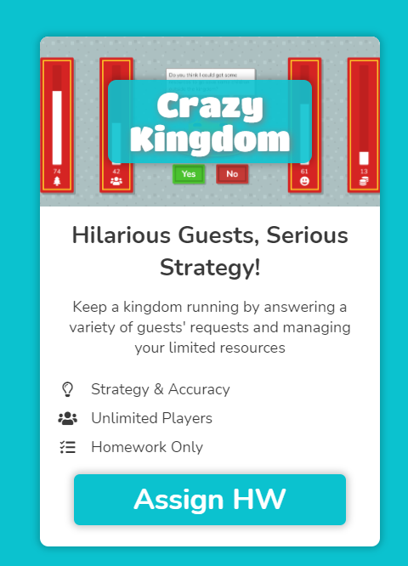
Blooket Screenshots
Excerpt of Homework results (can see question accuracy for group):

Slide 10
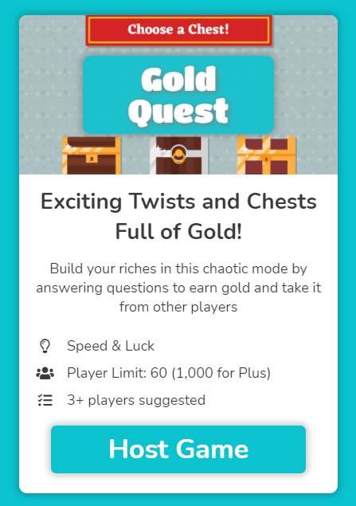
Let’s Play!
Join the game from another device if you can. We are going to play a short 3-minute timed game of Gold Chest about Microsoft Excel!
blooket.com/play
Click JOIN A GAME
Questions will be on YOUR SCREEN and the leaderboard and an activity feed will display on MY SCREEN (so a separate device will be more enjoyable; in class, I display the leaderboard on my teacher projector).

Slide 11
FACT
Students are more likely to participate if they are confident they know what they are talking about.

Slide 12
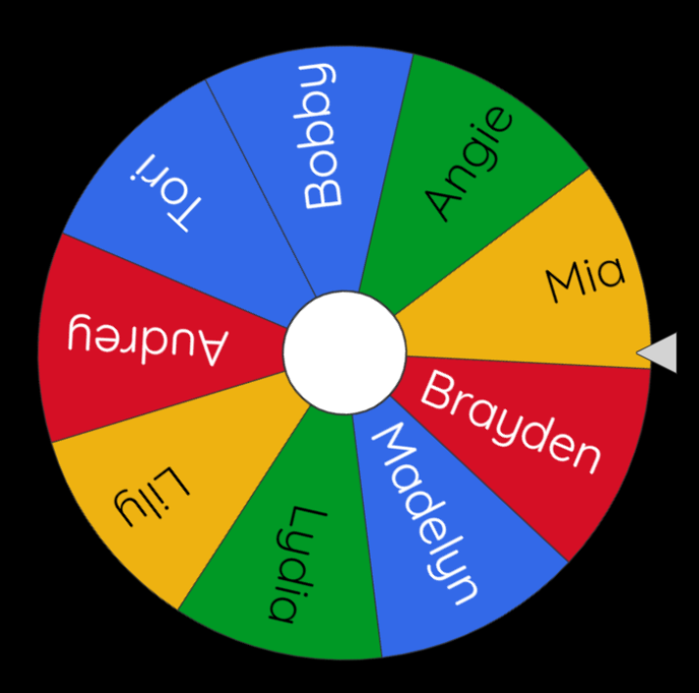
Group “Worksheets”
Instead of working alone on “end of chapter” questions, put them on a slide and put them groups to discuss the answers!
Let them know you will be calling on people to answer questions! I like to use the Wheel of Names but sometimes I just drop a penny on my seating chart.
Give them a specific time limit (ALWAYS!). I like the Ultra Timer Chrome extension.
Give it a “game show” vibe, if you can.
This takes zero prep and I don’t have to grade ✅. I just paste questions on a slide and then use my sound board for some “fun feedback” or pop the Confetti cannon as a Chrome extension.

Slide 13
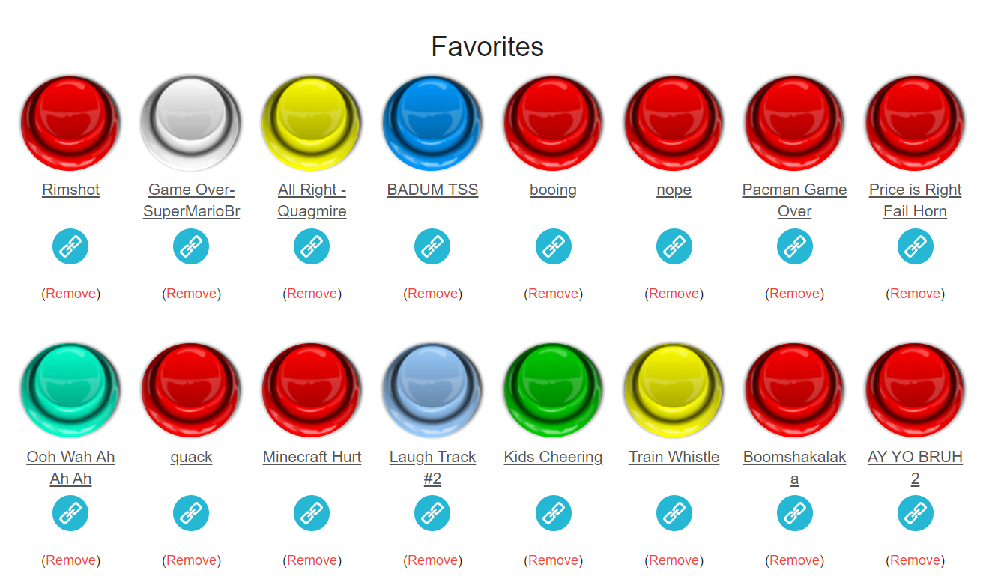
You can be a … sound effects artist!
My Example Soundboard
Use to encourage students to participate!

Slide 14
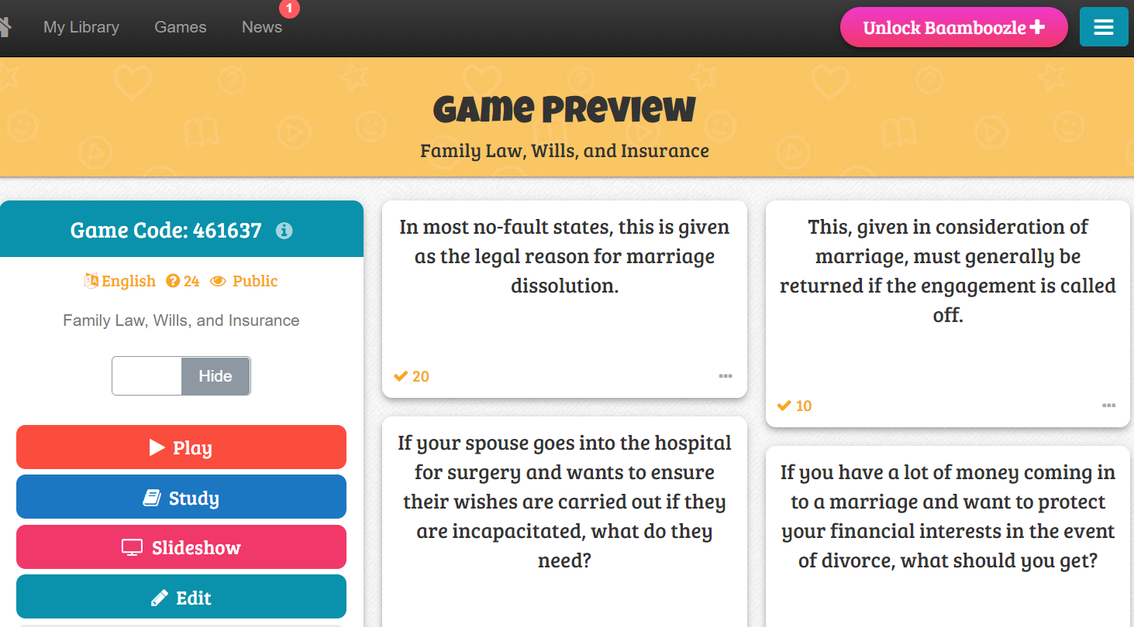
Bamboozle Group Game

Slide 15
Bamboozle Group Game

Slide 16
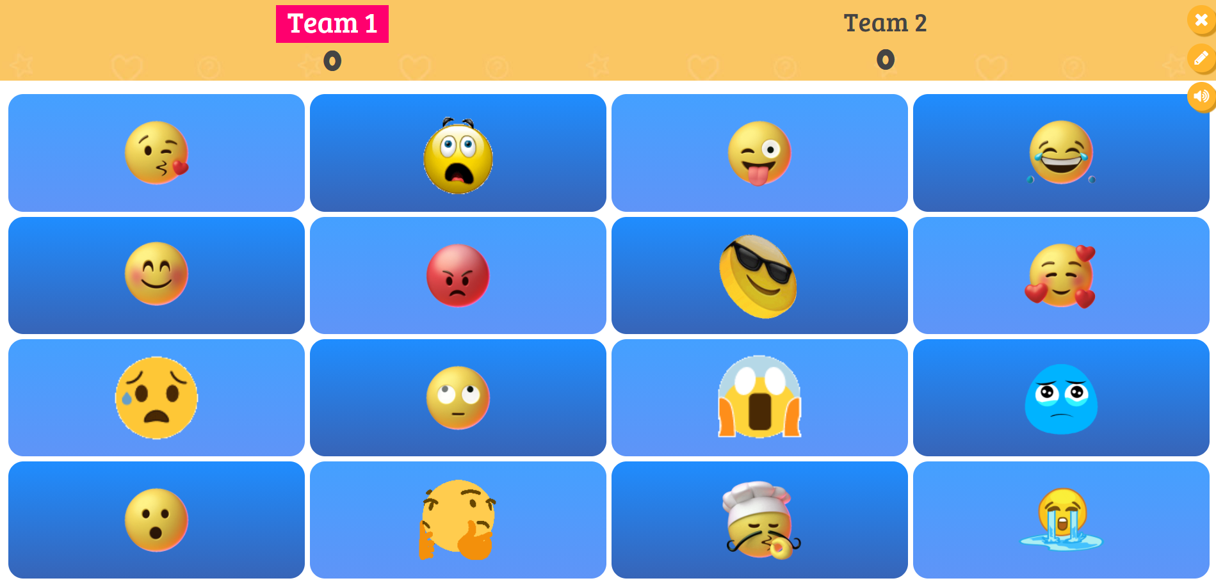
A “Fun” Board (theme)

Slide 17
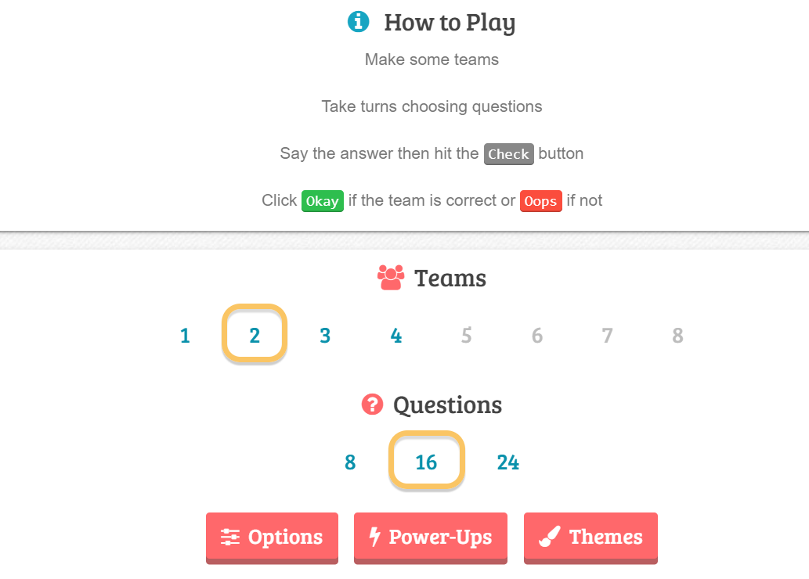
Bamboozle Group Game
Free version allows 4 teams; students sit together and answer questions (no device) and teacher runs it at their board.
Can play with “themes” or have numbers for them to pick questions to answer and there are power-ups so anyone can win.
Game Demo

Slide 18
FACT
If students have busy hands, it makes it more difficult to get on their phones.

Slide 19
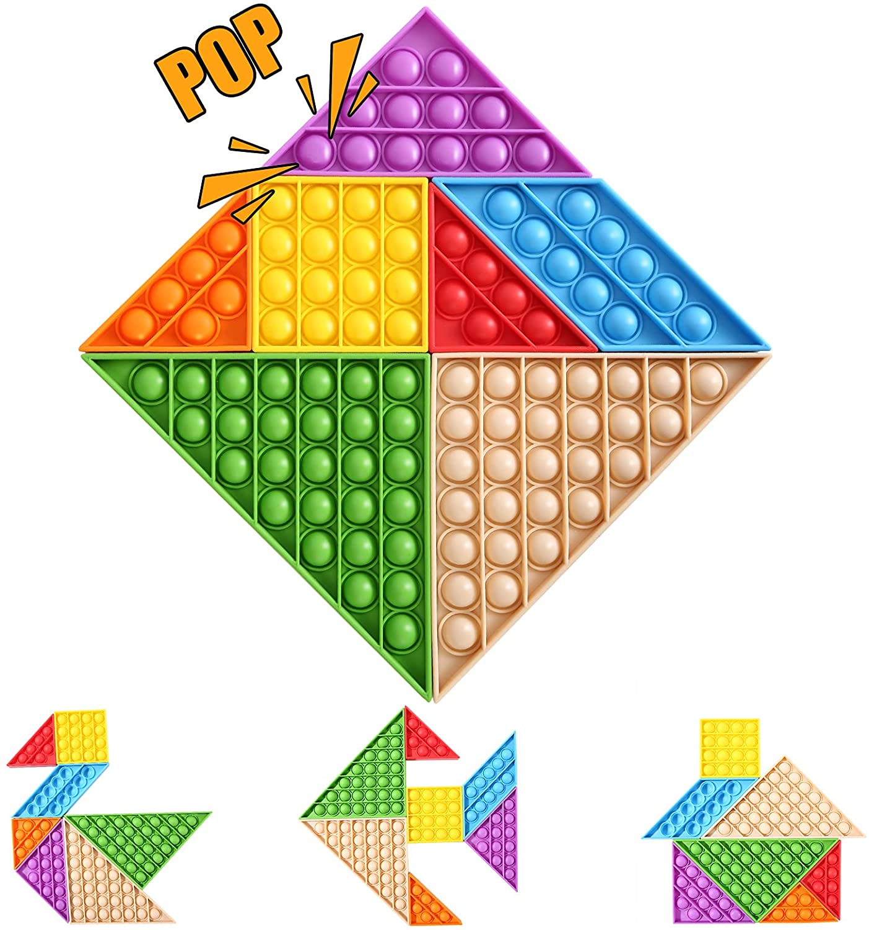
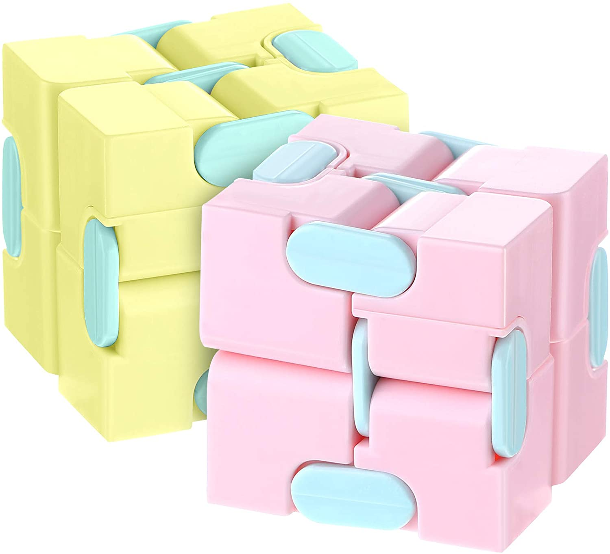
Fidget Things
Maybe my classroom is a busy playroom, but giving students fidget items keeps them paying attention during videos or lecture times when not directly engaged in writing/drawing.

Slide 20
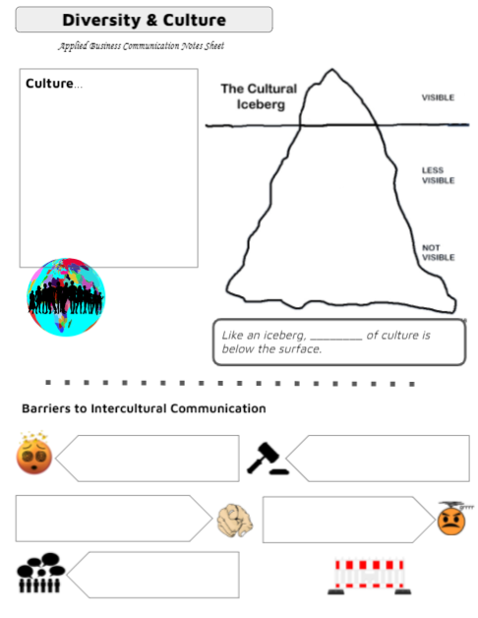
Visual Notes
Yes, I still use paper! Created in Google Slides, I print off visual notes sheets for units to encourage students to take notes and/or doodle to help activate their brains and keep them engaged with lectures.
BONUS: I let them use handwritten notes on quizzes

Slide 21
Ideas?
How do YOU engage students in your classroom?
Share in chat or unmute and give us your ideas!

Slide 22
Please reach out if I may be of assistance!
Twitter @tonyaskinner
School Email tskinner@jackson.k12.mo.us
Best of luck! Have a wonderful summer!

Slide 23
Icons from freeicons.io

