Slide 1
So You Want to Start an FCCLA Chapter?
Michelle Irvine, Grand Island Senior High

Slide 2
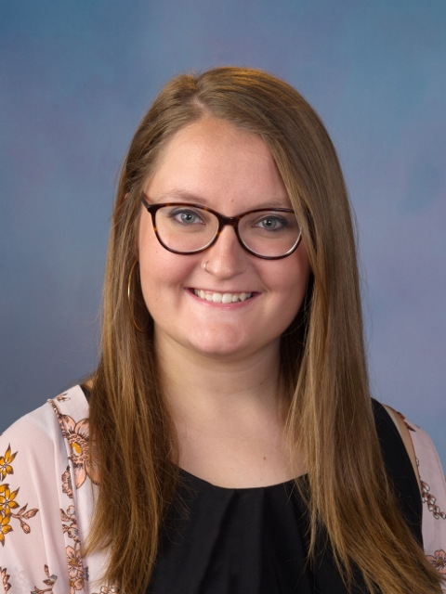
Hello!
I’m Michelle Irvine
I am the Head Adviser at Grand Island Senior High. We became a chapter in 2020.
You can find me at:
@ms_irvine_fcs on Instagram
miirvine4857@gmail.com

Slide 3
Reasons to Start a Chapter
”To give leadership opportunities to students” - Hannah Mayo, Winnebago
”To provide opportunities to compete, travel, and develop skills for students who may not otherwise be involved in school activities - Miranda Bright, Crete
“To provide opportunities to students in underserved schools and populations” - Carmen Hall, Plattsmouth

Slide 4
GISH FCCLA
My Why.

Slide 5
“
I love how FCCLA can help kids who don’t feel like they have a place in school find a place they feel they belong. It can also give kids who are only seen one way an opportunity to branch out and discover a new part of them self. As an adviser it’s so rewarding to see a kid go from a shy or difficulty ideal with JH kid to an amazing self confident leader by their senior year. It really helps to transform kids lives!”
Suzanne Martin, Medicine Valley

Slide 6
“
My own involvement in FCCLA in high school completely changed my life. It gave me so much confidence and helped me become so much more outgoing. I wanted to be able to give that opportunity and experience to my students. I have seen exactly that happen so many times and I LOVE watching my chapter members branch out, try new things, meet new people and gain so many skills. FCCLA gives them a place to belong in the school.”
Angie Ehlers, Overton

Slide 7
“
I love how FCCLA allows students to use and apply the skills they are learning beyond our classroom! FCCLA enhances the FCS program experiences and opportunities.”
Miranda Bright, Crete

Slide 8
So… What’s Next?

Slide 9
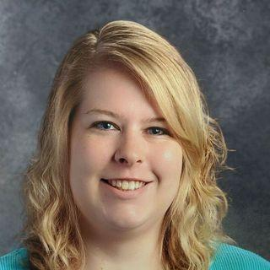
Contact the Nebraska
State Adviser
Chelsey Greene
You can contact her with any questions at chelsey.greene@nebraska.gov

Slide 10
The 3 R’s of FCCLA
Recruit
”What is FCCLA“ lesson in your classes
Use the school announcements
Ask teachers to advocate for the program to students
Retain
Host socials for the members to be together
Collaborate/compete with other CTSOs
Give members varying opportunities
Recognize
Let them letter
Create awards to be given throughout year
Utilize social media (also helps make community aware)

Slide 11
Find your Chapter Officers
Create a simple Program of Work

Slide 12
Grants
Community Partners
$$
Fundraising
Donations

Slide 13
Tips for Success
Starting a new chapter is very challenging but the rewards are 100% worth it. My biggest piece of advice: start small. Find one thing your chapter is a passionate about, and start there...ours was community service. We focused on community service for a few years and slowly added STAR projects.
Don’t be afraid to ask for help! There are great FCCLA advisers in Nebraska and they are willing to help. Attend as many fccla events and conferences as you can afford - that’s where you’re members will see the reward and spark more interest.
Michelle Galles, Wakefield

Slide 14
Thanks!
Any questions?
You can find me at:
@ms_irvine_fcs on Instagram
miirvine4857@gmail.com

