Slide 1
Photoshop Crash Course
Tonya Skinner, Presenter
Notes:
June 8 @ 11-11:45 AM
Whether you want to fix your photos, enhance them, or really create magic, this session is for you. Learn tips for making great selections, enhancing photos with adjustment layers, and using smart filters.

Slide 2
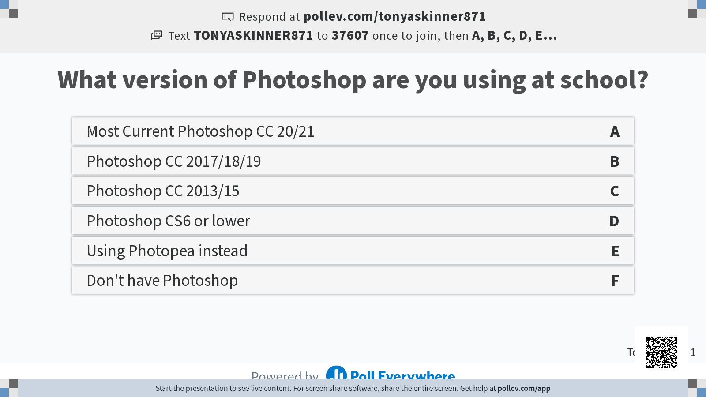

Slide 3
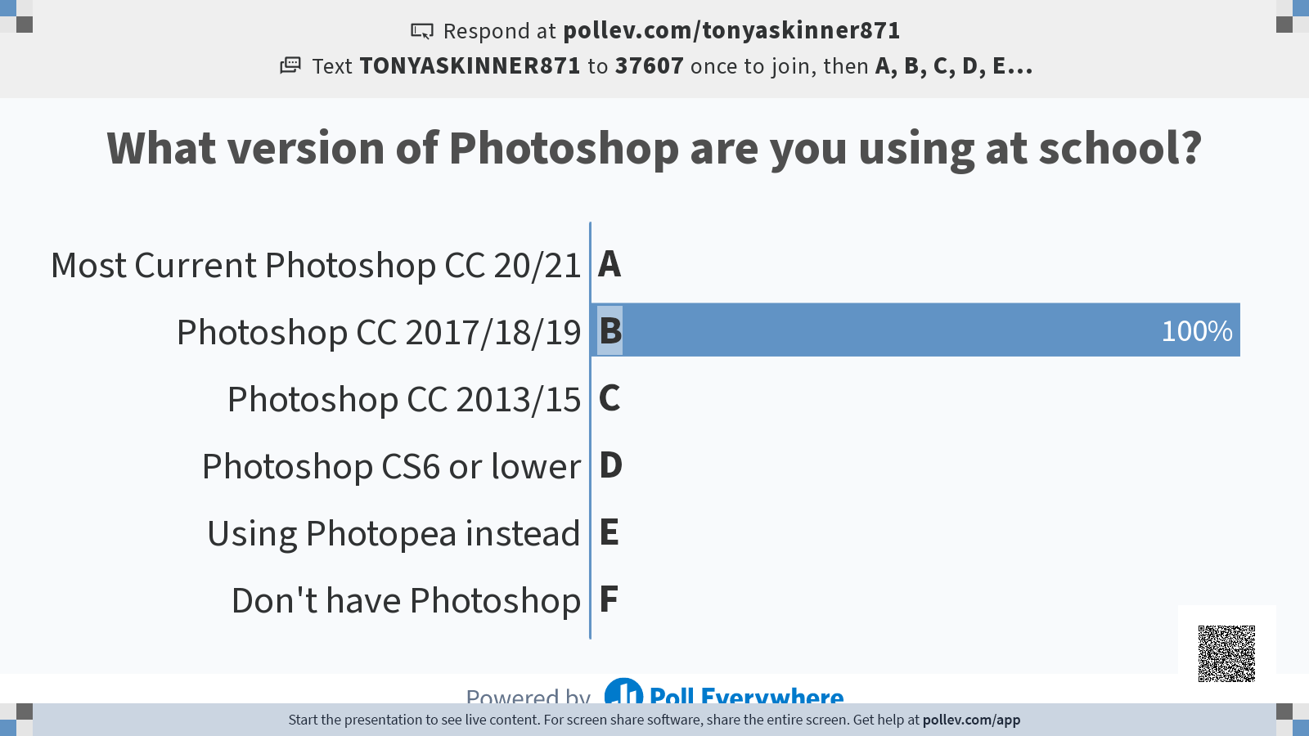

Slide 4
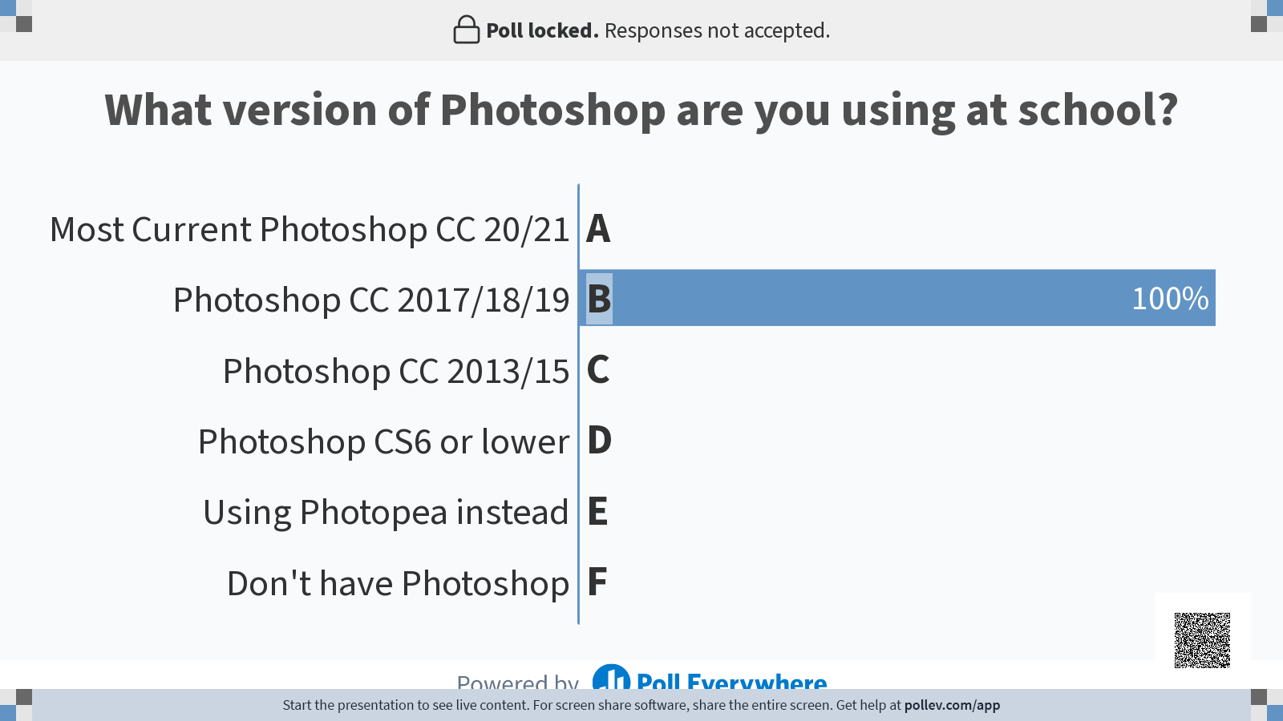

Slide 5
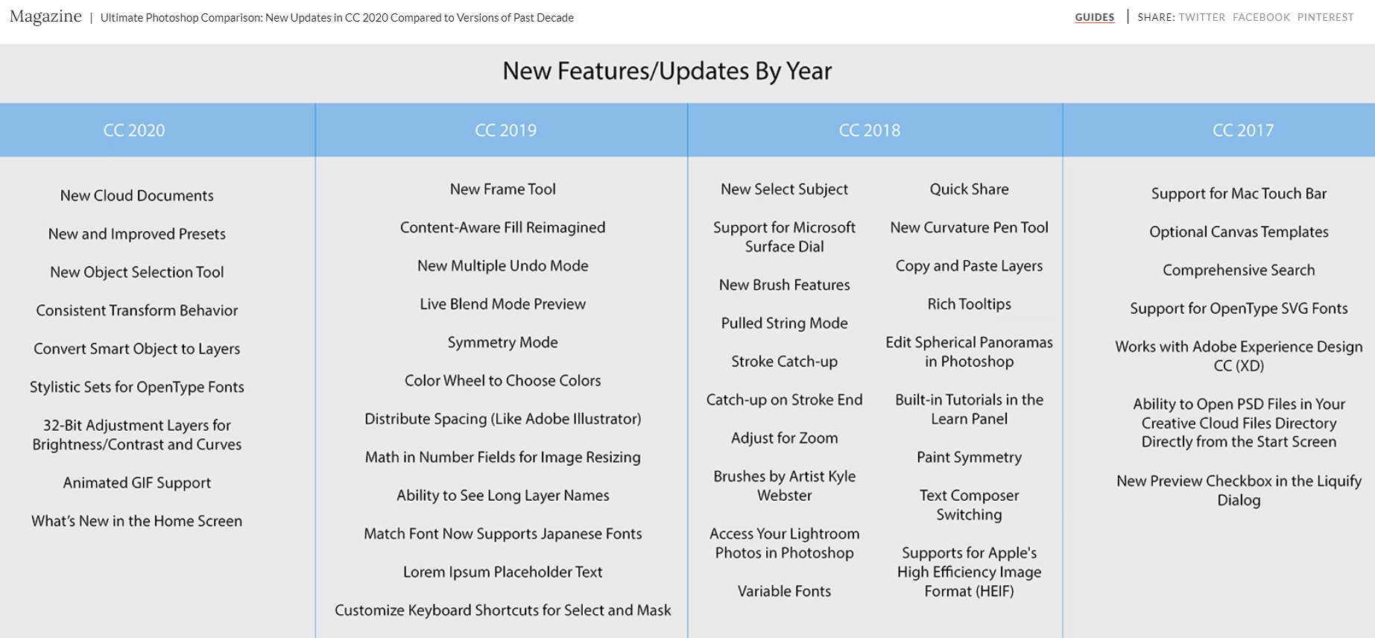
What’s New?
Adobe→ https://helpx.adobe.com/photoshop/using/whats-new.html
Phlearn Screenshot→ https://phlearn.com/magazine/ultimate-photoshop-comparison/
Transform without Shift

Slide 6
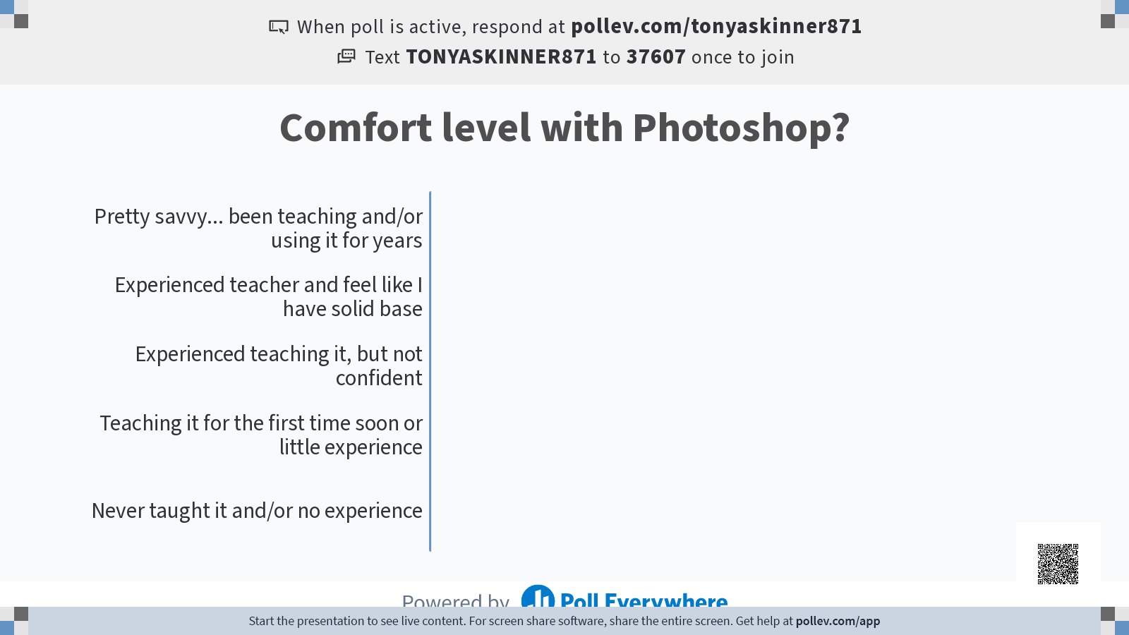

Slide 7
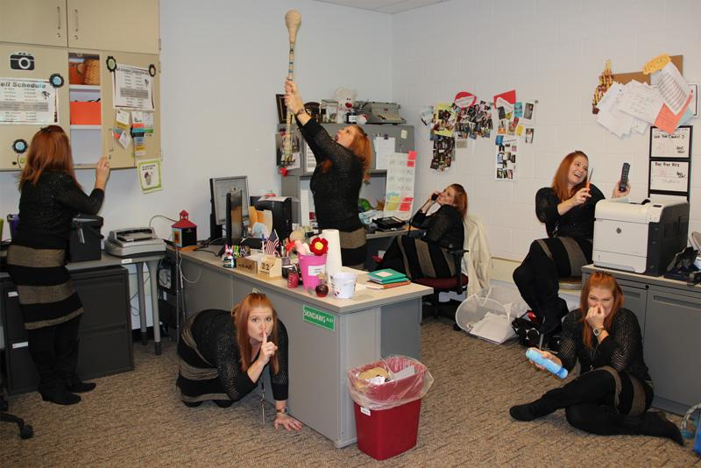
Basic Purposes of Photoshop
Touch Up Photos
Compositing Images (stacking layers)
Create Complex Graphics (text, shapes, images)
Animating

Slide 8

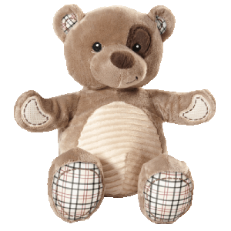
Lots of Fun!
Notes:
Animation Tutorial→ https://docs.google.com/presentation/d/1zYRMWUPdnB9Qe6YMjaIXkKaTfr7MFA-yDG0CLlckZ0Y/edit?usp=sharing

Slide 9



Slide 10
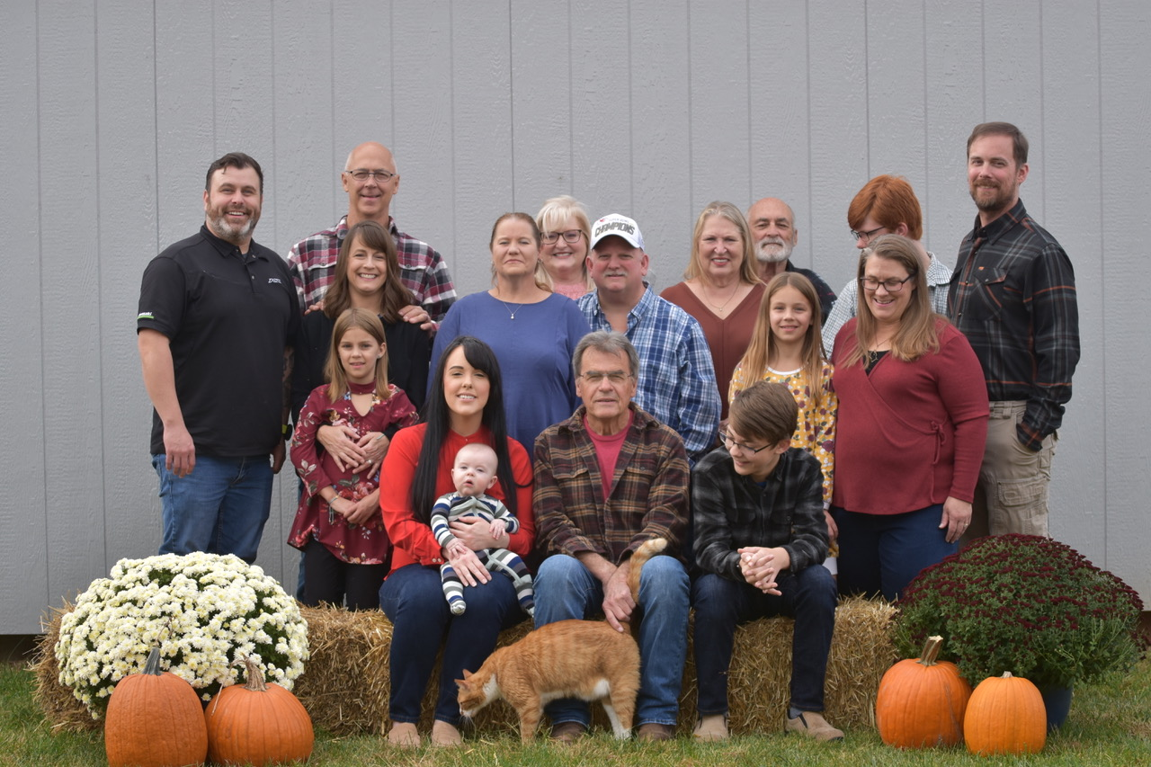
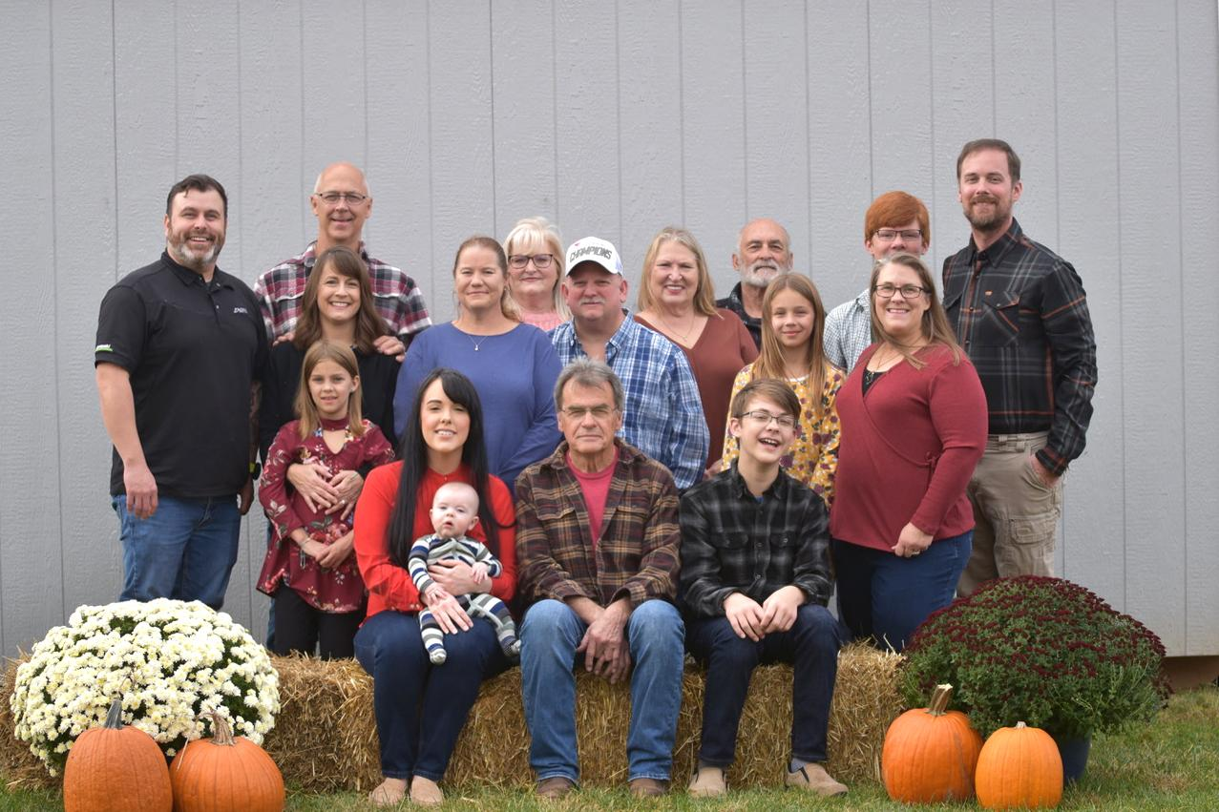
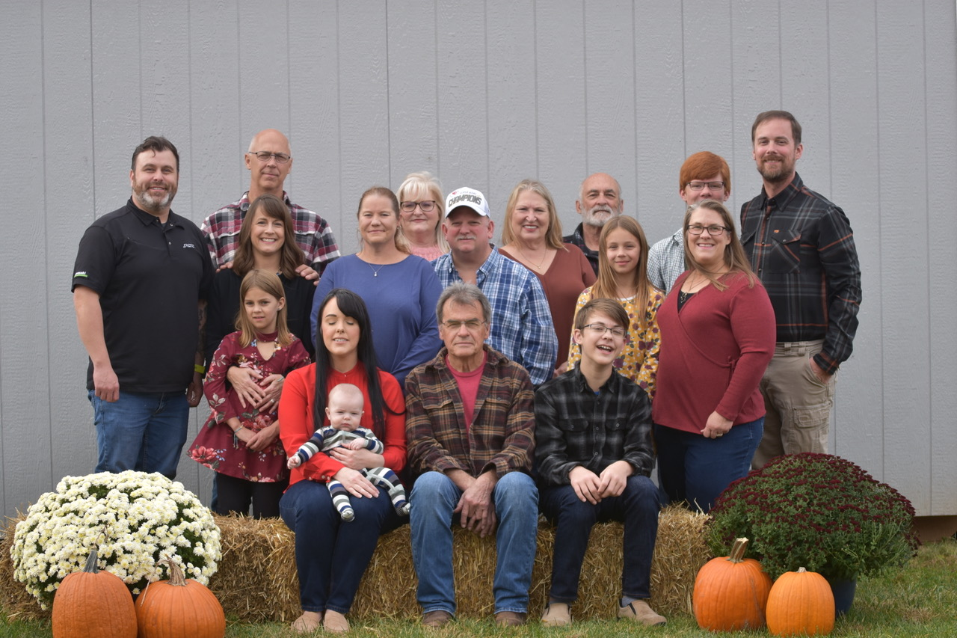

Slide 11
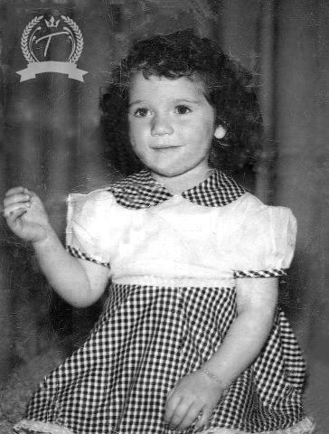

Slide 12

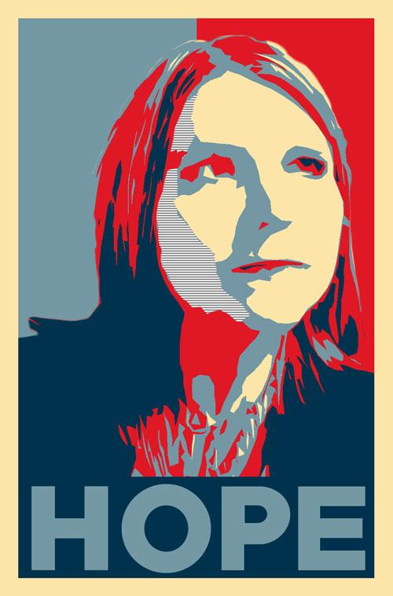

Notes:
Poster Tutorial→ https://docs.google.com/document/d/15jtcC8obD7_bw_d4FqlQZdVWLeMID5P3MIUiHDY0tF0/edit?usp=sharing

Slide 13
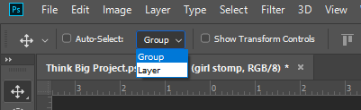
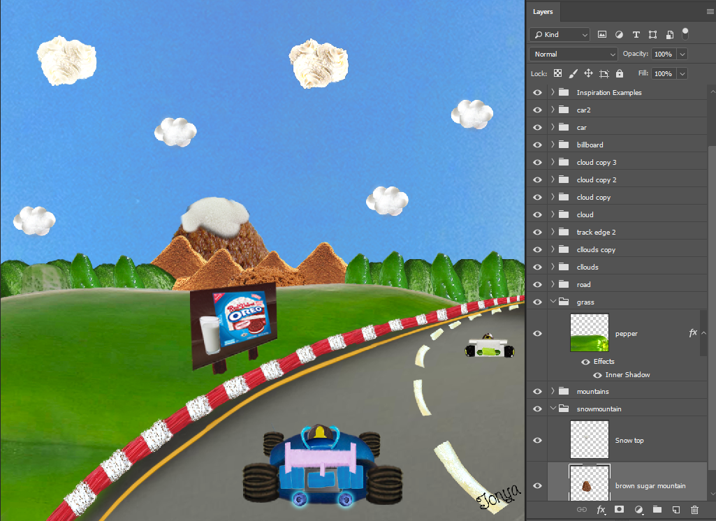
Basics -- Layers
On top is to the front
Create Layers automatically:
Drag in pics
Type
Insert shapes
Require Existing Layer:
Brush (will “glue” to current layer)
Move tool to select layers/objects and Transform them (rotate, etc.)

Slide 14
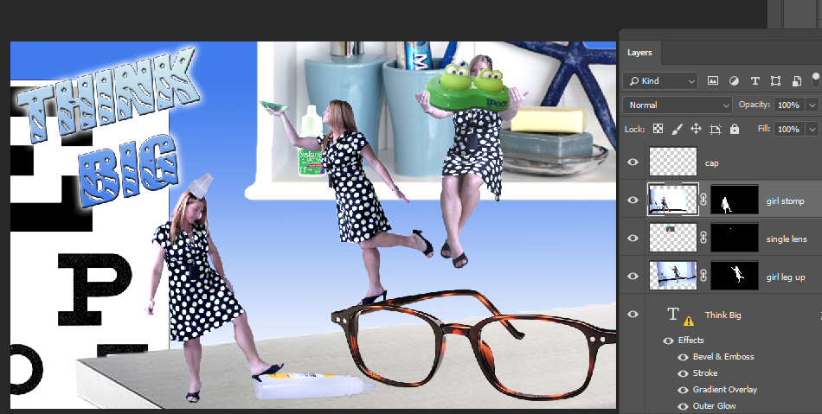
Basics -- Selections
bg
hidden
Case Problem:
Select Subject (great starting point) and how to add hair using Select and Mask and Refine Edge Brush
bg erased
Notes:
Skinner1

Slide 15
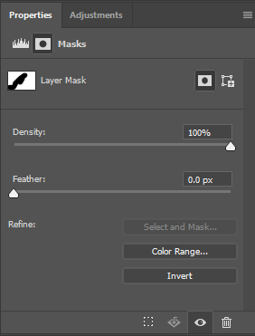
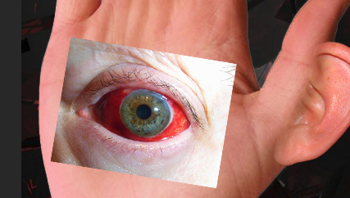
THE POWER IS IN
LAYER MASKS!
Case Problem:
Use a layer mask to blend (soft brush - black hides, white brings back)
Notes:
SkinnerFantasy

Slide 16
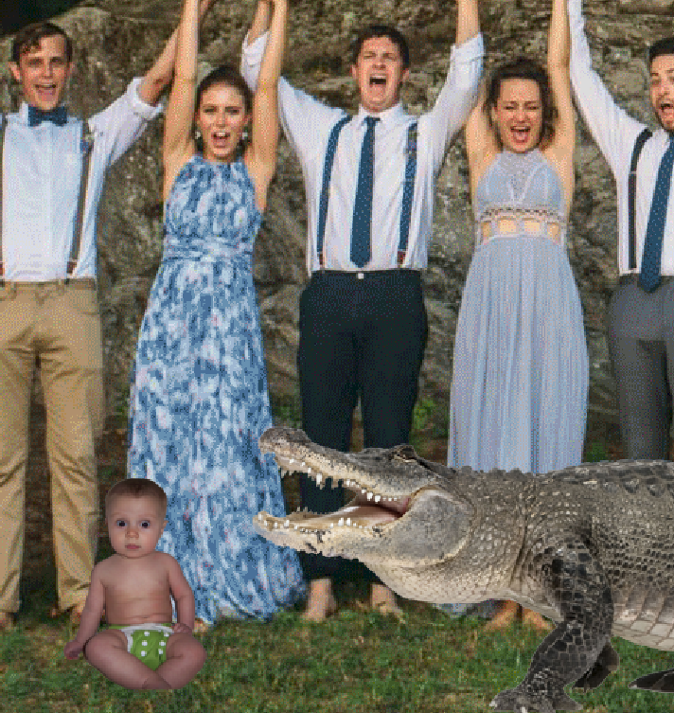
Adjustments! Critical Skill!
How can you make composites look “realistic” when you have to account for shading and color?
Adjustment layers!
Case Problem: Baby isn’t “orange” and is too dark
Solution: Curves or Levels AND “warming” Photo Filter
Notes:
Adjust-WeddingWoes

Slide 17

For My ADVANCED Photoshop Users… some tips and tricks!
Let’s look at some “maybe not as well-known” features and options!

Slide 18
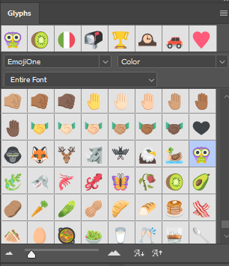
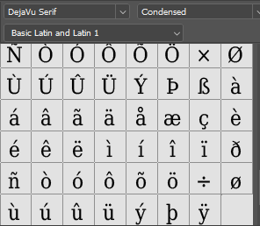
Glyphs Panel - Great for Dingbat fonts
OpenType fonts … lots of options!
Drop down for categories:
EmojiOne Font (CC2017+)

Slide 19
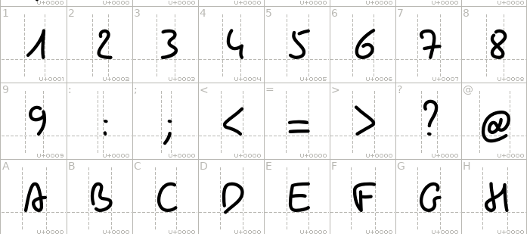

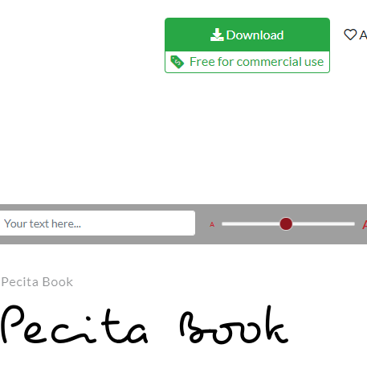
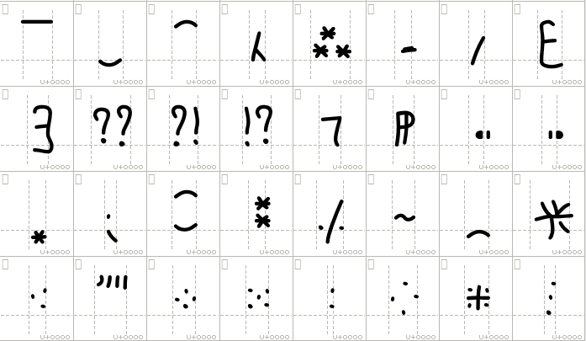
Let’s look at an OpenType font...
https://www.1001fonts.com/pecita-font.html

Slide 20
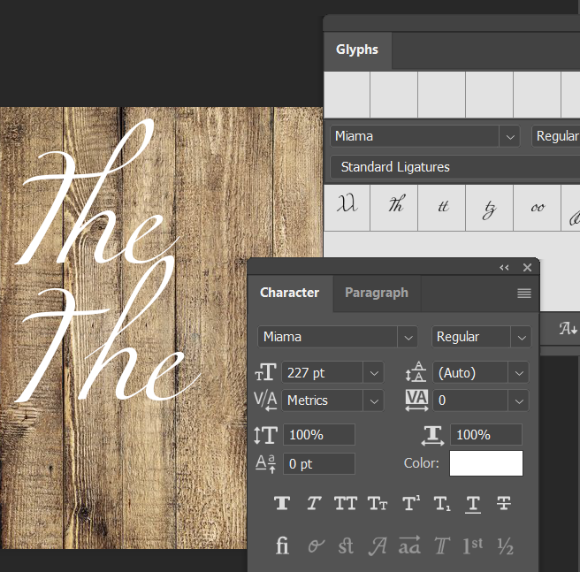
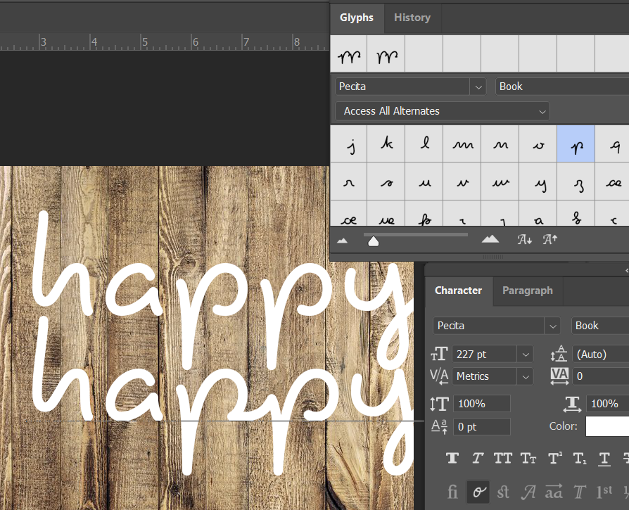
Photoshop Ligatures & Alternates

Slide 21
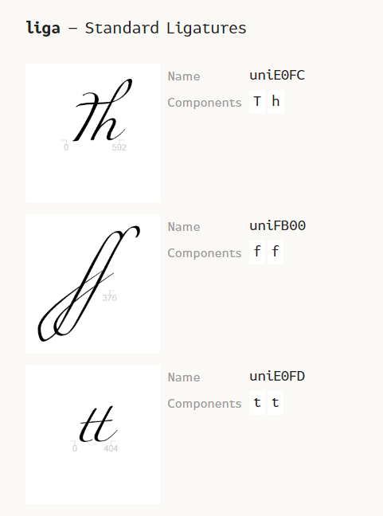
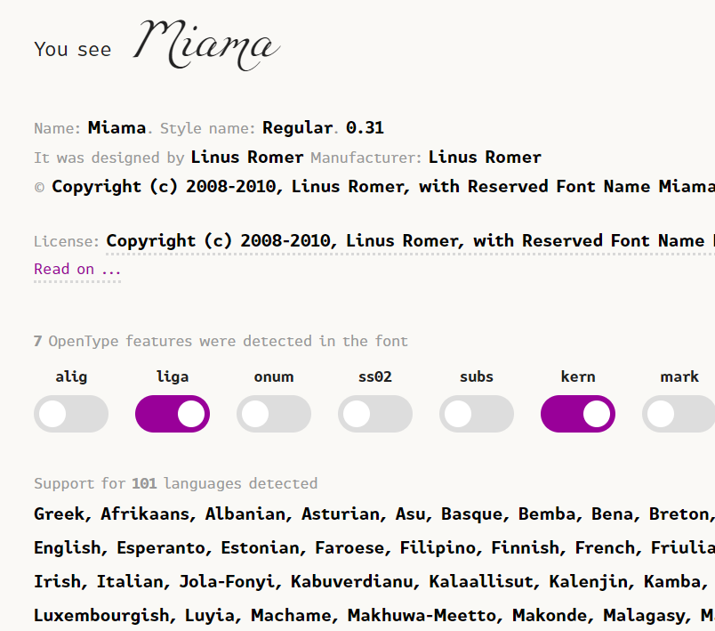
Font Features - Cool Website!
https://fontdrop.info/
Free Fonts for Commercial Use from 1001 Fonts

Slide 22
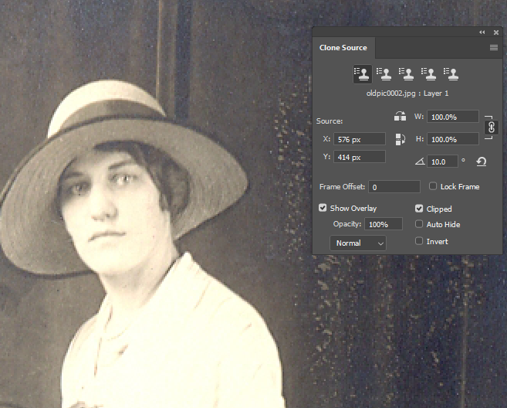
Clone Source Panel
The Clone Source Panel (under Window) works with the Clone Stamp Tool to give you the ability to define up to five sampling sources, and also to transform the sample by rotating, scaling, etc. You can even define a sampling source in another file.
Notes:
OldPic

Slide 23
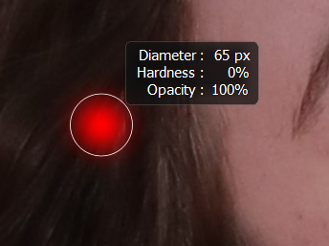
Brush Settings (on the fly!)
Brush tool (B)
Control+Alt+right click the mouse
  Drag up for softer and down for harder
  Drag left for bigger and right for smaller

Slide 24
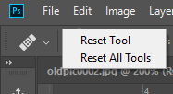
Resetting Tools (but not ALL tools)
Right click the leftmost button on the Options bar
Or, click the down arrow

Slide 25

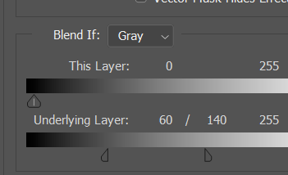
Blend If (Blend Mode / fx button)
Super cool way to blend naturally
Hold Alt and drag to separate and do fade
Use “This Layer” to remove black bg
Notes:
Bricks

Slide 26
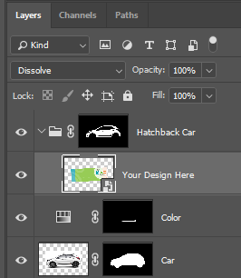
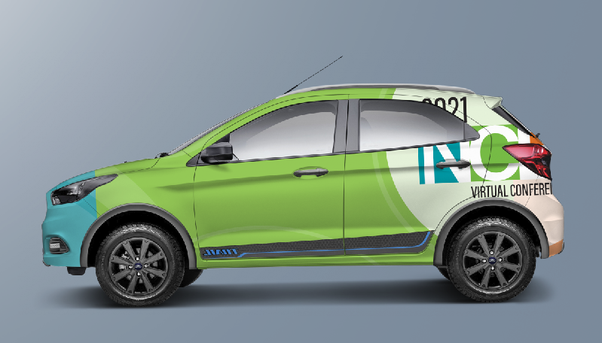
Smart Stuff
Smart Layers do not degrade when resized
Smart Filters (added to Smart layers) have layer masks to fine tune
Mock-ups come with Smart Layers for quick updates that are SUPER COOL to see your artwork in practice!
https://downloadmockup.com/free-psd/free-hatchback-car-mockup-psd/

Slide 27
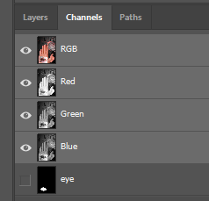
Save Selection
Saves in a channel
Must be saved as PSD
ALTERNATE WAY: Just add a layer mask and Control+Click thumbnail to re-select based on the mask!

Slide 28
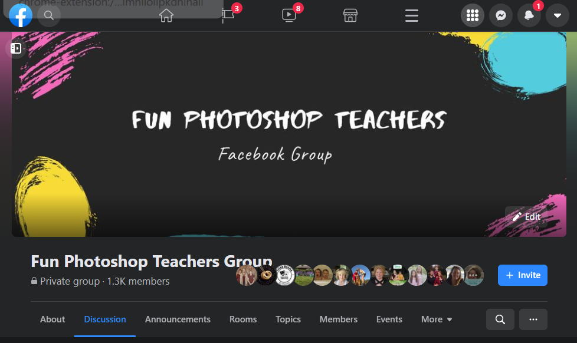
https://www.facebook.com/groups/funpsteachers
Join the Community!

Slide 29
Icons from freeicons.io

