Slide 1
Teaching Mechatronics in High Schools
Central Community College

Slide 2
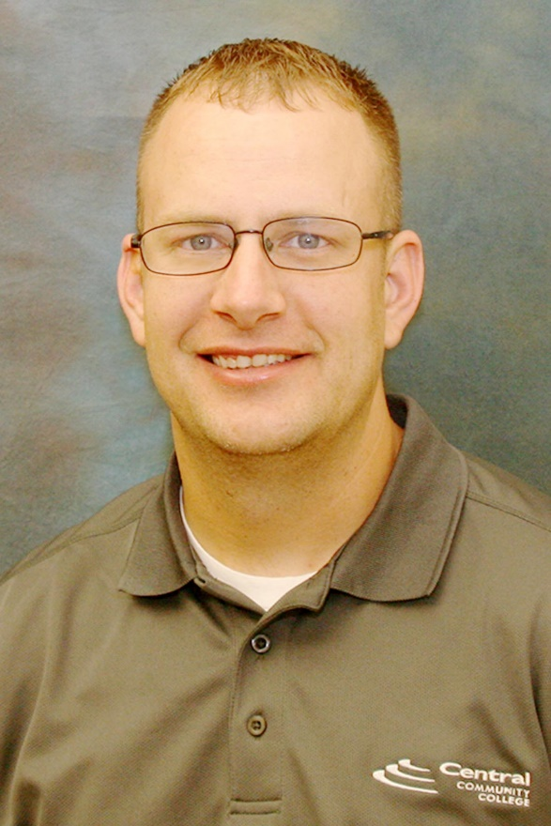
Session Facilitators: Dan Davidchik & Jared Pettit

Slide 3
Session Objectives:
Learn how college Mechatronics is being designed for delivery in high schools
Learn about Mechatronics awareness for the STEM classroom
Discussion:
Keys to building important local relationships
Where do want to go with STEM?

Slide 4
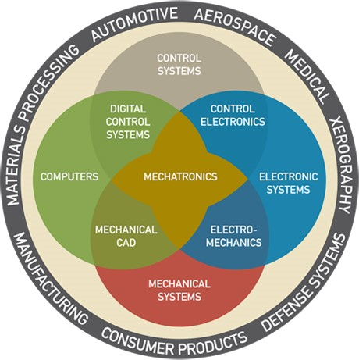
Mechatronics is…
The integration of computers, electronics, mechanics, and controls
aka AUTOMATION

Slide 5
From the college to the high school classroom
NSF project to engage “pilot” high schools with Mechatronics
Engaging students with hands-on lab activities
Providing schools with cost effective text materials
Developing HS educators knowledge base

Slide 6
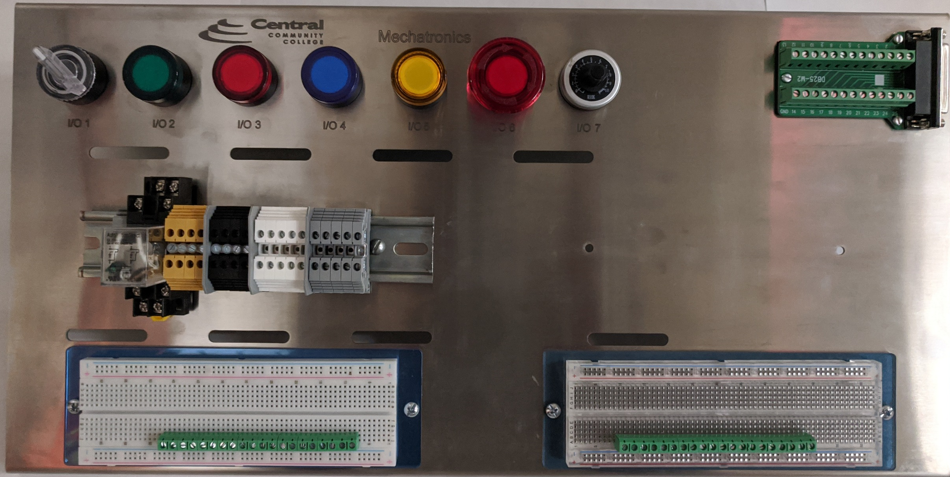
Concepts of Electronics I – hands-on trainer

Slide 7
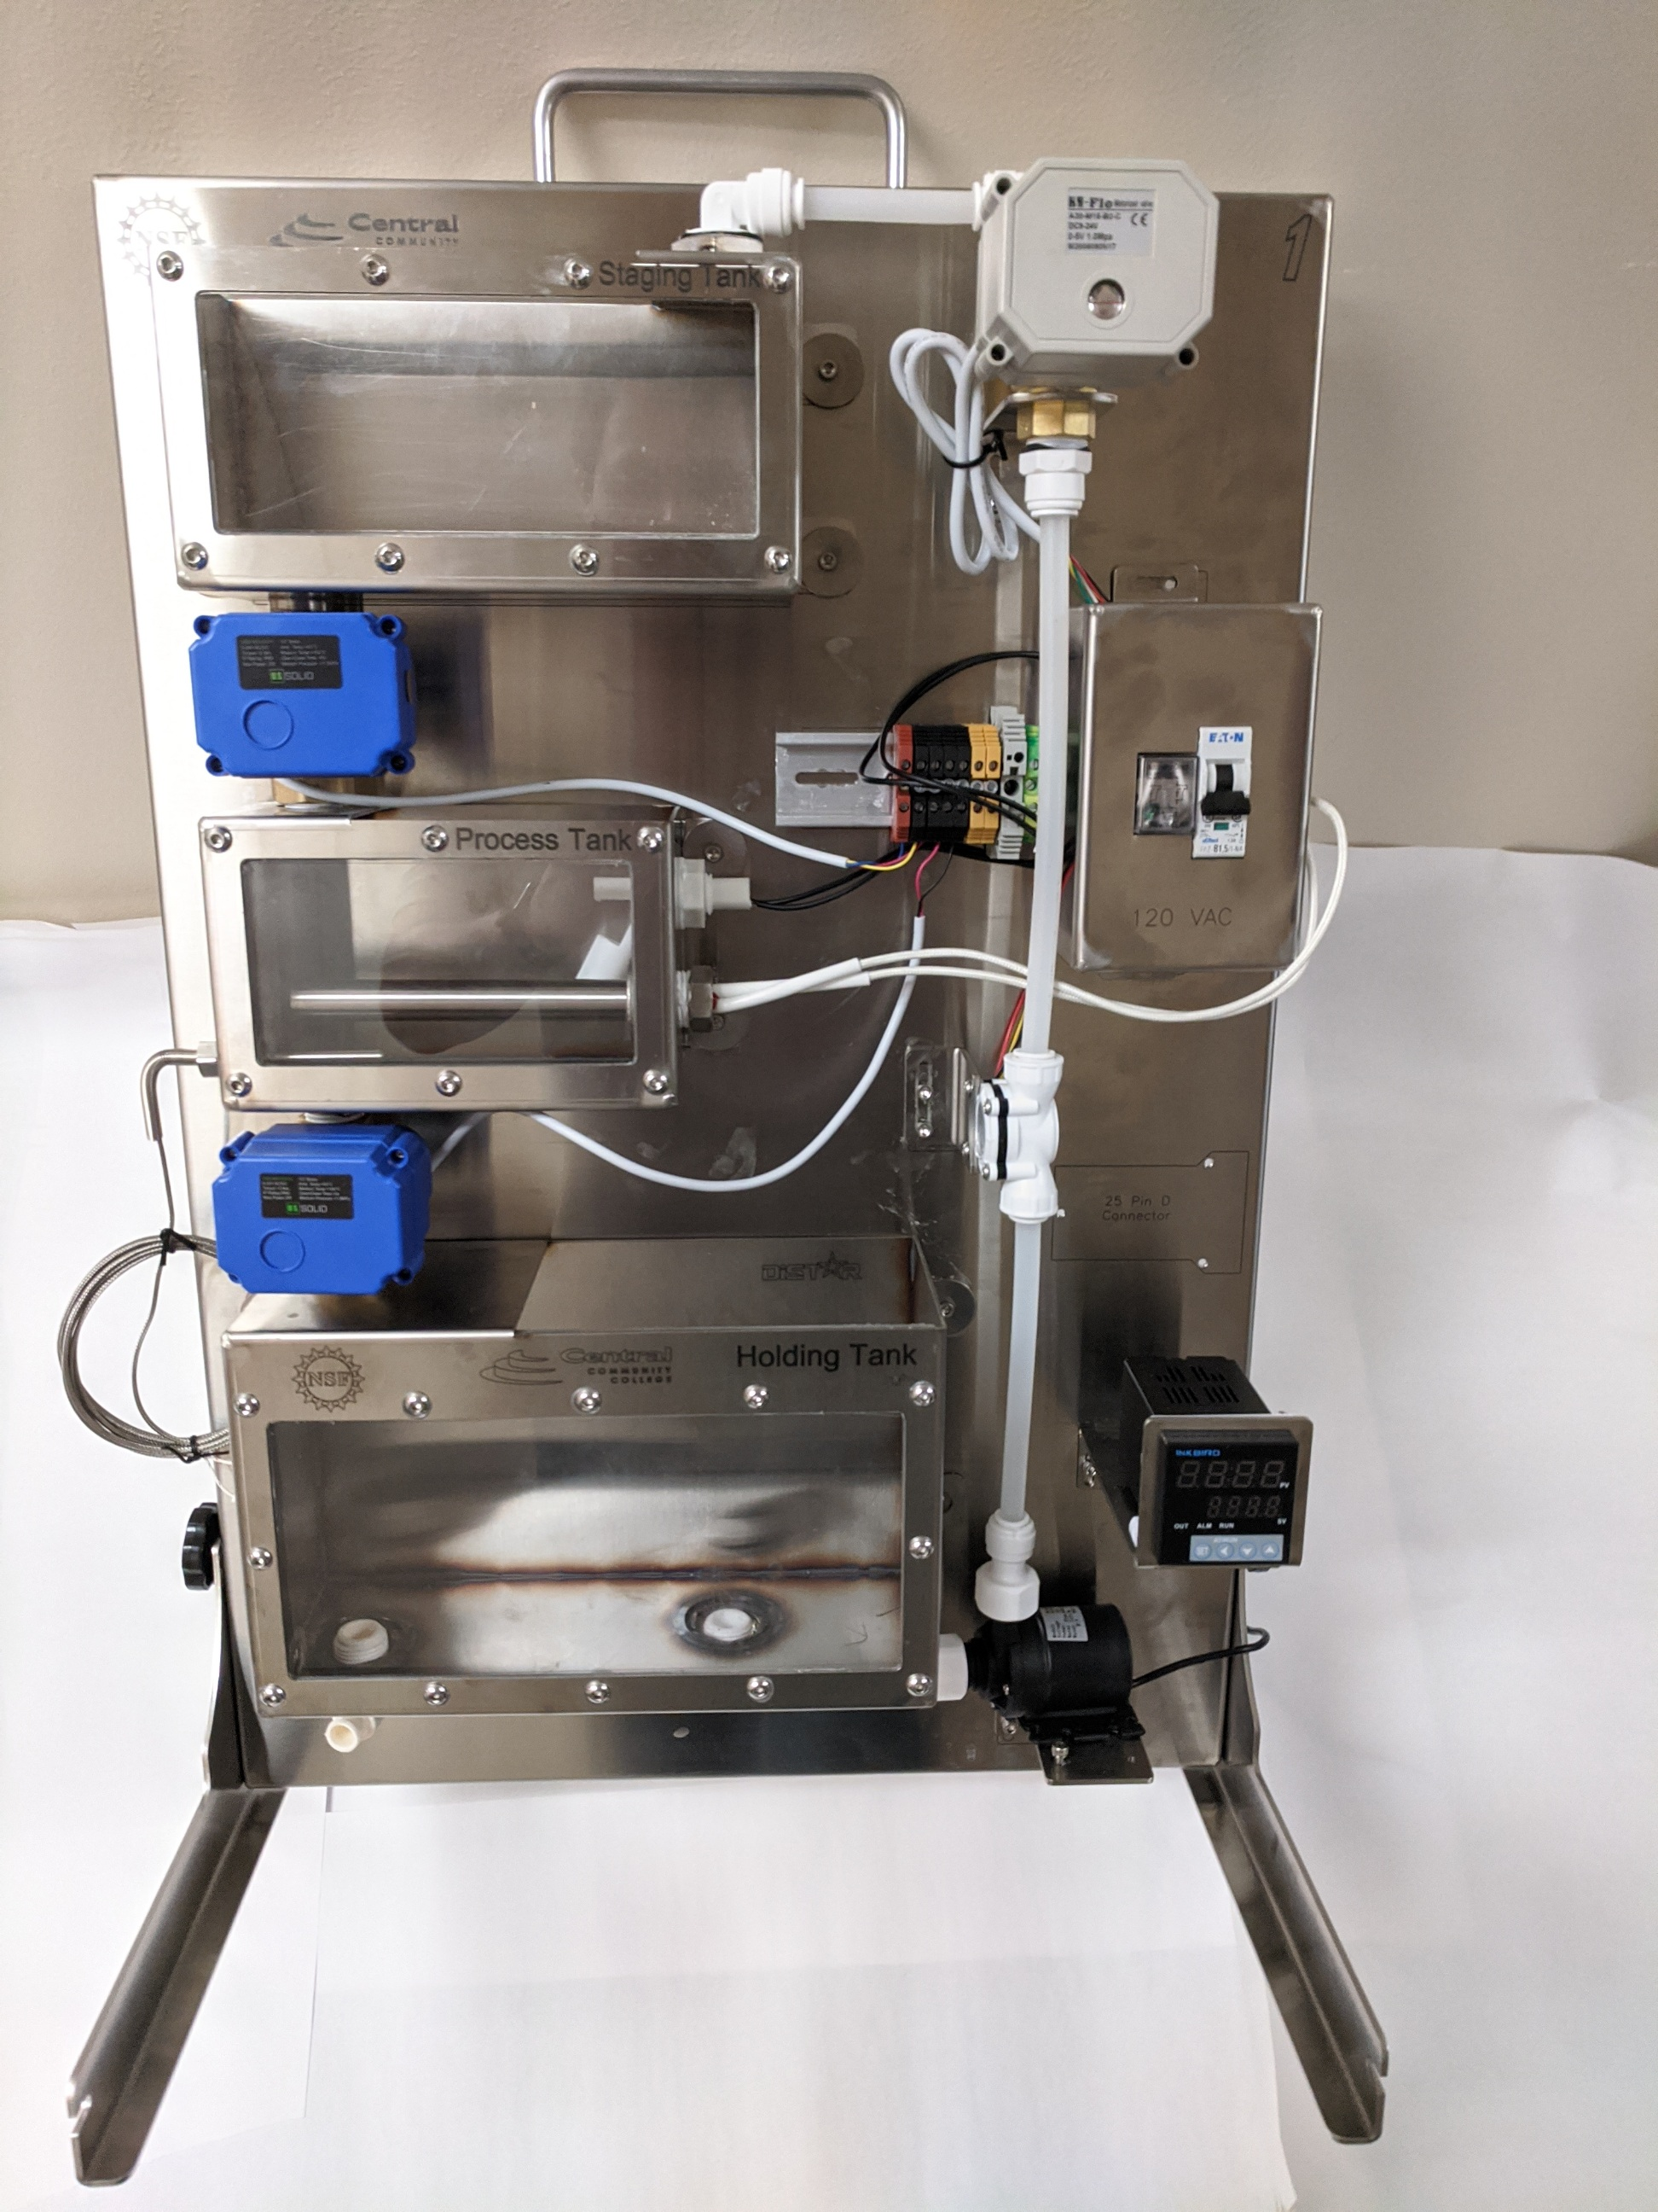
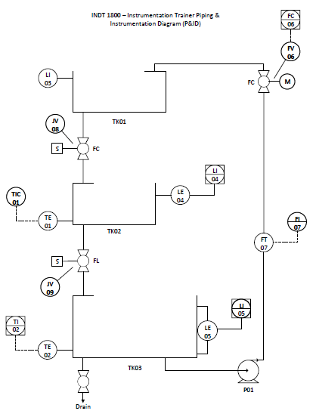
Introduction to Instrumentation – hands-on trainer

Slide 8
Open Educational Resources
OER text materials with Creative Commons licensing
Electronics -
https://www.allaboutcircuits.com/textbook/
Instrumentation - http://www.ibiblio.org/kuphaldt/socratic/sinst/

Slide 9
Nebraska High Schools “piloting” Mechatronics
1
Aurora HS
2
Axtell HS
3
Columbus Lakeview HS
4
Kearney HS
3
6
5
Lexington HS
6
Schuyler HS
5
1
4
2

Slide 10
Discussion of STEM connections
Science
Technology
Engineering
Math

Slide 11
Discussion on Building STEM in your school
Where do you want to go with STEM?
Building business-education relationships

Slide 12
Questions / Comments

Slide 13
Contact Information
Dan Davidchik
Mechatronics Instructor
Central Community College
Columbus Campus
ddavidchik@cccneb.edu
402-562-1408
Jared Pettit
Mechatronics Instructor
Kearney Learning Center
Central Community College
jaredpettit@cccneb.edu
308-338-4010

