Slide 1
Career Resources from
Nebraska Department of Labor
Jodie Meyer, Research Analyst
Nebraska Department of Labor

Slide 2
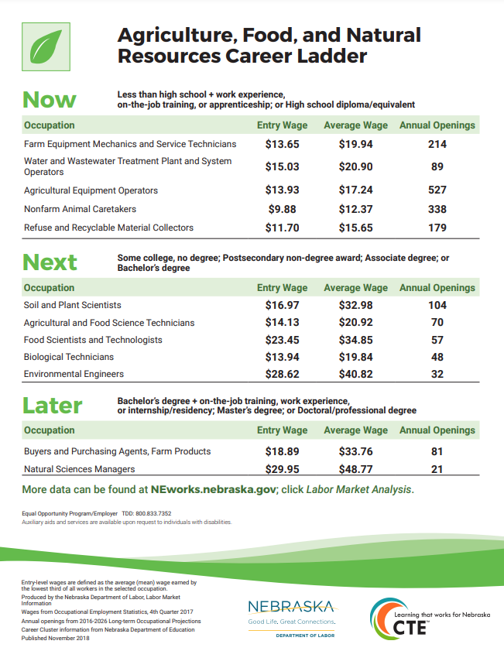
Career Ladder Posters
Color keyed to Nebraska Department of Education CTE Career Fields
Focuses on occupations for Now, Next and Later
Displays entry and average wages and annual openings
Letter (8.5 x 11) and tabloid (11 x 17) sizes available
Online at: https://neworks.nebraska.gov

Slide 3
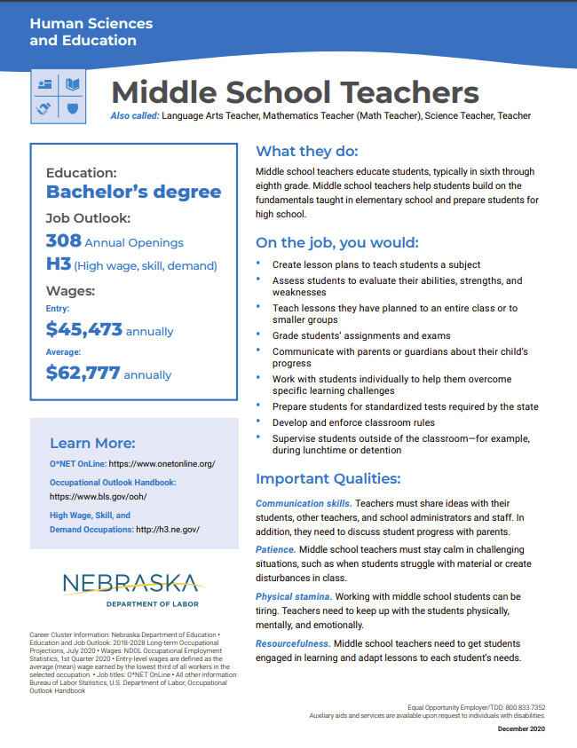
Occupational Profiles
Color keyed to Career Fields
Features general occupational information from O*NET and NDOL data
Occupations Available:
  Registered Nurses
  Accountants & Auditors
  Meeting, Convention, & Event Planners
  Electricians
  Welders, Cutters, Solderers, & Brazers
  Graphic Designers
  Web Developers
  Lawyers
  Middle School Teachers
  Food Scientists & Technologists
What others would you like to see?
Online at: https://neworks.nebraska.gov

Slide 4

Licensed Occupations
Occupations in Nebraska requiring licensing or certification
Survey of licensing authorities
Includes
  Occupation overview
  Contact information
  Licensure/certification/registration requirements
  Fee information
  Renewal information
  Licensing statistics
New data out later this year
Online at: https://neworks.nebraska.gov

Slide 5
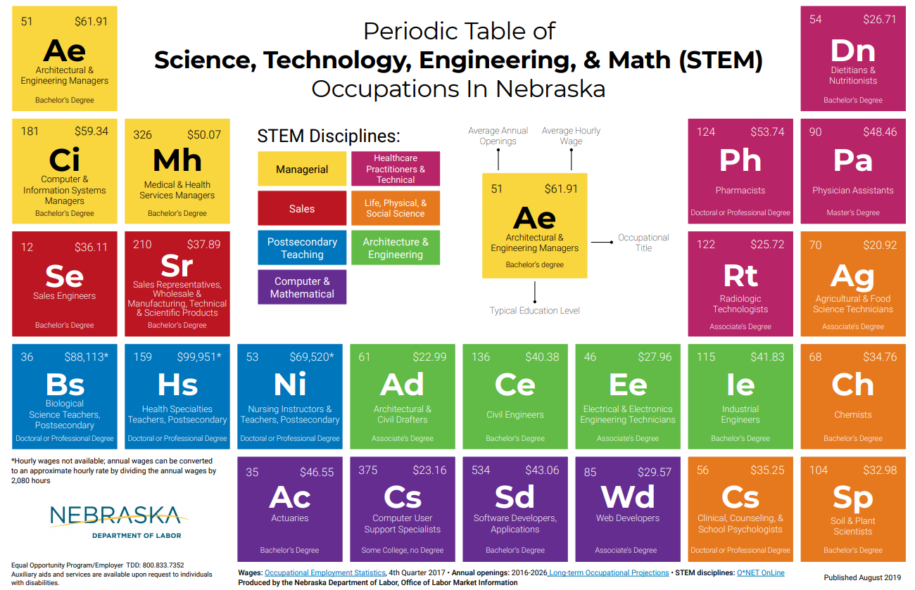
STEM Resources
STEM Occupations Poster
  Displays average wages and annual openings for science, technology, engineering, and math occupations
Online at: https://neworks.nebraska.gov

Slide 6
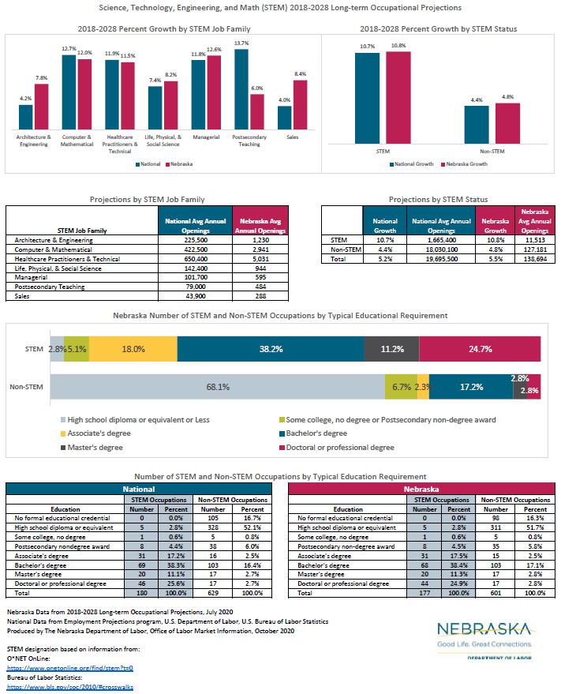
STEM Resources
STEM Excel Dashboard
  Compares STEM and Non-STEM occupations in Nebraska to the Nation
  One page overview handout
  Detailed information on individual occupations
Online at: https://neworks.nebraska.gov

Slide 7
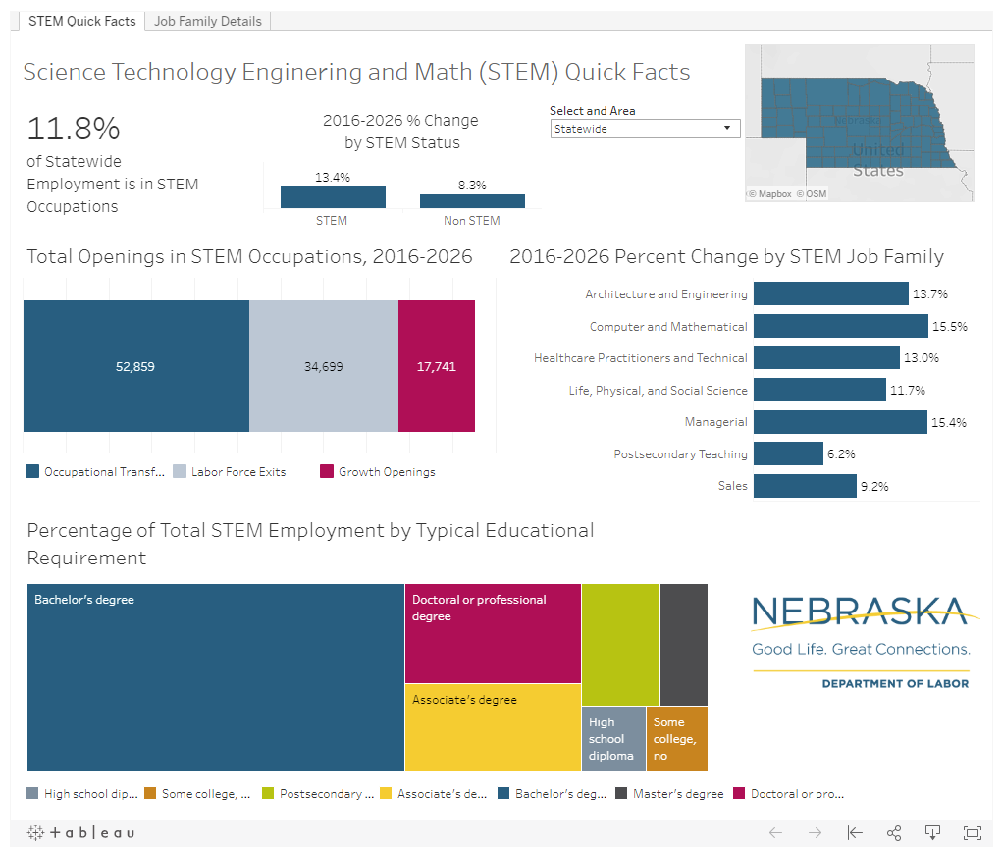
STEM Resources
STEM Tableau Dashboard
  Interactive
  Regional data
  Data on STEM job families
    Architecture and Engineering
    Computer and Mathematical
    Healthcare Practitioners and Technical
    Life, Physical, and Social Science
    Managerial
    Postsecondary Teaching
    Sales
Online at: https://neworks.nebraska.gov

Slide 8
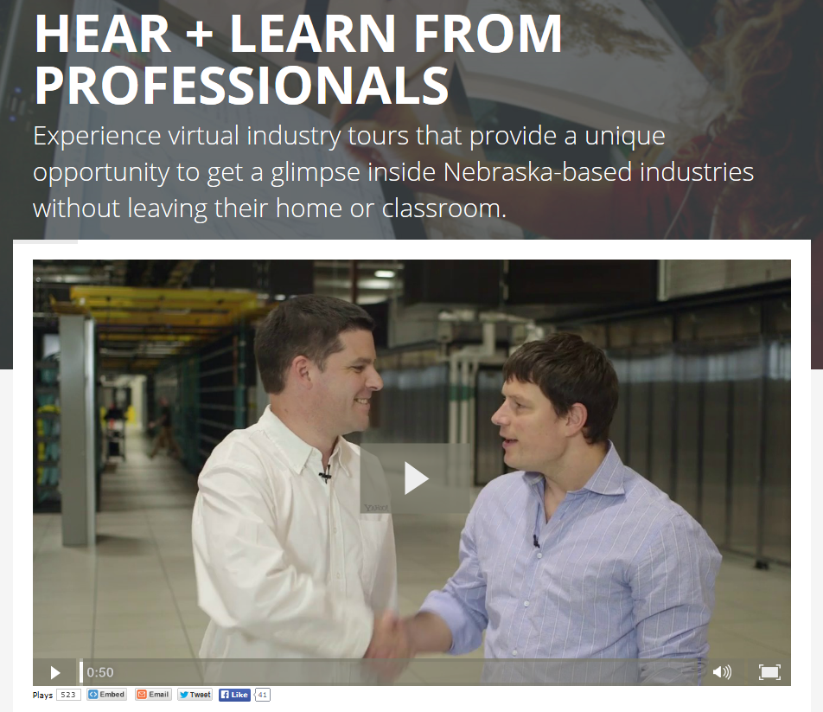
Career Videos
Videos Include
  Virtual tours of Nebraska Industries
  Interviews with employees and business representatives
  Labor Market Information in pop ups
Sponsored by Nebraska Departments of Education, Labor, and Economic Development
Free discussion guides under the “Resources” section!
Online at: https://www.nebraskacareerclusters.com/

Slide 9

Reality Check
Online tool from EducationQuest
Series of questions on desired lifestyle to help students understand expenses
Matches students with careers that pay enough for desired lifestyle
Shows wages and link to find more information on the career online
Online at: https://www.educationquest.org/realitycheck/

Slide 10
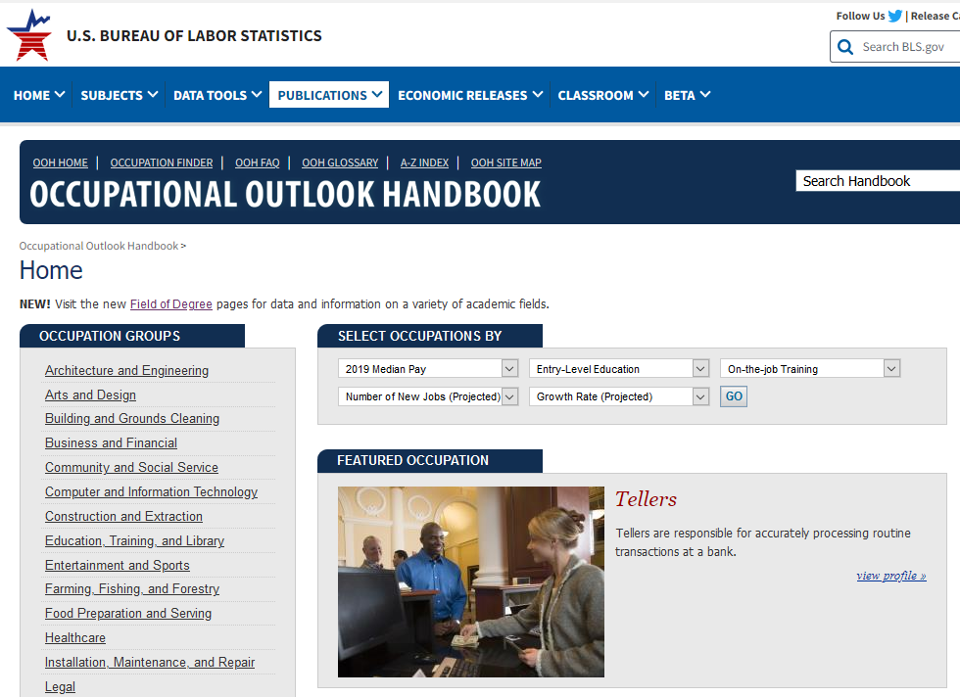
Occupational Outlook Handbook (OOH)
Tons of information on occupations!
Occupational Profile includes:
  Pay
  Education
  Job outlook
  Similar occupations
  And more!
Online at: https://www.bls.gov/ooh/

Slide 11
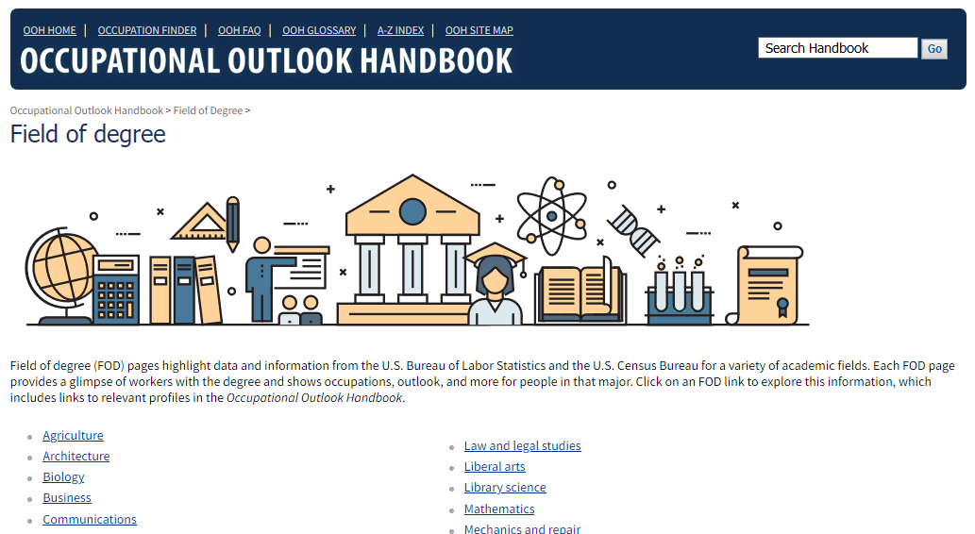
Occupational Outlook Handbook (OOH)
Field of Degree
  Looks at workers with different majors and provides a look at occupations, outlook, and more for people in that major.
OOH Teacher’s Guide
  Information for educators on how to navigate the OOH
Links for both towards the bottom of the OOH homepage
Online at: https://www.bls.gov/ooh/

Slide 12
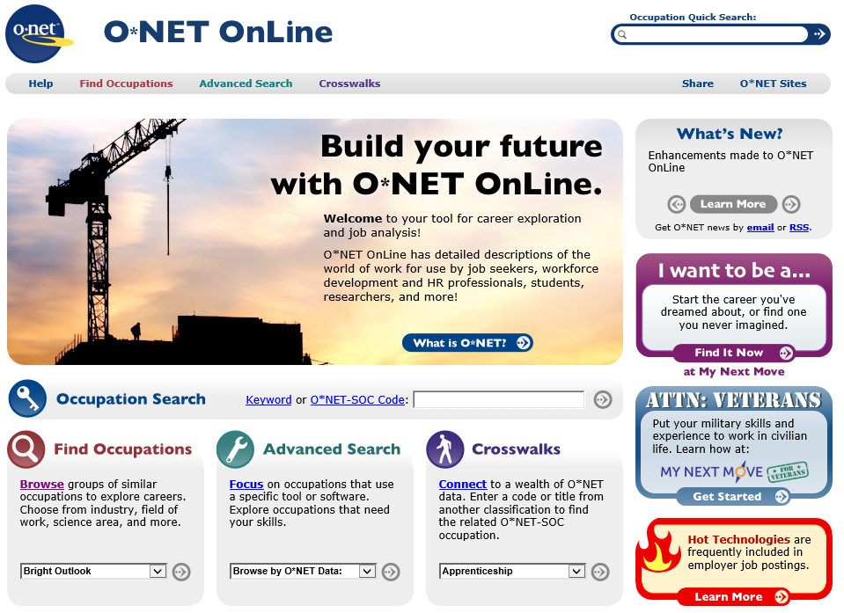
O*NET OnLine
One of the largest databases of occupational information
Survey of employers
Includes information on
  Skills, knowledge, abilities
  Wages
  Tools and technology
  Work activities
  And much more!
Online at: https://www.onetonline.org/

Slide 13
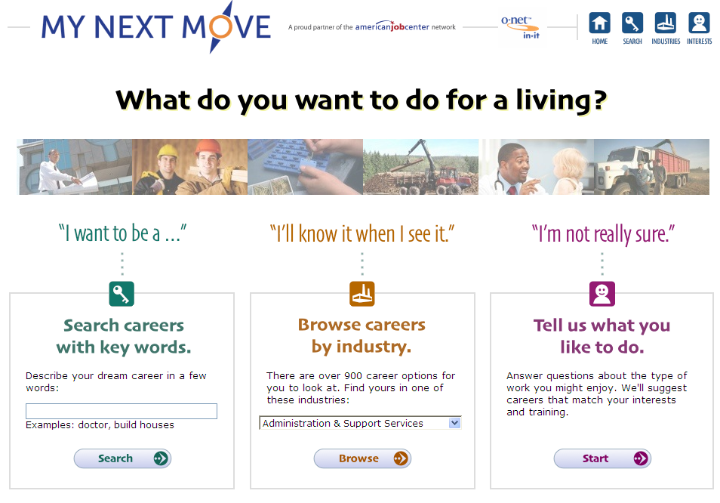
My Next Move
A branch of O*NET and contains similar information, but in an easier to read format
Also includes an interest profiler quiz to help in career exploration
Online at: https://www.mynextmove.org/

Slide 14
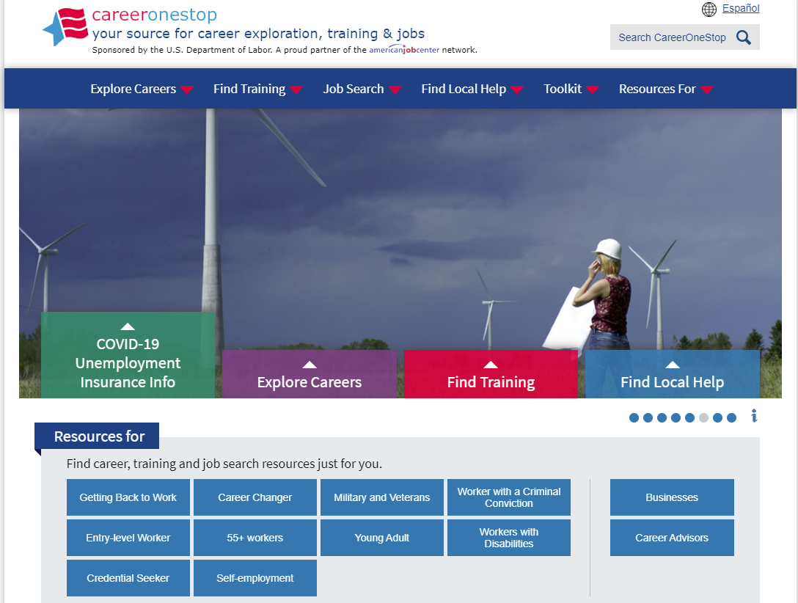
Career One Stop
A wealth of resources for career exploration and job seekers
Sponsored by U.S. Department of Labor Employment and Training Administration
Online at: https://www.careeronestop.org/

Slide 15
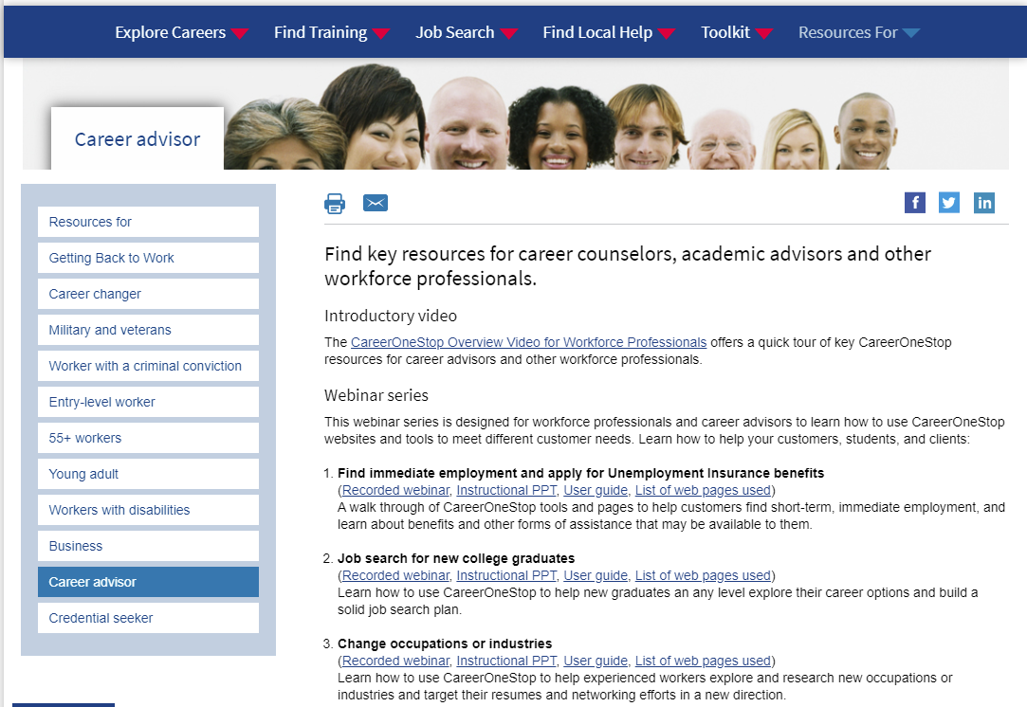
Career One Stop
The Career Advisor section has resources for career counselors and academic advisors
Free webinars, curriculum guides, toolkits, and much more!
Online at: https://www.careeronestop.org/

Slide 16

Get My Future
A branch of Career One Stop
Information, tools, and links to resources to help anyone age 16 to 24:
  Explore careers
  Learn about and locate training or education programs
  Conduct a successful job search
The goal of this site is to help young adults overcome barriers and plan and achieve a path to career success
Online at: https://www.careeronestop.org/

Slide 17
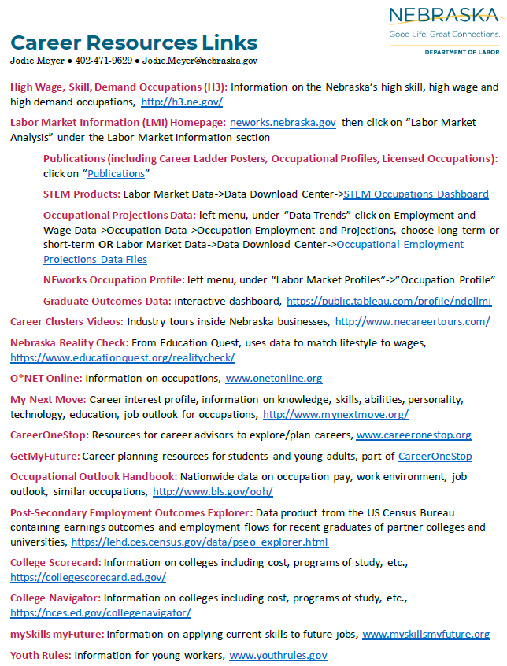
Website Demo Time!
NEworks: https://neworks.nebraska.gov
Career Videos: https://www.nebraskacareerclusters.com/
Reality Check: https://www.educationquest.org/realitycheck/
Occupational Outlook Handbook: https://www.bls.gov/ooh/
O*NET OnLine: https://www.onetonline.org/
My Next Move: https://www.mynextmove.org/
Career One Stop: https://www.careeronestop.org/

Slide 18

Questions?
Contact Information:
Jodie Meyer
Office of Labor Market Information
402-471-9629
Jodie.meyer@nebraska.gov

