Slide 1
Work Based Learning in Real Life
Tennille Allison, Kearney Public Schools

Slide 2
Tennille Allison
Work Experience
Kearney High School -12 years
Wood River Rural Jr.-St. High School -5 years
Humphrey St. Francis High School -1 year
Endorsements
7-12 Principal (in progress)
BMIT
Work Based Learning
Information Technology
School Librarian
Business Experience
H & R Block -15 years – part time seasonal tax preparer
Kinder Morgan – 3 years - full time operations administrator
Roles
Business & Technology Teacher
FBLA Adviser
New College & Career Coordinator
Work Based Learning Coordinator & Supervisor
Concession Stand Inventory Manager
Perkins Grant Manager
Department Head
NE Microsoft IT Initiative Program Administrator
Dual Credit Teacher
Notes:
Hello, my name is Tennille Allison. I have been teaching for 18 years with the majority at Kearney High School, but I have had experience in a Class C public school and a Class D private school as well. I have endorsements in BMIT, Work Based Learning, Information Technology, School Librarian, and I am currently about halfway into my 7-12 Principalship endorsement. My undergrad was in Business Administration, so I worked three years for Kinder Morgan. They had a regional office in Kearney where I worked supporting the operations side of the business. I also worked at an H & R Block franchise office in Kearney for 15 tax seasons. I prepared mostly individual income tax returns, but I did reach the level of Senior Tax Adviser III and was completing small business, basic farm, and basic trust returns during my employment. During my career, I have had many roles which have lead me to my new role next year which is College and Career Coordinator. It is a new/modified position for my district, so some of my tasks are still being defined. However, one specific role is taking more of an official lead role in our Work Based Learning programs. I have been supervising students for several years, but I’m taking more of a lead role with our business connections where that was previously done by an administrator.

Slide 3
Setting the Stage . . .
NDE reVision
SWOT analysis
What do we have? What are we doing well?
What do we need to match business & industry?
New school Fall 2016
Be patient to create the best fit
H3 – High Wage, High Skill, High Demand Jobs
Business & Industry Partnerships
Post Secondary Partnerships
Be cognizant of NDE course codes
Notes:
A little bit of background about Kearney Public Schools to frame the context of our Work Based Learning Experiences. Probably about 10 years ago we were part of the one of the first schools to do the NDE CTE reVision process. In that process we completed a SWOT analysis for all of our CTE areas to see what we were doing well and where we needed to step it up to match business and industry. That also coincided with our research and bond issue to build a new school, remodel, or build two high schools. We passed a bond to build a new high school that opened in Fall of 2016. We also tried a curriculum shift at the same time to a more career field focus, so it was much more than erecting a new building. Long story short we have had administrative changes and funding issues that do not allow us enough teacher staffing to create a complete wall-to-wall small learning communities like we had envisioned. However, we do have programs of study in all career fields and are providing more work based learning opportunities than we have when I started at Kearney High School 12 years ago.
Things that we needed to remember when we were molding our structure for the career fields and work based learning opportunities would be to be patient to create the best fit. If we tried to force something, then there’s more chance to create negative relationships and that doesn’t work for anyone. Kearney is nice size at around 30,000 people, but it is still small enough that people and businesses are really interconnected. If we burnt a bridge somewhere, then it would be difficult to re-establish that relationship later. We also kept in mind the H3 jobs, our business and industry partnership – current and new ones we wanted to form. We also are fortunate to have the University of Nebraska at Kearney (UNK) as a 4 year institution and Central Community College – Learning Center as a 2 year institution in our community which both provide amazing partnerships for us and our students. Finally, it is important to be cognizant of the NDE course codes, so what you are creating you will get credit for when the reports are pulled from your student information system.

Slide 4
Extended Learning Opportunities
Early College
Dual Credit
Online Career Education
School Based Experience
Cooperative Education
Internships
ELOs
Notes:
We group our Work Based Learning with some academic opportunities and call it ELOs. Extended Learning Opportunities are available for any student that meets the prerequisites and offers opportunities for a variety of student. I will share perquisites and describe the programs on the upcoming slides.
****Fix This Next Paragraph****
We continue to provide integrated college and career readiness activities within our courses at KHS, but our newest development is our Extended Learning Opportunities. We have been using the Extended Learning Opportunities or ELO terminology for the last couple years. It includes six options that students have to extend their learning beyond the classroom. The extensions are online career education which is supplied through the courses available on Odessyware and supervised by a KHS teacher. This allows students to take CTE courses that are not available at KHS. One popular career field has been Law, Public Safety, Corrections, & Security. We have Intro to Criminal Justice, but the online courses allow for students to take additional courses in the field. Dual Credit is where students earn credit from both the high school and a post-secondary institution. We have agreements with UNK and CCC where courses are taught at the high school, UNK, and CCC. Early College is for a student that wants to start his/her college career, but still be a high school student. Early college students do not earn high school credit. This basically opens the door to get a head start on college requirements.
Work-based Learning is the overarching title for Cooperative Education and Internships. As a specific element of new Perkins V legislation these two items will be explained in more detail in the next two slides.
Since the ELOs have only been available in this format for a couple of years, we will be working on communicating and promoting this information. There has been improvement from year one to year two, but there’s room to grow the opportunities.

Slide 5
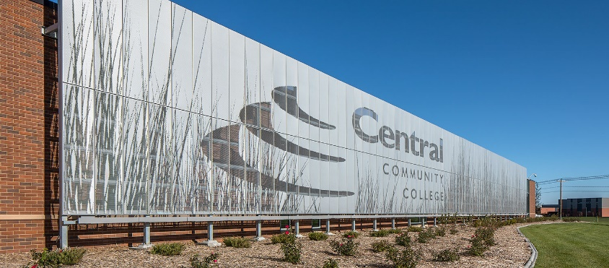
Non-Work Based Learning ELOs at KHS
Online Career Education
Odyessyware
Early College
Dual Credit
at KHS
at UNK
at CCC-Kearney Center
This Photo by Unknown Author is licensed under CC BY-SA
https://www.morrisseyengineering.com/experience/2/201/education/central-community-college-kearney-center/
Notes:
These are available to juniors and seniors who are on track to graduate and want different options than the electives we have internally. A brief description about our non-work based learning ELOS at Kearney High School include an online career education option. Students can take an online career education course offered through Odyessyware. They are to be taking courses that are not available from our current facility. Early college are college classes for college credit only, so a student on track to graduate and still wanting to be an active high school student can take a course basically from any post secondary school, following the necessary entrance requirements of those schools. Typically it is still going to be UNK or CCC, but a course other than one we have arranged for out student. Dual credit are courses for both high school and college credit. We have options that are taught within our high school by our own teachers like transportation, construction technology, entrepreneurship, and Microcomputer Applications. Options that are taught at post secondary institutions by college faculty. At the University of Nebraska at Kearney we have Introduction to American Politics which counts for their high school Political Science requirement. At Central Community College – Kearney Center, we have collaborated for College Algebra and CNA. KPS and UNK or CCC negotiates a Memorandum of Understanding defining the arrangement and whose paying for what.

Slide 6
Work Based Learning at KHS
Classroom Activities
School Based Experience
Cooperative Education
Internships
Notes:
We have the general classroom activities available to students to learn about work such a guest speakers, field trips, simulations, etc. But let’s focus on the others that are receiving more emphasis recently. The three categories available to KHS juniors and seniors are School Based Experience, Cooperative Education, and Internships. School Based Experience is not necessarily School Based Enterprise. We needed something to call our in house work based experiences and this is the title we landed on. Similar to Cooperative Education, we needed a name other than Work Study or Work Release because our SPED department has an experience called Work Study. It’s not only about working which is sometimes the assumption that accompanies Work Release. Cooperative Education signifies that it is something different and hopefully more than time off from school for work. Finally Internships is a collective title that also includes our Field Experience in Education and opportunities in most career fields.

Slide 7
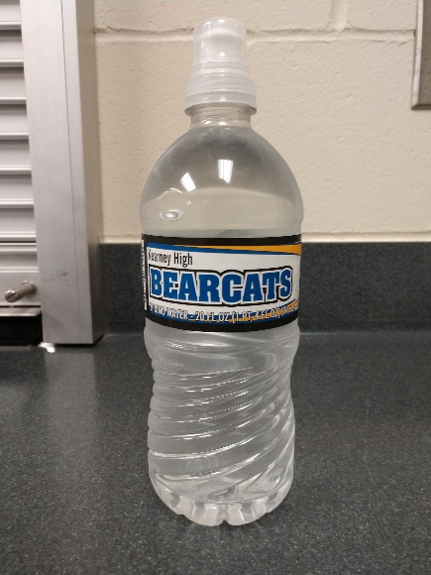
School Based Experiences
In house work based learning experience
Art Department – Print Shop & Ceramics
Business – FBLA – Concession Stand
Marketing – Initially School Store
Notes:
For us a School Based Experience is a work based learning experience that occurs within Kearney High School. It needs a job description and occurs during the supervising teacher’s plan time. We needed something to call and describe those things that occurred within our building. It is different than other courses because the student is working on projects most of the time, but it is not necessarily the same experience that a student would get with a job outside the building. It is coded as an Other Work-Based Learning Experience for the NDE Course Code. Typically there are not many students. The current jobs we have are a screen print shop in the art department and a concession stand inventory assistant. Our graphic design teacher has a class called Bearcat Design where students acquire design jobs from a variety of sources and then the screen print student has a block during the day to work the screen printing machine to complete the jobs. Our FBLA cooperates with the AD’s office to manage the concession stand. FBLA primarily handles the inventory and prepping the stand for an event. The concession stand inventory assistant has a block during the day to help me with the concession stand. (I’m the FBLA Adviser.) I’ve only been able to have one student so far, so we haven’t expanded much beyond the everyday activity of stocking drinks, ensuring we have enough food, and setting up the stand for an upcoming event. The concession stand itself is a whole other conversation. For the purposes of work based learning, the student gets a block on his/her schedule to do the behind the scenes activities. We have a school store that sells mostly apparel. We also considered School Based Experience for our school store. However, currently our teacher for Advanced Marketing has integrated the duties of the store into the class. When it first opened we tried to have it open before school and after school, so those students had School Based Experience on their schedule as their first block or fifth block class and earned elective credit. We didn’t have enough business during the day and the store does a lot of community business through the website, so the School Based Experience option is not needed right now.

Slide 8
Cooperative Education
Typical job for high school students
Prerequisites
3 courses in any career field
junior or senior
Jobs that typically qualify
Within KPS district
Schedule matches course schedule
Safe, appropriate, etc.
Participation – 50 requests
Semester Course
Up to 2 blocks per day
Earn up to 10 elective credits per year
2 teacher supervisors
Notes:
Cooperative Education is work release for high school credit. The students work a part time job at an approved work site and complete an online classroom component to earn high school credit and a paycheck.
To be eligible students need satisfactory attendance and behavior records. They need to have completed a minimum of 3 Career and Technical Education courses in any career field. Due to logistics and staffing we no longer have a careers or workplace readiness course. The soft skills and Nebraska Career Readiness Standards are integrated into our CTE courses, so we felt that having students complete a minimum of three in any career field would be at least a step in preparing them for a job. Most students have taken a minimum by their junior year and especially by their senior year, so it isn’t challenging expectation to complete.
For a job to be approved as a Cooperative Education location, it must be within the Kearney Public Schools district, the schedule for the student should be able to match the time allotted on their high school course schedule, and of course be safe, appropriate, follow all related laws, etc.
The last couple years we have had approximately 50 students request it each year. It is organized as a semester course on a block schedule, but some will take it all year. Students are eligible to have it on their schedule for two blocks per day and expected to work at least one hour per block. If a student takes it for a full year, they can earn 10 hours of elective credit.
We have had 2 teacher supervisors, so there is room to grow the program. It’s helpful to have a core area teacher involved if you can. Two years ago we had a Social Studies teacher acquire the Work Based Learning Endorsement over the summer and he really enjoyed the experience of supervising students. However, there were more student requests for his Criminal Justice class and the larger sophomore class meant that he was needed for World History. This past year I had a teacher new to KHS helping me and next year I will be doing it by myself. I’m going to see how it goes, but I do like to have a second teacher involved for cross training purposes.
It is important that this program is the right fit for the student and business as well. It’s not just working a part time job. It’s about the student developing their workplace skills to be a productive citizen, earning an appropriate wage, and serving their community.

Slide 9
Cooperative Education - Timeline
February Course Registration
April
Semester Assignments
Students include Coop Ed as one of their Course Requests
30 minute meeting for students who included it on request
On or before June 1
Employer information Form sent to students
June 30
Student deadline for employer information
July 1-31
Employment verification contacts
Add to student schedule
August
students work when school starts
Reflection Questions
Hours Reports
Worksite visits
Final Reflection & Presentation
Notes:
We start the course request process in February. Therefore to be juniors and seniors include Cooperative Education as one of their course requests. We had originally done an application process and the course request, but then we had students who would complete one and not the other. We have 100+ staff members that assist our students in course requests, so there is also a lot of opportunity for miscommunication, not on purpose, but it does happen. There are a lot of reasons, but one of the big ones is that there is a lot of information about all of our courses being presented at that time and it gets confusing for both students and teachers. Therefore, we just went with the course request for those who are interested, then in April I have a meeting with those students to explain the program, timeline, requirements, and expectations. The face to face presentation helps clarify a lot of misconceptions. Last year I couldn’t have it because of the pandemic and it was a challenging year for a variety of reasons, hopefully by holding the in person meeting next year will go smoothly. We had a few in person meetings in the Fall of 2019 and 2019-2020 was going well until the pandemic closures. I also created an EdPuzzle video of the presentation for the handful of students that could not attend the in person meeting. Students were required to attend the in person meeting or complete the EdPuzzle to stay on the request list. If not, then they go to the waiting list.
On or before June 1, I send an email to the students who requested Cooperative Education. This email includes a Google form that they need to complete by June 30. Again if it is not completed by June 30, then they move to the bottom of my list. The form request job location, supervisor name and contact information, what terms and blocks do they want it during the year, and any special information I need to be aware of when making employment contacts and verification such as after school activities like sports seasons.
During July, but usually the last two weeks, I make employer contacts to verify student is employed or will be employed during the school year, that the employer can schedule the student during the allowed time, and that it is a safe/appropriate work environment for the students. I do have 5 days as extended contract to pay for my time. Last summer I did contacts by phone, email, or Zoom due to the pandemic, but Summer 2019 I visited the businesses. I use my own vehicle and request mileage reimbursement for driving from business to business. I’m planning in person worksite visits for this summer.
As I get work sites verified, I work with administration and/or counselors to change student schedules. Up to this point students have a schedule full of required courses and electives. Coop Ed is not included until the student and the worksite have met the entrance expectations. For example we had a student who worked banquets for Younes Convention Center and wanted the afternoon for Cooperative Ed. When contacting her supervisor, they are finished with noon banquet cleanup typically before she could arrive and didn’t start for evening banquets until later in the day. The timing didn’t work out and she had to keep her other courses on her schedule. Another student wanted to work at a hospital. They needed him in the morning to pick up breakfast trays and prep/deliver lunch trays. He wanted Coop Ed for the afternoon because he had College Algebra in the morning. He could have chosen another job, but he decided to stick with his other elective courses.
During the semester all of their assignments are set up in Canvas. It is a response to one weekly reflection question and documentation of the hours worked for the week. Both assignments open at 8 a.m. on Monday morning and are due at the end of the week. The weekly reflection is due Sunday night at midnight and the hours can be submitted as an image or they can bring me a paper on Monday by 4 p.m. I can share the details about what I do for grading. The reflection questions are associated with the Nebraska Career Readiness Standards. They also do a self evaluation as one of their weekly reflections rating themselves on the Nebraska Career Readiness Standards. I also request that the workplace supervisors complete a one page evaluation rating their student worker on the Nebraska Career Readiness Standards. My goal is at least once a semester
Their final is a presentation with multiple reflection questions. As I shared earlier, there were misconceptions about the program, so I created a final that would hopefully help clarify and help recruit participants. They are to create a visual – most will do Google Presentations because we have Chromebooks, but some with do a Canva, Prezi, or simply write something on the whiteboard and take a picture. Then with that visual share the responses to the reflection questions in one of their classroom based courses. Therefore it requires them to plan ahead a bit and communicate with their teachers to have a few minutes out of the block one day. The questions include describing job location, favorite work member, frustrations, benefits, why they chose Coop Ed, what skills/knowledge did they use from their high school course work, plans after high school, how it helped them for life after high school, etc.

Slide 10
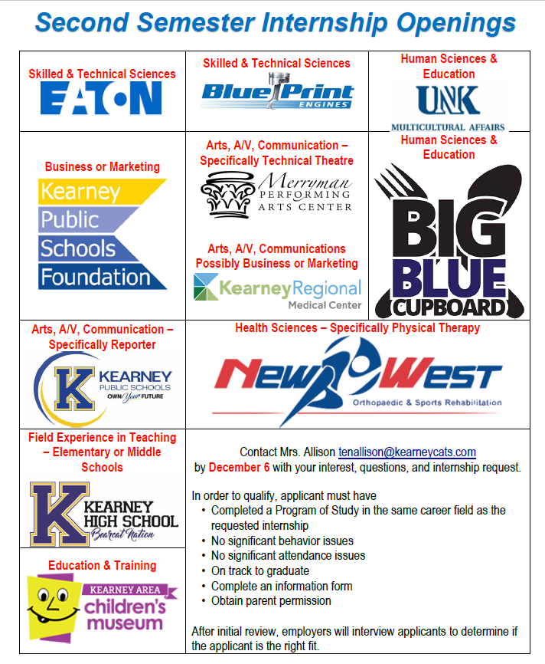
Internships
Arranged through an agreement with the business and KPS personnel
Must have completed a related program of study
Juniors or Seniors with no academic, attendance or behavior issues
Students apply and interview
Online classroom – reflection questions, attendance journal, and final
Integrates Nebraska Career Readiness Standards and career field specific activities
Largest group is Field Experience in Education
Notes:
Our verified internships are arranged through an agreement with the business and KPS personnel (typically administrative level). Internships could be paid or unpaid and relevant to the student’s career field of interest.
The student must have completed a related program of study. This ensures the student has some background knowledge in the career field and is prepared for the internship.
The students apply during the registration process in the spring and are interviewed by the employer to ensure it is the right fit for both the student and business.
The online classroom component assists students in making connection with the internship worksite and their academic work. It also helps them reflect and improve on their career readiness skills. Internship reflection questions are integrated with the Nebraska Career Readiness Standards and Career Field specific activities as well.
Our largest group of interns are the Field Experience in Education students.
Overall we had 20 interns in 2018-2019 and 15 in 2019-2020. We’re still working out some scheduling sequencing to appropriately prepare students.
We have 12 different businesses as well as the elementary and middle schools that are willing to host interns. We want to ensure that it is the right fit for the business and the student, so some internships are unfilled at times. On the slide you can see one of the promotional items that was included in our announcements to encourage students to explore an internship as an opportunity.
There is room to expand our internship opportunities as well. Again this takes a right fit situation for the student, school, and business.

Slide 11
Internship - Timeline
February Course Registration
End of April
Semester Assignments
May
Summer
August
students work when school starts
Reflection Questions
Attendance Journal
Worksite visits
Final Reflection
Add to student schedule
Students include Internship by career field in their course requests
15 minute conversations for students who included it on request
Administration creates sections
Employer contacts for previous internships
Interviews
Notes:
We start the course request process in February. Just like Cooperative Education - juniors and seniors can include and internship or Field Experience in Education as one of their course requests. The internships are separated and coded by career field. We had also tried the application process a couple years ago and it was confusing because it was hard to provide updates as we developed new internship locations. I didn’t do it during the pandemic last spring, and we only had Field Experience in Education as an internship this year. There was too much uncertainty or we did not have student interest for the others. In early May I met with students who requested internships based on career field During the conversation I shared what we had pre-pandemic and that I was in the process of contacting those businesses. We also visited about their interests, so I have some direction as I look to expand our internship placements.
I tried to coordinate interviews before the end of the school year, but I should have started earlier. We had a few right after school got out, but I will have to coordinate with the businesses to see what will work for them. They might wait to interview until the first part of August right before school starts. The goal would be to have the interviews and students placed before school gets out, so it gets on their schedule, and they can start their internship as soon as school starts in August.
During the semester all of their assignments are set up in Canvas. It is a response to two weekly reflection questions and an attendance journal to document their work hours.. Both assignments open at 8 a.m. on Monday morning and are due on Saturdays at midnight. The reflection questions are associated with the Nebraska Career Readiness Standards and a little more through that the Cooperative Education questions. The Field Experience in Education students complete one career readiness question and one question related to education. They also do a self evaluation as one of their weekly reflections rating themselves on the Nebraska Career Readiness Standards. I also request that the workplace supervisors complete a one page evaluation rating their student worker on the Nebraska Career Readiness Standards. My goal is at least once a semester. The Field Experience in Education students do an education related reflection during their second semester of experience.
Their final is a portfolio page. We used to do senior portfolios in Google Sites, so I had them add an internship page to their senior portfolio. We didn’t do senior portfolios this year, so they completed it in a format of their choosing. Some did Google Slide, some used Canva, and some did a basic Google Doc. Items included are short, intermediate, and long term SMART Goals, description of internship location, reflections regarding the overall experience, professional development in the career field, and career planning.

Slide 12
Sources and Additional Information
Nebraska Department of Education
Nebraska Career Education
Workplace Experiences for Nebraska
Perkins Administration
Launch WBL
MBA Research States Connection
WBL section
Content regarding ethics
Kearney Public Schools – Kearney High School
College & Career Readiness Guidebook
Internship Guidebook
Course Offerings Handout
Association for Career & Technical Education Online
ACTE Work Based Learning
Conferences
Online professional development
Both free and fee based
Notes:
Nebraska Career Education - https://www.education.ne.gov/nce/
Workplace Experiences for Nebraska - https://www.education.ne.gov/workplace-experiences/
Perkins Administration - https://www.education.ne.gov/nce/perkins-administration/
Launch WBL! - https://www.education.ne.gov/nce/launch-wbl/#1616591232039-b58e368e-86b0
MBA Research States Connection - https://mbastatesconnection.mbaresearch.org/index.php/portal/index
You do need an account, but Nebraska is a member state. Therefore the account it free. There are a lot of resources especially for business and marketing if you have not used it.
These probably need to go through some summer updates, but these are guidebooks and information we share with students who have questions and specifically during our course registration time.
KHS – College & Career Readiness Guidebook - https://docs.google.com/document/d/1MPS2Rg8tjTCNkfnK6DL2Q4CEJ1NXnIbDIKHZRMwhoqo/edit?usp=sharing
KHS – Internship Guidebook - https://docs.google.com/document/d/1F9Nj61TrARbnlZ0pN5FBffJWlXkU3scsn0L4OrSUbI4/edit?usp=sharing
KHS – Course Offerings Handout - https://docs.google.com/document/d/1hZy-2eaJtNLhWcCmF78r5gQ0xThuj6y4oNldyC-2Cyk/edit?usp=sharing
ACTE Work Based Learning - https://www.acteonline.org/professional-development/high-quality-cte-tools/work-based-learning/

Slide 13
Tennille Allison
College & Career Coordinator
Kearney Public Schools
tenallison@kearneycats.com

