Slide 1
Lead, Follow, or Get Out of the Way! Leadership Activities You Can Use
Tonya Skinner, Presenter

Slide 2
Pin-up For Session:
https://pinup.com/789Y96jS4

Slide 3
Leadership Belongs Everywhere!
Student Organizations (FBLA, DECA, etc.)
Advisory/Support Classes
Content Classrooms

Slide 4
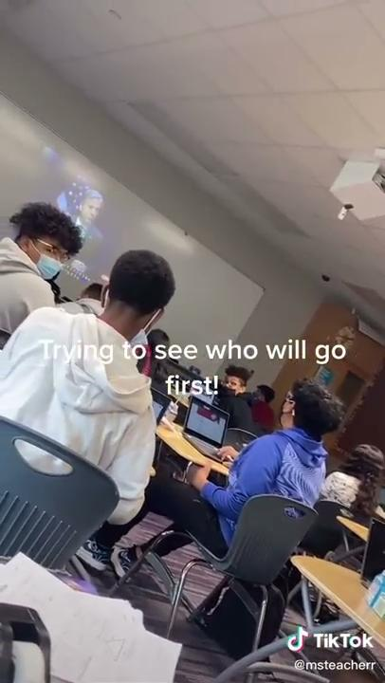
Sometimes, you have to be brave!

Slide 5
But...WHY?!
?
Create a positive mood.
Encourage trust and cooperation.
Encourage people to break out of their cliques and include others.
Develop social skills.
Build rapport between leaders and team members
Create a safe environment for learning and participation.
?

Slide 6
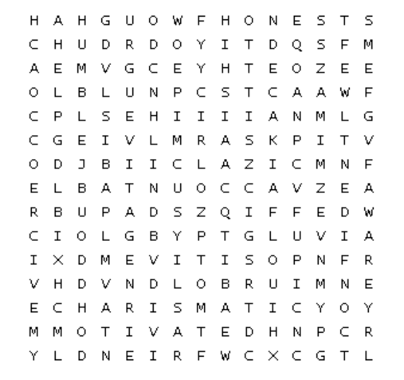
What Leadership Terms Do You See?
Type one you find in the chat! And, does this describe you? If so, say how! Share!

Slide 7
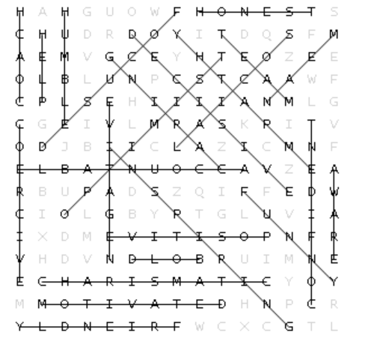
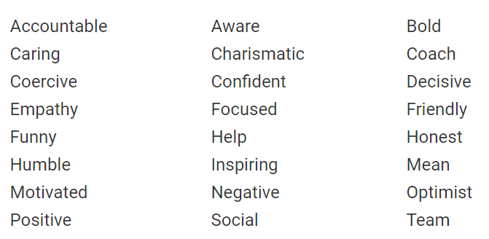
What Leadership Terms Do You See?

Slide 8
Get Ready to Draw!
On a sheet of paper, draw a box (or tear off a quarter piece of paper to draw on).
Inside, draw a person in the rain
1 minute! Go!
Notes:
https://brightside.me/wonder-quizzes/this-draw-a-person-in-the-rain-test-will-reveal-your-true-self-271710/

Slide 9
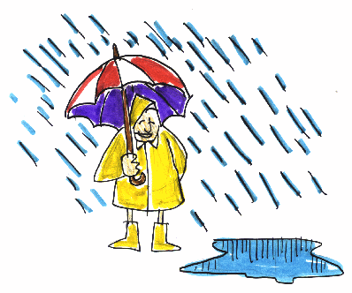
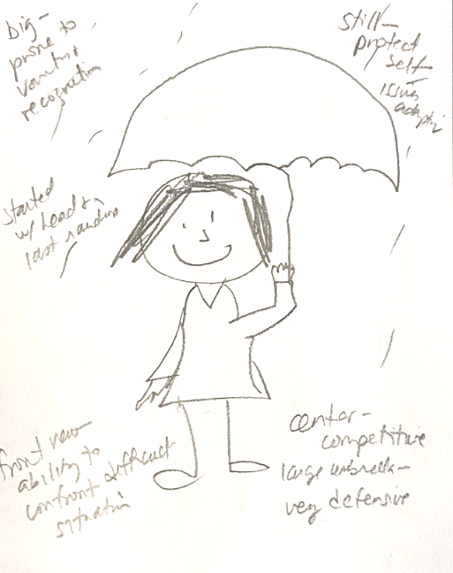
Results!
Orientation of the drawing (or your box)
Umbrella?
Human figure profile
Size of the drawing
How you drew (process)
Movement?
Brightside

Slide 10
5 Roadblocks for Potential Leaders
Self-doubt. You’re unsure of your own leadership skills.
Trouble being perceived as a leader. You may be confident, but others don’t see you as their leader.
A lack of leadership skills. You know you don’t have the skills you need, and you’re not sure how to get them.
Feeling inauthentic. You hesitate to lead because it doesn’t feel natural.
No time/energy to lead. You’re already doing too much and you’re too tired to take on the responsibility.
Source: https://observer.com/2016/08/the-top-5-introvert-leadership-challenges-and-how-to-beat-them/
Notes:
Image from Pexels
https://observer.com/2016/08/the-top-5-introvert-leadership-challenges-and-how-to-beat-them/

Slide 11
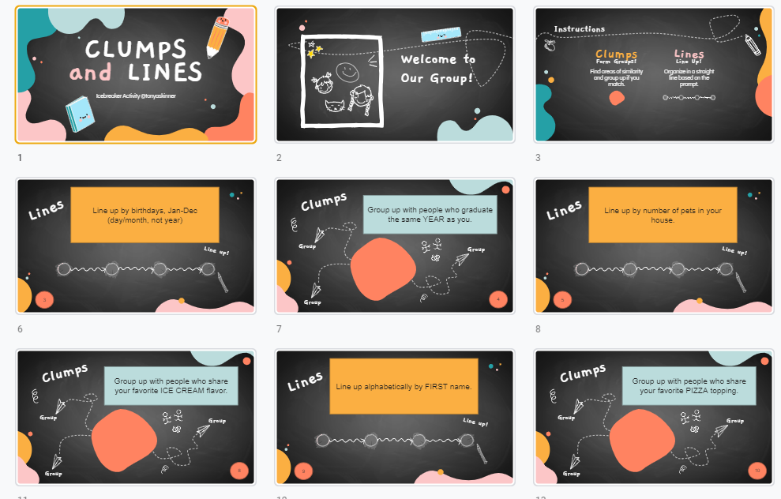
First, get students talking and comfy!
Clumps and Lines
Slideshow based game where they either group up or line up based on criteria.
Slideshow Game Link
Notes:
https://christiancamppro.com/9-fun-games-with-blindfolds/

Slide 12
Sometimes, you just have to lead!
Get that Ball
How to play: Prepare the playing area by scattering soda cans. Place small balls in a pail and put it at the other end of the soda cans. The other empty pail will be placed at the starting area.
Using a coach, players will have to cross the area blindfolded without knocking off any soda cans, then he or she will grab a ball and will run back to the start area to place the ball onto the empty pail. The next player will cross the cans.
Notes:
https://christiancamppro.com/9-fun-games-with-blindfolds/

Slide 13
Low Intimidation Activities - Combat Self Doubt
Word Scramble
Give each group 7 letters to use to form words (at least 3 letters each) in three minutes. Learn to work together for a task, not personal, leaders will emerge naturally.
7 letter word – 40 points
6 letter word – 30 points
5 letter word – 20 points
4 letter word – 10 points
3 letter word – 5 points
Bad Stock Images Caption Contest
This is a purely fun and creative game. You goal is to find 3-4 bad stock images, download and paste them onto a sheet of paper and hand out. Ask them to caption the ridiculous images, collect and then read some out (energizing and fun).
Quick success at varied levels
Self
Doubt
Notes:
https://www.leadershipgeeks.com/leadership-icebreakers-word-scramble/
https://teambonding.com.au/i-hate-team-building-icebreaker-games-for-introverts-and-sceptics/

Slide 14
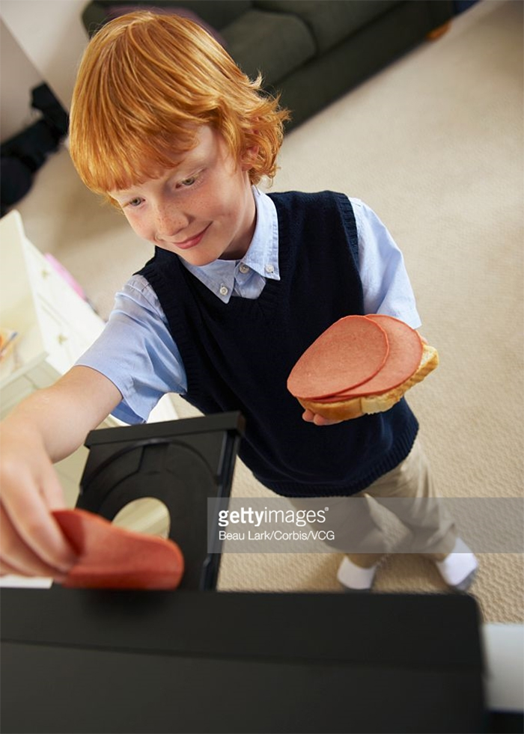
Sample - Bad Stock Images
Image from Getty
Site referencing some rather odd ones…. https://www.demilked.com/stock-photos-weird-funny-wtf/
Image from Pexels

Slide 15
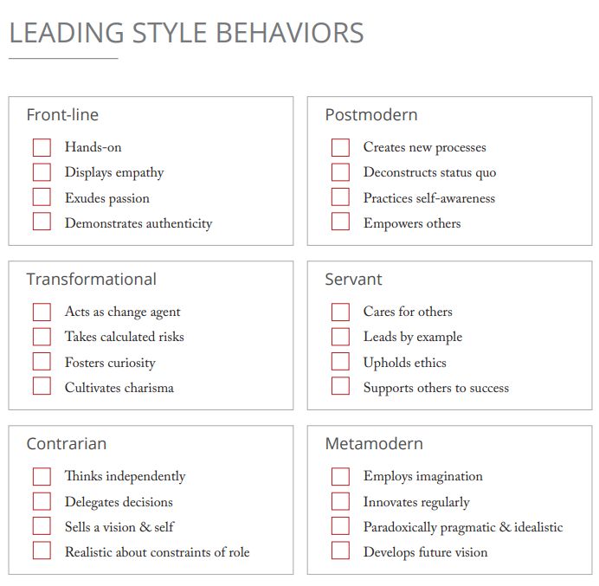
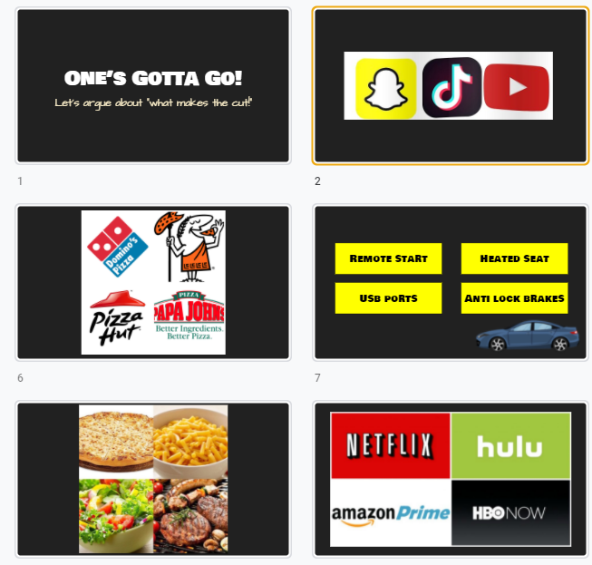
Activities - Improve Perception
Boss of the World
3 Minutes/1 Notecard: You are boss of the world today and get to make one law for perpetuity. What do you decide?
Interactive Leadership Style Assessment
Six Leadership Styles:
Servant
Front-Line
Transformational
Metamodern
Postmodern
Contrarian
https://eml.usc.edu/blog/leadership-style-quiz
Ebook by USC Price (PDF)
Nice complement to this quiz→
One’s Gotta Go Icebreaker
**require them to agree/work together to decide which to eliminate**
Public
Perception
Notes:
My leadership style- Metamodern Leader

Slide 16
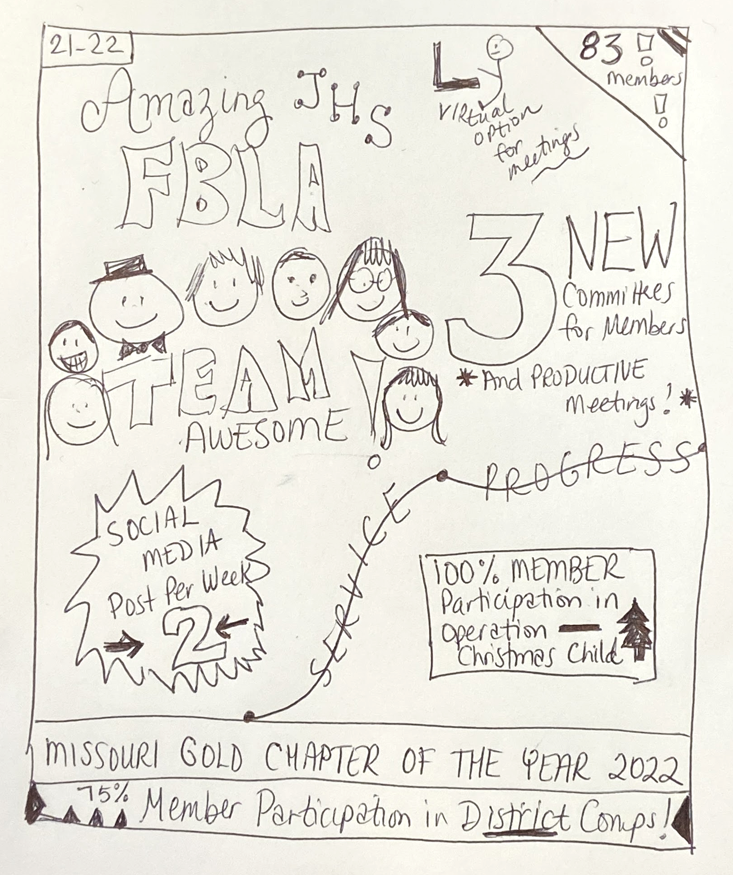
Activities - Improve Perception
Magazine Story
The team has to create an imaginary magazine cover or story about a successful project, their organization in a few months, or a specific goal/achievement. They have to get the right images, come up with headlines, formulate quotes, etc. Clearly define how you want the organization to appear to others in the future.
This is an ideal activity for student groups that you advise; focus on vision and goal setting
Public
Perception
Notes:
My leadership style- Metamodern Leader

Slide 17
Activities - Develop Skills
Pet Projects
Ask everyone to go around in a circle and answer the following question:
Do you have a passion project or hobby you look forward to doing in your time off?
Pest Projects
A pest project is a part of someone’s life that they want to improve.
Level 1: What’s one skill you always have wanted to learn?
Level 2: If you could change one thing about yourself what would it be?
Level 3: What do you worry about most?
Working Teams - Stop, Start, Continue Exercise
*Sticky Notes or Big Board Activity*
What’s working? Let’s do more of that.
What’s not working? Let’s do less of that.
What’s meh? Let’s discuss.
Lack of Skill
Lack of Skill
Notes:
https://www.scienceofpeople.com/team-building-activities/
https://www.scienceofpeople.com/start-stop-continue/

Slide 18
Activities - Develop Skills
Stand By Your Quote
Place on the walls around the room thoughtful quotes about leadership.
Students walk around and stand by one quote that they particularly like. Discuss/share.
You cannot be a leader, and ask other people to follow you, unless you know how to follow, too.” – Sam Rayburn
“Great leaders are not defined by the absence of weakness, but rather by the presence of clear strengths.” – John Zenger
What you do has far greater impact that what you say.” – Stephen Covey
Lack of Skill
https://www.cleverism.com/95-leadership-quotes-lessons-famous-ceos-and-entrepreneurs/
Notes:
https://www.cleverism.com/95-leadership-quotes-lessons-famous-ceos-and-entrepreneurs/

Slide 19
Activities - Develop Skills
Leadership Envelopes
Participants work in groups to come up with real-life application of leadership principles. The groups take multiple rounds to build upon the ideas of each other, passing envelopes and adding ideas/cards.
Example provided: (one for each envelope)
Five principles taken from James M. Kouzes and Barry Z. Posner's The Leadership Challenge (Jossey-Bass Publishers, 1995):
Challenge the process
Inspire a shared vision
Enable others to act
Model the way
Encourage the heart
https://www.leadershipchallenge.com/research/five-practices.aspx
Lack of Skill
https://www.sessionlab.com/methods/leadership-envelopes
Notes:
https://www.cleverism.com/95-leadership-quotes-lessons-famous-ceos-and-entrepreneurs/

Slide 20
Activities - Develop Skills
Dance Coach
Participants will teach the group some sort of choreography (or other activity). This also evaluates how well others can follow, how well the “coach” can manage stress, and how to give/receive criticism and reinforcement.
Related Tedx Talk -
What Tango Can Teach About Leadership
Great Articles -
Leadership Lessons of the Tango
“The leader must embrace the idea that the follower is not subservient, but an active collaborator. Followers, typically just as ambitious as leaders, have to learn to accept the lead for the dance to work. Both are essential, equal partners.”
3 Leadership Lessons from the Argentine Tango
Understanding another point of view is essential
Without a clear leader, the follower cannot shine
Intuition goes hand in hand with communication
Communication
Respect
Negotiation
Lack of Skill
Notes:
https://www.cleverism.com/95-leadership-quotes-lessons-famous-ceos-and-entrepreneurs/

Slide 21
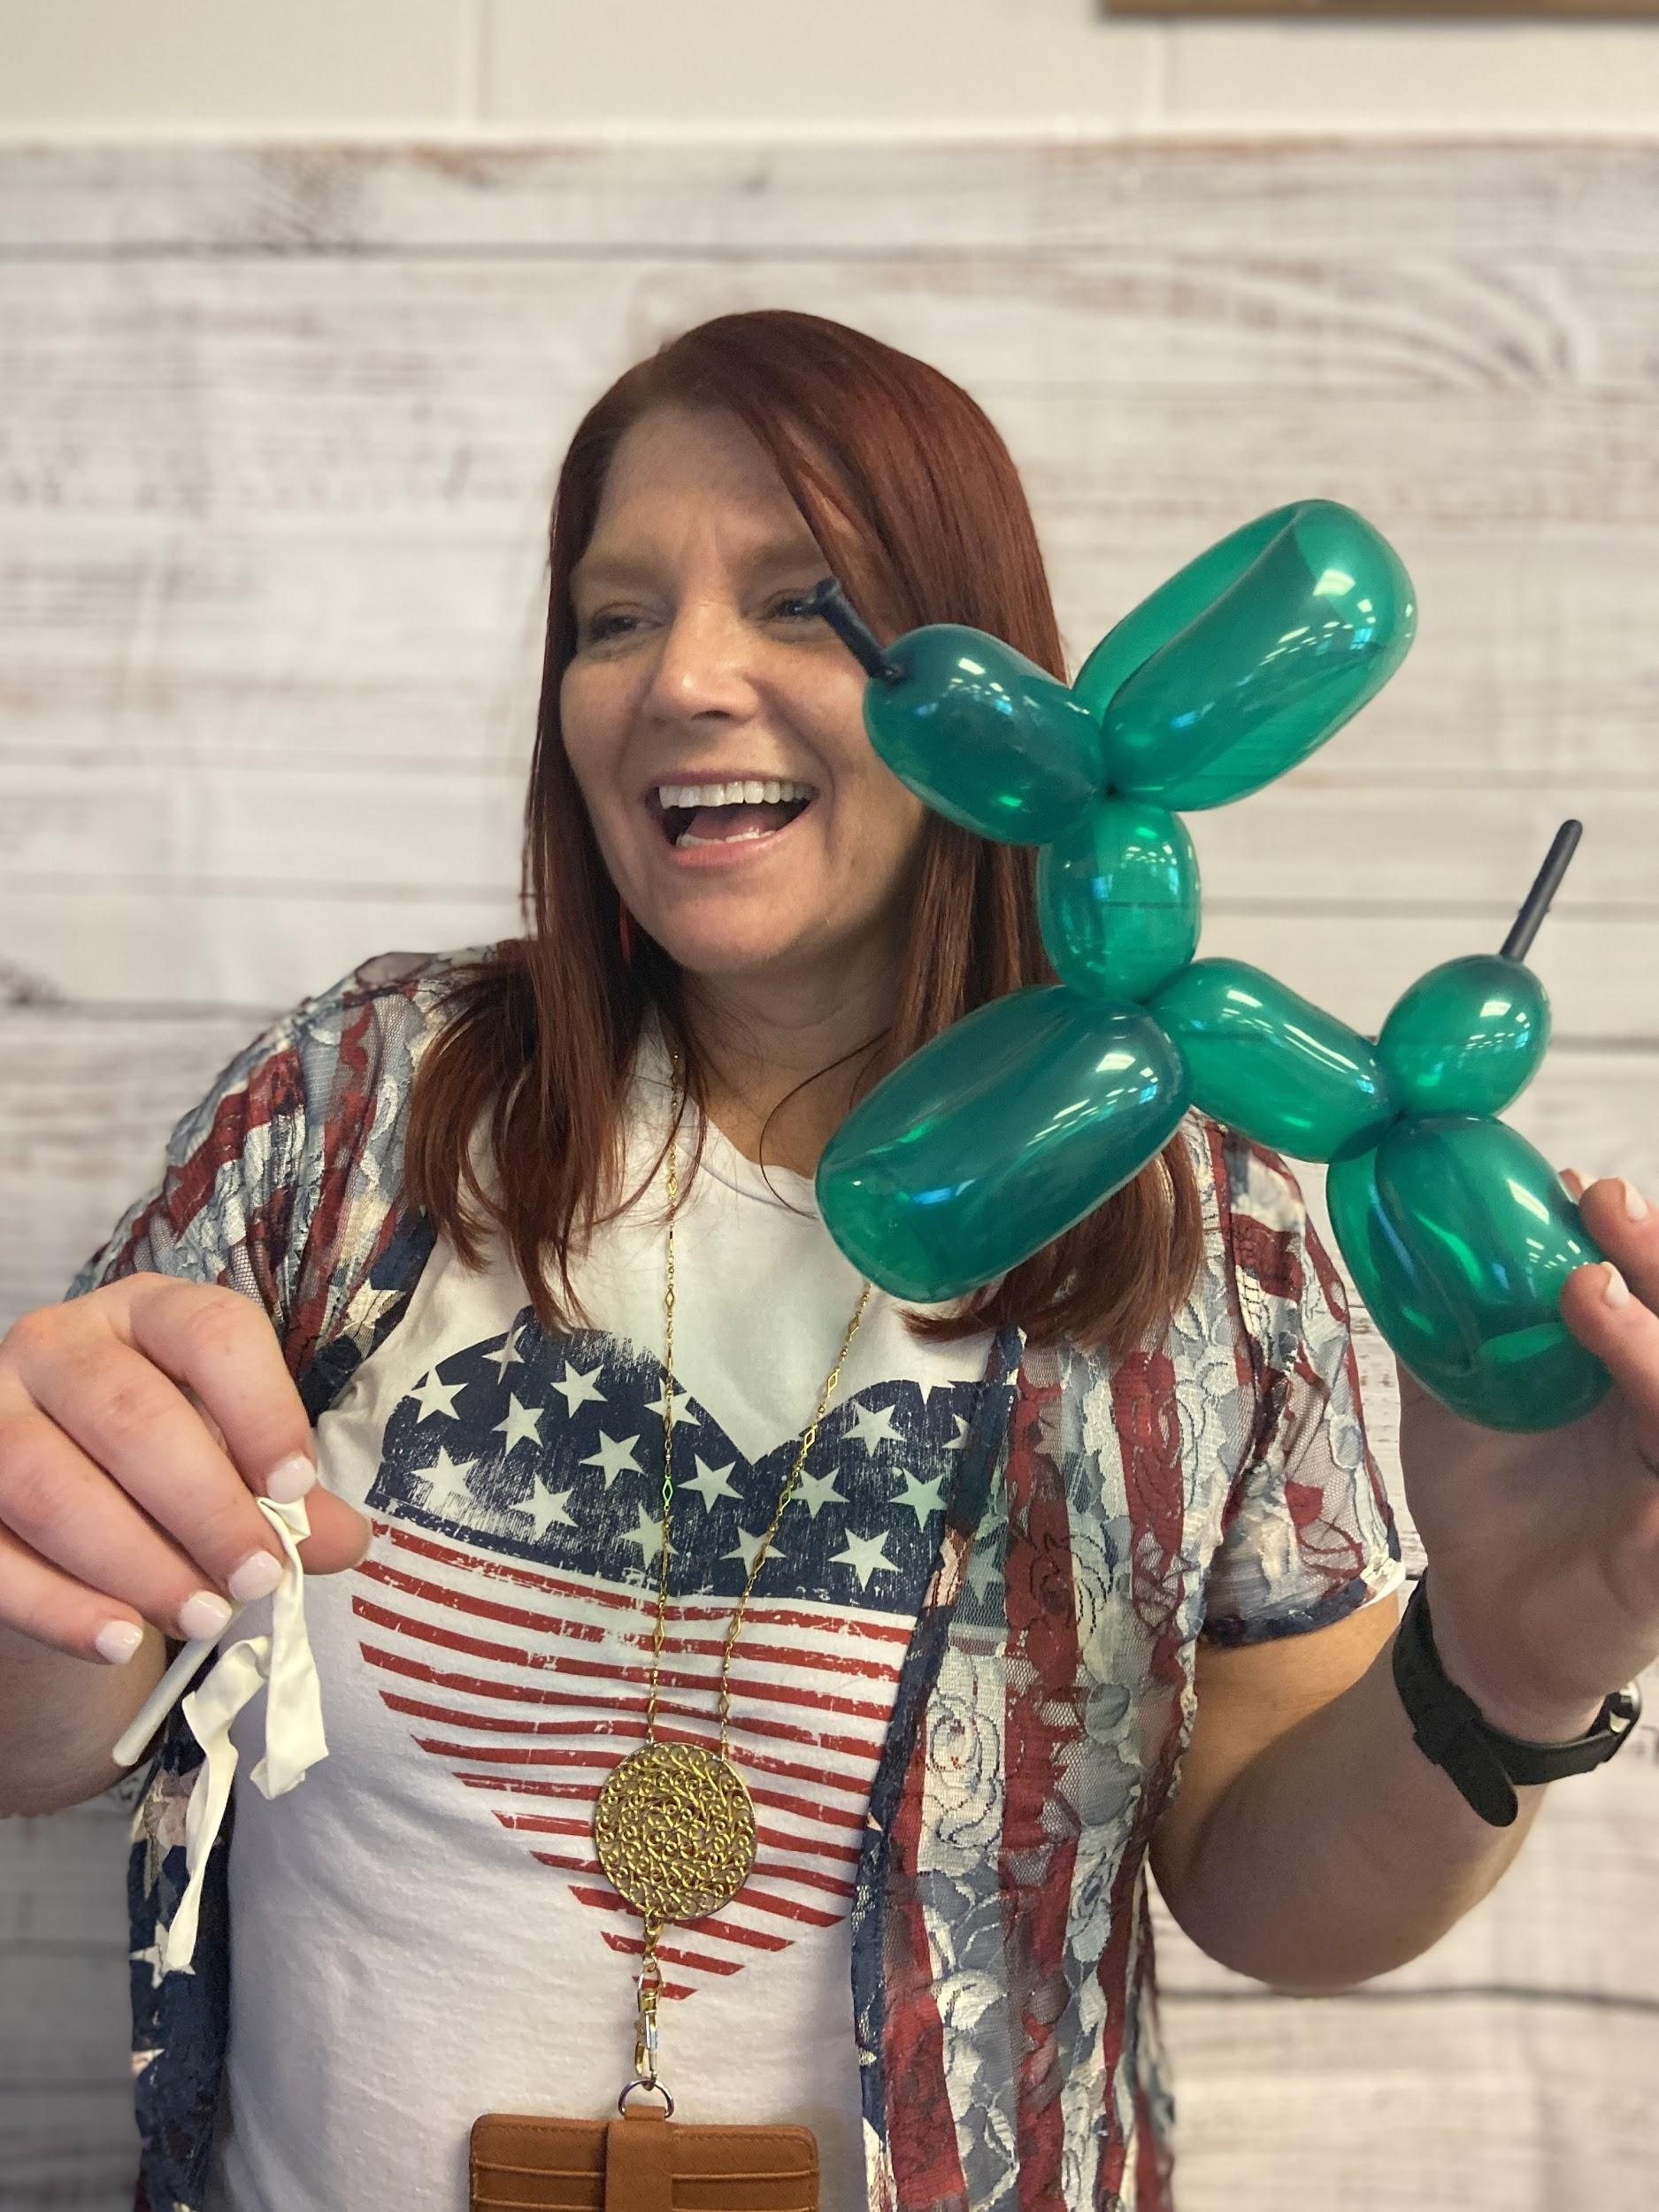
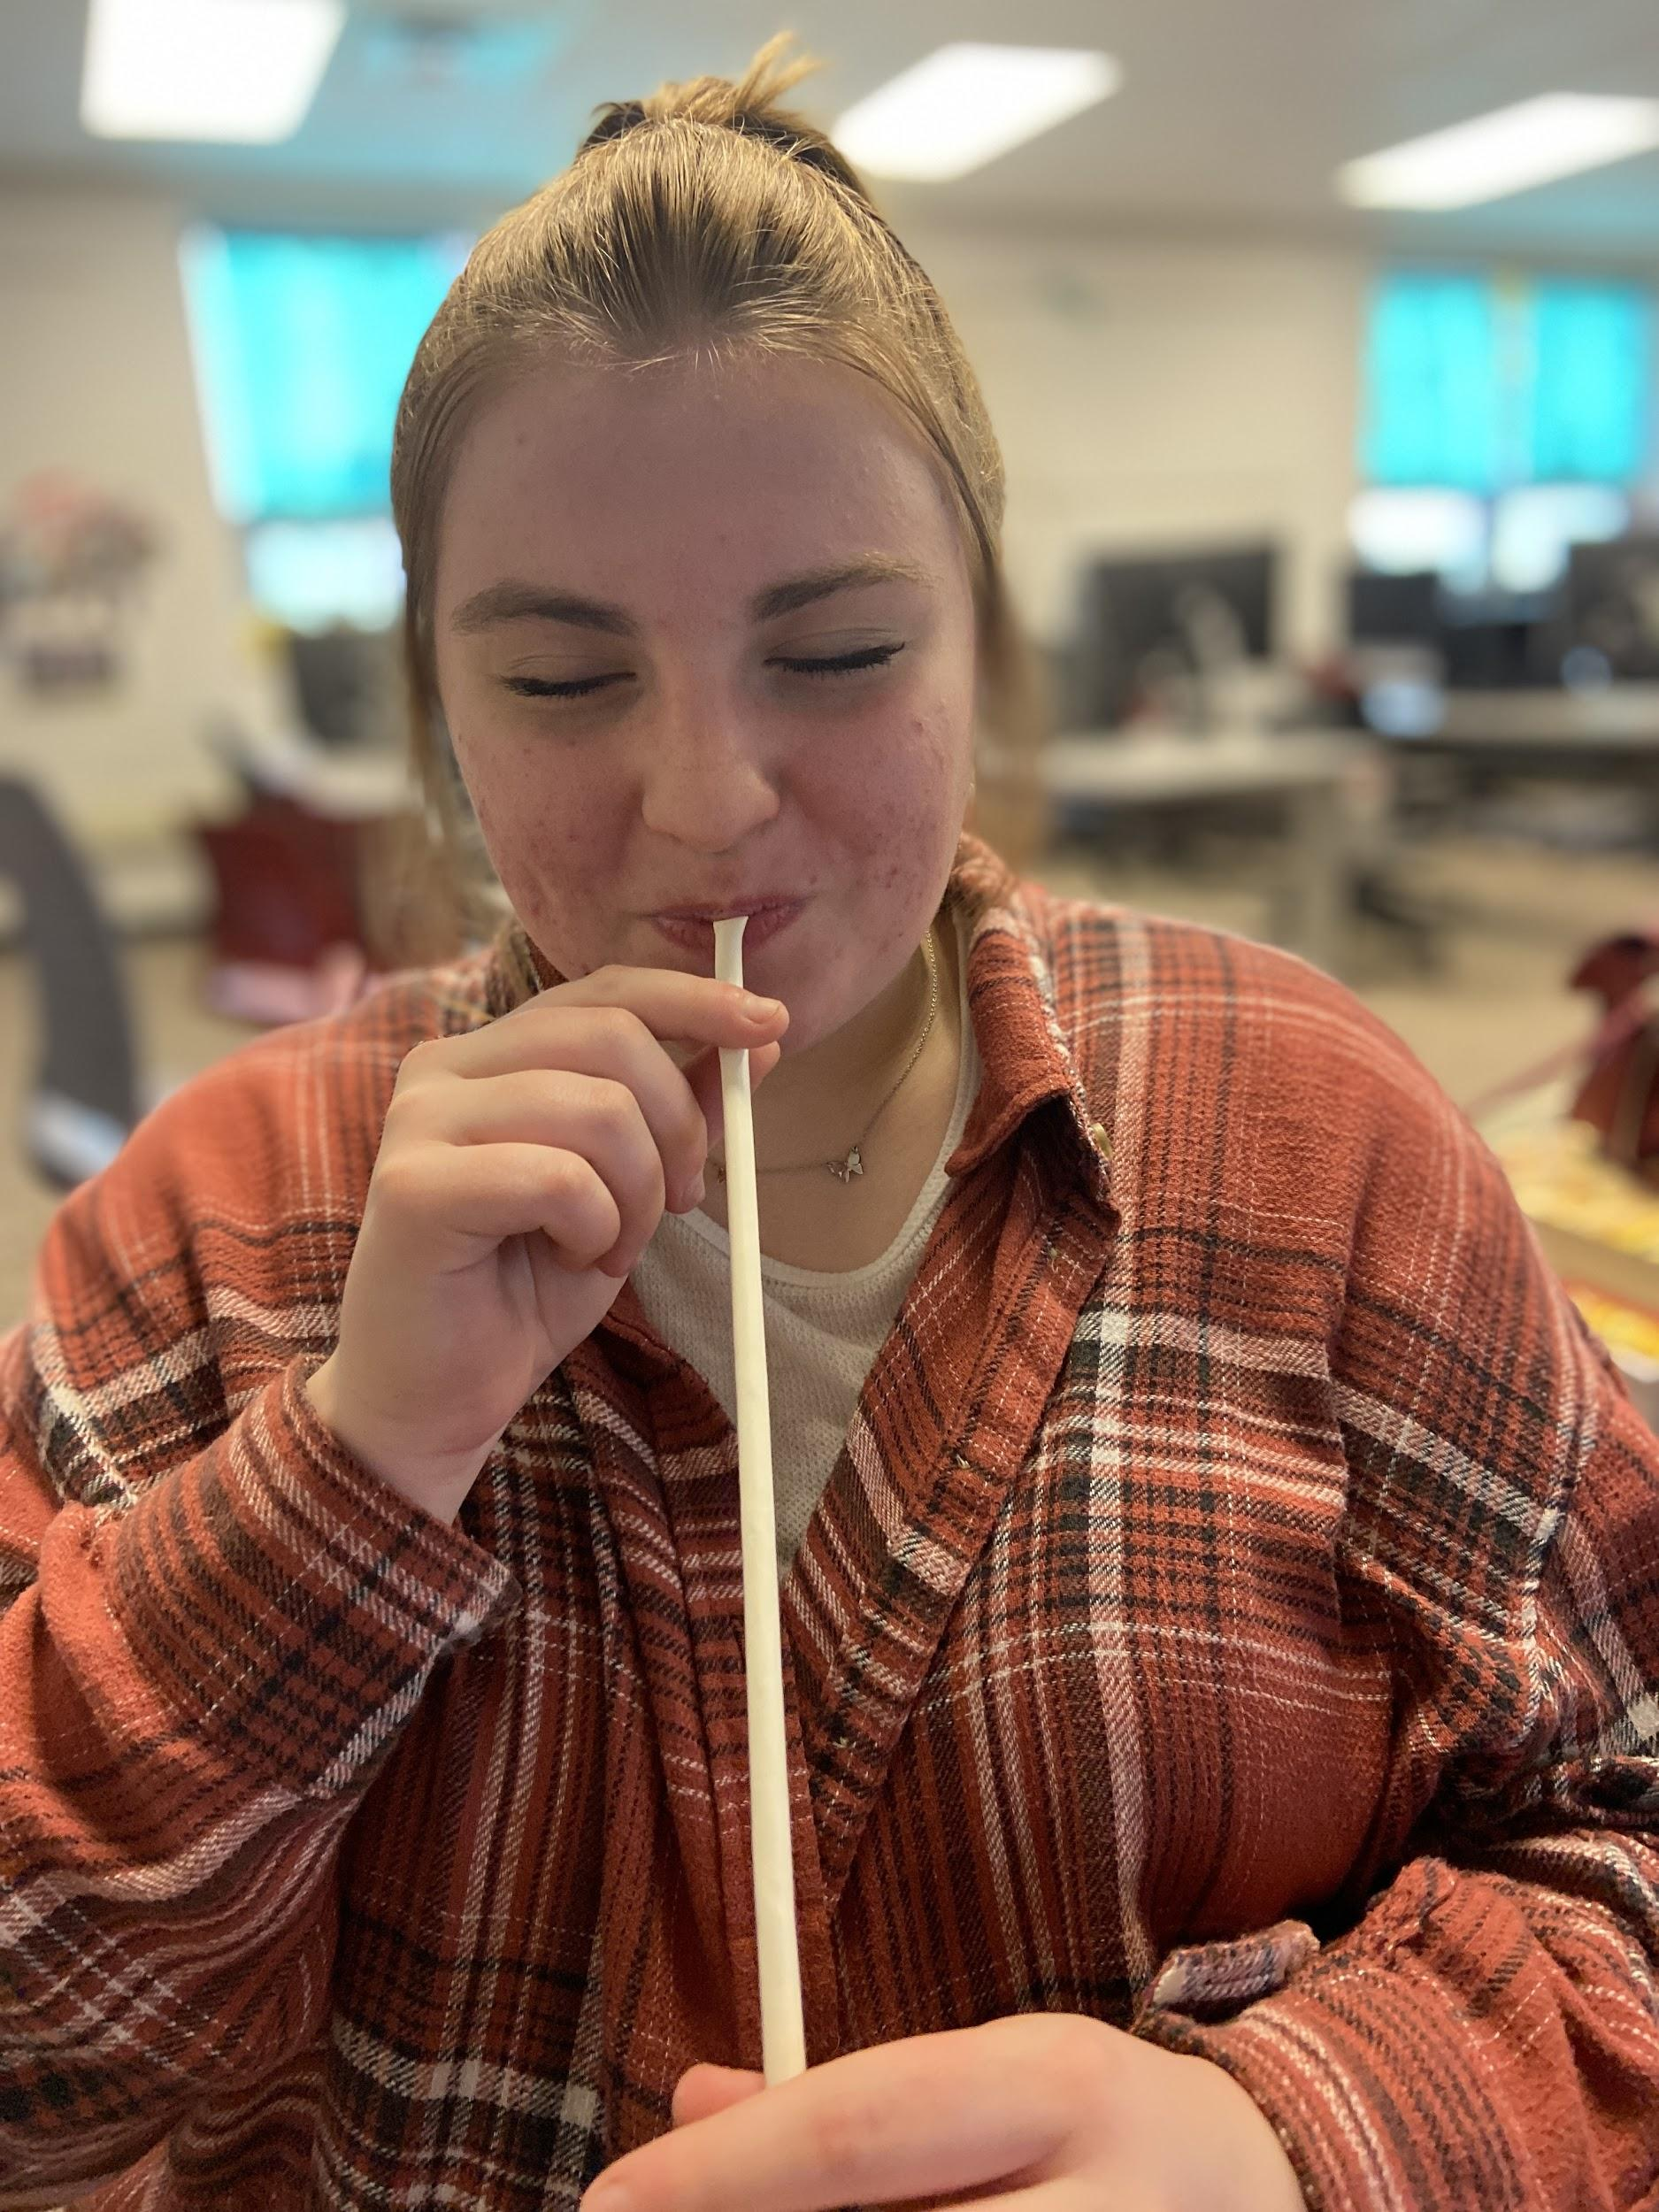
Activities - Develop Skills
Balloon Animal Lessons (YouTube)
Lack of Skill
Notes:
https://www.cleverism.com/95-leadership-quotes-lessons-famous-ceos-and-entrepreneurs/

Slide 22
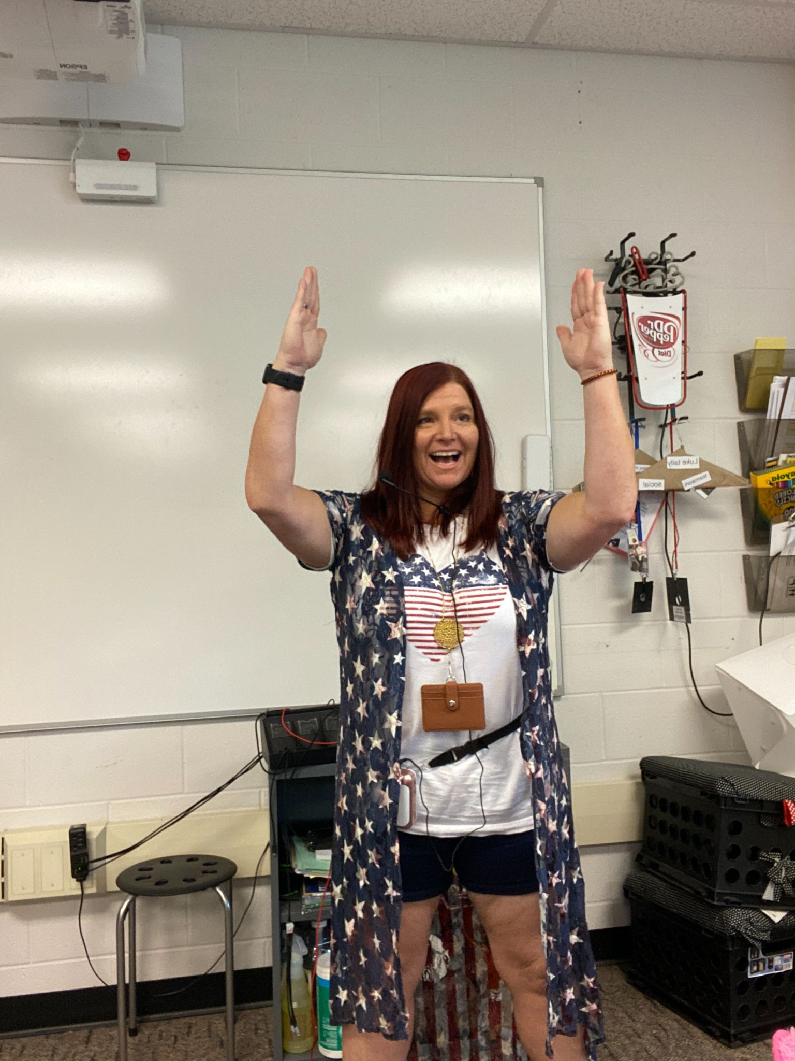
It’s tough, but leaders need to learn to be “okay” with feeling silly!
https://www.amazon.com/gp/product/B071H2PDHN/ref=ppx_yo_dt_b_search_asin_title?ie=UTF8&psc=1

Slide 23
Activities - Develop Skills
Prove It!
After a “big project” that demonstrates skill, rather than just typing a paper or turning in a project, require students to prove the knowledge with a video (Flipgrid, AwesomeScreenshot, etc.) that requires use of vocabulary and really proves they LEARNED from the experience.
SUCH A BIG THING! Many students can “do it” but not “explain it” and this process helps reinforce their learning! (it also prevents cheating and ensures work is authentic and learning is real!)
Lack of Skill
Notes:
https://www.cleverism.com/95-leadership-quotes-lessons-famous-ceos-and-entrepreneurs/

Slide 24
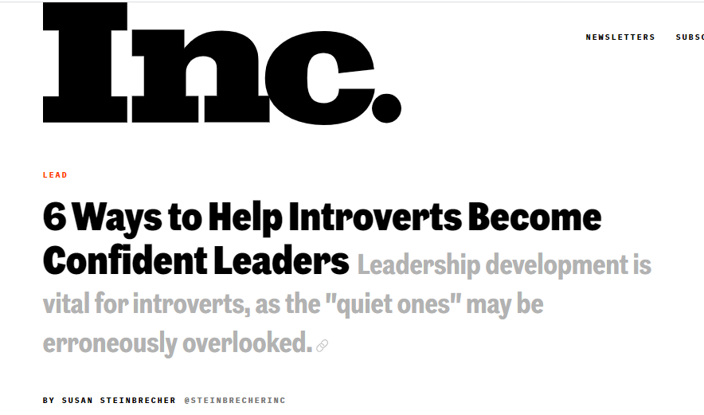
Activities - Authenticity
Explain appearance and assumptions of silence
Ask for input
Provide positive feedback
Consider their perspectives
Encourage
Train and provide tools
Feeling
Fake
https://www.inc.com/susan-steinbrecher/6-ways-to-help-introverts-become-confident-leaders.html
Notes:
https://www.inc.com/susan-steinbrecher/6-ways-to-help-introverts-become-confident-leaders.html

Slide 25
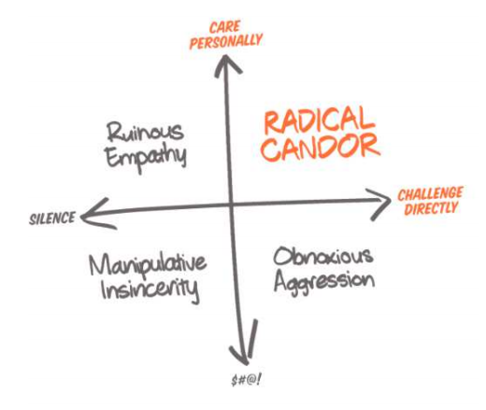
Activities - Authenticity
Radical Candor - HHIIPPP
“Care personally,
Challenge directly.”
Criticism that is kind and clear, and praise that is specific and sincere.
Low Stakes Practice Idea
Feeling
Fake
https://www.justcolor.net/
Notes:
Radical Candor is HIP: Humble, Helpful, Immediate, In person, Public praise/Private criticism, not Personalized (about personality). Radical Candor builds trust and opens the door for the kind of communication that helps you achieve the results you’re aiming for. In short, Radical Candor is Compassionate Candor. It engages the heart (Care Personally) and the mind (Challenge Directly). Practicing Radical Candor also involves telling people when their work isn’t good enough — and when it is; when they are not going to get that new role they wanted, or when you’re going to hire a new boss “over” them; when the results don’t justify further investment in what they’re working on. Delivering hard feedback, making hard calls about who does what on a team, and holding a high bar for results — isn’t that obviously the job of any manager? https://www.youtube.com/watch?v=MIh_992Nfes

Slide 26
5 Roadblocks for Potential Leaders
Self-doubt.
Trouble being perceived as a leader.
A lack of leadership skills.
Feeling inauthentic.
No time/energy to lead.
Have to want to make time!
Self
Doubt
Public Perception
Lack of Skill
Feeling
Fake
Source: https://observer.com/2016/08/the-top-5-introvert-leadership-challenges-and-how-to-beat-them/
Notes:
Image from Pexels
https://observer.com/2016/08/the-top-5-introvert-leadership-challenges-and-how-to-beat-them/

Slide 27
@tonyaskinner
tskinner@jr2mail.org

