Slide 1
SESSION MISSION: IMPOSSIBLE
Your mission, NCE Conference Attendee, should you decide to accept it, is to create an understanding of gamification and game-based learning. As always, should you or any of the other attendees be caught increasing student engagement or learning through gamification the NCE Conference presenter will disavow any knowledge of your newly acquired tools.
This message will disappear in five seconds.
Good luck, NCE Conference Attendee!
Notes:
Session Mission
Original quote from Mission: Impossible: Your mission, Jim, should you decide to accept it, is to stop Turek and B-230. As always, should you or any of your IM Force be caught or killed, the Secretary will disavow any knowledge of your actions. This tape will self-destruct in five seconds. Good luck, Jim.

Slide 2
Gamifying the FCS Classroom
Miranda Bright, Crete High School
Notes:
Welcome to my Gamifying the FCS Classroom presentation my name is Miranda Bright. During this presentation we will define gamification, compare gamification to game-based learning, and provide access to created materials and recommended resources to gamify your own classroom. There is a handout for this presentation with additional links and information.

Slide 3
What is gamification?
“Gamification is applying the most motivational techniques of games to non-game settings, like classrooms.”
-Michael Matera,
Explore Like A Pirate
Notes:
What is gamification?

Slide 4
What is gamification?
“When students are having a good time learning, the energy is electric, and they are fully immersed; however, let me assure you that games and gamification done right extends far beyond that. The challenge, collaboration, creativity, and critical thinking that are woven into game play bring a complexity that goes much deeper than points and badges.”
- Tisha Richmond
Make Learning Magical
Notes:
What is gamification?

Slide 5
Gamification
Game-Based Learning
uses game components. Missions or Challenges, Mini Games, Badges, XP‌, & More.
uses games.
Notes:
Gamification vs. Game-Based Learning

Slide 6
Game-Based Learning

Slide 7
Spot It
Learning Objective: Review names of terms with pictures.
Spot It: Kitchen Tools PDF
Learning Objective: Review kitchen tool names
Game Objective: Collect the most cards.
Cost: Free
Preparation: Print cards double sided. Cut out circles.
Summary of Game Play: Place two cards face-up on the table and try to find the kitchen tool match on both cards.
Notes:
Spot It -> Kitchen Tools

Slide 8
Spot It: Kitchen Utensils PDF
Find the kitchen tool match on both cards.
Notes:
Spot It Cards

Slide 9
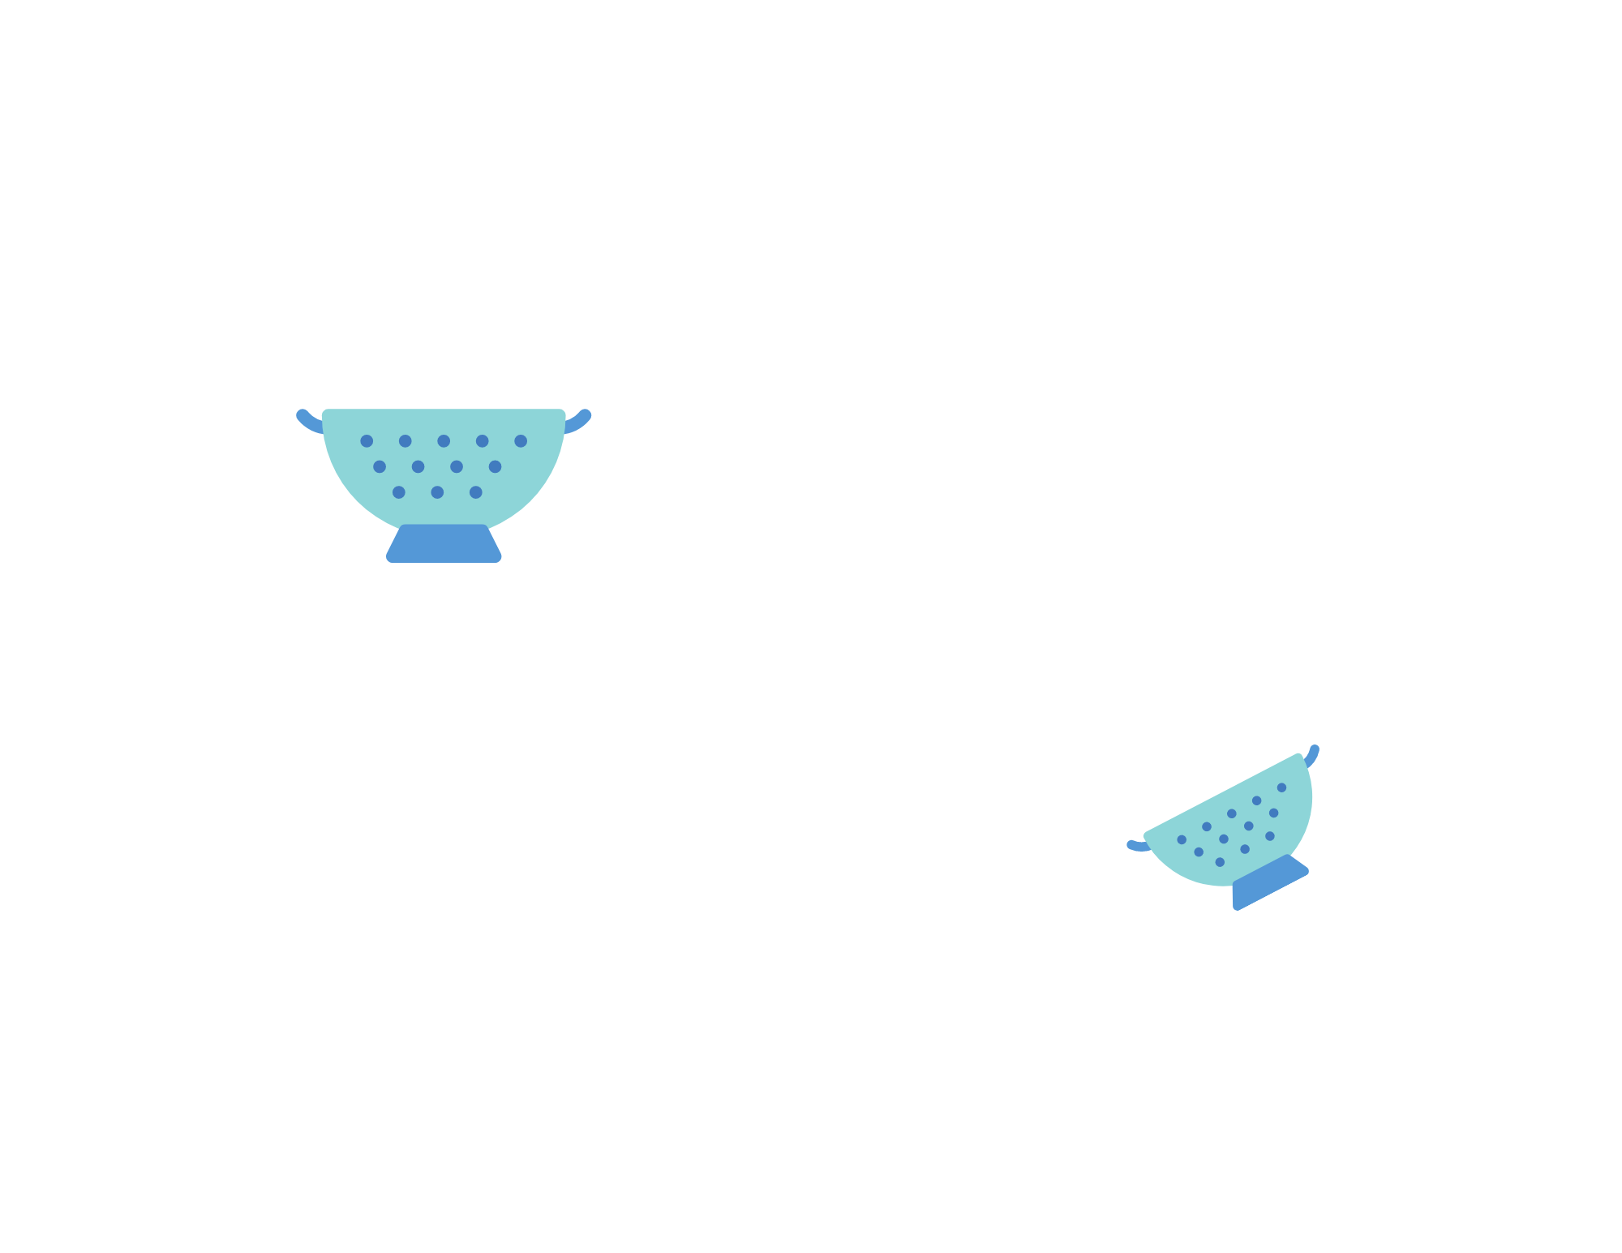
Spot It: Kitchen Utensils PDF
A colander is on both cards.
Notes:
Spot It Answer

Slide 10
5 Second Rule
Learning Objective: Identify three answers related to a specific category.
FCCLA 30 Second Rule PDF
Learning Objective: Review and learn about FCCLA.
Game Objective: Earn the most points.
Cost: Free, could purchase 30 second sand timers
Preparation: Print cards double sided. Cut out cards.
Summary of Game Play: Take turns providing correct answers to a specific category in less than 30 seconds.
Notes:
5 Second Rule -> FCCLA 30 Second Rule

Slide 11
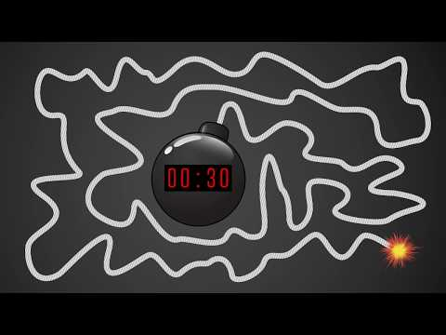
FCCLA 30 Second Rule PDF
Name 3 reasons to join FCCLA.
A few examples: Travel - Meet New People - Participate in Competitive Events— Develop Life and Career Ready Skills - Explore Various Career Pathways - Scholarships - Develop Leadership Skills
Notes:
FCCLA 30 Second Rule
More Game-Based Learning Resources on the handout.

Slide 12
Gamification

Slide 13
Missions or Challenges
Use individual or team challenges to demonstrate learning in a creative way.
FCS Ideas:
Babysitting Toy Challenge Doc
Food Truck Mission PDF
Chopped Challenge Slides
Notes:
Use individual or team missions or challenges to demonstrate learning in a creative way.

Slide 14
Mini Games
Use for learning new terms, reviews, or brain breaks!
Notes:
Use mini games for learning new terms, reviews, or brain breaks!

Slide 15
Badges
Use badges for achievements. Could also be awarded with experience points (XP).
ProStart Badges
Level I Canva Template
Level II Canva Template
Extra Canva Template
Award by printing on mailing labels or uploading digitally.
Notes:
Use badges for achievements. Could also be awarded with experience points (XP).

Slide 16
Gamified Lesson Example
Notes:
Gamified Lesson Example

Slide 17
ProStart Gamified Lesson Example
ProStart Level I, Edition 2, Chapter 11: Foodservice Equipment
Mission: A local restaurant has requested your help with their new breakfast menu. They would like their signature dish to be pancakes. Help the owner decide what type of range (gas or electric) they should use and how they should plate the pancakes.
Mini Game:
Chapter 11 Quizizz
Badges:
Voted People’s Choice
Chapter 11
Top Score in Quizizz
Took A Quizizz More Than Once
Notes:
ProStart Gamified Lesson Example

Slide 18
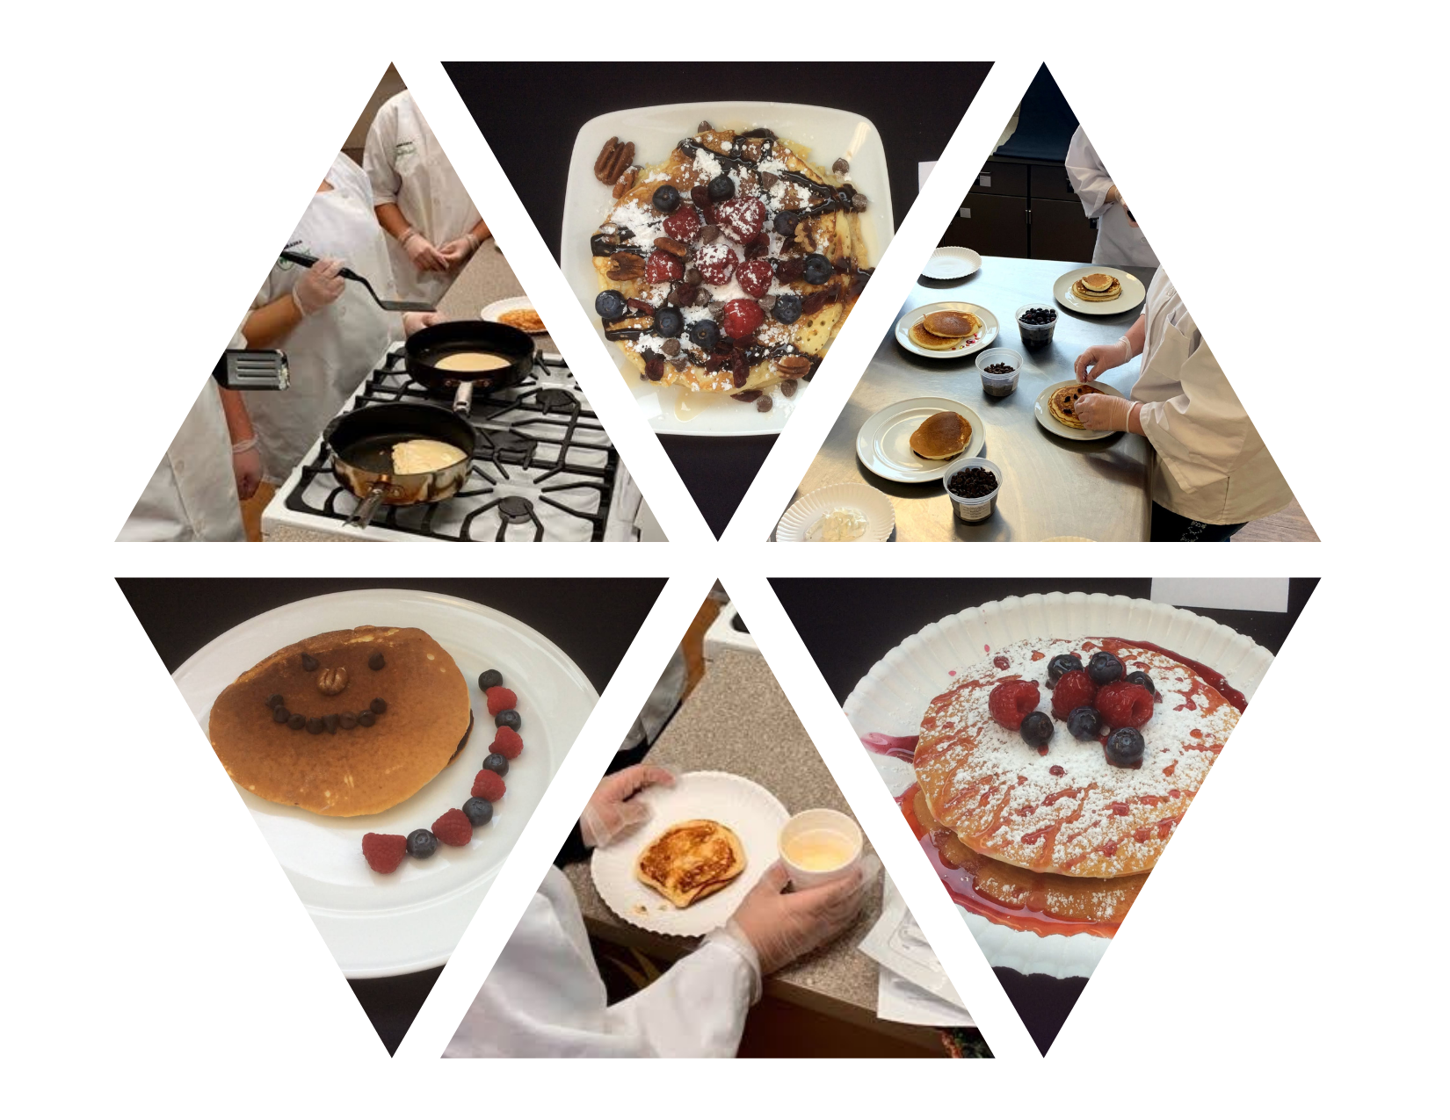
ProStart Gamified Lesson Example
ProStart Level I, Edition 2, Chapter 11: Foodservice Equipment
Mission: A local restaurant has requested your help with their new breakfast menu. They would like their signature dish to be pancakes. Help the owner decide what type of range (gas or electric) they should use and how they should plate the pancakes.
Notes:
ProStart Gamified Lesson Example: Mission

Slide 19
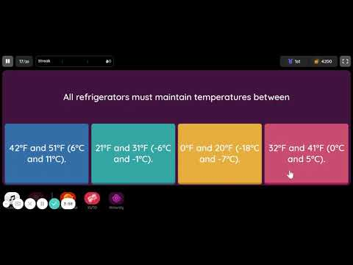
ProStart Gamified Lesson Example
ProStart Level I, Edition 2, Chapter 11: Foodservice Equipment
Mini Game:
Chapter 11 Quizizz
Notes:
ProStart Gamified Lesson Example: Mini Game

Slide 20
ProStart Gamified Lesson Example
ProStart Level I, Edition 2, Chapter 11: Foodservice Equipment
Badges:
Voted People’s Choice
Chapter 11
Top Score in Quizizz
Took A Quizizz More Than Once
1 | 3 | 5 | 7 | 9 | 11 | 13 | 15 | 17 | 19 | Chapter 11
2 | 4 | 6 | 8 | 10 | 12 | 14 | 16 | 18 | 20
Notes:
ProStart Gamified Lesson Example: Badges

Slide 21
You've unlocked the Session Attendee Badge!
Congratulations, you’ve earned yourself a Session Attendee Badge! Today you explored gamification and game-based learning as well as received access to created materials and recommended resources to gamify your own classroom. Best of luck with your mission of gamifying your FCS classroom!
Notes:
You've unlocked the Session Attendee Badge!

Slide 22
Miranda Bright
miranda.bright@creteschools.org
Twitter: @mrs_mbright
Notes:
Please contact me if you have any questions!
Reminder: Please see the handout for more Game-Based Learning and Gamification Resources.
Thank you for your time and willingness to try something gamification with your students.

