Slide 1
Design for Delight
A design thinking introduction

Slide 2
Hi, I’m Karla!

Slide 3
Why Design Thinking?
#1 Trending Skill …
Automotive
Consulting
Finance
Manufacturing
Media
Technology
Telecom

Slide 4
Photo by Mobilus in Mobili
We live in a world where everything is designed.
Notes:
Truly everything is designed in our society: not just products, technology, and posters. It is also our laws, our cities, our treatment of different genders, our food, and more. “Design” here refers to a broader concept: the creative process of developing solutions to existing problems. Design is when a human being makes a decision about the way something should be.

Slide 5
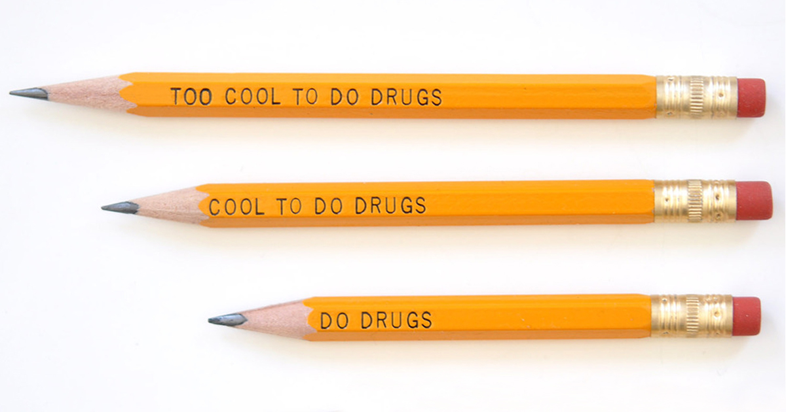
Photo by Ethan Miller/Getty Images
But not all designs are good.
Photo by wszystkookuchni.pl
Photo by tierraeste.com
Notes:
But not all designs are good. What makes these bad designs?
<get 2-3 answers and tell the Miss Universe story if they do not know it.>
Miss Universe Story: In 2015, Steve Harvey read the wrong name for Miss Universe, crowning Colombia as Miss Universe rather than the representative from the Philippines. He only noticed the error after the crown had already been given to Colombia, and ended up having to embarrassingly remove the crown and give it to Philippines on live television. He was put under a lot of fire for this, but it wasn’t all his fault. This was also a case of poor information design.

Slide 6
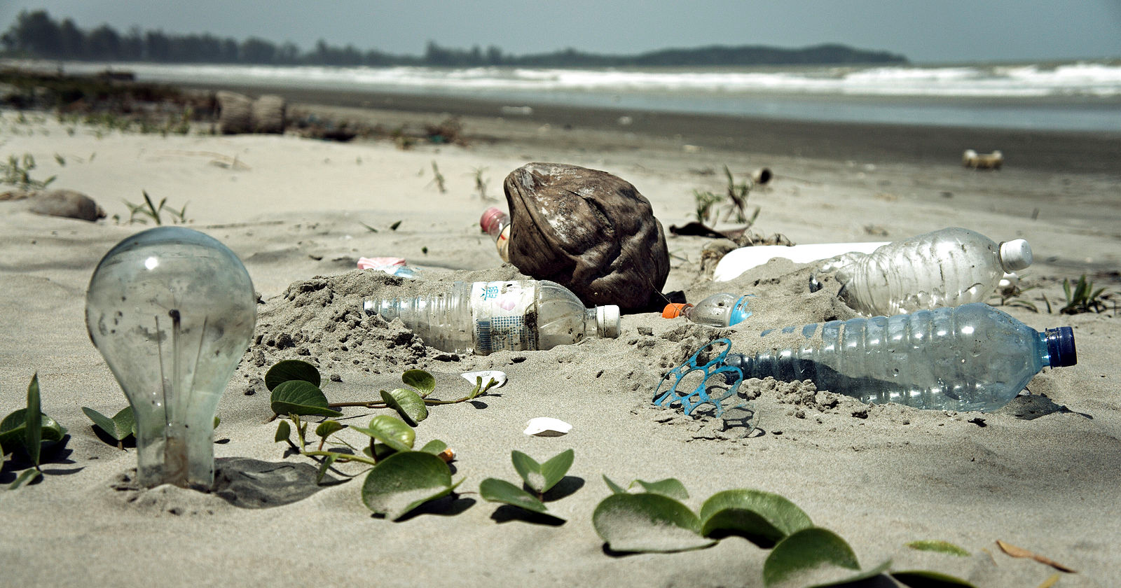
Wikimedia Commons: epSos.de
Pixabay: Wokandapix
But not all designs are good.
Pickpik
Flickr: UN Photo/Sahem Rababah
Notes:
So those were all funny examples, but often times, bad design isn’t as funny. That’s the case for a lot of the problems that exist in the world. From refugee crises to plastic in our oceans, every problem that exists was designed, and that means it can be redesigned. These decisions and creations were made by humans, and better decisions can be made to reverse these problems.
Someone designed plastic packaging without thinking about how it would end up polluting our oceans and not compost.
Someone designed classrooms to be rows of students in seats rather than engaging and interactive.
Someone designed stairs without thinking from the perspective of those who use wheelchairs and can’t access that form of walkway.
And despite centuries of persons being replaced by tyrannical governments or natural disasters, we still do not have a good design for what temporary shelter for refugees can look like.
There are many problems in the world around us, but many of them are human-made and designed. We need your help to redesign them!

Slide 7
How might we design a better….

Slide 8
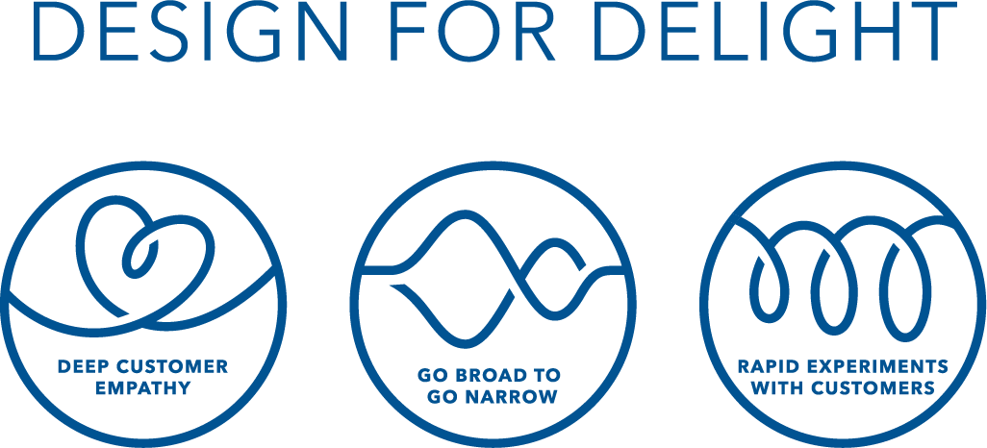

Slide 9
The “Traditional” Way to Solve Problems
You experience a problem
You think of a way to solve it
You build the solution
You try to use or sell your solution
Notes:
Traditionally, problems are solved after you yourself experience a problem, and then come up with a way to solve it that just applies to you. This can be very limiting: it restricts you to only address problems you have experienced yourself, and doesn’t take into account the ideas and feedback of others who could benefit from your solution.

Slide 10
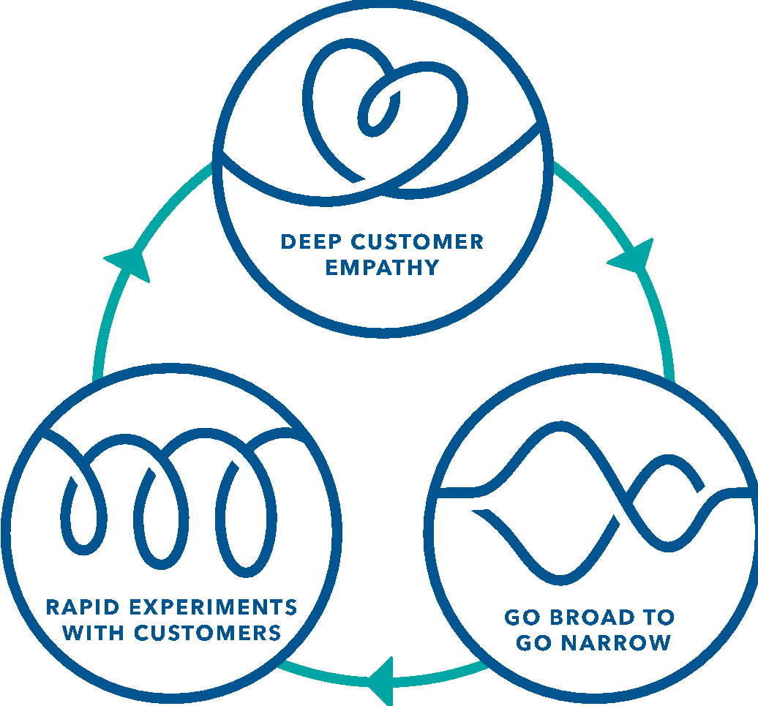
How is Design for Delight (D4D) different?
Start with the customer’s problem - not yours
Repeat many times
Test ideas before investing in them
Come up with lots of ideas, not just one
Notes:
The traditional problem-solving process is limiting and ineffective. Here at Design for Delight, we emphasize the importance of iterative design: only after testing the product with your customer and adapting the solution according to their needs, can you settle on an effective idea to build. The Design for Delight process has 3 main principles, and lots of methods for making sure to stick to those principles, that you will learn through the next few lessons.

Slide 11
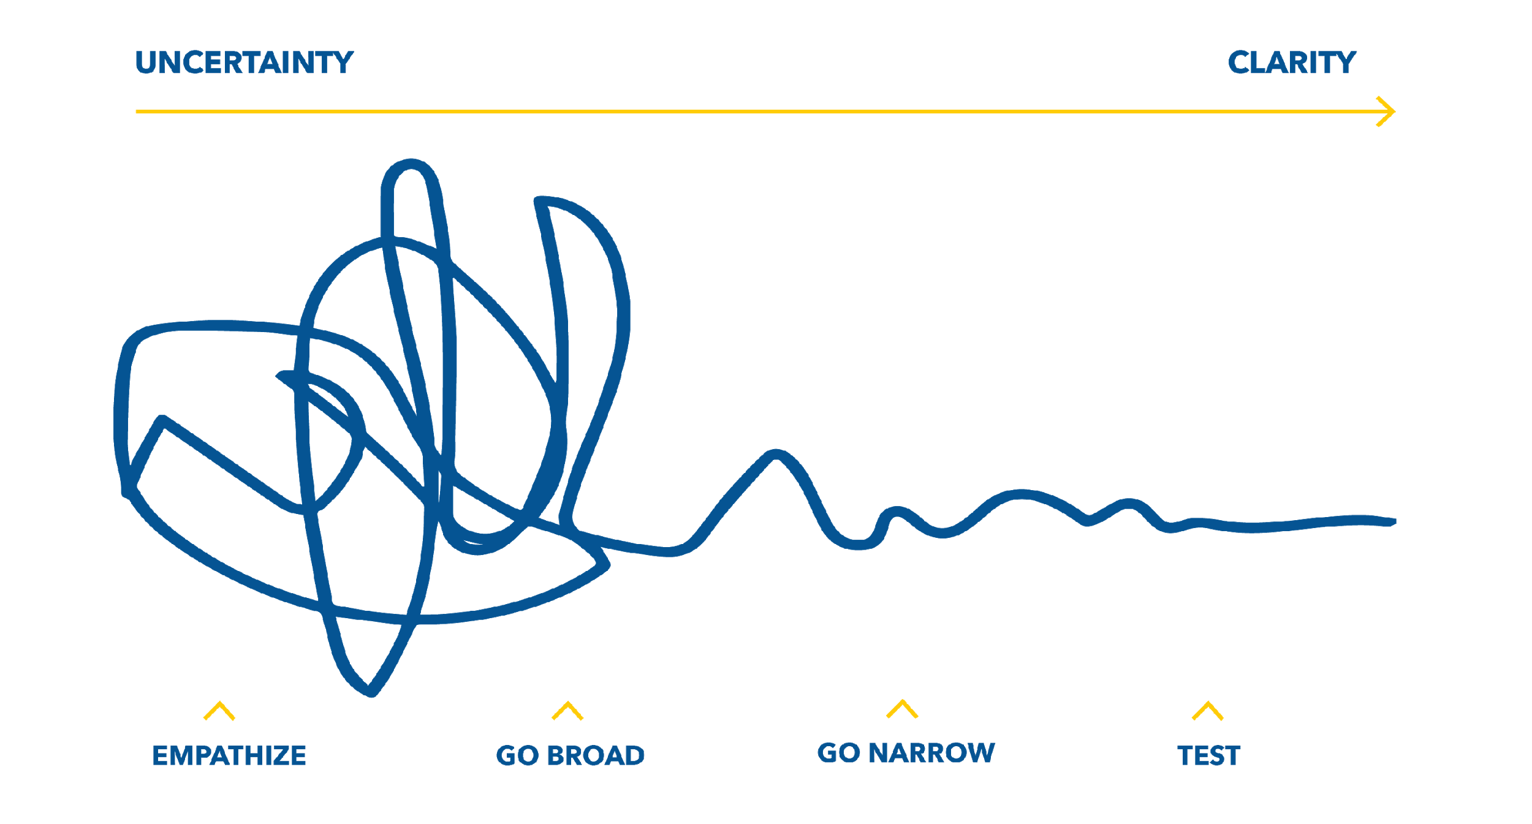
What D4D Feels Like
Notes:
Remember, getting to great solutions is oftentimes a messy process. You might come up with the wrong solution at first, and then have to loop back and understand the problem some more, and on and on. But be confident that even if the path feels messy, you’re moving in the right direction.

Slide 13
Deep Customer Empathy
Go Broad to Go Narrow
Rapid Experiments with Customers

Slide 14
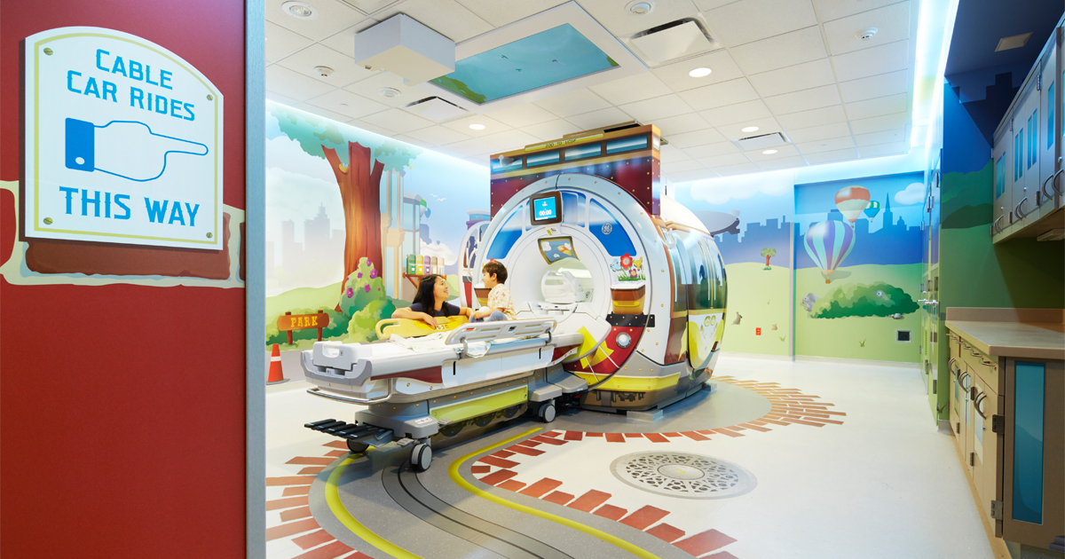
Designing for Delight
Photo by UCSF Medical Center at Mission Bay

Slide 15
Deep Customer Empathy
Go Broad to Go Narrow
Rapid Experiments with Customers

Slide 16
Ideal State - 11 Star Method

Slide 17
On “Bad” Ideas

Slide 18
Frame
How might we…
Design a better CTSO experience?
menti.com
Enter code: 3352 5023

Slide 19
Generate
What are things students/kids love to do for fun?

Slide 20
Generate
What are things you need to accomplish in CTSOs?

Slide 21
Mash-Up
How can you combine your ideas around what kids love to do for fun & project management in your CTSO?

Slide 22
Deep Customer Empathy
Go Broad to Go Narrow
Rapid Experiments with Customers

Slide 23
Why do Rapid Experiments?
Avoid making a product that customers don’t want
Avoid building something really expensive until you test the design!
Notes:
Rapid experiments can help you avoid making a product that no one wants. How could Nabisco (the company that makes Oreos) have experimented to see if customers actually wanted a Watermelon flavored Oreo? How could a car company experiment to test the design of their car before building a lot of expensive cars?

Slide 24
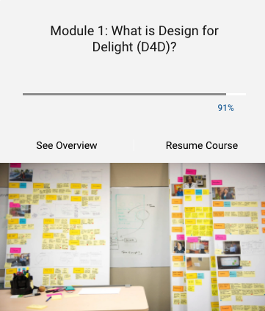
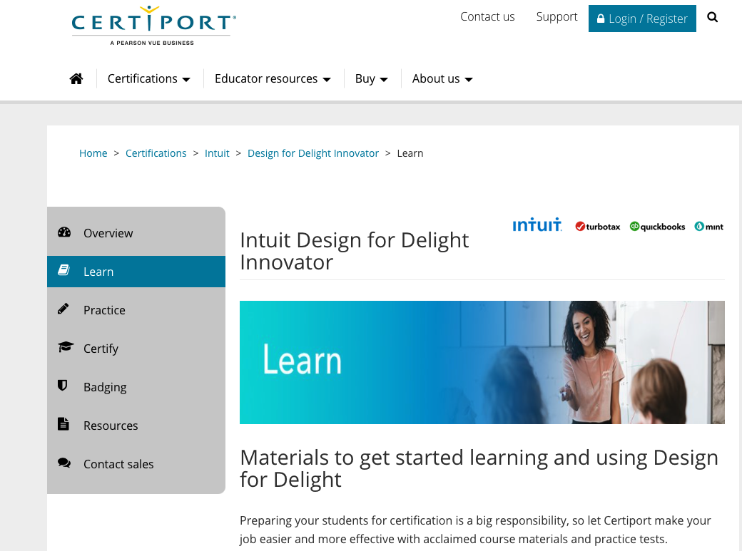
Resources
Brainstorm Cards
Thinkific D4D Course
Link Here
Brainstorm Cards
D4D Certification
Brainstorm Cards
Link Here
Brainstorm Cards
Toolkit: Lesson Plans, Worksheets & D4D Activities
Link Here
Notes:
This is a sample Testimonials slide.
To Replace the Pictures on this Sample Slide (this applies to all slides in this template that contain replaceable pictures)
Select the sample picture and press Delete. Click the icon inside the shape to open the Insert Picture dialog box. Navigate to the location where the picture is stored, select desired picture and click on the Insert button to fit the image proportionally within the shape.
Note: Do not right-click the image to change the picture inside the picture placeholder. This will change the frame size of the picture placeholder. Instead, follow the steps outlined above.
Tip: use the Crop tool to reposition a picture within a placeholder. From the Picture Tools Format tab on the ribbon, click the Crop button. Click and drag the picture within the placeholder to reposition. To scale the picture within the placeholder (while Crop is active), grab a round corner handle and drag to resize. Hold Shift key to constrain picture aspect ratio when resizing.

Slide 25
Q&A

