Slide 1
Discover MBA Research’s Resources for the Classroom
Tammy B. Cyrus
Director of Professional Development
MBA Research & Curriculum Center

Slide 2
Session Goals
Overview of MBA Research & Curriculum Center
A look inside of State’s Connection
Additional Classroom Resources
Notes:
The goals for today’s session includes:
An overview of MBA Research and Curriculum Center
Taking a look inside of State’s Connection
Additional classroom resources

Slide 3
MBA Research Mission
. . . to support educators in the preparation of students for careers in business and marketing
Notes:
MBA Research and Curriculum Center is a nonprofit organization designed to make your life easier in the classroom. Our mission is to support educators in the preparation of students for careers in business and marketing.

Slide 4
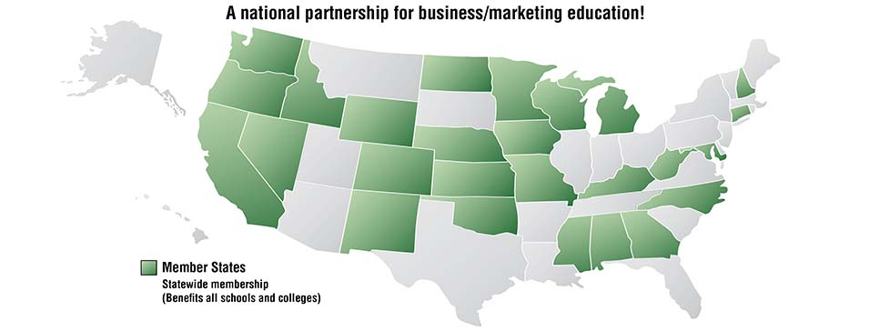
Member States
Notes:
We currently have 26 state departments of education throughout the country that we work directly with to provide materials and services specifically for business and marketing teachers. Being a part of this consortium means that each of these states are member states. Business and Marketing teachers within these states have access to numerous resources to assist them with lesson planning, classroom activities, and topic specific materials that can be integrated into current course material or used as the main resource for classrooms. Our resources are available for purchase by all states; however, member states do receive a discount. We also have several resources available at no cost to teachers thanks to our partnerships with the Daniels Fund and Project Management Institute Educational Foundation, also known as PMIEF.

Slide 5
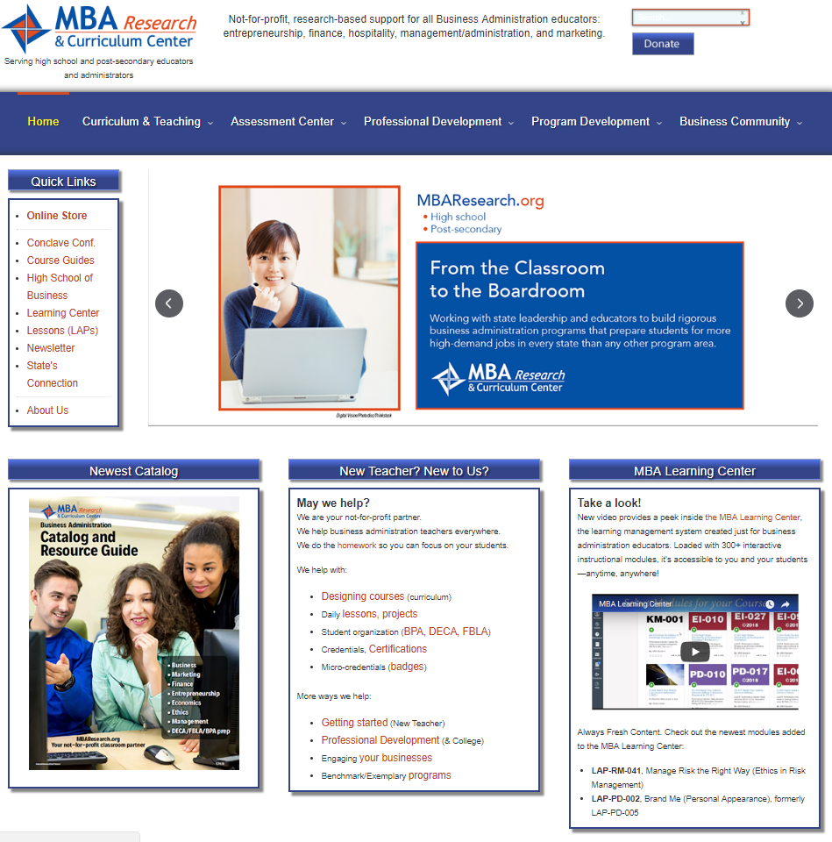
www.mbaresearch.org
Notes:
The starting point for everything that you are going to see today is MBA Research’s website. It should be your go-to location for all of the organization’s services and products. You’ll find that all of these fit into an instructional system—rather than being independent stand-alone items.

Slide 6
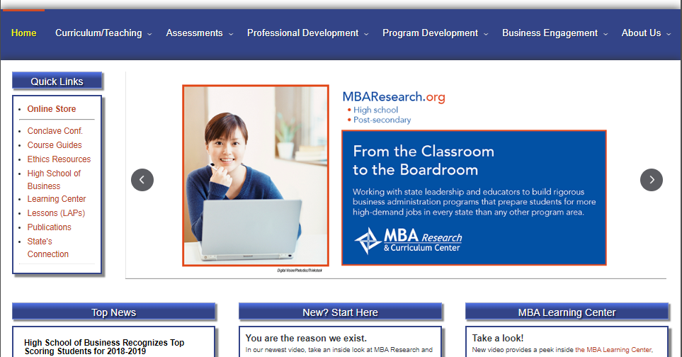
www.mbaresearch.org
Notes:
As a member state, you have access to State’s Connection. Here teachers will find free tools, content, and resources. You can access our Curriculum Builder tool, ethical case studies, project management tools, and more! To access State’s Connection, go to mbaresearch.org and click on State’s Connection under Quick Links.

Slide 7
Register or Log In
Notes:
If you aren’t already registered, you can register by clicking on the link. If you already have login information, you can log right in. Bookmark State’s Connection and check back often. New things are being added all the time—and it is all free.

Slide 8
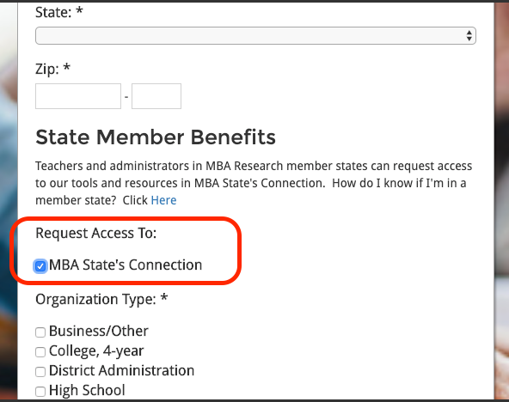
Register for State’s Connection
Notes:
If you do not have an account, then select register here and it brings you to the registration form. Here is a screenshot of the registration form to complete. Make sure that you select the MBA State’s Connection under Request Access to in order to get enrolled in State’s Connection. After submitting the registration form, you should receive an autogenerated email within a few minutes to validate your State’s Connection account. If you created a password during the registration process, use the same password when prompted to create password. If you do not receive the email within a couple of minutes, check your spam folder as sometimes this type of email ends up in spam folders. You need to access that email to activate your account.

Slide 9
What’s in Your State’s Connection?
Action Briefs
Bookmarks
Course Guides
Curriculum Builder
Gray Zones
The Learning Center
MBA Dictionary
Programs of Study
Project Ideas
Project Management Tools
Rubrics
School-Based Enterprise
Work-Based Learning
Notes:
On your State’s Connection page, you’ll find action briefs discussing current trends in business and marketing, program of study kits, links to course guides, Gray Zones from LAPs, bookmarks of recommended websites, a glossary of terms used in MBA curriculum, rubrics, project management tools and more. Let’s take a look at these resources.

Slide 10
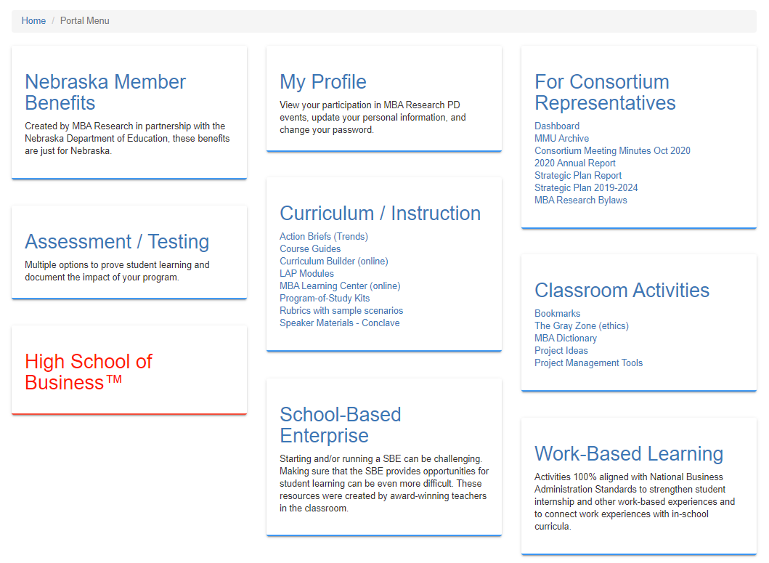
What’s in Your State’s Connection?
Notes:
This is what the main page of Nebraska’s State’s Connection looks like. The Consortium Representatives category is only available to your consortium rep – the liaison for your state. Your State’s Connection will not have that category available to you as a teacher. All of the blue links are accessible. The red High School of Business in this screenshot is only accessible to those teachers who are High School of Business teachers, which is a special program that brings college-inspired business administration courses to high schools across the U.S.

Slide 11
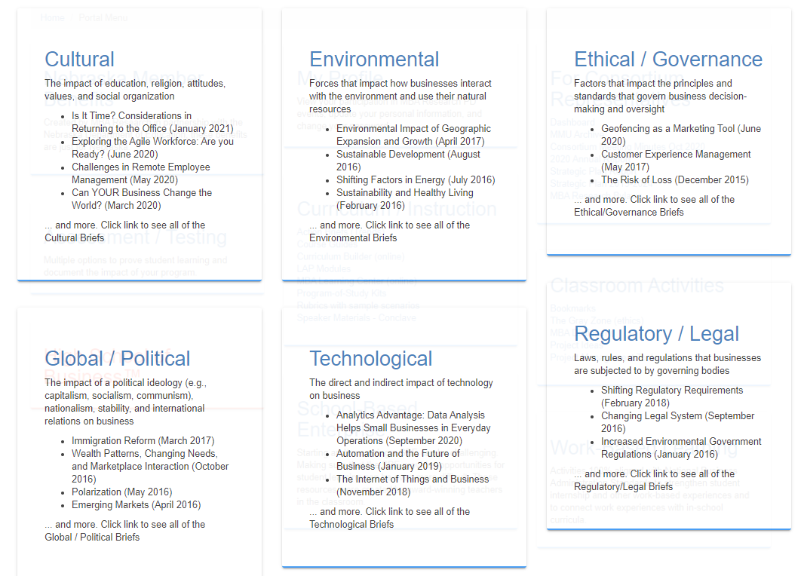
Action Briefs
Notes:
In our ongoing conversations with the business community, we asked them to identify business trends impacting the workplace.

Slide 12
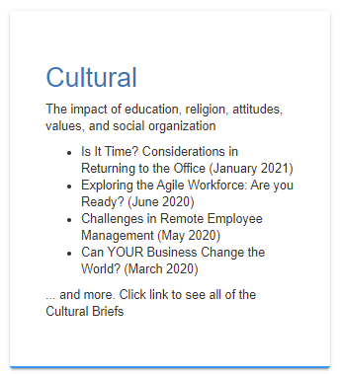
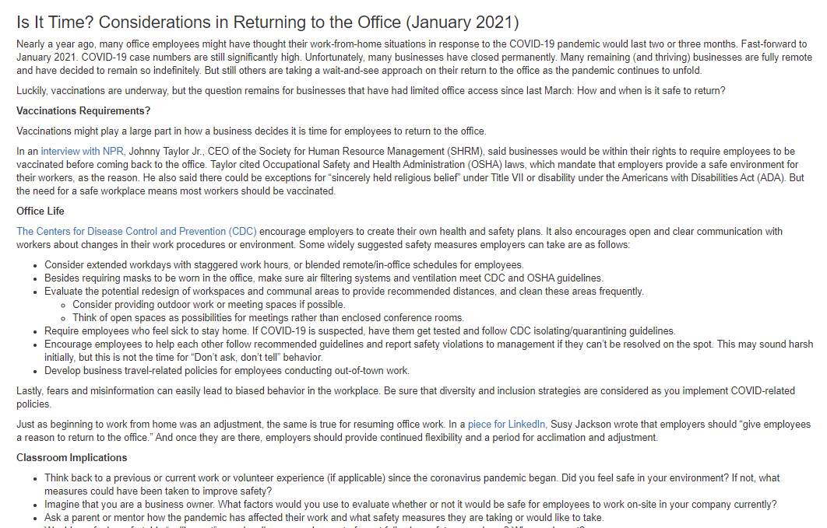
Action Briefs
Notes:
Action Briefs are recent trends and their workplace and classroom implications. Here’s a quick look at the action brief on Cultural. There is a workplace implication and a classroom implication. As a teacher you can use the Action Briefs in many ways—as an assignment to discuss with their employer or another adult, as a beginning of a research project, as an idea for a debate, as a ticket in or out the door, or even as a topic for an advisory committee meeting to get examples from your community.

Slide 13
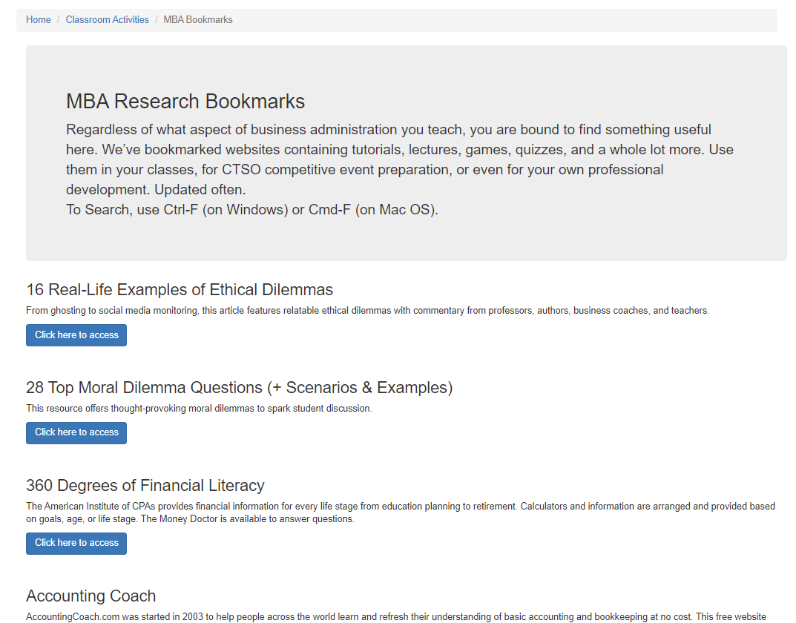
Bookmarks
Notes:
Have you ever gone to the internet to look for a better lesson, a new resource to use in teaching, or just a different idea to add to a lesson? I have, and I have to tell you, the internet can be my black hole. I may come back out of the black hole an hour or more later having bought something, having watched a funny video, or been distracted by my social media account but have not found anything useful for that lesson.
When you are looking for topics, websites, or activities to bring into the classroom, consider using the Bookmarks found in State’s Connection. These bookmarks are vetted websites that have awesome resources. Let us make searching the Internet for educational tools and materials easy for you. Regardless of what aspect of business administration you teach, you are bound to find something useful here. We’ve bookmarked websites containing tutorials, lectures, games, quizzes, and a whole lot more. Use them in your classes, for CTSO competitive event preparation, or even for your own professional development. Bookmarks are updated weekly.
The Find feature is available for bookmarks – CTRL + F for PCs and CMD + F for Macs

Slide 14
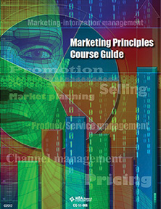
Course Guides
Course description
Recommended sequence of instruction
Instructional objectives
Projects and activities
Briefings
Test items
Resources
Notes:
Course Guides are now free, thanks to our partner, the Daniels Fund. The Daniels Fund is a nonprofit focused on providing ethical education at high school and post-secondary education. Course guides include a course profile but are so much more. They include the recommended sequence of instruction, instructional starter ideas, projects, assessments, and resources. In order to get the free course guides, you do have to complete a short survey so we can gather data to report to the Daniels Fund. The survey is only a couple of minutes long and certainly worth the $80–$100 savings per course guide.

Slide 15
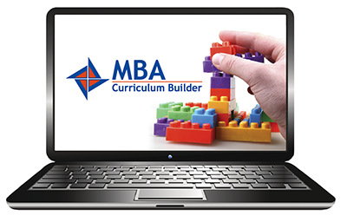
Curriculum Builder
Notes:
MBA Curriculum Builder is a database tool that you can use to design your own courses using the MBA Research standards for Business Administration. There is a learning curve to familiarize yourself with it, but it will help you create a new course, revise an existing course, or improve a course you are already teaching. If you are looking for specific activities tied to a standard, then this would be a way that you could see what resources are available.

Slide 16
Curriculum Builder
Allows you to view detailed resource information about existing courses
Allows you to build a course using the National Standards for Business Administration
Look up information about specific performance indicators
Notes:
Curriculum Builder provides you the opportunity to look at detailed resource information about our courses, the National Standards for Business Administration including performance indicators, curriculum planning levels, sequence of instruction, assessment information, etc. You can look up individual components of existing courses, build a course using the National Standards for Business Administration, which is ideal for presenting to local administrators ideas for a course implementation. You can also look up particular performance indicators to view information about that performance indicator, which courses that PI is used, the activity tied to that PI, whether or not there is a LAP, etc.

Slide 17
Learning Activity Packages (LAPs)
Notes:
Learning Activity Packages (LAPs) are research-based, topic-specific lesson plans used within the classroom. LAPs provide teachers with resources that include a student handout written at the high school level to help students understand the topic. Additional components of a LAP include a PowerPoint presentation, discussion guide, individual and group activities, a learning guide, posttest, etc. Due to the partnership that we have with the Daniels Fund, you have free access to 72 ethic LAPs that go along with the two Ethical Leadership Course guides that were developed to help bring ethics into the classroom.
All of our LAPs are housed in the MBA Learning Center, which is in a Canvas platform.

Slide 18
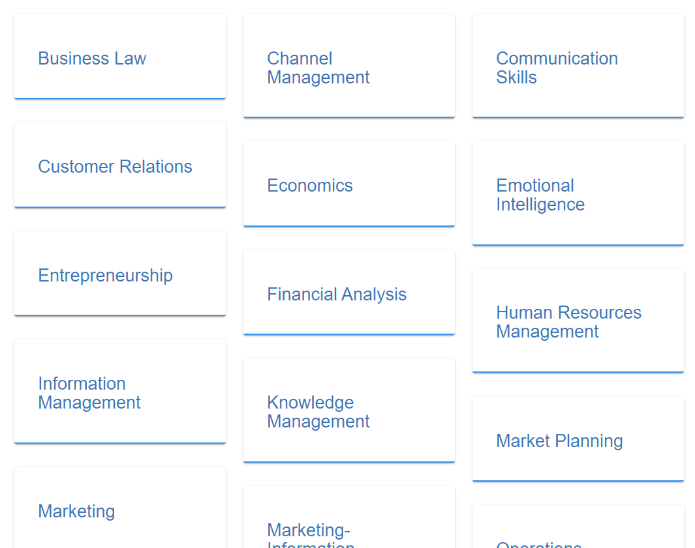
The Gray Zone
Notes:
How do your students view the business world? Do they see it strictly in terms of black and white? Or, do they understand that it also includes many shades of gray? Use The Gray Zone to introduce your students to problems and situations that don't have one specific right or wrong answer. Each Gray Zone is based on a unique performance indicator from MBA Research’s national standards and presents students with an ethical dilemma in business to resolve. Updated often.
Discuss these ethical dilemmas with your students and help them see that business decisions are not always black and white!
Each Gray Zone is located in one of our LAPs – giving you the opportunity to expand on the topic.
Use The Gray Zone to introduce your students to problems and situations that don't have one specific right or wrong answer.
They are great for introducing students to competitive events, as an assignment to discuss with an employer or other adult, as a debate, or as a weekly activity (i.e., Ethics Wednesdays).

Slide 19
The Gray Zone
Discuss these ethical dilemmas with your students and help them see that business decisions are not always black and white!
Notes:
Here is a screenshot of different Gray Zones. At the end of the ethical dilemma, you are provided with the LAP that this Gray Zone is in just in case you are interested in pulling additional information/activities from the LAP. You have access to all of our LAPs at no additional cost through the MBA Learning Center.

Slide 20
The MBA Learning Center
Notes:
The MBA Learning Center currently has 300+ lesson plans and classroom activities available. Learning Center accounts are set up by school and five teachers within that school can have access to the Learning Center. Nebraska is an enhanced membership state. Your MBA Learning Center account has been paid for by your State Department of Education.

Slide 21
Accessing the MBA Learning Center
Enhanced Membership States have FREE access to the MBA Learning Center
Send the following information to helpme@mbaresearch.org
Your name
Email address (school issued email required)
School Name
School Address
City, State, Zip
Notes:
If you have not already signed up for The Learning Center, you will need to do that before you can access it. Here is the information that MBA Research needs from you in order to create an account for the Learning Center. If you have not obtained an account at this point, send your name, email address (school email address required), school name, school address, city, state and zip to helpme@mbaresearch.org. The normal turn around time is a couple of days. You will receive an email from Canvas once your account has been created.

Slide 22
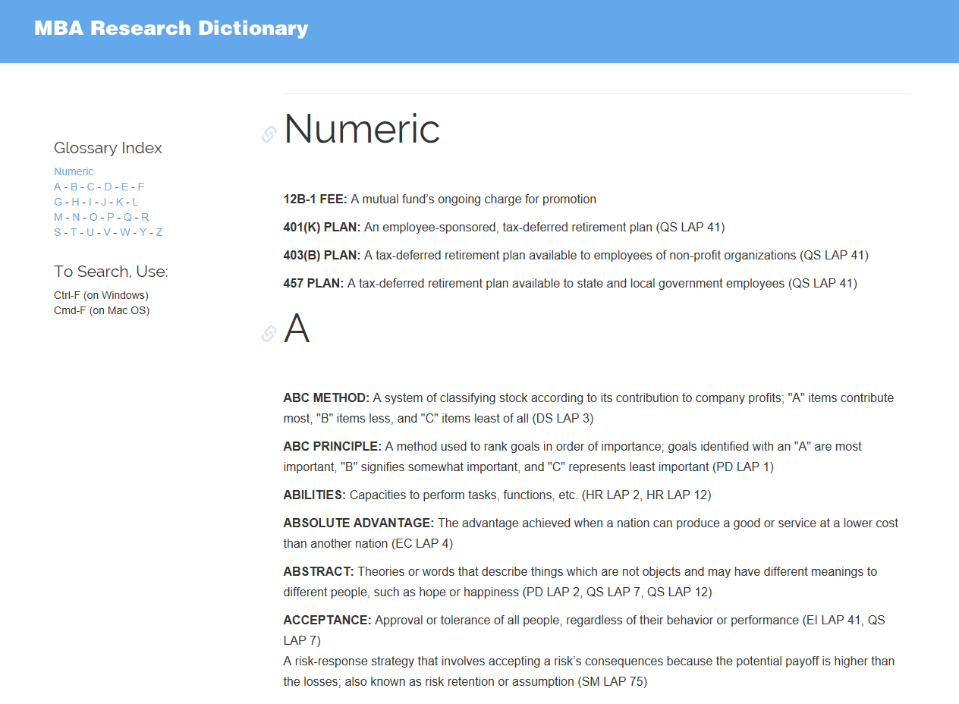
MBA Dictionary
Notes:
This glossary of terms, dubbed the MBA Dictionary, contains every vocabulary term and definition referenced in MBA Research LAPs—including current LAPs as well as LAPs that are out-of-print. The dictionary is updated quarterly.

Slide 23
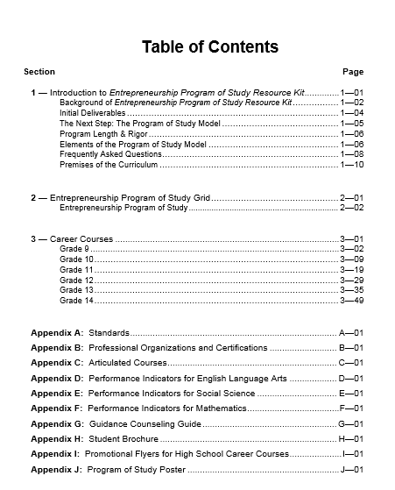
Program of Study
Notes:
The program-of-study models are designed to meet current and anticipated Perkins requirements. Each is a comprehensive list of courses and course content (including academics) that outlines recommended courses for ninth grade through college. Guidance counselor resources are included, along with specific guidance for business and marketing teachers. Kits are free in member states. Here’s a quick look at the table of contents of an Entrepreneurship Program of Study kit.
These PoS Resource Kits (available free to all educators in member states) can serve as starting points when creating programs for:
Business Management and Administration
Entrepreneurship
Finance
Marketing

Slide 24
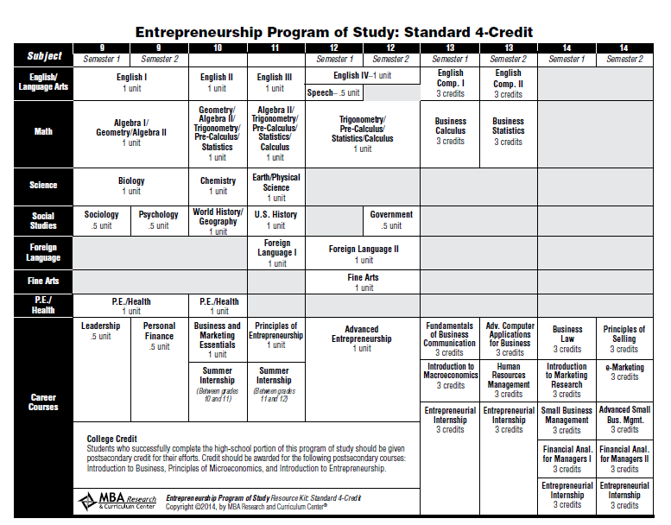
Program of Study
Notes:
This is the Program of Study grid for Entrepreneurship. Notice how there is a plan for grades 9–14.

Slide 25
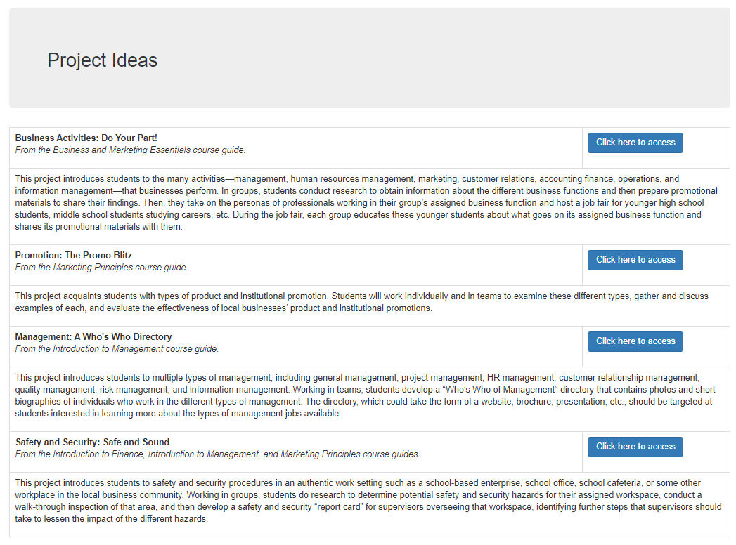
Classroom Project Ideas
Notes:
Hands on Classroom Projects is a series of project-based learning projects that can be used as PBLs or as regular projects. There are currently four free projects in State’s Connection. Those projects include: the project, the performance indicators for that project, and a step-by-step instruction guide. These are great projects that are yours to use as is or customize and can be used to help strengthen your program.

Slide 26
Classroom Project Ideas
Notes:
In this example, you see the performance indicators covered with this project. In addition, the project description and the step-by-step guide is included to assist you in bringing this project into the classroom.

Slide 27
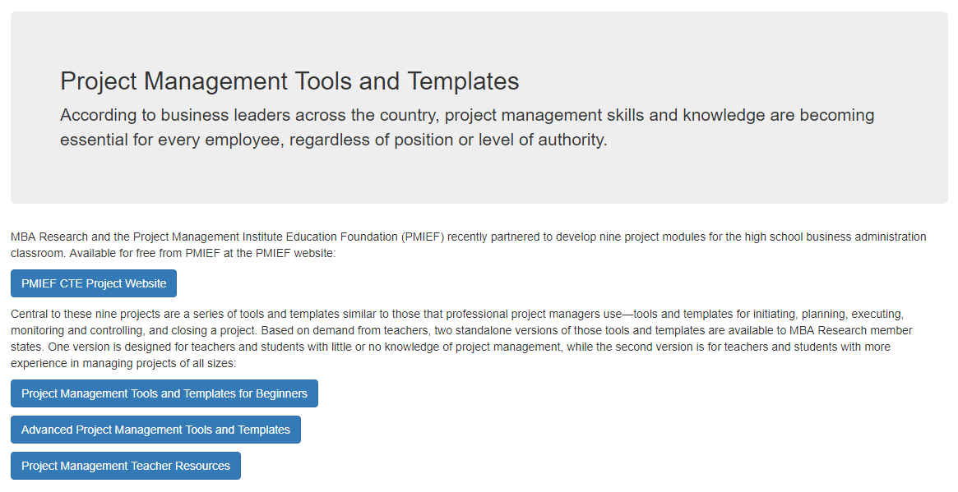
Project Management Tools
Notes:
Project Management is a fast growing “necessity” in the business world. MBA Research and PMIEF have a partnership where MBA Research created project modules for PMIEF for the high school classroom. These projects are available for free at the PMIEF website. The first link takes you to the PMIEF website. You must create an account. There are numerous resources available to you on Project Management including an instructional module for the teacher to learn project management and a module that allows you to bring Project Management into the classroom for students.
Last year, we partnered with PMIEF again to develop material on bringing project management into the classroom. There are several resources available for project management found on our website. Because these resources were developed with grant funding, there is a survey that you have to complete to get the digital downloads for those materials.

Slide 28
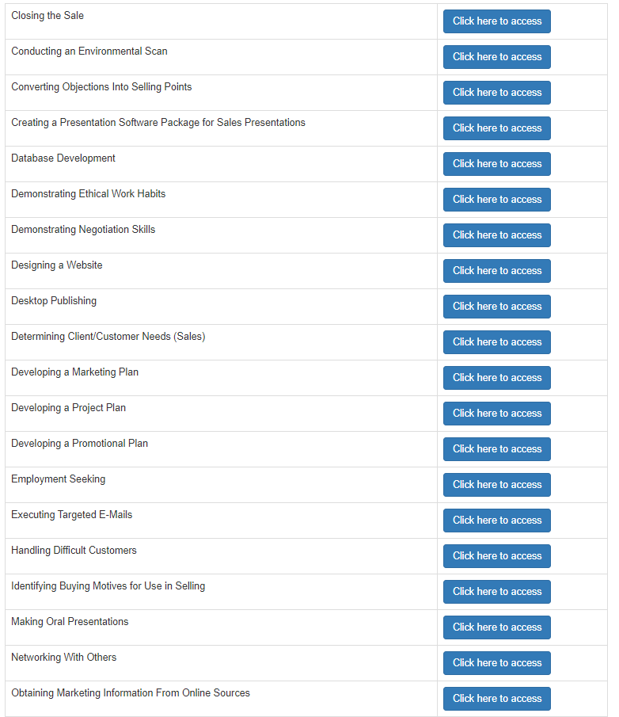
Rubrics
In-depth, research-based rubrics include three sample scenarios each.
Rubrics include detailed behavioral anchors, making them useful for both assessment and instructional purposes.
Use to assess capstone activities, for competitive event preparation, in student career portfolios.
Highly recommended for performance-oriented programs.
Notes:
In-depth, research-based rubrics include three sample scenarios each. Rubrics include detailed behavioral anchors, making them useful for both assessment and instructional purposes. Use to assess capstone activities, for competitive event preparation, and/or in student career portfolios. This is highly recommended for performance-oriented programs.

Slide 29
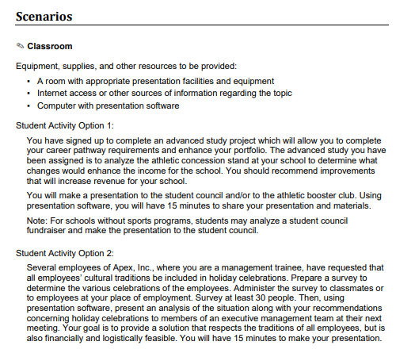
Rubrics
Notes:
Here is an example of what is included in our rubrics. This one is for Making Oral Presentations. There are two student activities that you see for the classroom. The scenarios list the equipment needed to complete the assignment, as well as provides the scenario options to choose.

Slide 30
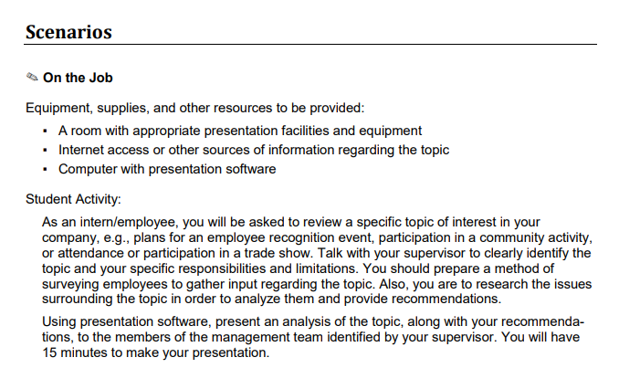
Rubrics
Notes:
This example shows the student activity that pertains to an on the job scenario. Again, the scenario provides equipment needed to complete the assignment, as well as the student activity.

Slide 31
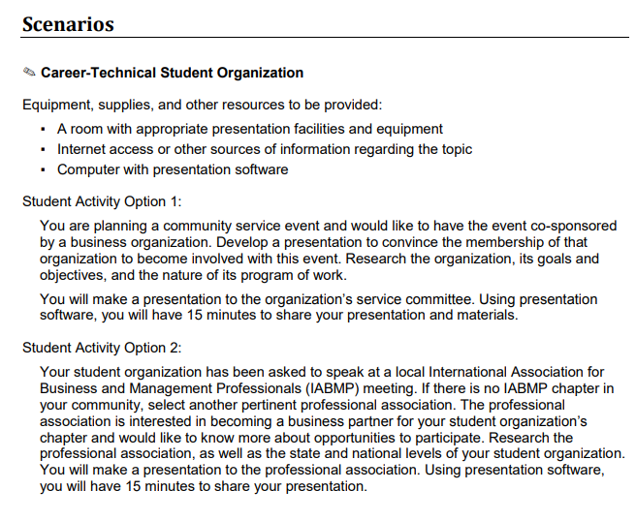
Rubrics
Rubrics
Notes:
The third scenario includes an activity for a Career-Technical Student Organization. The equipment needs and student activity options are listed.

Slide 32
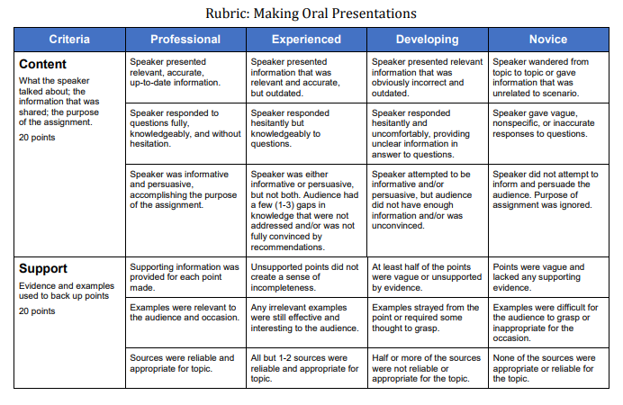
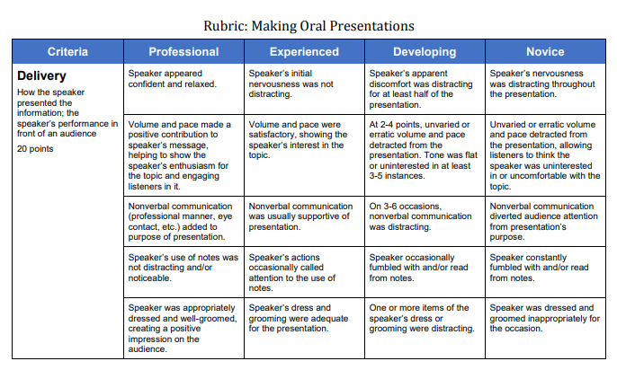
Rubrics
Rubrics
Notes:
For this rubric, there are several overall topics being assessed, known as criteria. For this topic – Making Oral Presentations, there are six total criteria identified in scoring this activity. As you can see the levels of performance (categories) range from novice to professional. Each one of these levels contain descriptors that spell out the quality of student performance. This paints a clear picture of the expectations for both you and the student in evaluating their performance. Make sure that students are provided a copy of the rubric and review it with them. Make sure they understand the terminology used throughout the rubric and how the rubric is used in the evaluation process.

Slide 33
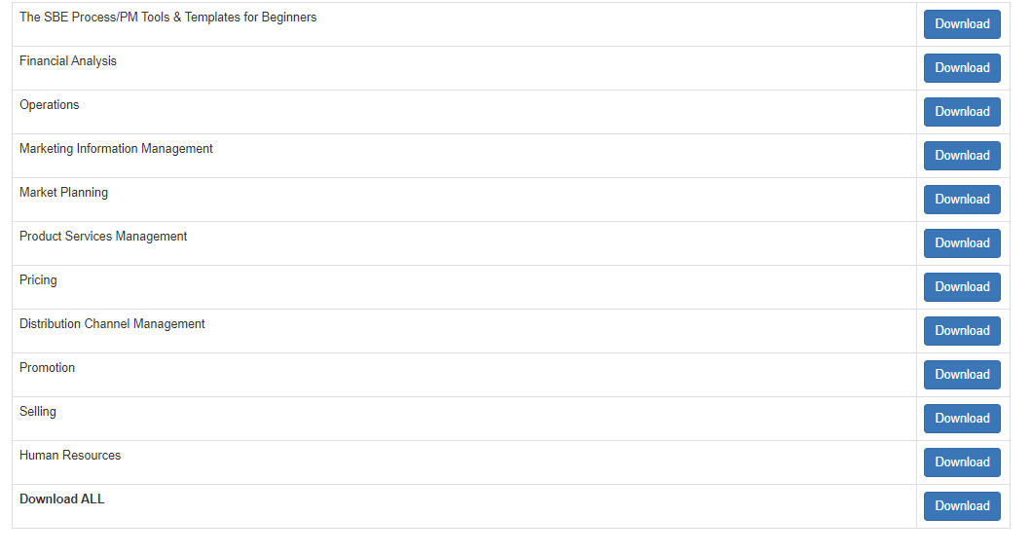
School-Based Enterprise (SBE)
Notes:
Another resource that you have access to are modules for a School-Based Enterprise, also known as SBEs.
Starting and/or running a school-based enterprise can be challenging. Making sure that your school-based enterprise provides opportunities for student learning can be even more difficult. The SBE resources located in State’s Connection were created by award-winning teachers in the classroom. A special thanks to Dr. Ann Stewart, Stewarts Creek High School, Tennessee, teacher and SBE Director extraordinaire (she and her students have started and currently operate six SBE's) for providing the resource on how to start a SBE.

Slide 34
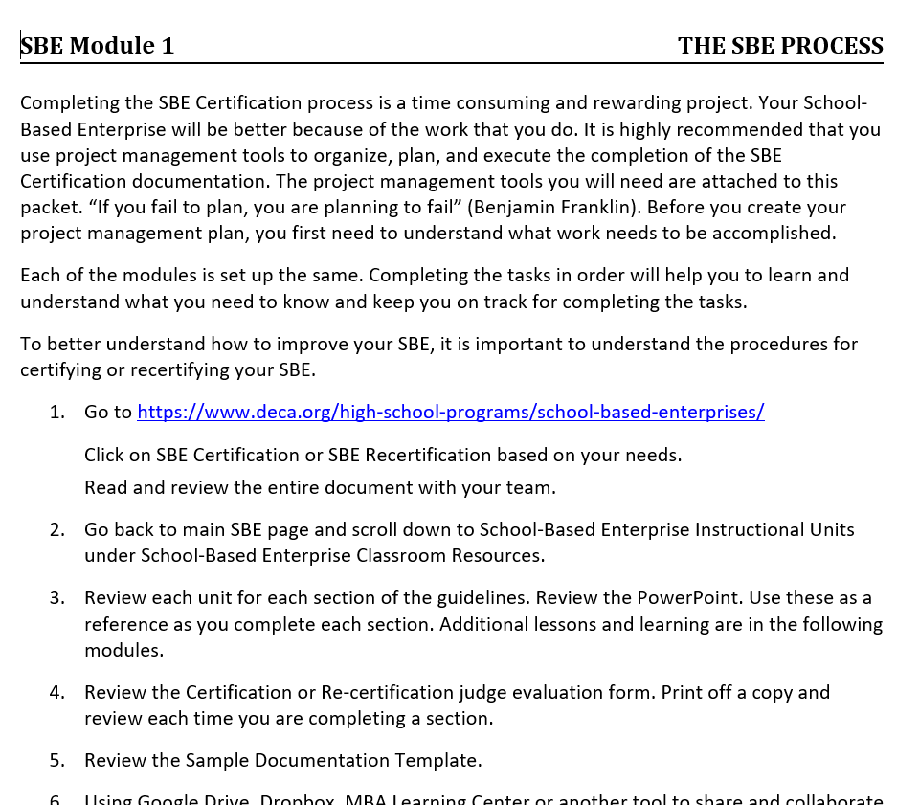
School-Based Enterprise
Resources on how to start a SBE
Activities and projects are 100% aligned with the National Standards for Business Administration
Can be used to integrate SBEs with core business administration curricula and various cluster content for entrepreneurship, finance, management and marketing
Notes:
These downloadable modules were developed as a resource on how to start a SBE. The activities and projects are 100% aligned with National Business Administration Standards to integrate SBE’s with core business administration curricula and various cluster content for entrepreneurship, finance, management, and marketing.
Here is an example of SBE Module 1 which provides guidance on completing the SBE Certification process

Slide 35
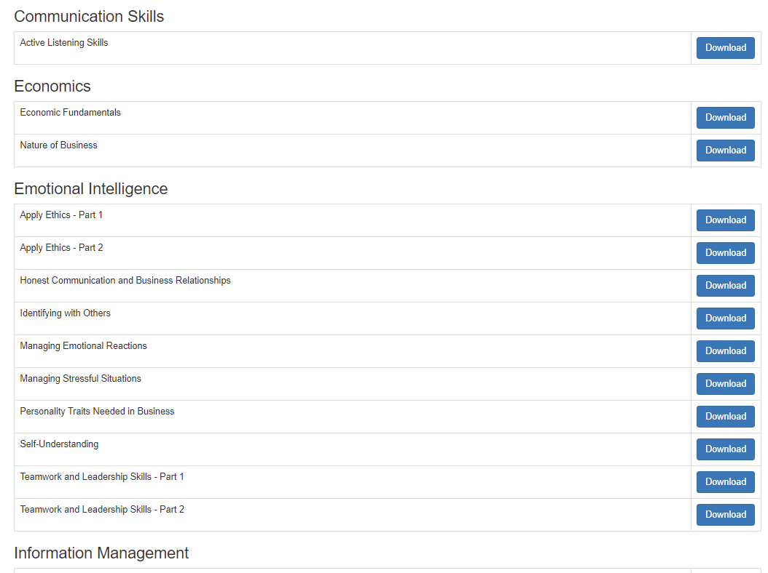
Work-Based Learning
Notes:
We have Work Based Learning Modules inside of State’s Connection. These activities are designed to strengthen student internship and other work-based experiences and to connect work experience with in-school curricula.
This is a snapshot of some of the modules that are available. They are broken down by instructional areas.

Slide 36
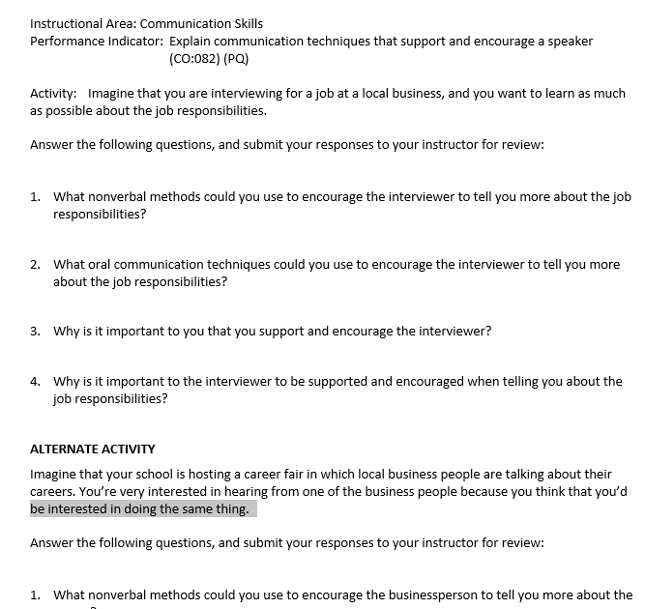
Work-Based Learning
Activities are 100% aligned with the National Standards for Business Administration
Used to strengthen student internship and other work-based experiences
Significant implications for most work-based experiences, not just the business administration core
Notes:
Our work-based learning activities 100% align with National Business Administration Standards to strengthen student internship and other work-based experiences and to connect work experiences with in-school curricula. Oriented to the business administration core, but with significant implications for most work-based experiences. Activities referenced by Performance Element in the National Business Administration Standards with each Element containing multiple Performance Indicators. Click the button to download activities for the Performance Indicators in each Element.
In this example, the instructional area is Communication Skills. The performance indicator is identified, which ties to the National Standards for Business Administration. The activity is providing a scenario for the student, in this case the student is imagining that he/she is interviewing for a job at a local business, and he/she wants to learn as much as possible about the job responsibilities. A series of questions are given to the student to think about responses and communication techniques that could be used during the interview. The assignment is for the student to answer the questions and submit to the teacher for review.

Slide 37
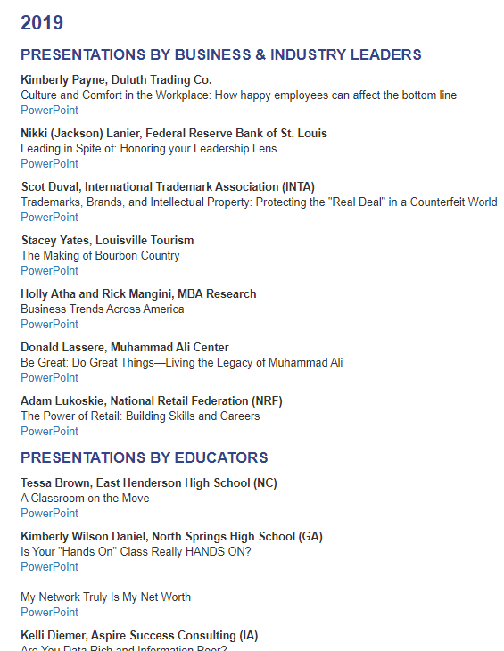
Conclave Speaker Materials
Access to presentations from previous MBA Conclaves
Access to handouts from presentations provided during the sessions
Notes:
Speaker Materials from previous Conclaves are available in State’s Connection. The speaker materials are from business and industry leaders and educators throughout the country. You may find some of these topics helpful, particularly those from other teachers who often share best practices.

Slide 38
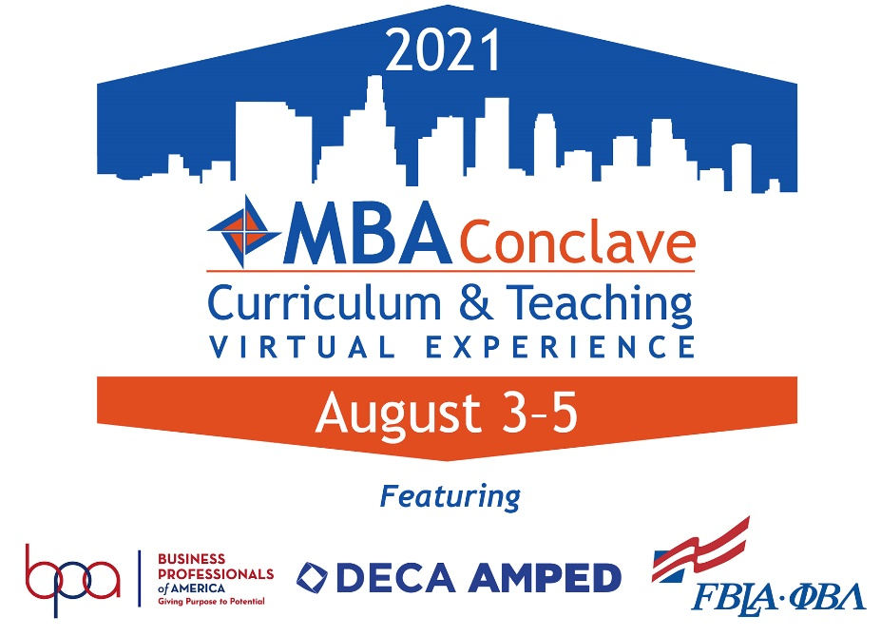
MBA Conclave Curriculum and Teaching Conference
The premier gathering for Business, Marketing, Finance, Management, and Entrepreneurship educators
Notes:
Each year, MBA Research & Curriculum Center hosts the MBA Conclave. This curriculum and teaching conference is the premier gathering for business, marketing, finance, management and entrepreneurship educators. The goal of Conclave is to provide teachers and administrators with a comprehensive overview of contemporary curricula, pedagogy and program development strategies, including dialogue with leading educators and industry executives.
Presenters at Conclave include senior-level Fortune 1000 managers, entrepreneurs with a unique story, and leading educators, including successful classroom instructors. This year BPA, DECA, and FBLA are all a part of Conclave. Each CTSO will have their own track of sessions for advisors. The best part is that in celebration of our 50 year anniversary, registration is FREE. We would love to have you join us for this special event!

Slide 39
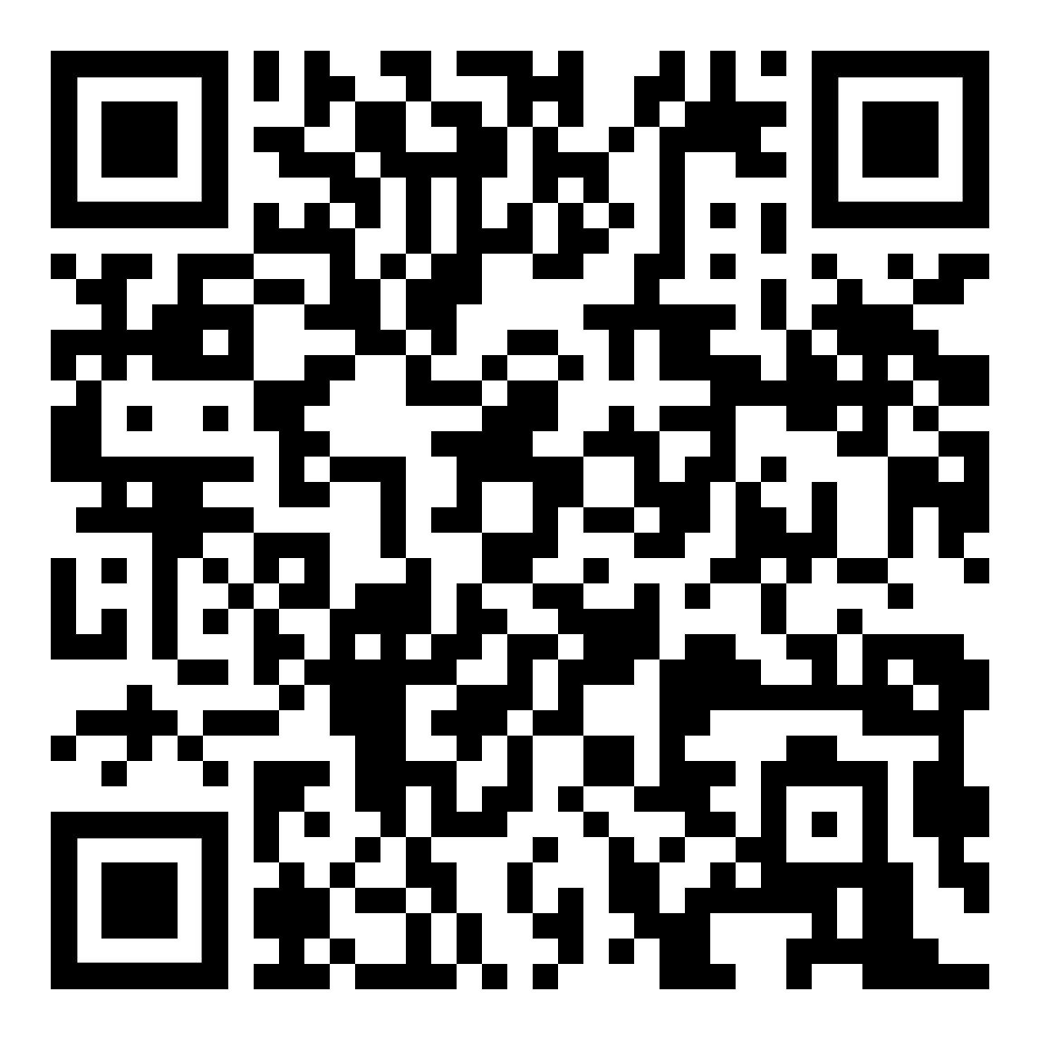
Free ethics resources
Access to MBA Research Course Guides
Access to 72 LAP modules on ethics
Access at mbaresearch.org
Select Ethics Resources in the Quick Links box
Notes:
There are additional resources available on our website. Thanks to the Daniels Fund Ethics Initiative you have access to free ethics resources that consist of two Ethical Leadership Course Guides and 72 LAPs on ethics. You also have access to our other course guides at no additional charge. There is a survey that you need to complete to access those. The QR code can take you directly to the webpage on our website or you can access the webpage by going to mbaresearch.org and selecting Ethic Resources under the Quick Links. There is a short video that tells you how to access the resources as well as written instructions.

Slide 40
Free project management resources
Access at mbaresearch.org
Select Curriculum/Teaching tab
Select Project Management
Access in State’s Connection
Notes:
We also have free project management resources available. MBA Research has partnered with the Project Management Institute Educational Foundation (PMIEF) to develop educational resources to help teachers bring project management into the classroom. You can access project management resources to take students to a higher level of learning for FREE! You can use the QR code to go straight to the webpage on our website or you can go to mbaresearch.org, select the Curriculum/Teaching tab and select project management. The link is also available in State’s Connection.

Slide 41
Questions?
Notes:
Are there any questions?

