Slide 1
Integrating Educators Rising into Education and Training Classes
Beth Cosentino, M.S.
Family Consumer Science Teacher, Omaha, NE

Slide 2
About ME

Slide 3
What is Educators Rising?
Previously Future Teachers of America
Pipeline for students to become future teachers
Educators Rising
Educators Rising Collegiate
Competitions (State & National)
Diversity
Teacher quality
PDK
Notes:
Educators Rising is a community-based model, in which chapters at schools feed teacher preparation programs at institutes of higher education with the support of State Departments of Education and local funders and foundations. These entities come together to provide a clear pathway to increase teacher diversity and teacher quality.
Educators Rising is a career and technical student organization (CTSO) in which 1) Chapters provide our 51% diverse students a place for support and networking, a strong 2) Curriculum delivers a structured way for students to prepare for their future profession, while 3) Competitions give students a chance to prove themselves as professionals, and 4) Conferences provide a national stage in which to network and be recognized for their achievements to the profession and develop the, 5) Collegiality that comes from being part of a network, a family of professionals, and a movement.
Educators Rising Collegiate provides Teacher Prep and Education Policy Programs a reliable pipeline of passionate aspiring educators from high school programs. Our collegiate chapters help grow the profession by offering supports to keep students on the path to graduate and get certified, while our diversity programming is designed to lower the access gap with respect to content and ability to pass state summative assessment requirements.
After all, it costs an average of $10,000 to recruit and onboard a teacher and almost 60% of teachers come back and teach within 20 miles of where they went to school. With 51% of Educators Rising members being students of color AND being 400% more likely to stay with their aspirations from high school to enter the teaching field than to enter other fields (such as medicine, law, or engineering), shouldn’t your community have an Educators Rising Program to ensure that you can grow your own teachers?

Slide 4
Offered by Educators Rising
Curriculum Options
Curriculum
Micro-Credentials
Standards for Rising Educators

Slide 5
5 Ways to Incorporate Educators Rising Into Your Classroom
Notes:
How my Intro to ed class works. Teaching 2 days a week and practicum on 3rd day.

Slide 6
Incorporating Educators Rising into the Classroom
Use competition as grade
Extra credit if competing at State

Slide 7
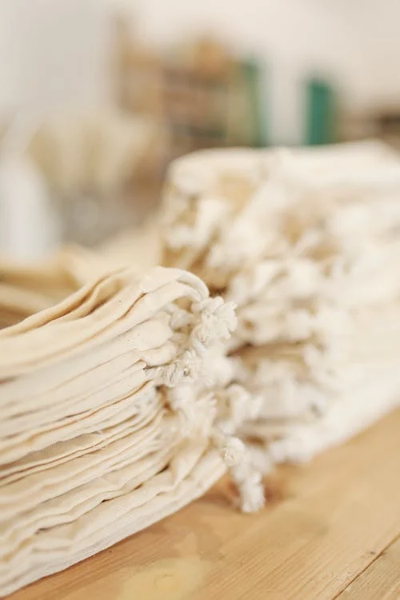
Incorporating Educators Rising into the Classroom
Service project

Slide 8
Incorporating Educators Rising into the Classroom
Use scenarios from competition for teaching about ethics

Slide 9
Incorporating Educators Rising into the Classroom
State Leadership

Slide 10
Incorporating Educators Rising into the Classroom
EverFi modules on diversity

