Slide 1
SketchUp in Interior Design
Shelby Bockelmann

Slide 2
Welcome!
Please answer the following questions in the Zoom Chat:
Do you currently use technology in your interior design classroom? If so, what types of technology do you use?
Today I will be using:
SketchUp Pro (downloaded to my device)
SketchUp for Schools (Google App)
Simply learning through observation today!

Slide 3
Introduction
Shelby Bockelmann
Family & Consumer Sciences Teacher
Millard South High School
Omaha, NE
Wayne State College, 2016
Bachelors in Family & Consumer Sciences Secondary Education
Wayne State College, 2020
Masters in C & I Leadership and Family & Consumer Sciences

Slide 4
Objectives
The attendee will demonstrate technological skillsets through the application of SketchUp.
The attendee will be able to apply information to classroom instruction to enhance and strengthen career development in the interior design classroom.
The attendee will be able to teach to the postsecondary and industry standard of technology use in interior design.

Slide 5
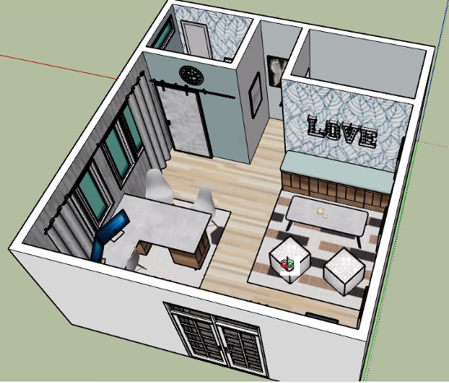
Agenda
Purpose of SketchUp Use
Teaching with SketchUp
Demonstrations on SketchUp
Project Ideas & Student Examples
Final Notes and Conclusions

Slide 6
SketchUp for Interior Design
Why:
Postsecondary Recommendation
Industry Standard
3D Demonstration of Design Ideas
When:
1st Manual Drafting
2nd SketchUp
Notes:
Aligned CTE Programs
Systemic Career Development
Student Achievement
(wall thickness, door sizes and types, etc.)
Then move to SketchUp where students practice the same skills on the computer.
Next, teach about bathroom design – then practice on SketchUp
Kitchen Design – then practice on SketchUp

Slide 7
Teaching with SketchUp
How:
Teach alongside traffic patterns and home design
Demo each step with the students
Save projects frequently with new project names
Example: Bockelmann 1.0, Bockelmann 1.1, Bockelmann 1.2
Have project checks
Expect progress, not perfection!

Slide 8
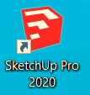
Demonstrations on SketchUp & “How To” SketchUp 2020
Notes:
Share how to document with teachers

Slide 9
Projects with SketchUp
Project Ideas:
House/Apartment (single story – 1 bedroom)
Tiny House Project
Elements & Principles of Design Project (single room)
Room Makeover
Classroom Design
Possibilities are endless!
Notes:
Interior Design firms, soccer stadium, hair salon, parks, shopping areas, pools, etc.

Slide 10
Student Project Examples

Slide 11
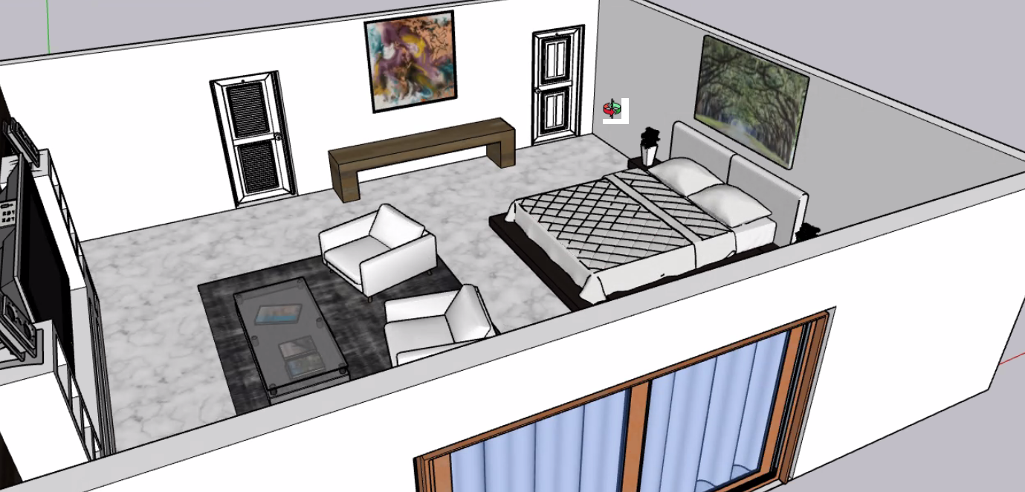
Gavin W.

Slide 12
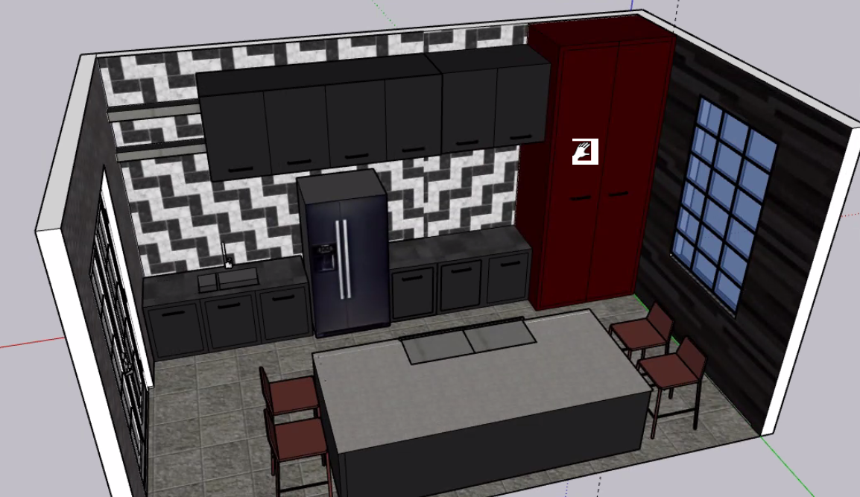
Lexi C.

Slide 13
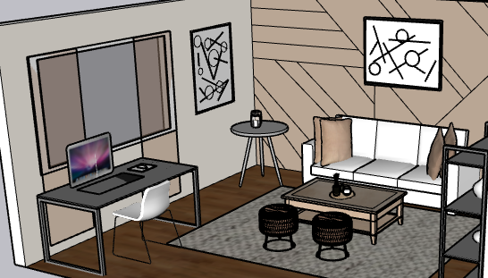
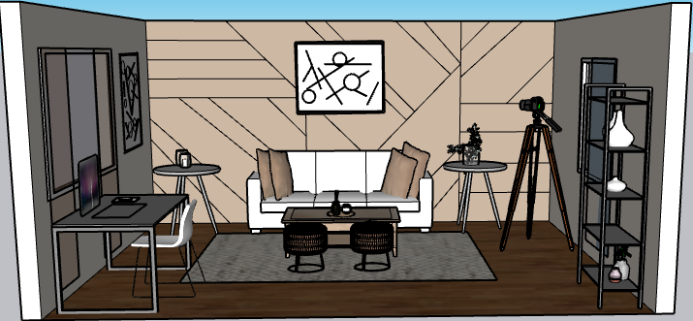
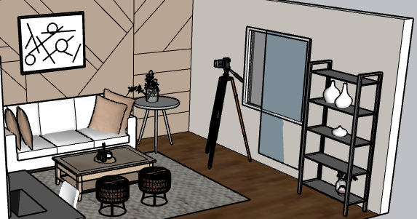
Hillary L.

Slide 14
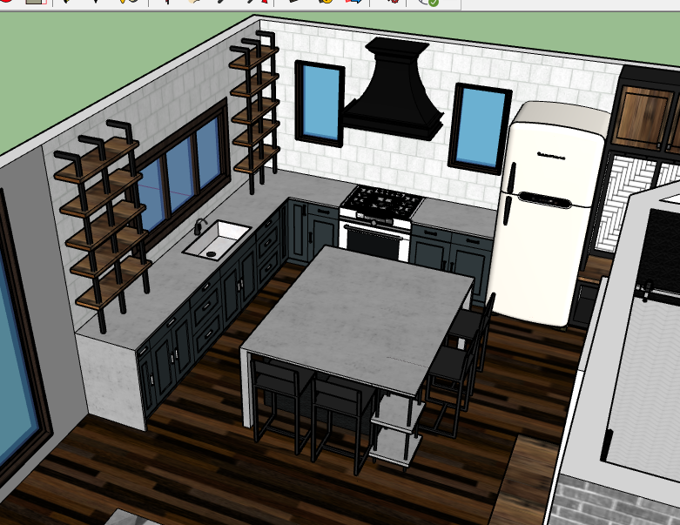
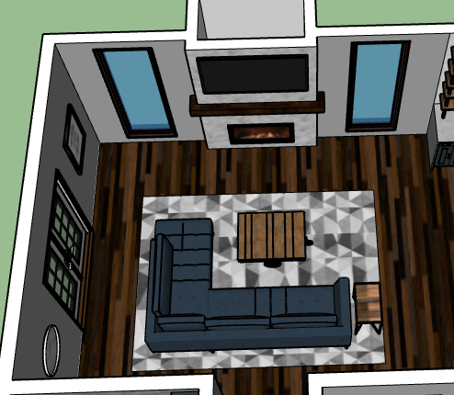
Mia N.

Slide 15
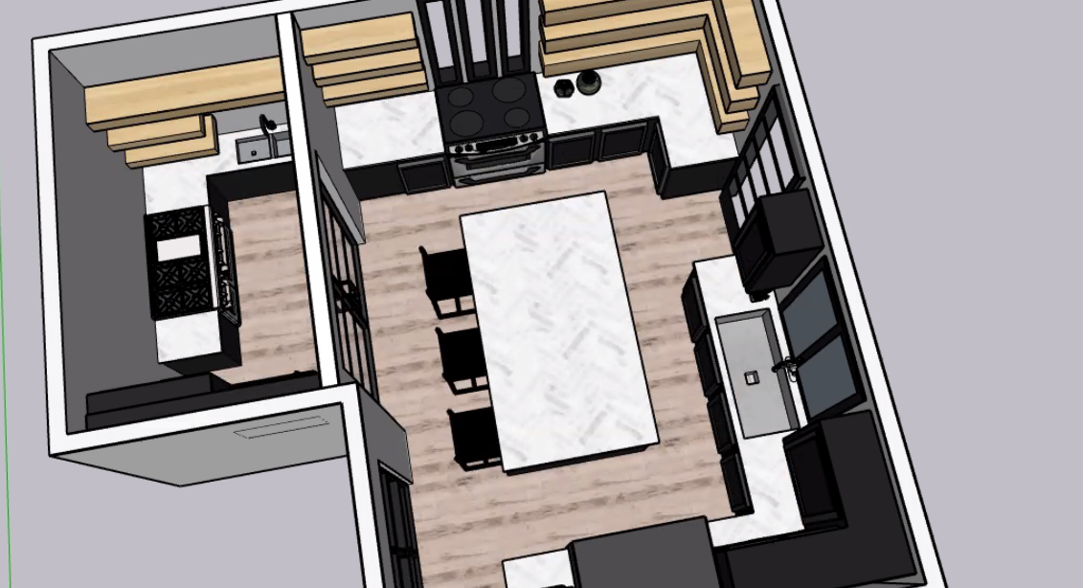
Persephyne S.

Slide 16
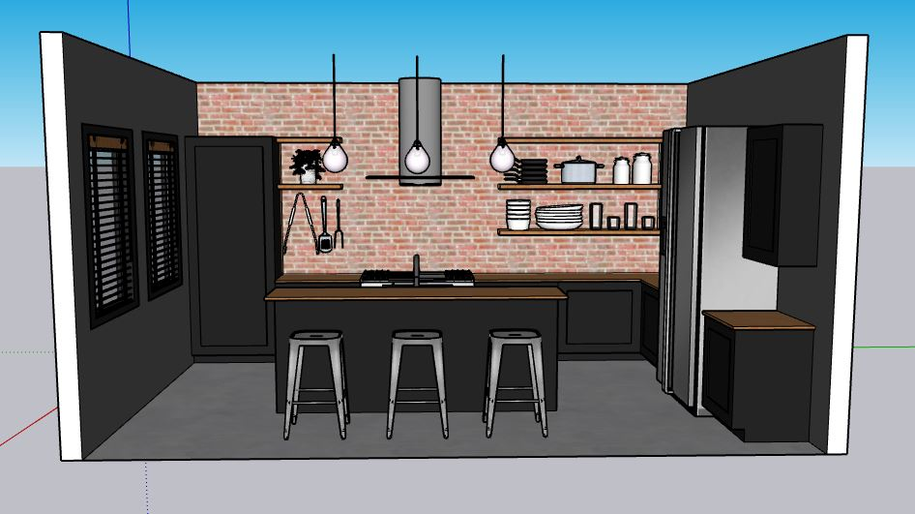
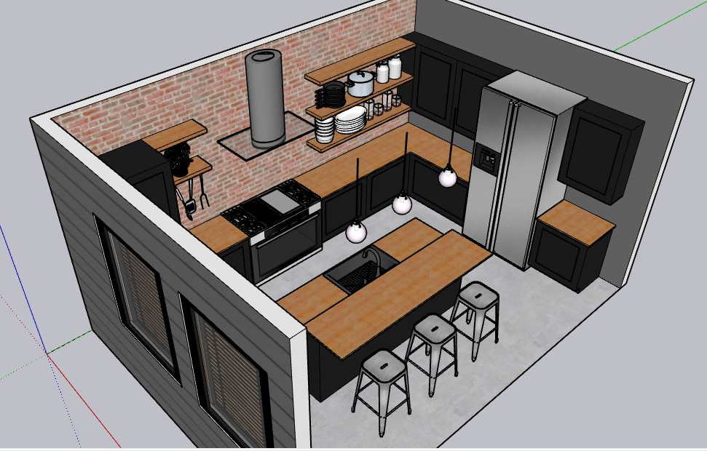
Allison I.

Slide 17
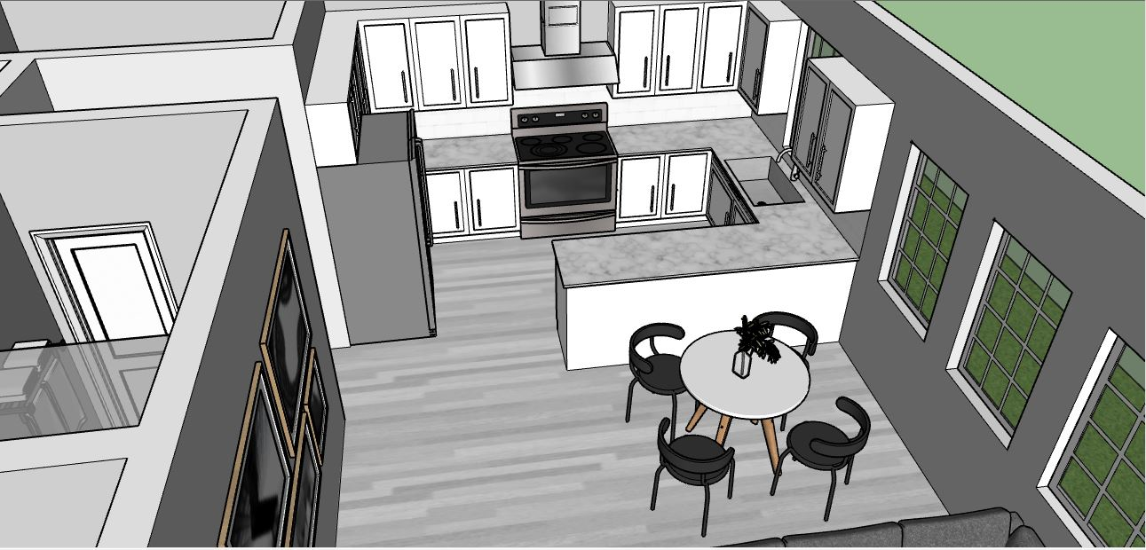
Allison I.

Slide 18
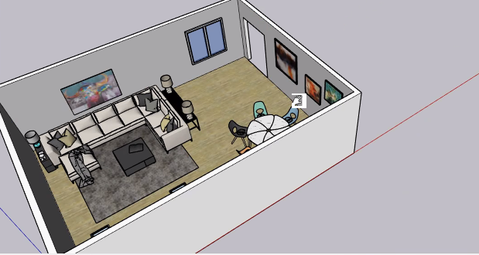
Preslee W.

Slide 19
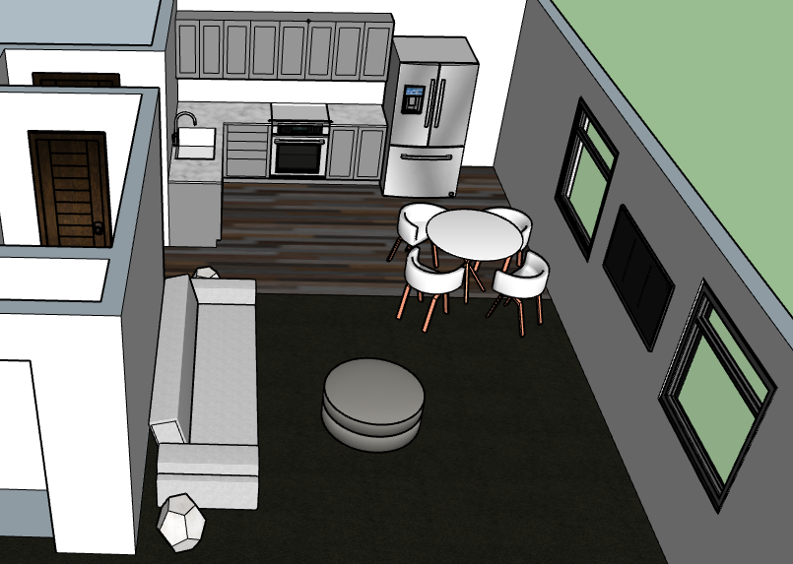
Addison Z.

Slide 20
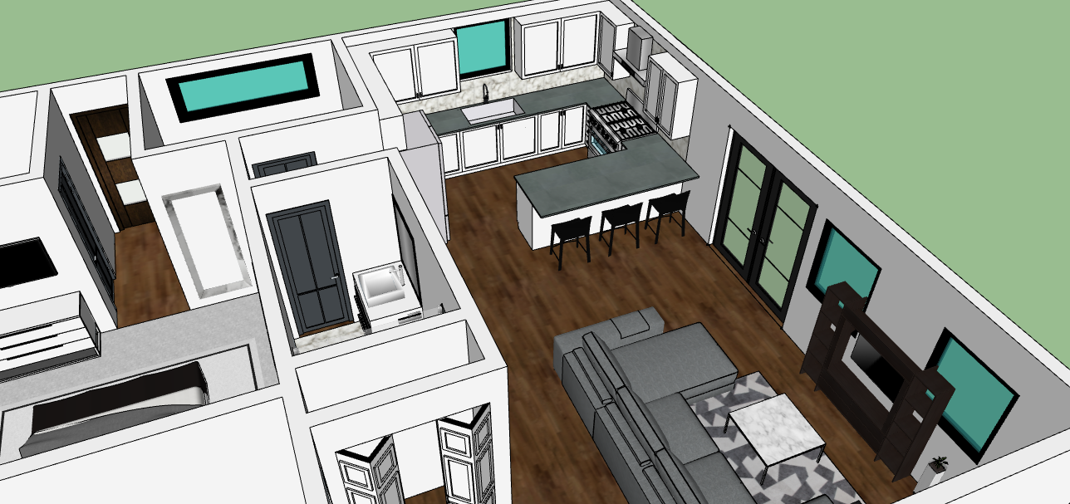
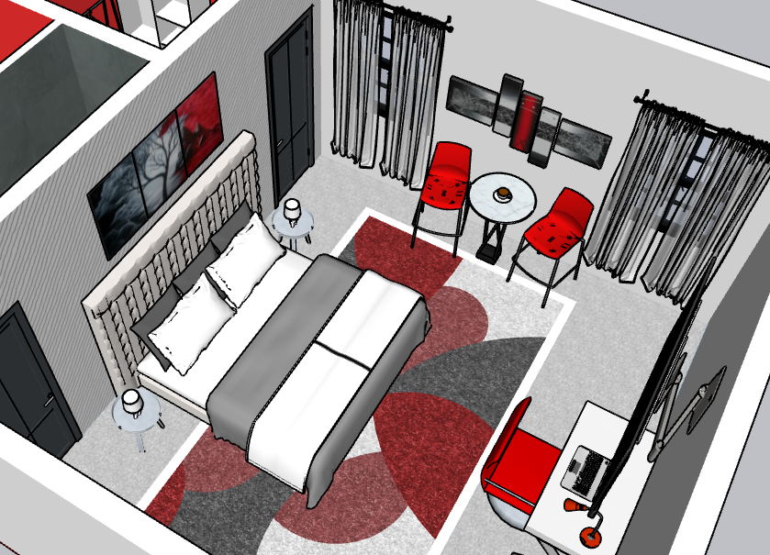
Nevaeh W.

Slide 21
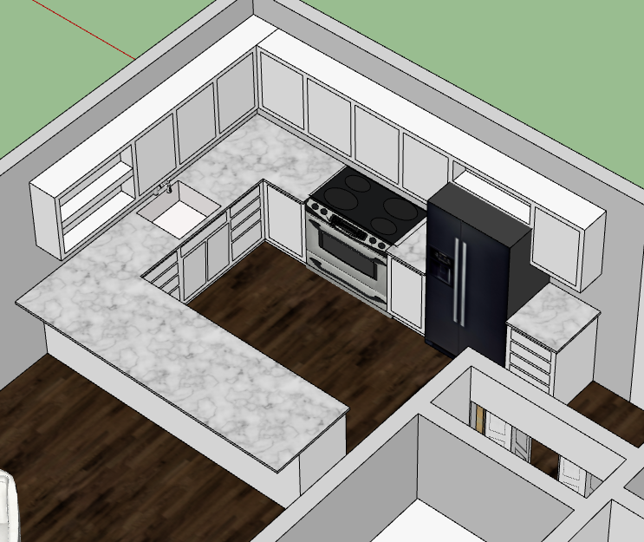
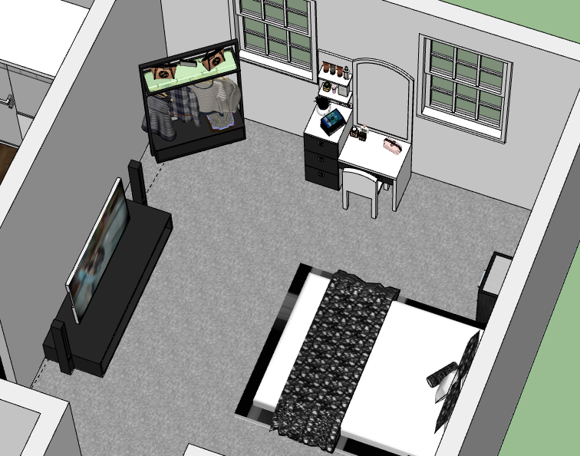
Amiah S.

Slide 22
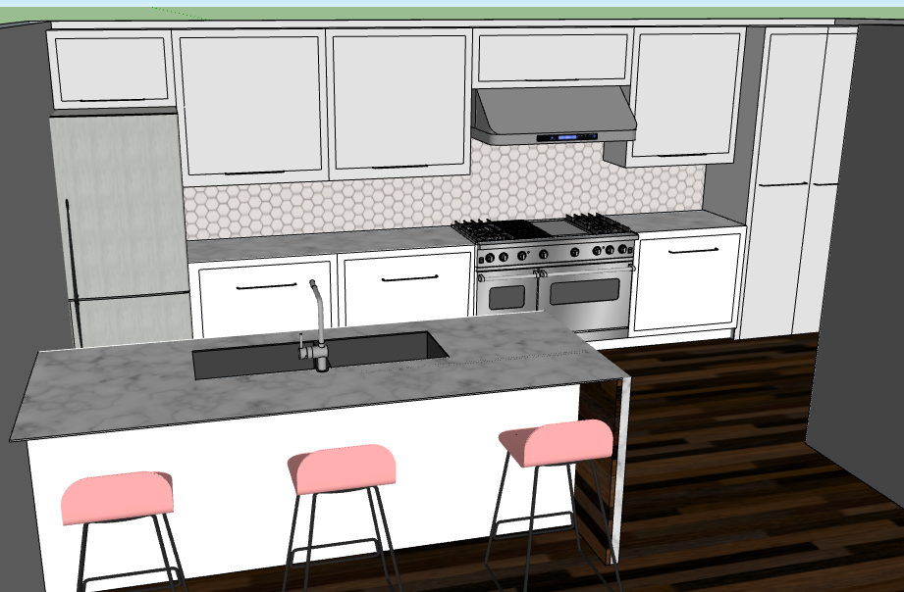
Lexi P.

Slide 23
Final Notes:
PROCESS > PRODUCT
Encourage students to explore beyond program limitations
Always start with manual drafting on paper
Save frequently and have fun!
Notes:
Students are not going to experts! It is a learning process!
Invite the Technology Department in to help with setup!

Slide 24
Questions?

Slide 25
Shelby Bockelmann
Family & Consumer Sciences Teacher
Millard South High School
Contact: slbockelmann@mpsomaha.org

