Slide 1
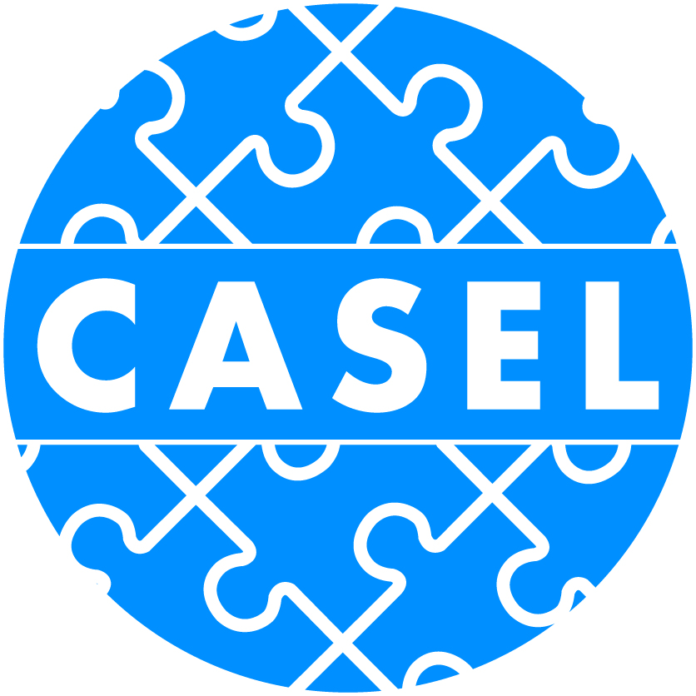
Social and Emotional Learning for the New Way of Work
Dr. Dana Godek Pat Connor

Slide 2
Welcoming: What was your first job?
How have you used those skills in your career?
How are you using those skills now?

Slide 3
What is Social Emotional Learning?
Social and emotional learning (SEL) is an integral part of education and human development. SEL is the process through which all young people and adults acquire and apply the knowledge, skills, and attitudes to develop healthy identities, manage emotions and achieve personal and collective goals, feel and show empathy for others, establish and maintain supportive relationships, and make responsible and caring decisions.

Slide 4
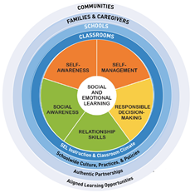

Slide 5
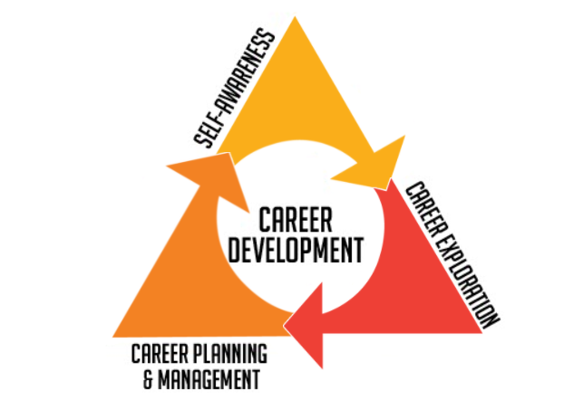

Slide 6
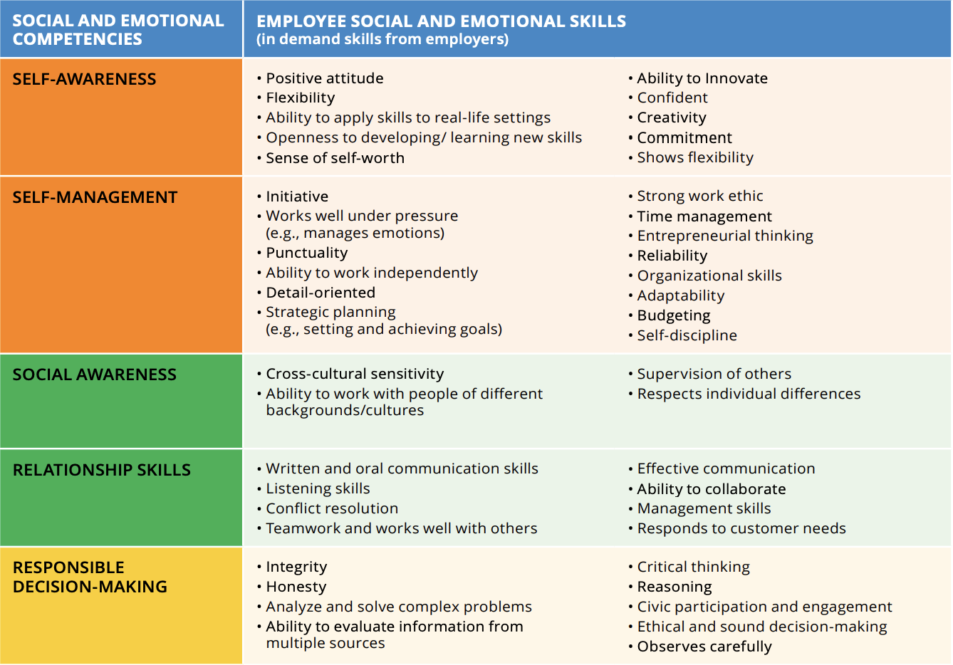
Employers are Seeking SEL Competence

Slide 7
SEL and Workforce Integration: State Examples
Delaware:
Community of practice
Guidance for the field
Integrated standards
Kansas:
Community of practice
Resources for the field
Wisconsin:
Community of practice
Guidance for the field
Nebraska:
NE Career Development Model
Policy Guidance

Slide 8
Inspiration: Future of Workforce

Slide 9
Themes in SEL/Workforce COPs
Integrated crosswalks
Strategic prioritization
SEL cross training
Advisor counselor professional learning
Resources and tools for the OST field

Slide 10
Optimistic Closure:
Think back to that first job, what gift could you give that youth now?

