Slide 1
School Based Enterprises that Work: a Panel Discussion
Matthew Burg, Kalen Carlson, Janet Shelbourn, and Jan Osborn

Slide 2
Meet our Panelists
Matthew Burg, Fremont High School
Kalen Carlson, Westside High School
Janet Kilbourn, Cody-Kilgore
Jan Osborn, Sargent High School

Slide 3
Deja Brew Fremont High School

Slide 4
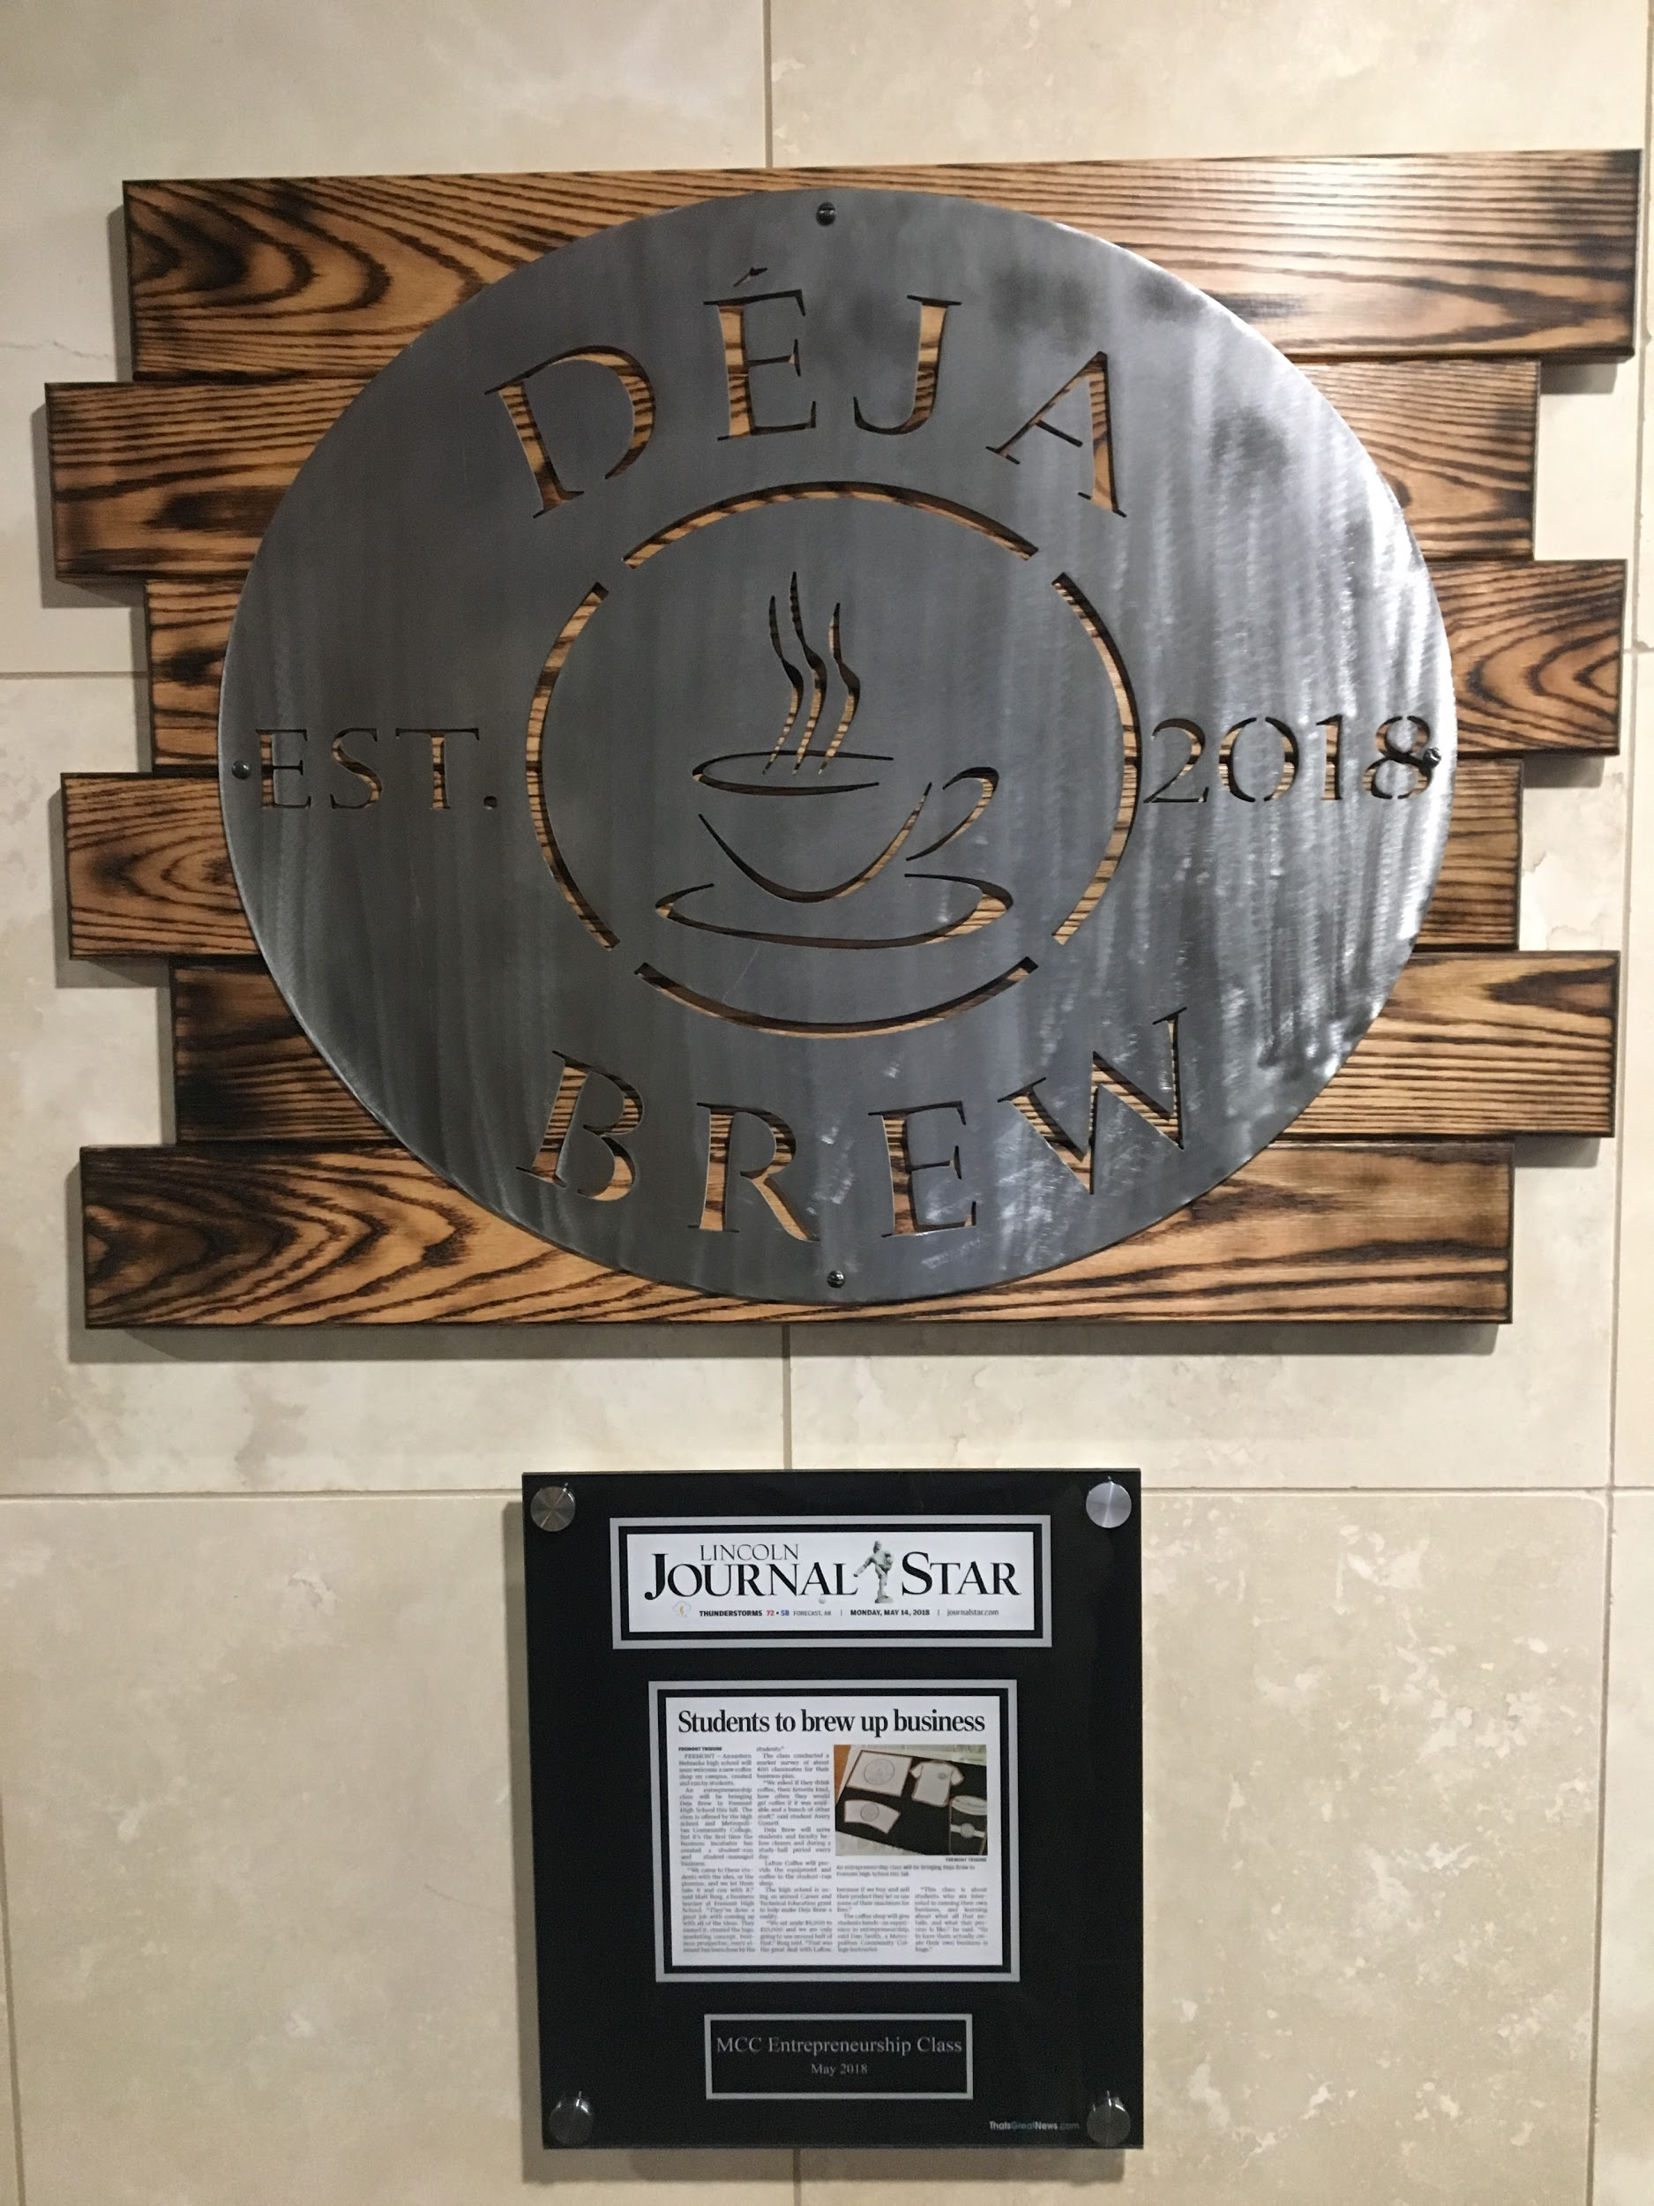
Background
Started in 2018
Funded through the Perkins Grant
Incubation took place during the 4th quarter of 2018
Grand Opening was August of 2019
Completely student run and operated

Slide 5
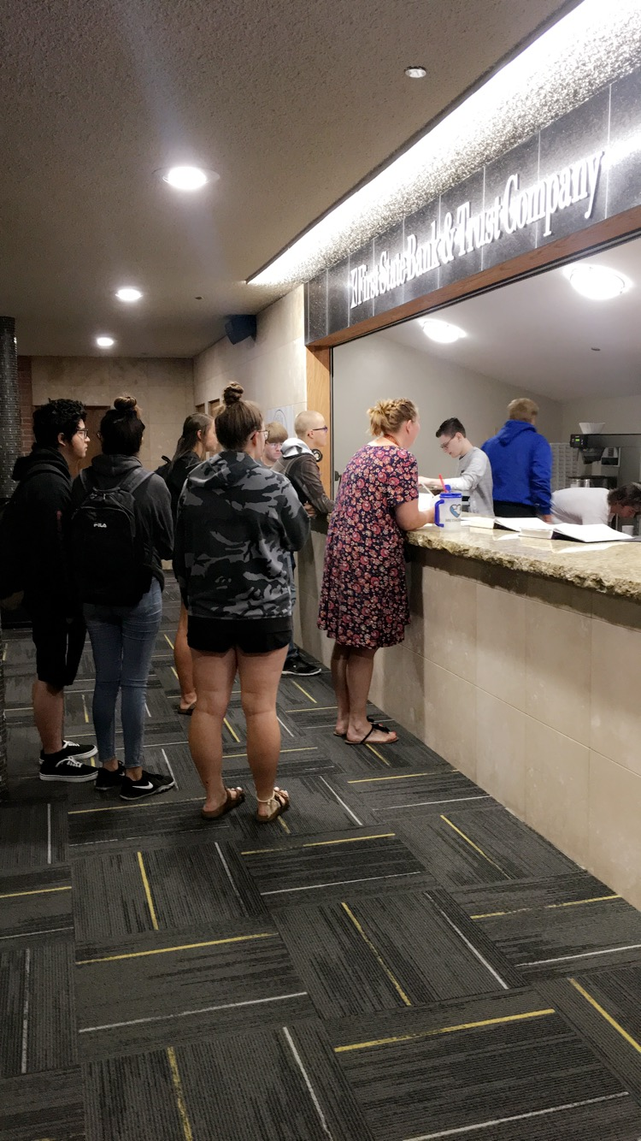
Operation
We are open daily from 7:00-7:45 and 3:10-3:45 (before and after school.
We serve staff and students during that time.
Students are in charge of the entire operation of the shop.

Slide 6
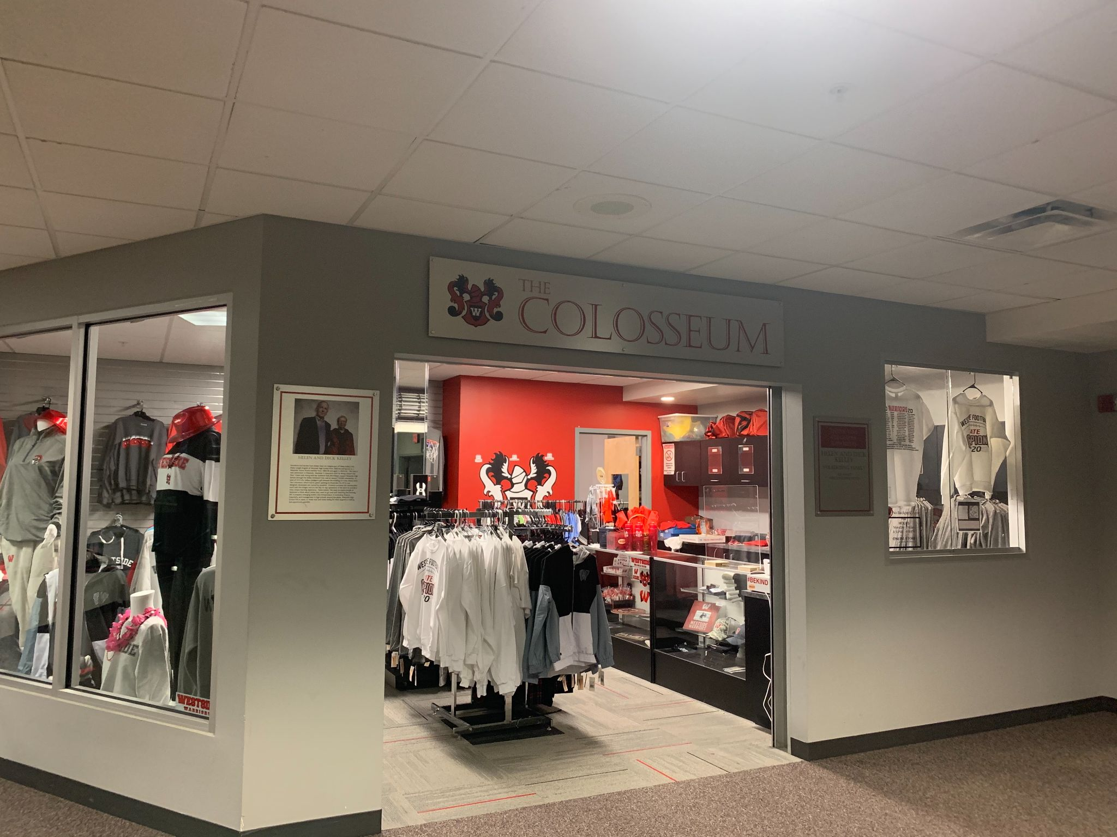
The Colosseum
Westside High School

Slide 7
History
Current store opened in December 2015
Made possible by a gift pledged by supporters of Westside
Students help purchase merchandise, design apparel, print apparel, work with the budget and run day-to-day operations
Students must be in Marketing 1 or Marketing 2 (juniors and seniors) to run the store on their own
Business principles class (sophomores) has started to also take on the store working with smaller orders

Slide 8
Growth
Have been recognized as a gold-level SBE through DECA for ….. Years in a row
Average sales between $40,000-$60,000
Bundle theme shirts during football season
New website this year, still working on how to make it the best version it can be
Partnerships with middle school and all 10 elementary schools in district
Starting to look to work more directly with athletic teams

Slide 9
Tips
Don’t be worried about students messing something up...at the end of the day, it’s usually just a $2 t-shirt
Sell everything, even the mess-ups, people will pay at least something for it
Never stop looking for the best deals. This sounds like common sense but it’s easy to get stuck with one wholesaler because of convenience when you could possibly find better deals elsewhere
Don’t be afraid to fail. Some things seem like great ideas and end up making no money. Some things seem like ok ideas and end up working out great!

Slide 10
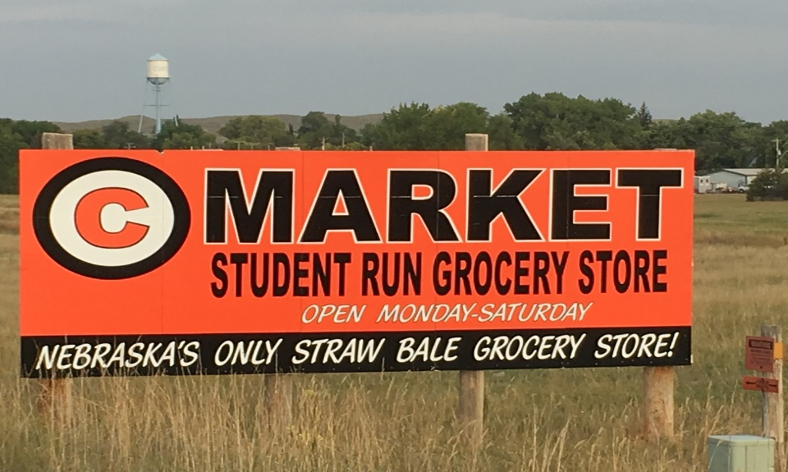
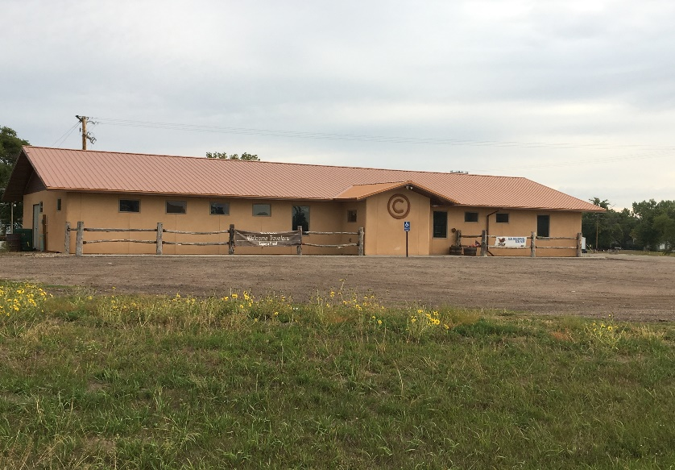
Circle C Market
Made possible by an
inner-local agreement and store board
that includes the village, school,
and GRIT board members

Slide 11
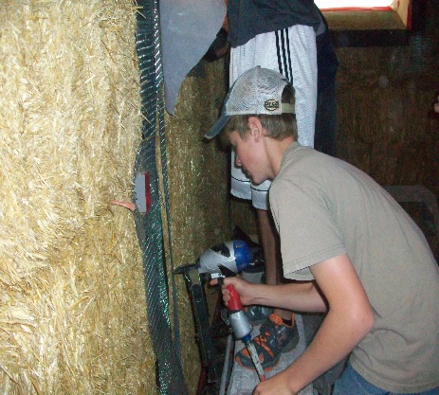
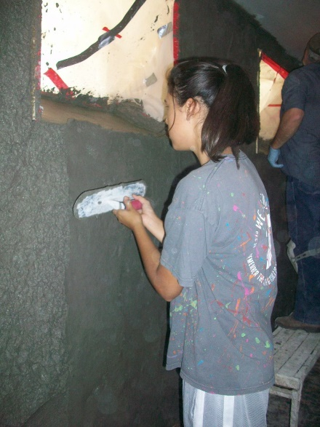
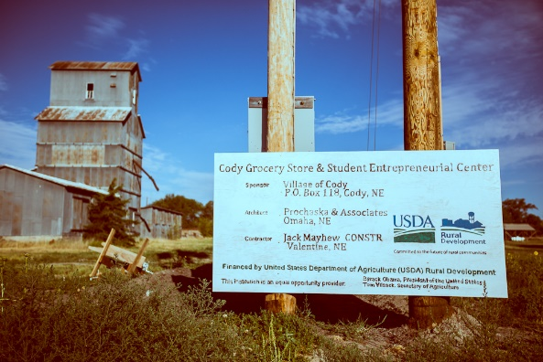
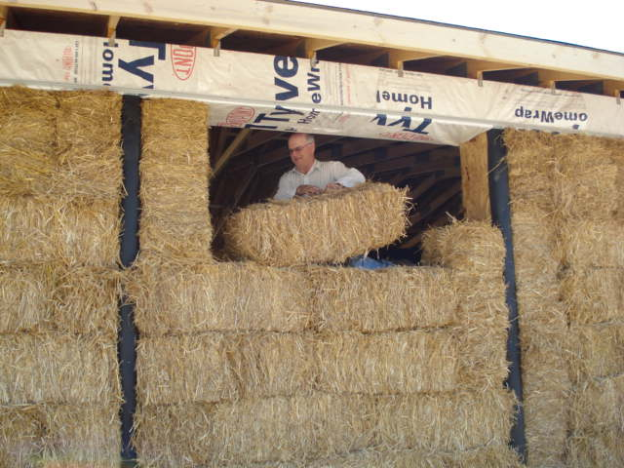
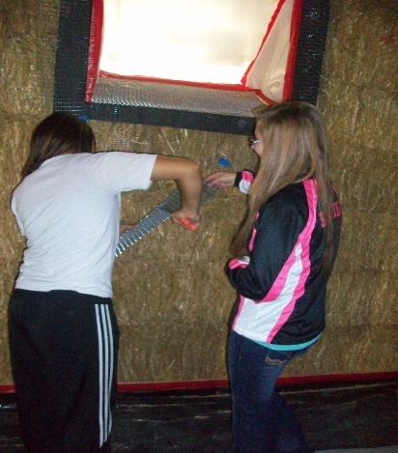
It took a community to build…

Slide 12
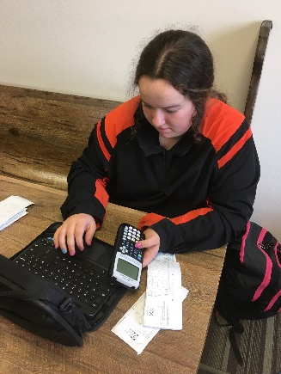
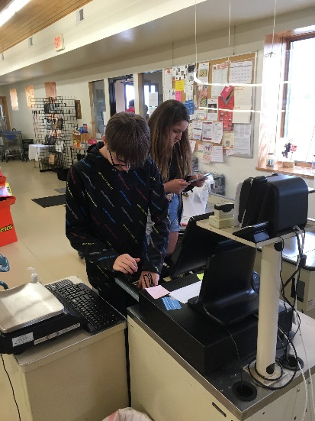
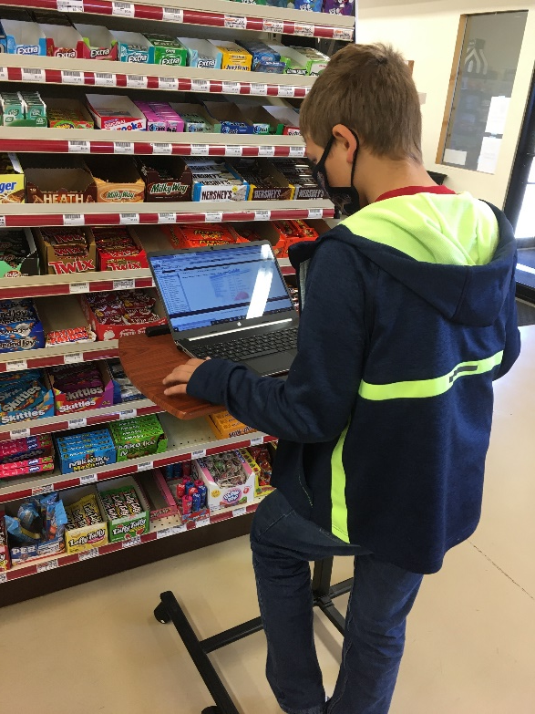
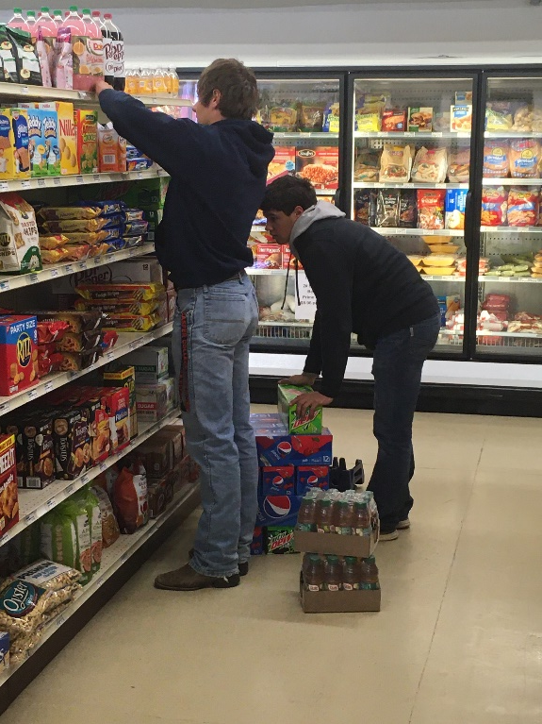
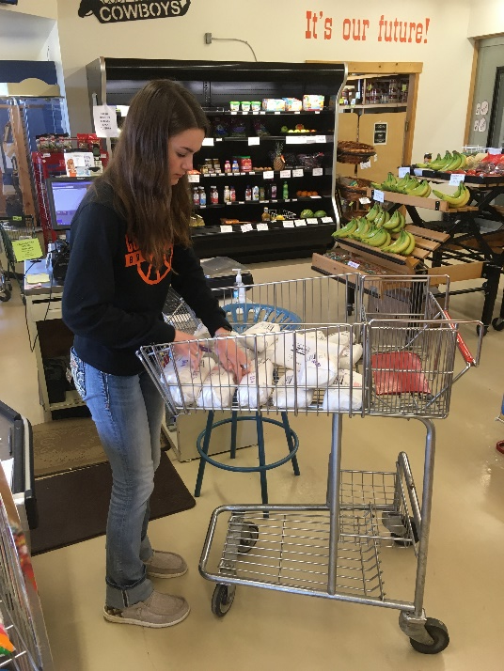
And we work hard…

Slide 13
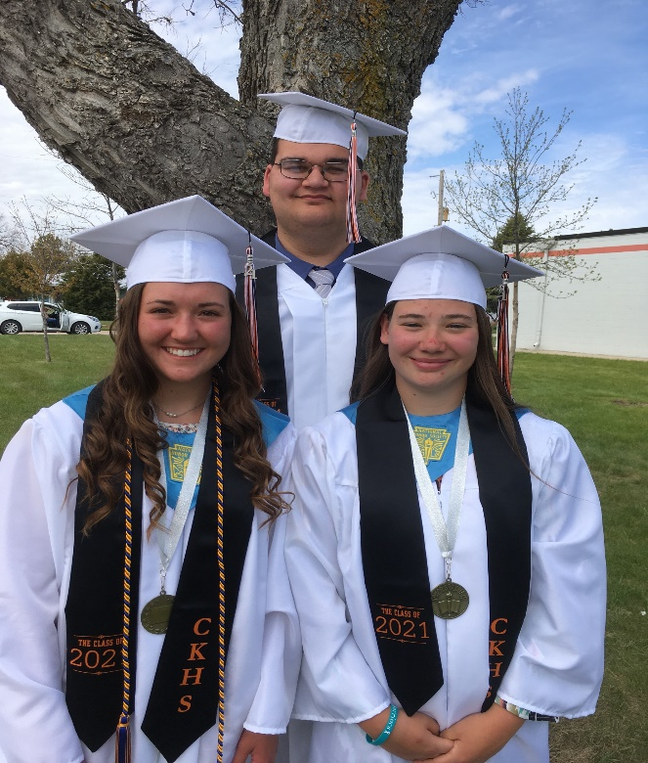
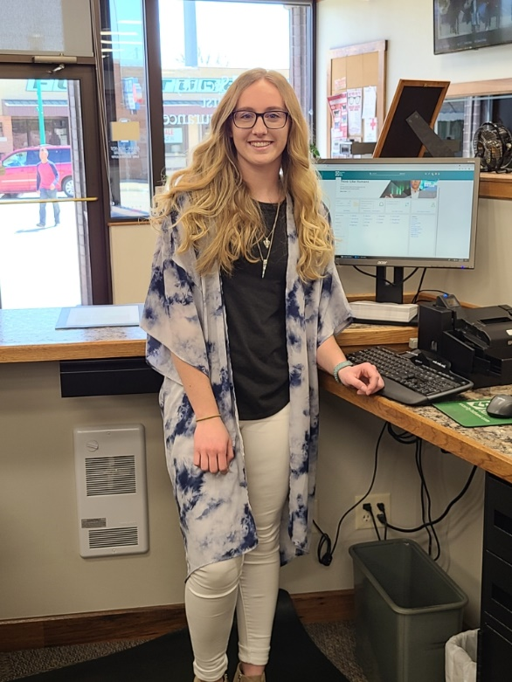
And continue to dream and move on to bigger things!

Slide 14
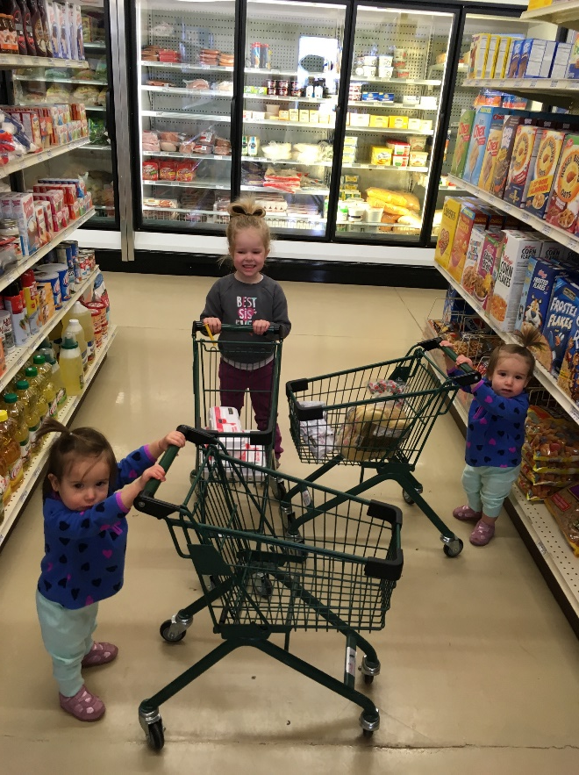
The Next Generation!

Slide 15
School Based Enterprises Sargent Public Schools
Jan Osborn, Sargent Public Schools

Slide 16
Wolf Den –School Apparel Store
Opened in November 2011
Year after co-op for sports
Run by Sargent FBLA
Open during events
Officers/Adviser plan needs for the year

Slide 17
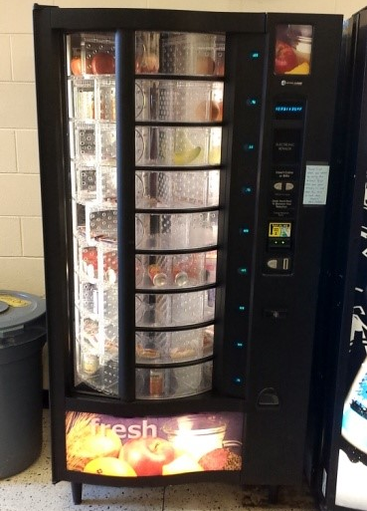
Healthy Snack Vending Machine
FBLA Managed
Revolution style
Donations/Fundraising bought the machine
Purchase food from local grocery store
Use USDA Smart Snacks in Schools standards

Slide 18
S’Cool Beans Coffee Shop
Entrepreneurship class – Febr 2019
3 mornings/week 7am-8am
Home events
Moved downtown for the summer 2019
Mond-Fri 7am-11am
Fall 2019-Febr 2020
Back at school
Febr 2020 – only open for open events
State review of food service
Closed morning hours
Summer 2020
Moved back downtown – COVID restrictions

Slide 19
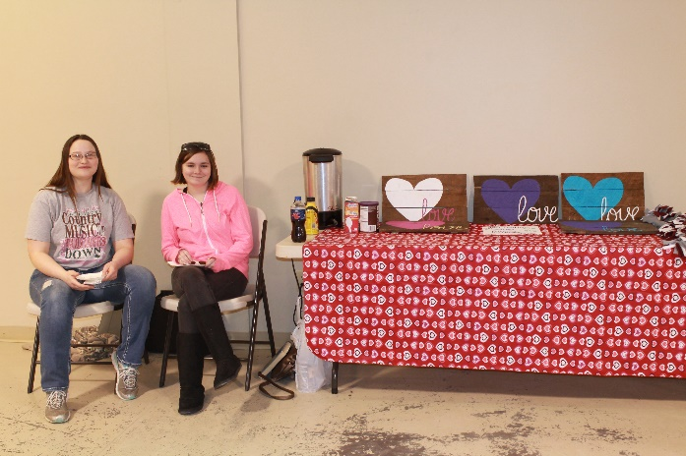
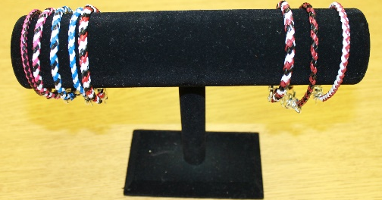
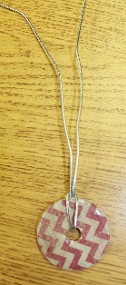
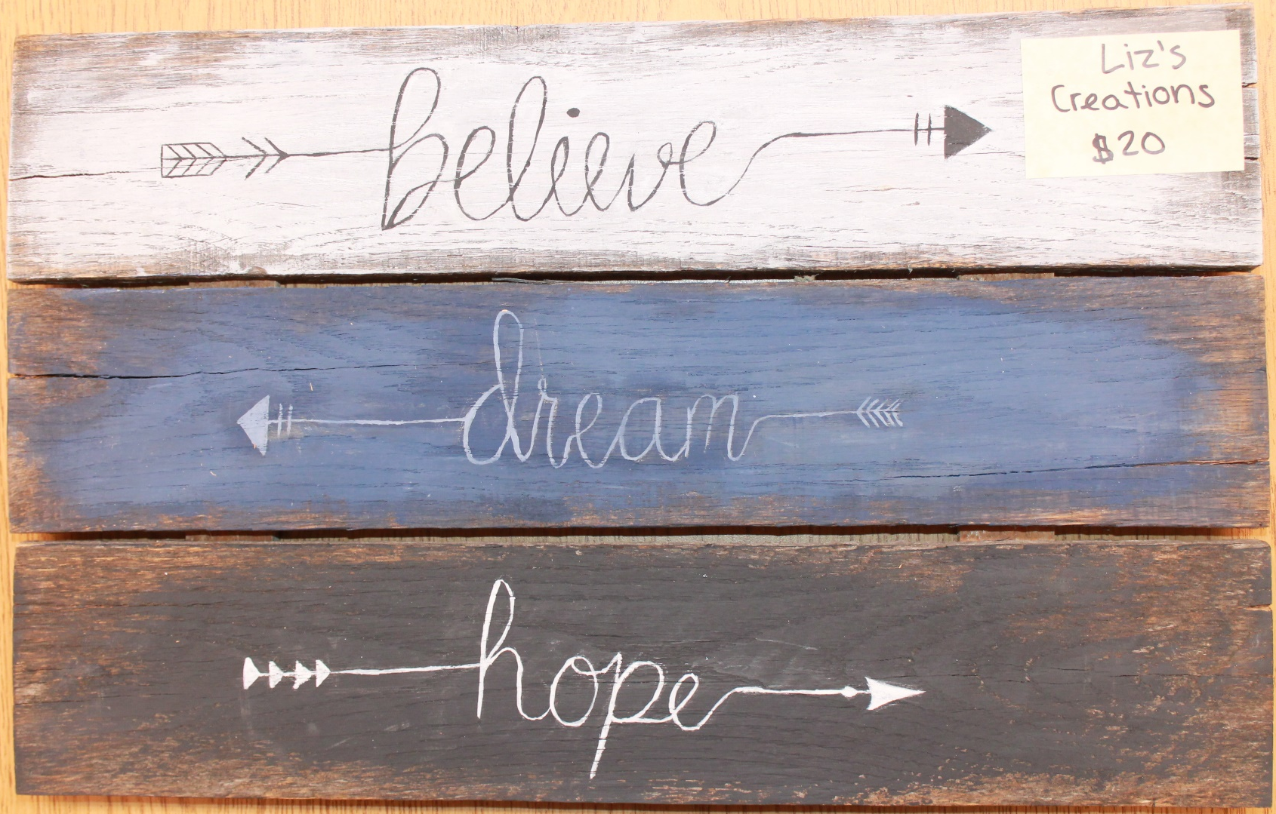
Entrepreneurship Through the Years

Slide 20
Panelist Info (also found on the conference website)
Matthew Burg, Fremont High School
Matthew.Burg@fpsmail.org
Kalen Carlson, Westside High School
carlson.kalen@westside66.net
Janet Shelbourn, Cody-Kilgore-
jshelbourn@cody-kilgore.com
Is moving to Valentine this upcoming school year, so this will change
Jan Osborn, Sargent High School
jan.osborn@sargentpublicschools.org

