Slide 1
Foundational SAE Teacher Resource Hub
Mr. Noble, Miss Swotek, and Miss Zimmer

Slide 2
Introduction to SAEs
Why have an SAE Presentation
Why have an SAE Guided Notes

Slide 3
Ag Explorer Introduction (click pic below)
Allow students to explore their preferred pathways
Encourage students to take the “career finder” quiz
Use “SAE Ideas” Button to find 3 SAE Ideas
Expand on their findings by creating an “SAE Brochure”

Slide 4
Logging their Foundational SAE on AET for the first time.
AET Step-by-Step Setup Instructions
Progression of Each Unit
1 - Presentation with Guided Notes
2 - Activity to work with terms
3 - Tie to SAE Ideas
4 - Use the SAE Library and Lesson to show a specific example
5 - Test and Log Journal Entry on AET

Slide 5
Agribusiness Systems
Intro to Agribusiness Presentation
Guided Notes
Agribusiness SAE Library
Video
Lesson Plan - 45 min

Slide 6
Biotechnology Systems
Intro to Biotechnology Presentation
Guided Notes
Biotechnology SAE Library
Video
Lesson Plan - 50 min

Slide 7
Natural Resource Systems
Intro to Natural Resource Systems Presentation
Guided Notes
Natural Resources SAE Library
Video
Lesson Plan - 60 min

Slide 8
Agricultural Education
Current Events Guided Worksheet
Ag Education SAE Library
Video
Lesson Plan - 30 min

Slide 9
Environmental Service Systems
AET Step-by-Step Setup Instructions
ESS SAE Library
Video
Lesson Plan - 60 min

Slide 10
Plant Systems
Plant Parts Presentation
Guided notes
Plant Systems SAE Library
Video
Lesson Plan: 120 minutes

Slide 11
Animal Systems
Intro to Animal Science Presentation
Guided notes
Animal Systems SAE Library
Video
Lesson Plan: 30 minutes

Slide 12
Food Processing Systems
Food Science Presentation
Food Systems SAE Library
Video
Lesson Plan: 60 minutes

Slide 13
Power, Structural, and Technical Systems
Machinery Presentation
Price is Right Game
Power, Structural, and Technical Systems SAE Library
Video
Lesson Plan: 90 minutes

Slide 14
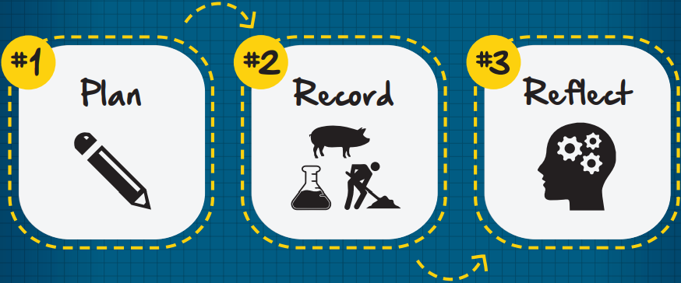
Grading Objectives for Foundational SAEs
Project goals, time and financial investment
Record income, expenses, assets, inventory
Reflect on growth, both personal skills and business scope

Slide 15
AET Grading Tools
Top 10 Grading Tools on AET
Foundational Grading Rubric
Entrepreneur Grading Rubric
Paid Placement Grading Rubric
Unpaid Placement Grading Rubric
Research Grading Rubric
How to Navigate Grading on AET

Slide 16
Questions?

