Slide 1
Family & Consumer Sciences
Teacher Recruitment
NAFCS State Conference, 3/20/2021
Sheree Moser (UNL) & Kristin Vest (NDE)
Notes:
I’ll introduce the back and forth we are going to do and the sections we are both going to present in the next slide’s comments.

Slide 2
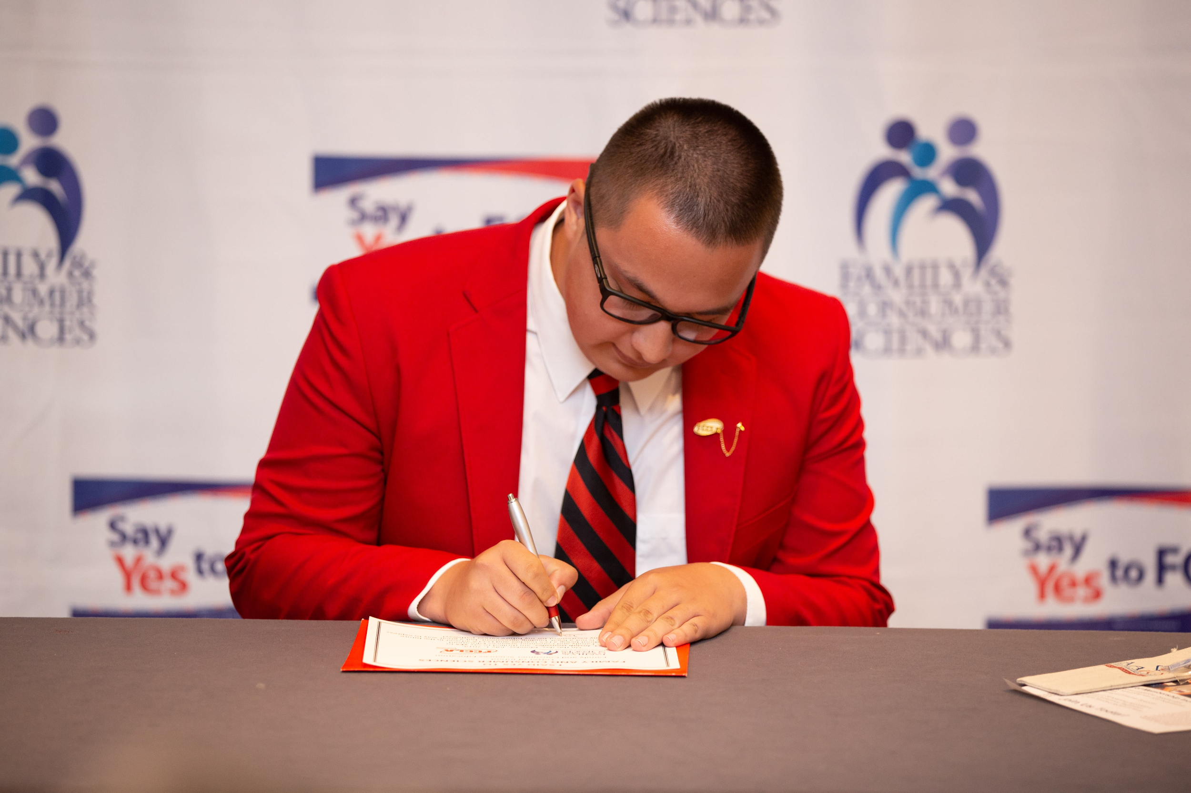
Presentation Outline
National Shortage Updates
How do we compare to our neighbors?
Nebraska Survey
Say YES to FCS
Recruitment Efforts in Nebraska
Notes:
National Shortage and Neighboring States -- Kristin
Nebraska Survey & Shortages – Sheree
Say YES TO FCS & Recruitment – Kristin

Slide 3
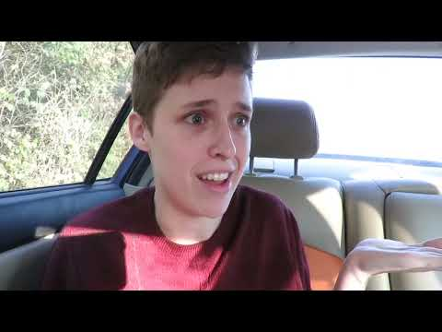
Notes:
Video made by Purdue University FCS Student.

Slide 4
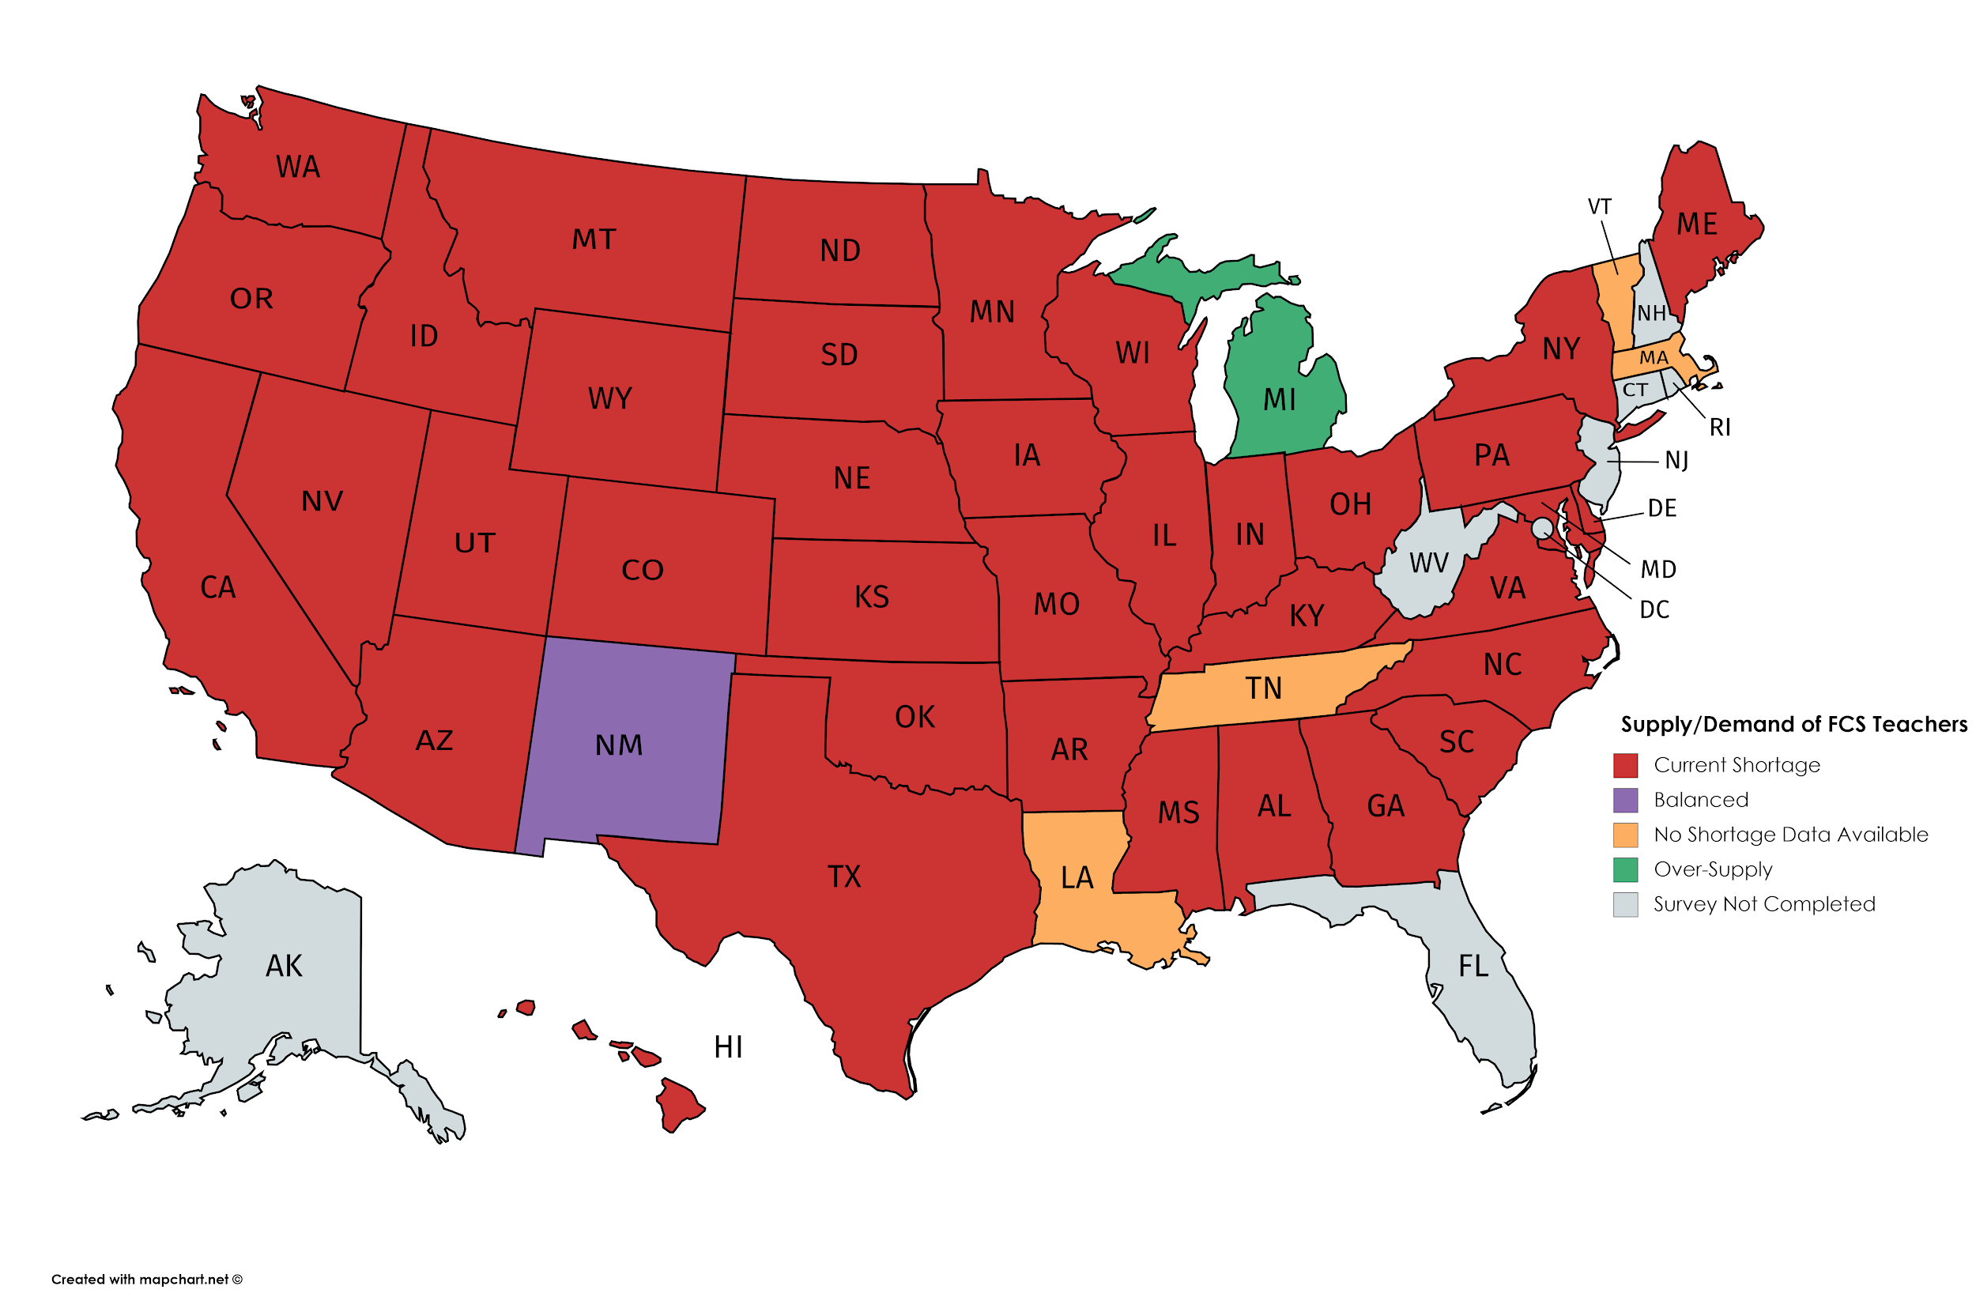
National Shortage Updates
Red = Current Shortages
Purple = Balanced
Gold = No Shortage Data Available
Green = Oversupply (1 state)
Gray = Survey Not Completed
Werhan, 2018

Slide 5
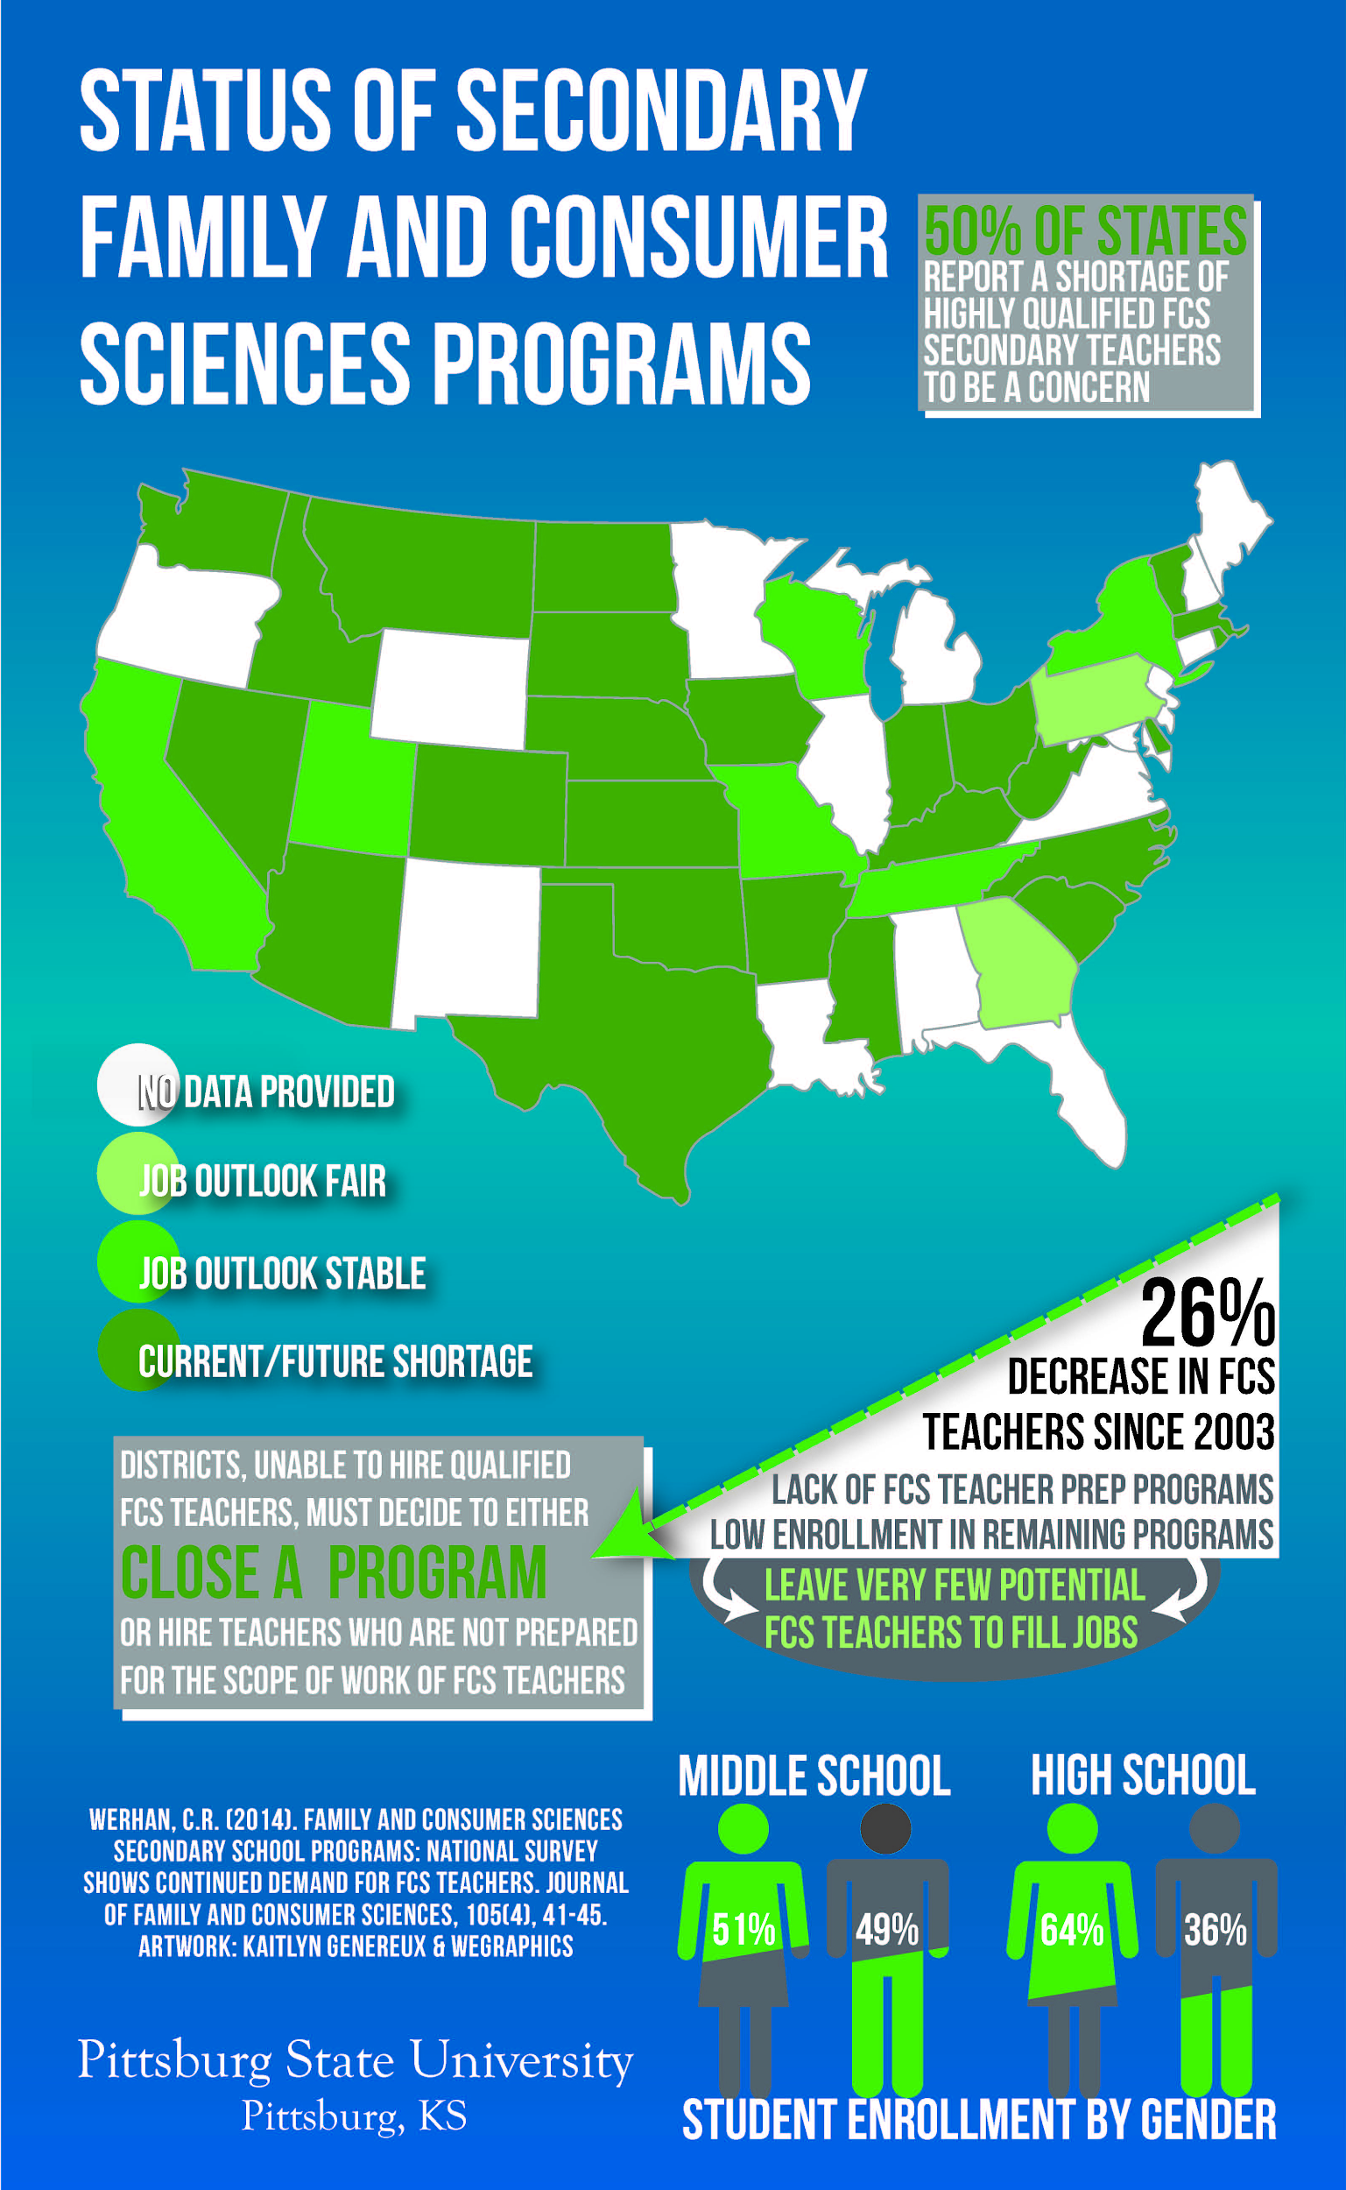
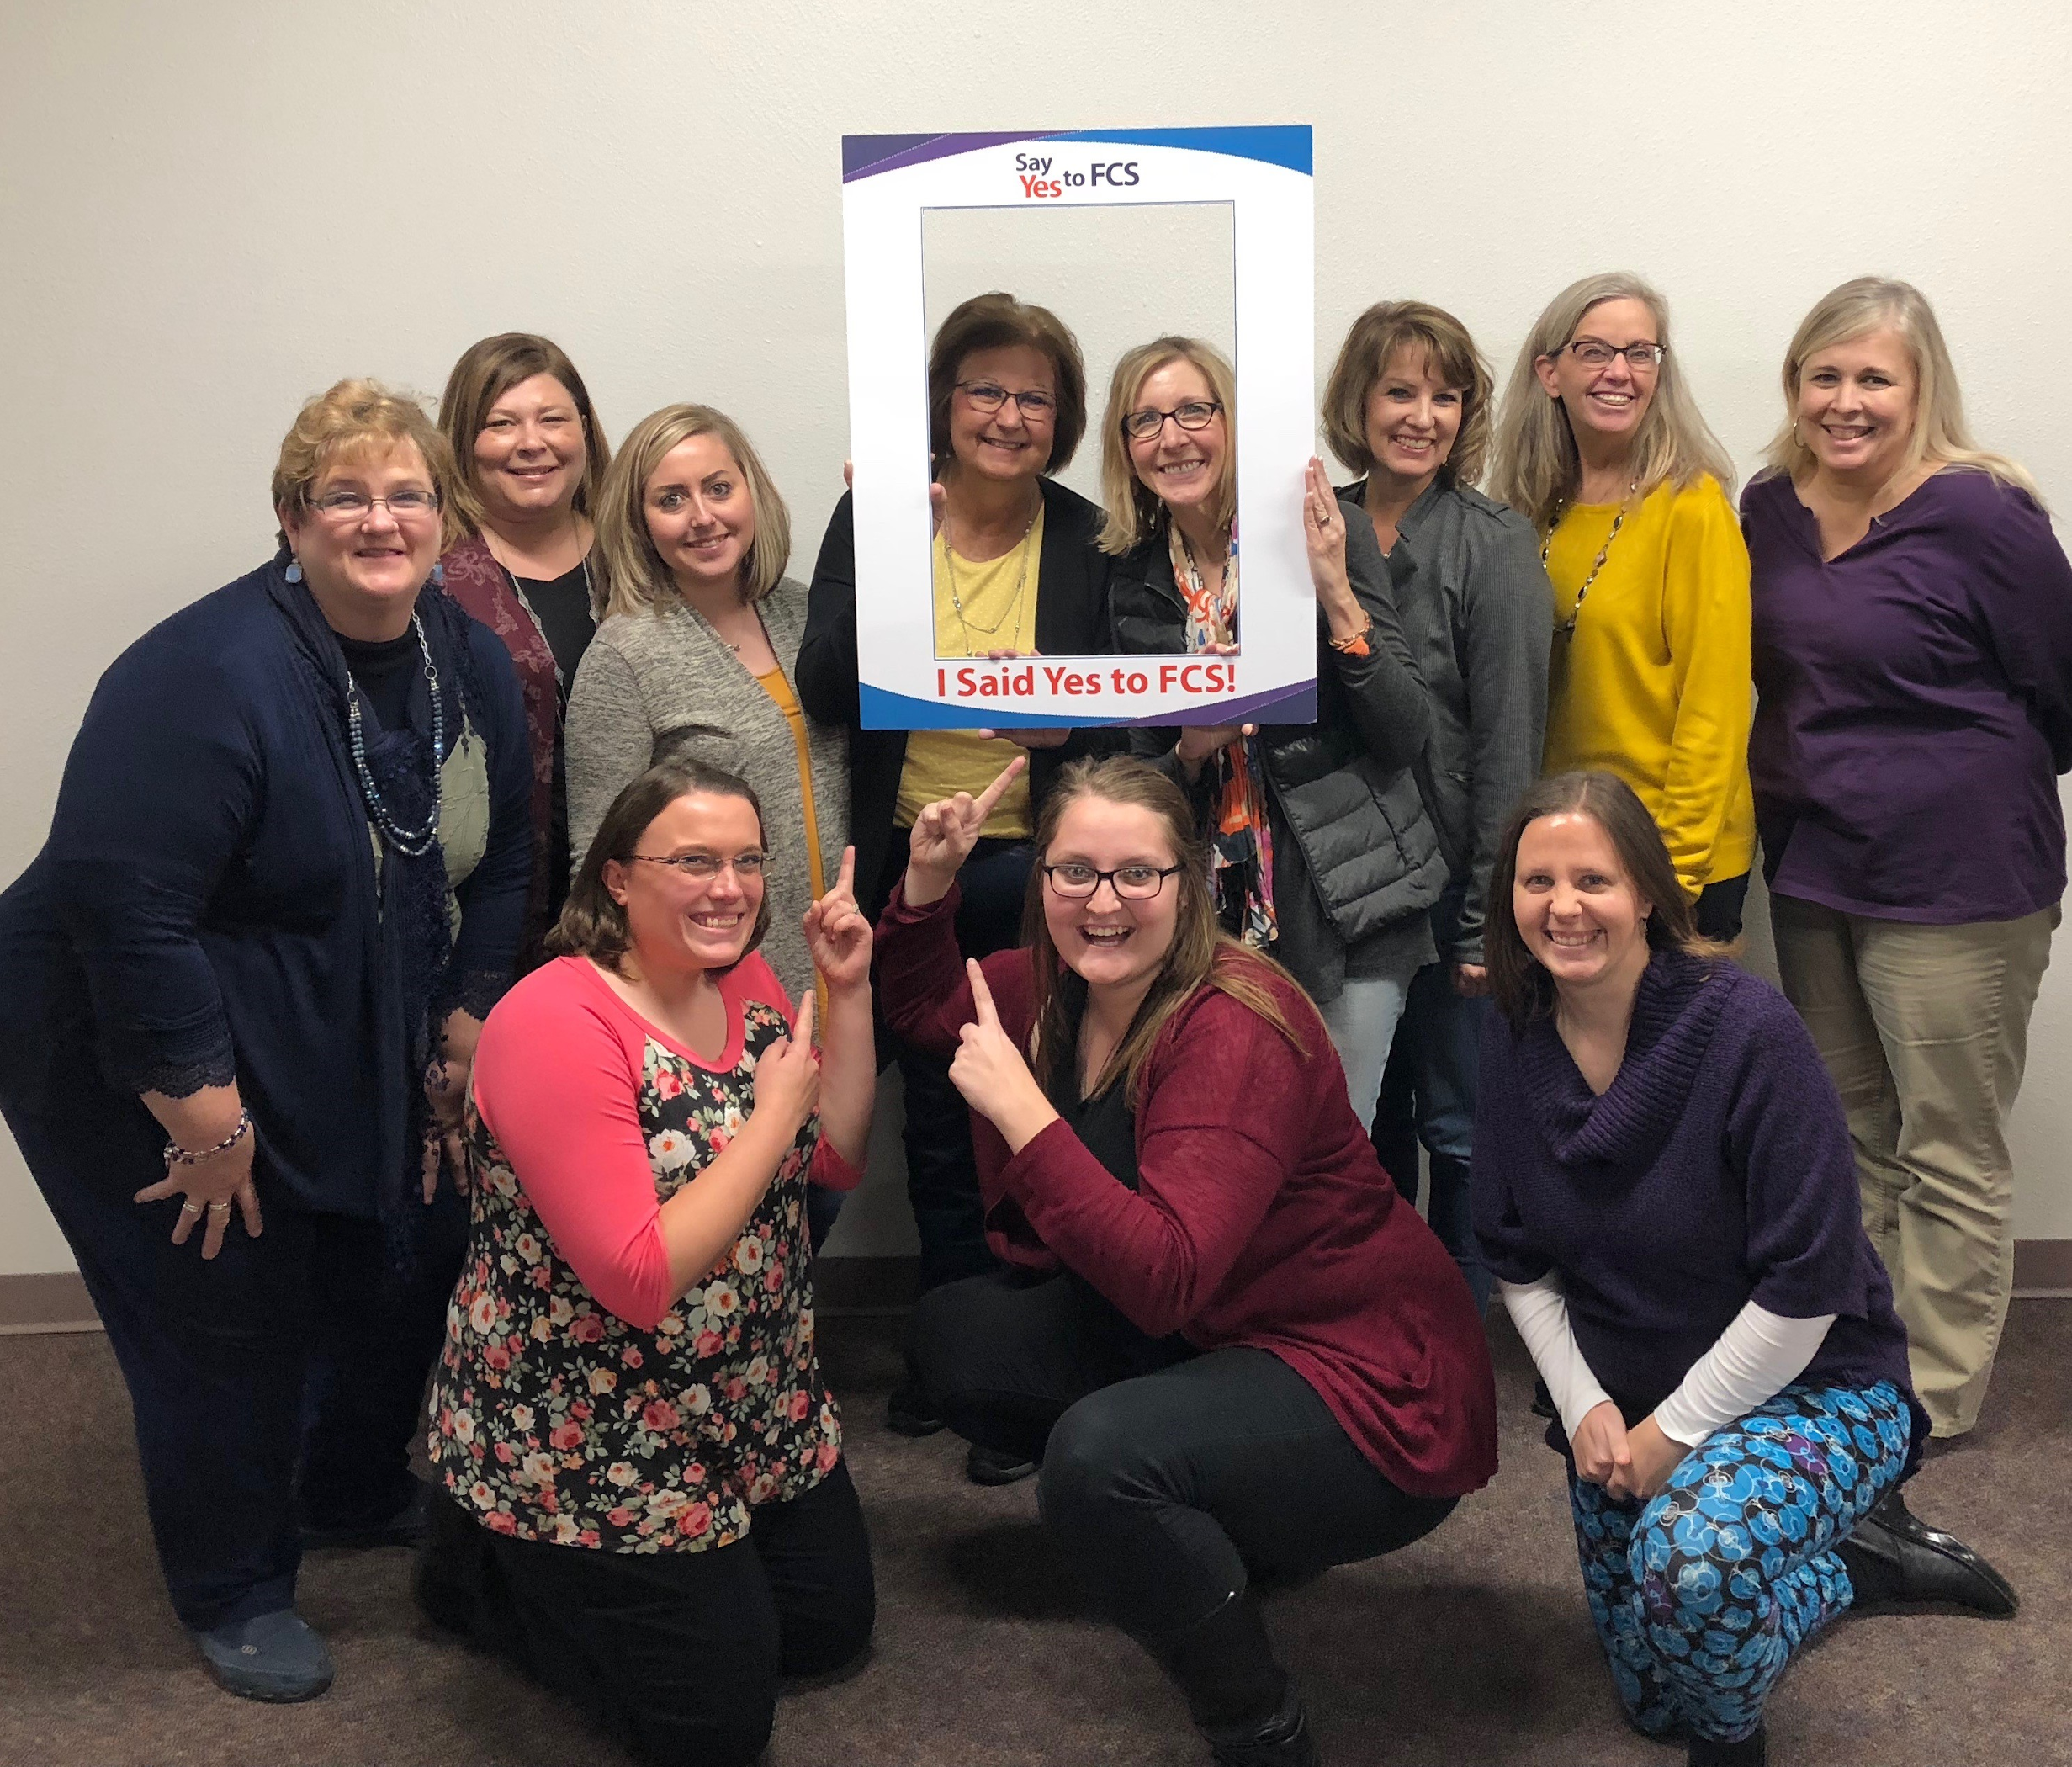
All dark green states are experiencing a current shortage of FCS teachers.
Light green states are those where the job outlook for FCS teachers is fair or stable.
Notes:
Data isn’t existing and that’s what the research articles are about.
Supports the awareness to the issues, but isn’t presenting actual data about shortages yet.

Slide 6
2019-2020 Teacher Vacancy Report
443 Nebraska districts/systems (261 PK-12 public, 17 ESUs, & 182 Nonpublic)
Career Education has been a shortage area the last 5 years
Notes:
Districts/systems were allowed to identify multiple reasons for unfilled** positions. The top reasons were “No applicants who were fully qualified based on endorsement area” (29%), “No applicants” (25%) and “Preferred a specific non-fully qualified applicant over fully-qualified applicant” (22%). The survey offered solutions from which districts/systems could choose from when identifying how they solved the dilemma of unfilled** positions. The most reported solutions were: “Hired a person who holds a provisional permit” (16%); “Hired a person not appropriately endorsed in the content area” (12%); and “Position was not filled” (12%). Nonpublic systems had a larger portion of solutions of “Utilized existing staff not appropriately endorsed in the content area” than did the districts (17% compared to 6%). For further information, see Tables 10a-c in the full report.
Shortage areas determine federal loan forgiveness.
https://cdn.education.ne.gov/wp-content/uploads/2020/01/2019-Teacher-Vacancy-Summary.pdf

Slide 7
How do we compare to our neighbors?
South Dakota
2020: One position not filled in FCS
2021: 5 openings so far, more openings than graduates
Iowa
2017: 278 HS FCS programs, shortage
557 teachers with FCS endorsements
Post-bac non-degree program at Iowa State
Notes:
Colorado has a program at Colorado State.
Wyoming still has nothing.
Utah has BYU.
Kansas had a retirement and is hiring a replacement, but not in place at this point so no data available.
The difference between Iowa and South Dakota is unbelievable!!
SDSU (Nicole Graves) Info from Today:
2020--only one position not filled in FCS and one in “any area of CTE”
2021--5 openings so far, so more openings than graduates at this point in time.
Iowa Information: 2016-17
278 HS FCS programs in Iowa
557 teachers with FCS endorsements - indicates a shortage but not any specific data
CTE specific placements for specific classes
Post-bac non-degree program at Iowa State
Kansas Information:

Slide 8
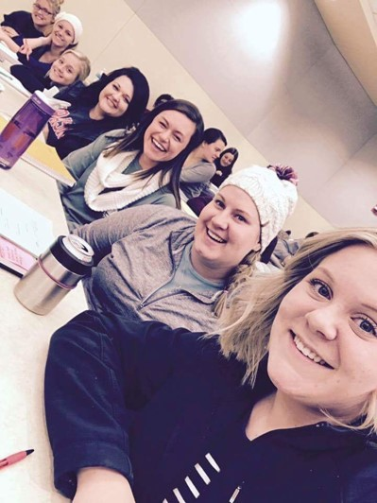
Nebraska Teacher Survey 2019
Years of Teaching FCS?
1-5 years = 30.2%
6-12 years = 25.5%
13-20 years = 14.6%
21-30 years = 15.1%
31 & over = 14%
Years before retiring?
1-2 years = 14.1%
3-4 years = 10.3%
5-6 years = 10.8%
7-10 years = 8.1%
11 & over = 72.9%
Current teaching by school class:
A - 37.3%
B - 16.2%
C1 - 13.5%
C2 - 8.6%
D1 - 12.3%
D2 - 11.9%
A & B = 53.5%
C & D = 46.3%
Notes:
Because of the increase in the number of students majoring in FCS and the growth of the Wayne State and UNL programs, we are flipping the number of years FCS teachers have been in their positions, as well as the 73% who will not be retiring within the next 10 years.
There is also a myth that there are not as many Class C & D programs in Nebraska and it is starting to be an area of growth.

Slide 9
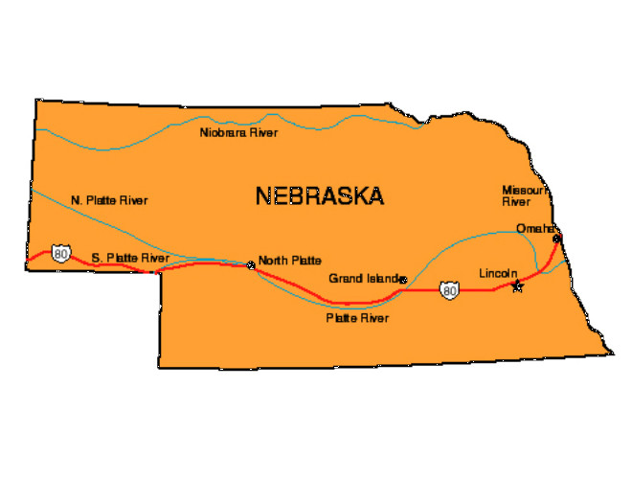
Nebraska Teacher Survey 2019
Where did you earn your degree/certification?
Bachelor’s Degree in FCS Ed--121 (65.4%)
Alternative Program to Add Certificate--13 (7%)
Adding FCS Endorsement to Current Certificate--11 (5.9%)
Master’s in FCS Education--27 (14.6%)
Other--13 (7%)
2020-21 - 255 Teachers
91% of the FCS positions are full time.
50.3% have an FCCLA Chapter
Average # of members is 45
Other student organizations sponsored by FCS teachers:
Educators Rising
ProStart
Skills USA
HOSA
Notes:
2020-21 Teacher List by Endorsement Area (submitted by School Districts)
255 Teachers with the following endorsements: FCS, FCS Occupational, Middle Level FCS, Hospitality and Tourism and Human Services. Reported to be teaching the following subject matter areas: HSE, Ed&T, Personal Services.
Survey question: What other subjects fill your schedule if you are part time?
Health--22 (50%)
Health Sciences--7 (12.7%)
Careers, Guidance, English Language Arts--4 (7.3% each)
Technology or Keyboarding, Social Studies, Media, Special Education, Yearbook--2 (3.6% each)
Other--1 (1.8% each)
Art, Spanish, Consumer Math, Sports, Graphic Design, PE, Teen Living, Junior High Religion, Grant Coordinator

Slide 10
Nebraska Teacher Survey 2019
Helpful Information from Post-Sec Programs?
Updated Curriculum--115 (65.7%)
Speakers--74 (42.3%)
Teaching Strategies--71 (40.6%)
Program Information & Handouts for Students--55 (31.4%)
Information about Jobs or Careers--49 (28%)
Life Skills for non-college Seeking Students--48 (27.4%)
Available Scholarships--46 (26.3%)
Textbook Selection; Technology Resources & Information--43 (24.6%)
Dispelling Myths Related to FCS--42 (24%)
Updates on the Teacher Education Program--41 (23.4%)
Community & Business Partners?
Grocery or Retail Store--125 (80.1%)
Newspaper or Local Radio Station--45 (28.8%)
Extension Office--43 (25.6%)
Educational Service Unit--41 (26.3%)
Childcare Facility--40 (25.%)
Community College--33 (21.2%)
Fabric or Quilting Store--32 (20.5%)
Notes:
I will be skimming these results...
Other suggestions for post-sec educators:
Counseling & Mental Health--67 (39.6%)
Culinary Arts--55 (32.5%)
FCCLA Co-Curricular Lessons--54 (32%)
Nutrition--53 (31.4%)
Critical Thinking Strategies--52 (30.8%)
Connecting 2-4 Year College Programs--51 (30.2%)

Slide 11
Nebraska Teacher Survey 2019
Most prevalent support systems?
Other Teachers 132 (72.9%)
Administration 104 (57.5%)
FCS ListServ 71 (39.2%)
Parents 42 (23.2%)
Community 42 (23.2%)
How could we better publicize FCS?
TV ads or Mini-Lessons 77 (45.6%)
Events 67 (39.6%)
Speakers or Presentation 59 (34.9%)
Radio 53 (31.4%)
Websites 53 (31.4%)
Newspapers 47 (27.8%)
Flyer/Newspaper/Posters/Bulletin Board 40 (23.7%)
Notes:
Again, skimming these results...

Slide 12
Conclusions:
We had an excellent response rate, but also discovered FCS teachers in our state who were not listed on the Professional Directory. More work to identify all of the programs would be helpful in the future.
The trajectory of new programs has been constant and increasing over the past 10 years. More new buildings are being added to the Metro area and programs in smaller districts being reopened.
The number of undergraduates has grown but is still not meeting the need for certified students in our state.
The number of districts hiring candidates without a teaching certificate is still large and sometimes the same number as graduates from all 3 post-secondary programs combined.

Slide 13
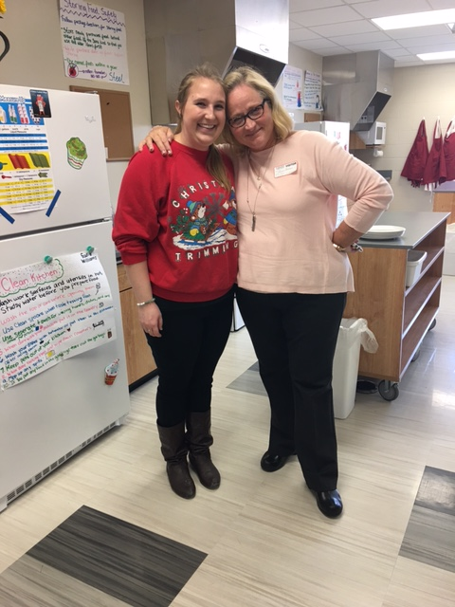
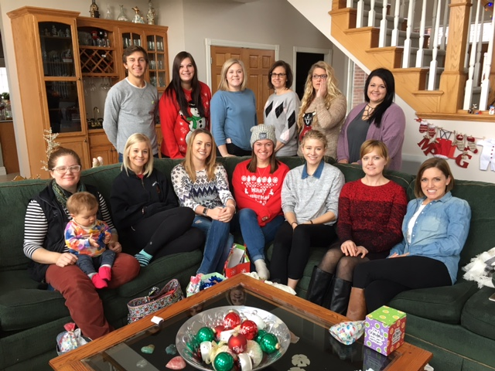
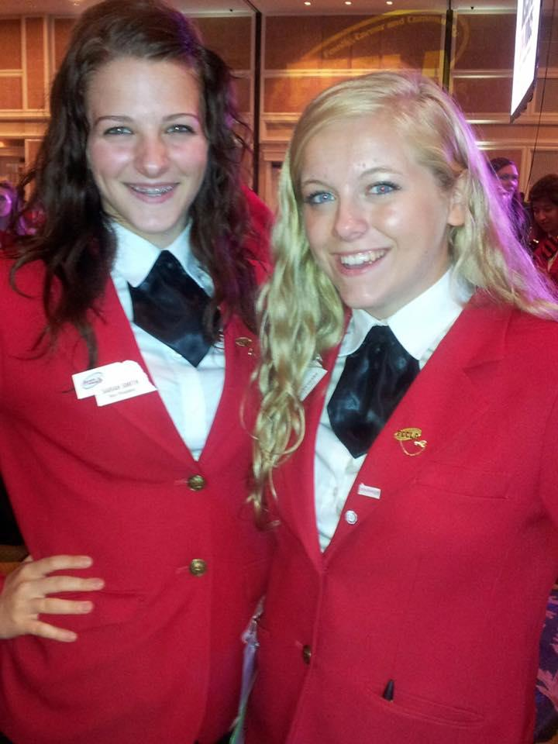
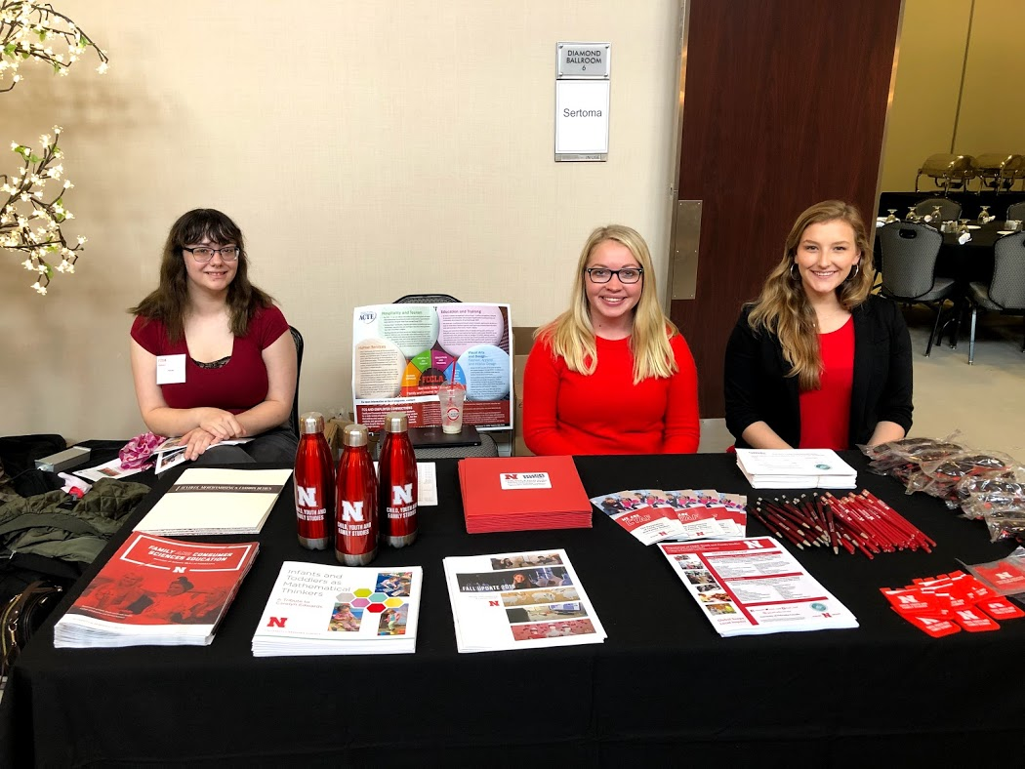
Nebraska Open Positions 2011--Present
Total Number of Openings: 462
89% full time
10% part time
Teachers hired out of certification: 83 (18%)
Positions not filled: 41 (.09%)
Retirements: 129 (28%)
New Programs: 46 (10%)
Notes:
18% = 83 teachers
I would love to see what the retention rate is because I have known of 3 of these that didn’t even last 2 months in the position.
These stats do not include this year’s data:
43 openings so far
11 new programs or openings (may have been previously closed or has been open for a number of years)
11 retirements

Slide 14
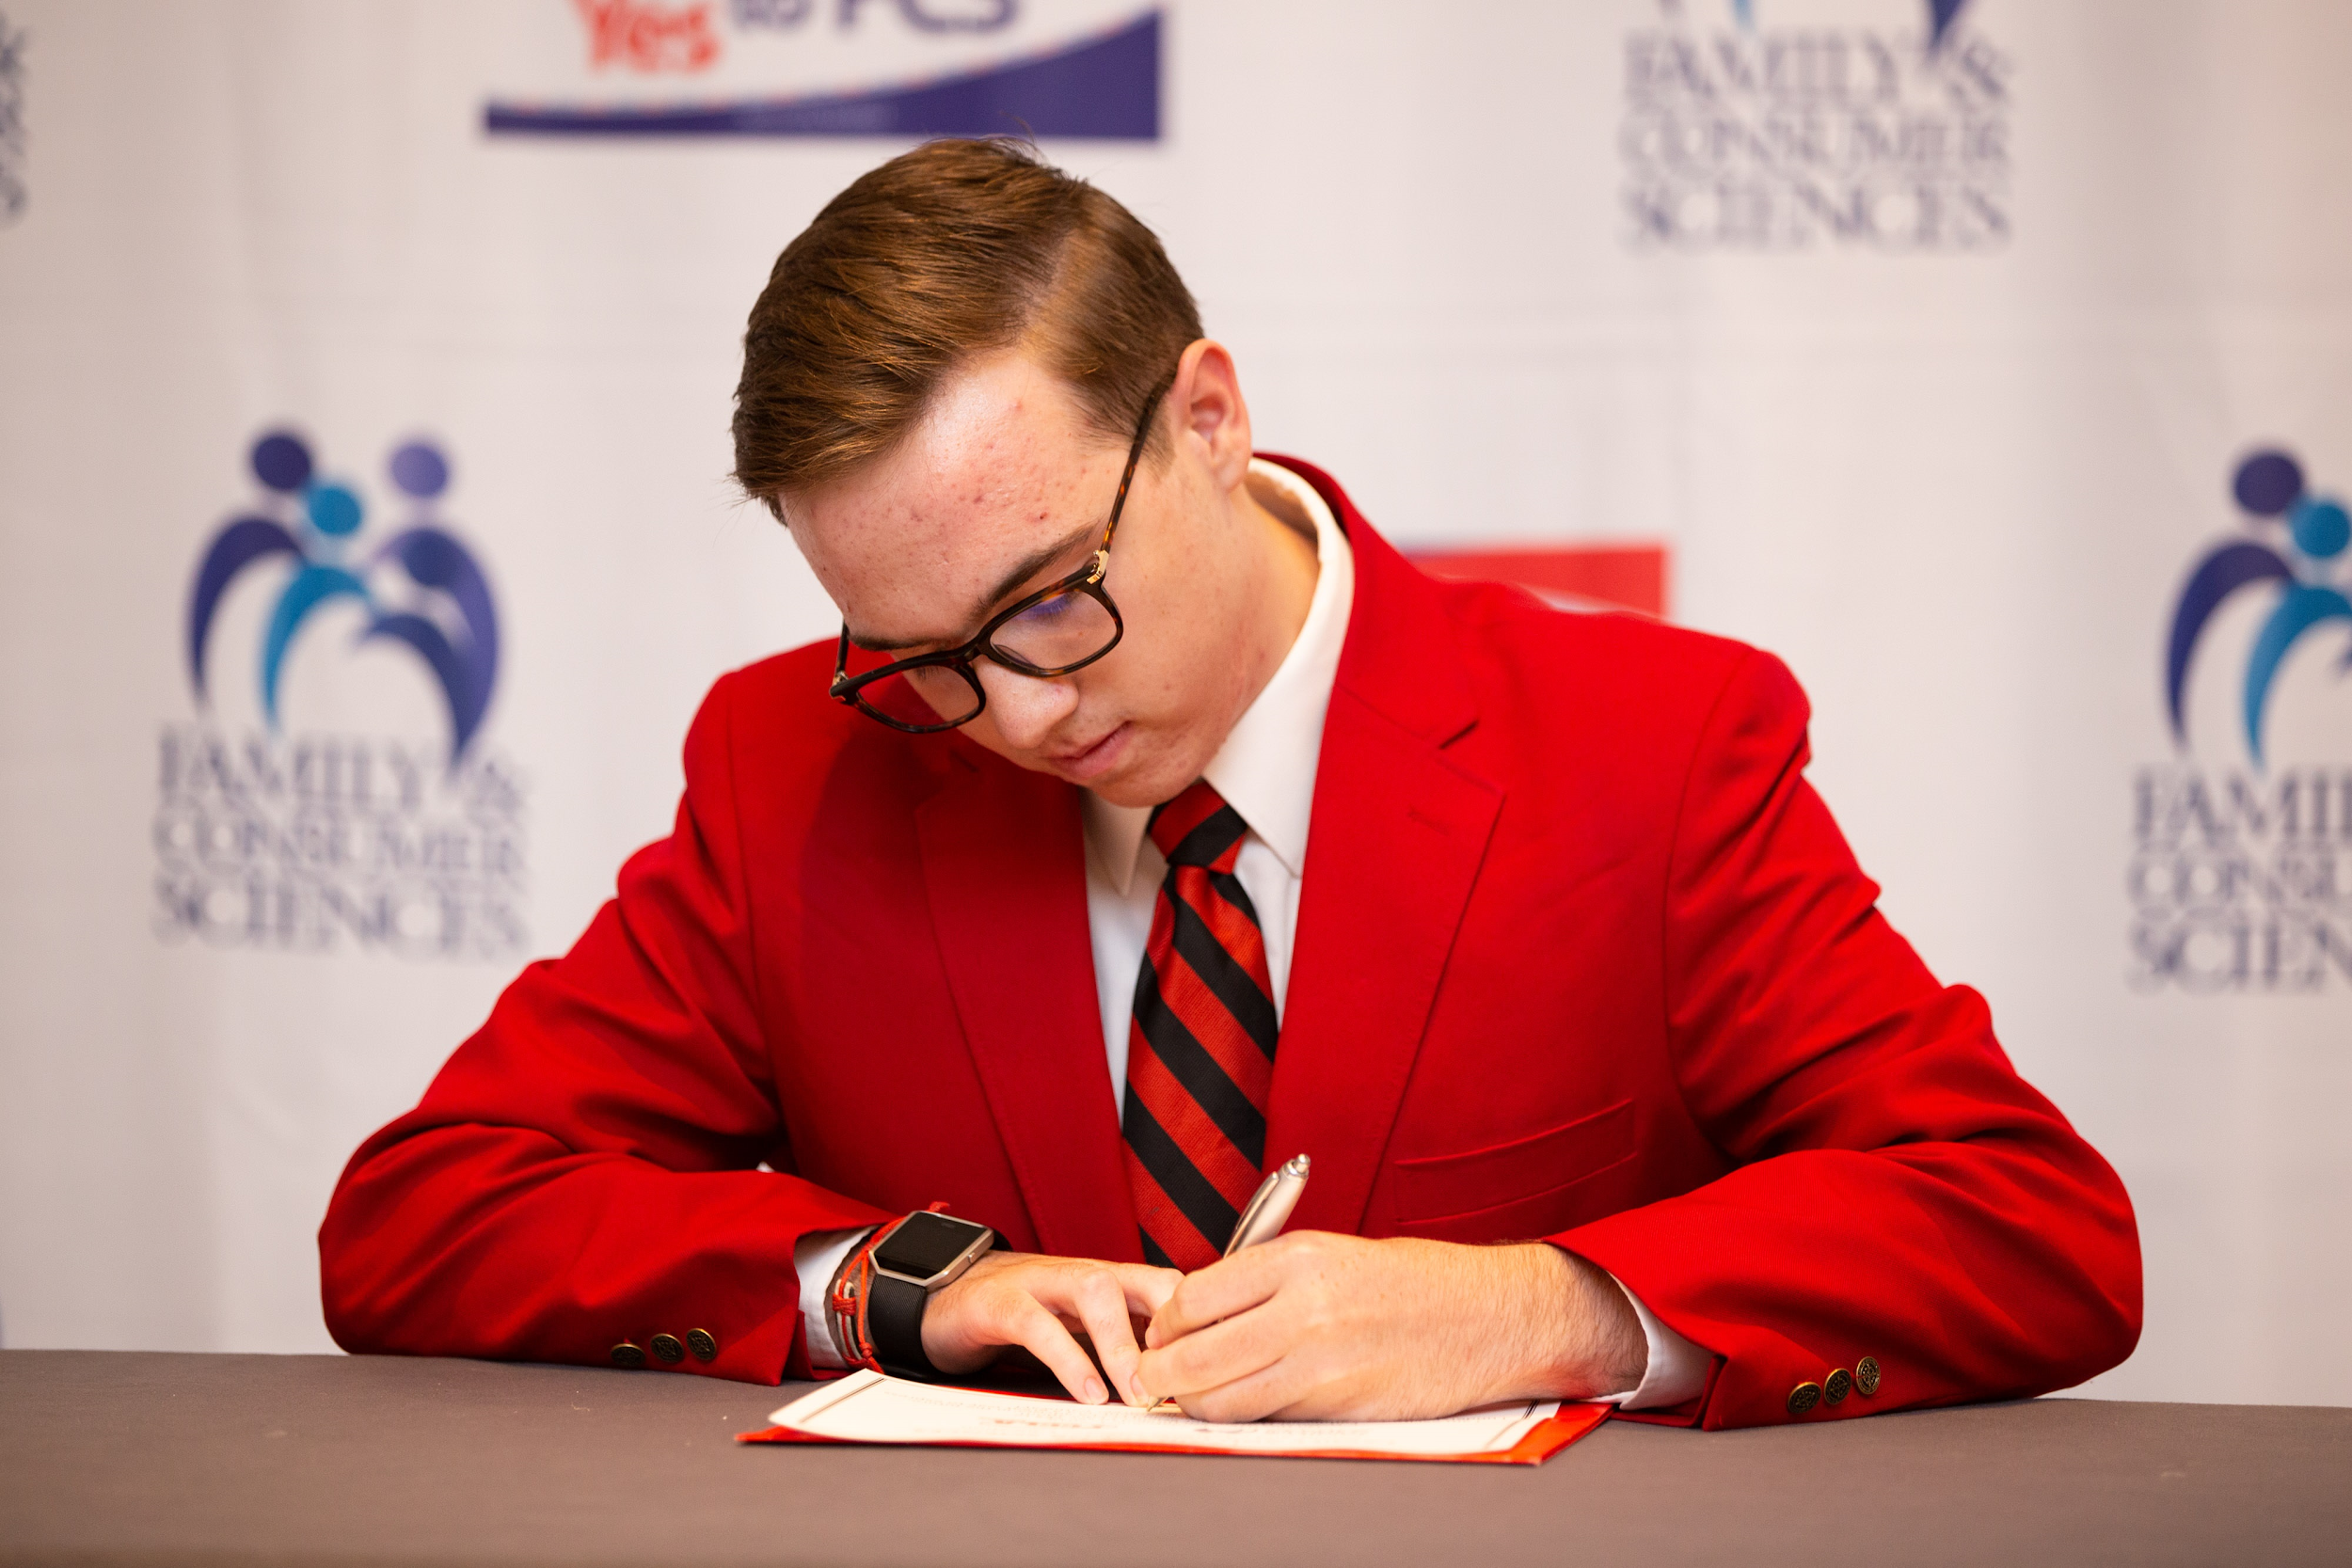
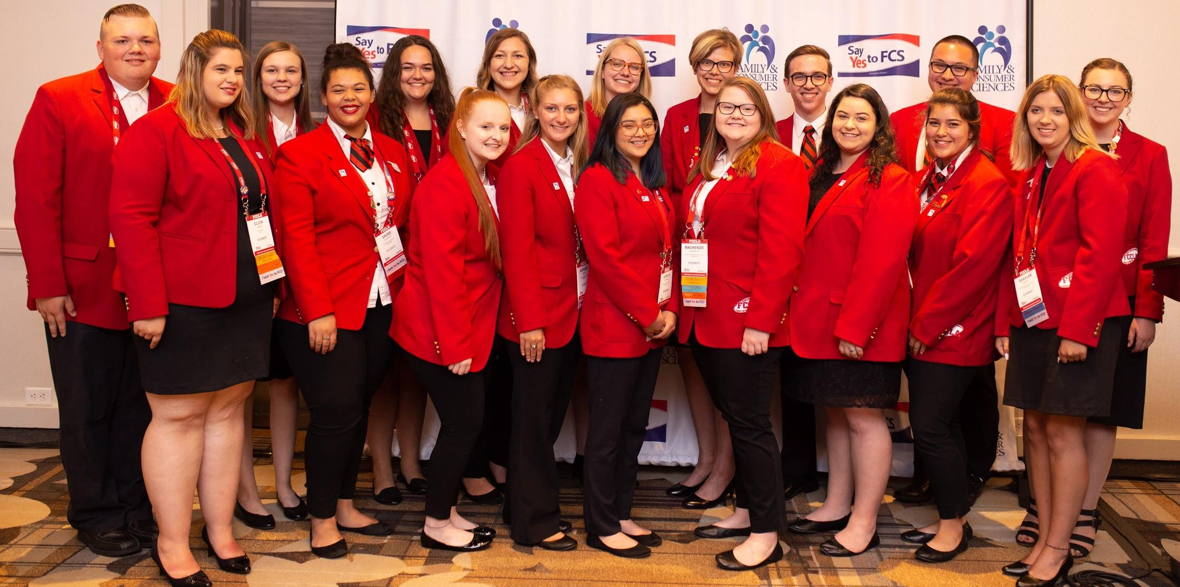
In Nebraska:
Join the State Action Team!
FCS Educator Day during FCCLA Week
Say Yes to FCS Signing Event for FCCLA on April 13
Statewide Teacher Signing Day - April 21
National Resources:
National Partnership Grant to Recruit, Prepare and Support FCS Educators - Recruitment Toolkit
19-20 Say Yes to FCS National Signing Event
Notes:
Say Yes to FCS National Signing Event during National FCCLA Leadership Conference 40 students signed virtually in 2020! 5 students from Nebraska the last 4 years!
State Action Team Planning Guide
Future FCS Teacher Dinner since 2015. 5 years before COVID w/27-35 participants each year. Collaboration among all 3 post-secondary teacher preparation programs. Dinner supported by donations from retired FCS teachers -- keeping a network of retirees since 2015. (Probably = over $2,500 donated so far).

Slide 15
Notes:
This may be a little aggressive. HA! ;’)

