Slide 1
Entrepreneurship in your Community
Creating your own Career
Economic Lessons for Secondary Teachers
Sponsored by the UNO Center for Economic Education, Nebraska Council on Economic Education, and Centris Federal Credit Union

Slide 2
Dr. Jamie Wagner
Assistant Professor of Economics and Director of the Center for Economic Education
University of Nebraska at Omaha
jfwagner@unomaha.edu
Twitter and Instagram: @profjWags

Slide 3
Dr. Jennifer Davidson
President, Nebraska Council on Economic Education
Assistant Professor Practice in Economics
University of Nebraska-Lincoln
jdavidson2@unl.edu
Twitter: JDEconRules

Slide 4
Lesson 2
Entrepreneur-Is it me?

Slide 5
Lesson 2
Entrepreneurs: individuals who use economic resources and create new products or a new business, bearing most of the risks and enjoying most of the rewards.
Human Capital: The skills and knowledge that people obtain through their education, experience, and training.

Slide 6
Lesson 2
Please write down on the provided paper what skills entrepreneurs are likely to possess and that contribute to their human capital.
Post your answers.

Slide 7
Lesson 2
Human Resource: People who contribute to the production of a good or a service.

Slide 8
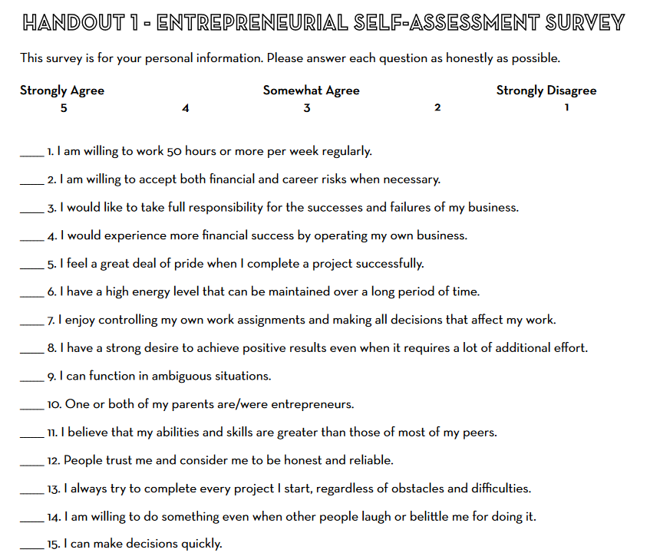
Lesson 2

Slide 9
Lesson 2
Please find the corner of your room associated with your score.
15-20
Break out room 1
21-37
Break out room 2
While you are in your groups, please discuss what skills you feel like the people in your group have. What common skills are there among your score group? Prepare to have a member of your group report on your findings.
38-56
Break out room 3
57-75
Break out room 4

Slide 10
Lesson 2
Debrief—what did you have in common?

Slide 11
Lesson 3
What’s in it for me?

Slide 12
Lesson 3
Get into groups of 3-4.
Assign one person to be the recorder for your group.
You will have 1 minute to write down all the reasons why a person would want to start their own business.
See if your group can produce the most written responses.

Slide 13
Lesson 3
Please report on how many reasons you produced. Do not tell any other group the reasons you produced.

Slide 14
Lesson 3
Round 2
You are going to have another minute to record reasons why someone would want to open their own business.
Two new rules.
1. You must use the backside of your paper.
2. You cannot use any of the reasons from Round 1.
The group who has the most responses in Round 2 will get a prize for each team member!

Slide 15
Lesson 3
Please record your responses from Round 1 and Round 2 on the board.
Why were you able to produce more reasons during the second round than you were in the first?

Slide 16
Lesson 3
The prize that you were competing for is called an incentive.
Incentives: Factors that motivate and influence human behavior.
The reason you worked harder and produced more during the second round was because you had an incentive.

Slide 17
Lesson 3
Monetary incentives usually influence people to go into business for themselves.
People usually want to achieve financial or material gain or avoid financial or material loss.
Which of your reasons to go into business involve a monetary incentive?

Slide 18
Lesson 3
There are personal incentives as well that do not involve money that can impact a person’s decision to start a business.
Which of your reasons to start a business are personal incentives?

Slide 19
Lesson 3
Why are personal incentives important? How do they influence a person?
Satisfaction and happiness are important to people.
Being satisfied or happy with your job is a big reason people might want to own their own business.
Economists use the term utility.
Utility: A person’s happiness or satisfaction when consuming a good or service.

Slide 20
Lesson 3
There can be a great deal to gain from having your own business, but you must be willing to give up something as well.
Trade-offs: These involve accepting or choosing less of one thing to get more of something else.
When you start your own business and it begins operations, you have to give up your job working for someone else.

Slide 21
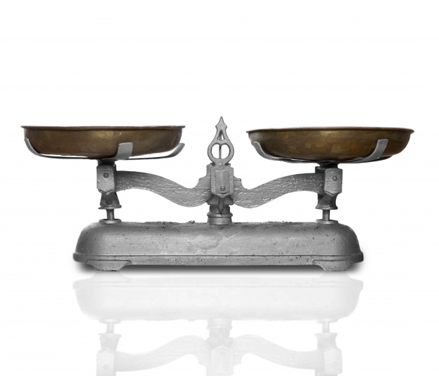
Lesson 3
Benefits: Something that promotes or enhances well-being
Costs: something to give up—usually amount paid or required in payment for a purchase.
To receive the most satisfaction from your decision, you should choose the alternative that gives you the most benefits and the least costs.

Slide 22
Lesson 3
Please work on activity 3-1: What is the Best Choice?

Slide 23
Lesson 3
Activity 3-1 Key
 | Criteria A | Criteria B | Criteria C | Criteria D | Criteria E | Total Utility
Criteria Utility Score | 3 | 5 | 1 | 4 | 2
 | Criteria A | Criteria B | Criteria C | Criteria D | Criteria E | Total Utility
Alternative 1 | 1 | 3 | 3 | 2 | 2
Alternative 2 | 3 | 2 | 1 | 1 | 1
Alternative 3 | 2 | 1 | 2 | 3 | 3
Alternative 1: (3 x 1) + (5 x 3) + (1 x 3) + (4 x 2) + (2 x 2) = 33
Alternative 2: (3 x 3) + (5 x 2) + (1 x 1) + (4 x 1) + (2 x 1) = 26
Alternative 3: (3 x 2) + (5 x 1) + (1 x 2) + (4 x 3) + (2 x 3) = 31

Slide 24
Lesson 3
 | Criteria A | Criteria B | Criteria C | Criteria D | Criteria E | Total Utility
Criteria Utility Score | 3 | 5 | 1 | 4 | 2
Alternative 1 | 1 ___3__ | 3 __15___ | 3 ___3__ | 2 __8___ | 2 __4___ | 33
Alternative 2 | 3 | 2 | 1 | 1 | 1 | 26
Alternative 3 | 2 | 1 | 2 | 3 | 3 | 31

Slide 25
Lesson 3
Please work on Activity 3-2 in groups of 2-3.
Please do not complete the final question about opportunity costs.
You have 10 minutes.

Slide 26
Lesson 3
What alternative should Indy Pendant select to receive the greatest satisfaction? Sue Curity?
Both women used the same criteria to evaluate the same alternatives so why did they select different alternatives?

Slide 27
Lesson 3
Both women need to consider their own values when making decisions to gain the most satisfaction from their decision. We always make trade-offs when we make decisions.
Opportunity Cost: The forgone benefit of the next best alterative when scarce resources are used for one purpose rather than another.
What is Indy’s opportunity cost?
What is Sue’s opportunity cost?
You now have 3-5 minutes to finish the last question on Activity 3-2.

Slide 28
Lesson 3
Entrepreneurs must
Analyze the costs and benefits of going into business.
Make trade-offs that will result in the greatest satisfaction from the decision they make.
Give something up for the alternative they choose and that is the opportunity cost of making their decision.

Slide 29
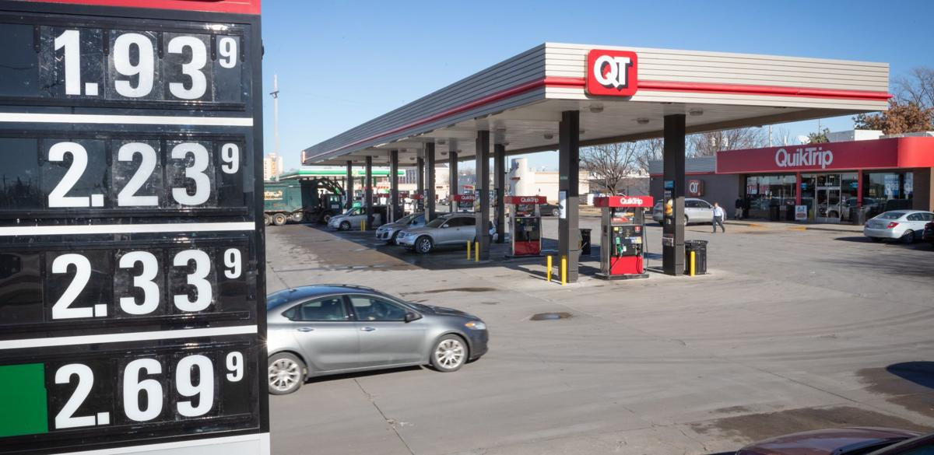
Lesson 8
I’m in Business, Now What Do I Charge?

Slide 30
Lesson 8
Entrepreneurs are in business to make a profit.
Profit the amount that remains after a business pays the cost of producing a good or service. (Revenue minus costs)
The price set by businesses must be high enough to cover their costs.
The price that just covers costs is known as the break-even price.

Slide 31
Lesson 8
Take a look at Activity 8-1: When do I Start Making Money? And take 10 minutes to complete it.
A. Depreciation of Mower and Trailer = $$\frac{original cost−salvage value}{useful life}$$
B. Social Media Advertising
C. Maintenance and Repair
D. Gasoline/Oil
Total Expenses (A+B+C+D)
Break-even Price per Lawn (Total Expenses/Total # of Lawns)

Slide 32
Lesson 8
8-1 Answers
A. Depreciation of Mower and Trailer = $$\frac{original cost−salvage value}{useful life}$$ | $$\frac{\$3000−500}{5 years}=\$500$$
B. Social Media Advertising | $20.00
C. Maintenance and Repair | $100.00
D. Gasoline/Oil | $600.00
Total Expenses (A+B+C+D) | $1,220.00
Break-even Price per Lawn (Total Expenses/Total # of Lawns) | $\frac{\$1220}{200 lawns}=\$$6.10

Slide 33
Lesson 8
Is the break-even price a price that Lupita could reasonably charge for mowing a lawn?
If Lupita decides to charge the break-even price for each lawn, what will her net profit from her summer business be? (net profit = revenue – expenses)
Based on the answer to Question 2, would the break-even price be the price Lupita should charge for mowing? Why or why not?
What are some other factors Lupita should consider when establishing the price she will charge for mowing a lawn?

Slide 34
Lesson 8
How do entrepreneurs determine how much profit is enough?
Remember the price cannot be set so high that no one will buy their goods or services.
Even if you would like to have unlimited profit, there will be limits.
Economic Resources: The land, labor, and capital resources used to make goods and services.
Land: Any natural resource used to produce a good or service.
Labor: The human resource or people used to produce a good or service.
Capital: anything that we produce that is then used to make other goods and services.
What are examples of economic resources?

Slide 35
Lesson 8
Take a look at Activity 8-2: Pricing for a Reasonable Profit and take 10 minutes to read and complete it.
A. Total Explicit Expenses (From 8-1)
B. Forgone Wages
C. Forgone Interest
D. Total Opportunity Cost (B+C)
E. Total Expenses and Opportunity Cost (A+D)
Break-even Price Per Lawn (E/Total Lawns)

Slide 36
Lesson 8
8-2 Answers
A. Total Explicit Expenses (From 8-1) | $1220
B. Forgone Wages | $1000
C. Forgone Interest | $3000 x .045 = $135
D. Total Opportunity Cost (B+C) | $1000 + 135 = 1135
E. Total Expenses and Opportunity Cost (A+D) | $1220 + 1135 = $2355
Break-even Price Per Lawn (E/Total Lawns) | $$\frac{\$2355}{200 lawns}=\$11.78$$

Slide 37
Lesson 8
Is $8.00 per lawn enough to charge to cover all of Lupita’s expenses?
If Lupita decides to charge this price for each lawn, what will her net profit from her summer business be? (Net profit = revenue – explicit costs)
What if she could charge a price higher than the price found above, should she charge the higher price or be satisfied with her profits at the lower price. Explain your answer.

Slide 38
Lesson 8
Opportunity Cost: The value of the next best options when a decision is made.
Explicit Cost: The direct expense of producing a good or service, such as wages, rent, supplies, etc.

Slide 39
Lesson 8
Suppose an entrepreneur determines the price that they must charge to cover their explicit and opportunity costs and realizes that they cannot charge that price and make a reasonable profit. However, they still decide to start the business and to charge a lower price to cover their expenses and allow them to make a reasonable profit, although not one large enough to cover their opportunity costs.
Why would they do this?
Entrepreneurs should consider both explicit and opportunity costs when setting prices, along with what they feel their customers will be willing and able to pay.

Slide 40
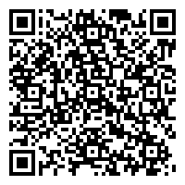
Access the Guide

Slide 41
Contributors
This curriculum was created by
Dr. Jamie Wagner: UNO Center for Economic Education
Dr. Jennifer Davidson: President of the Nebraska Council on Economic Education
Ms. Sydney Kobza: Assistant Director of CTE at the Nebraska Dept. of Education
Mr. Matthew Pierson: Economics Teacher at William Jennings Bryan High School in Omaha.
Ms. Gigi Wolf: Lead Economic Education Specialist for the Federal Reserve Bank of Kansas City
This presentation was created by Mr. Matthew Pierson
Please contact Dr. Jamie Wagner (jfwagner@unomaha.edu) for any questions about this curriculum.

Slide 42
Copyright Information
Entrepreneurship in your Community: Creating Your Own Career © 2021 Nebraska Council on Economic Education
Slides can be reproduced and edited for classroom use only.
Sponsored by the UNO Center for Economic Education, Nebraska Council on Economic Education, and Centris Federal Credit Union

